Slide 1
THE
ART
OF ILLUMINATION

Slide 3
Islamic Art
Islamic art encompasses the visual arts produced from the seventh century onward by both Muslims and non-Muslims. Islamic art covers a range of artistic fields including architecture, calligraphy, painting, glass, illumination, ceramics, and textiles, among others. Calligraphy and the decoration of manuscript Qu’rans is an important aspect of Islamic art as the word takes on religious and artistic significance.

Slide 4
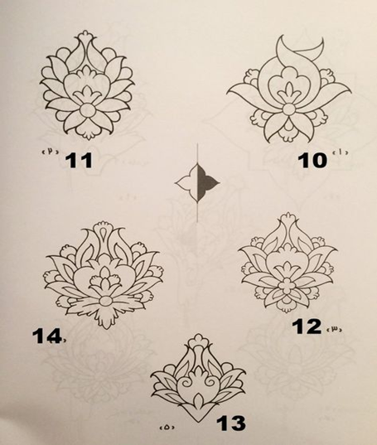
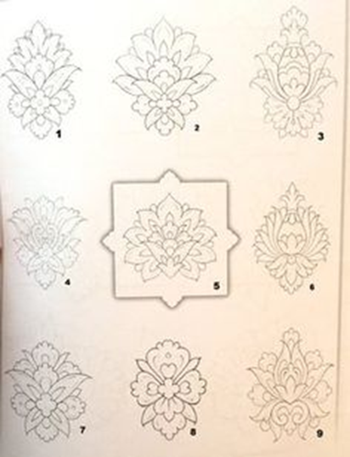
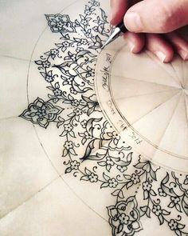
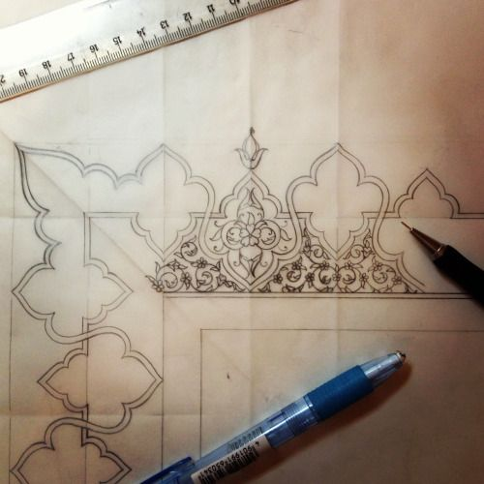
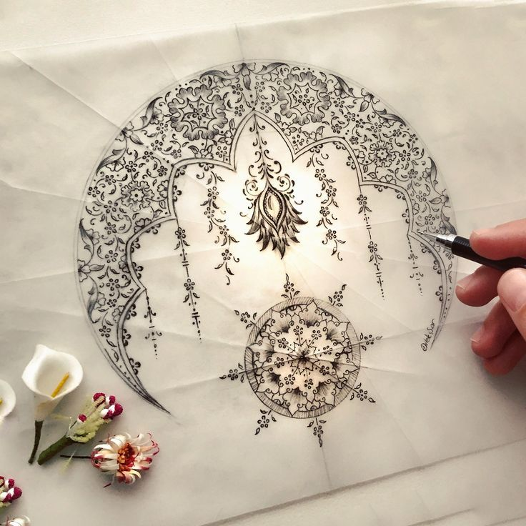
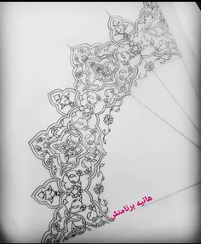

Slide 5
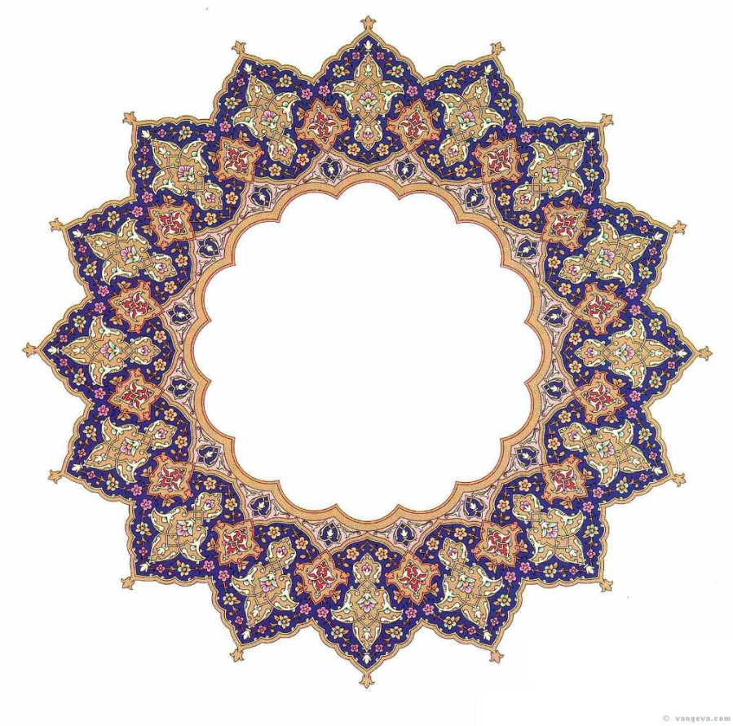
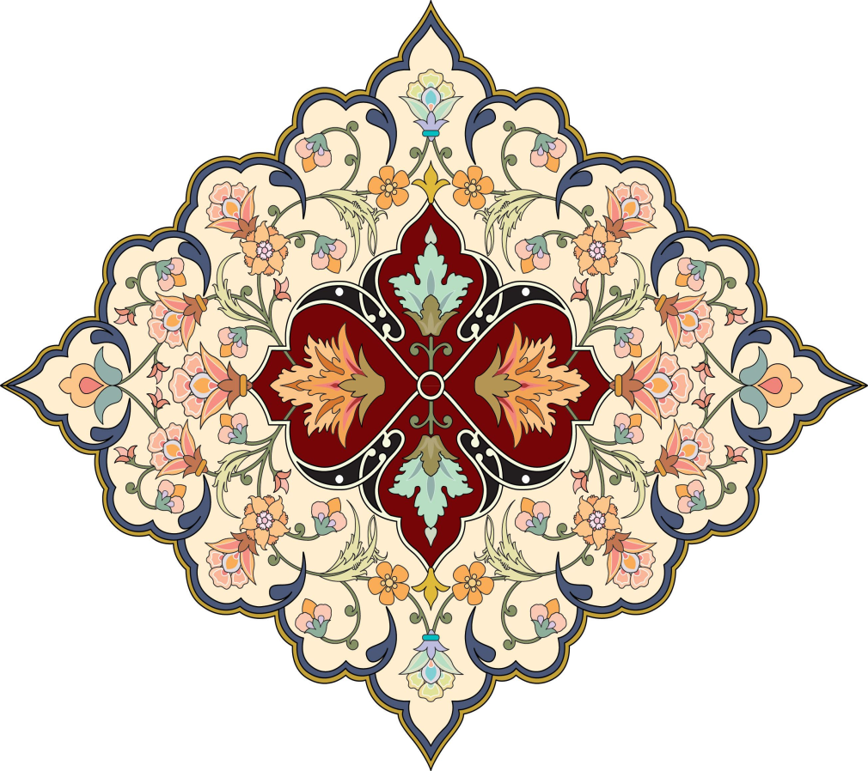

Slide 6
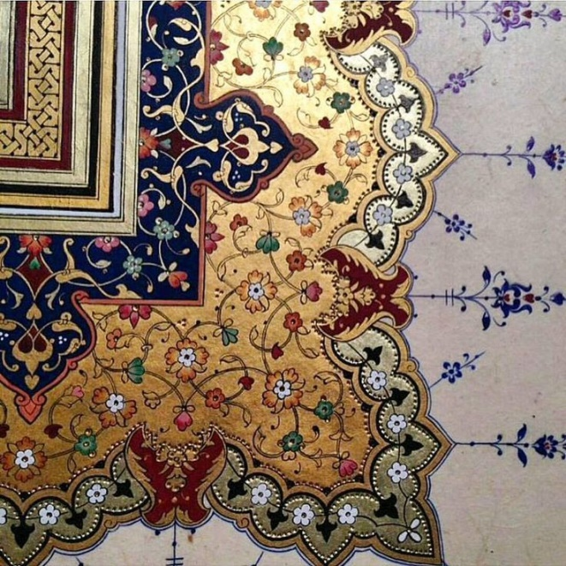
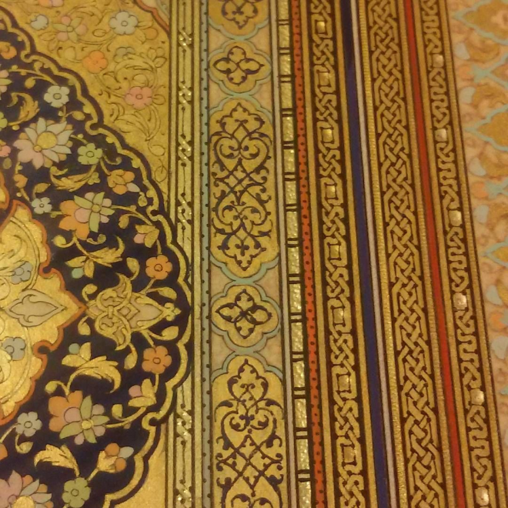

Slide 7
Themes of Islamic Art
There are repeating elements in Islamic art, such as the use of stylized , geometrical floral or vegetal designs in a repetition known as the arabesque . Islamic art has focused on the depiction of patterns and Arabic calligraphy, rather than human or animal figures.
Arabesque inlays at the Mughal Agra Fort, India: Geometrical designs in repetition, know as Arabesque, are used in Islamic art to symbolize the transcendent, indivisible, and infinite nature of God.

Slide 8
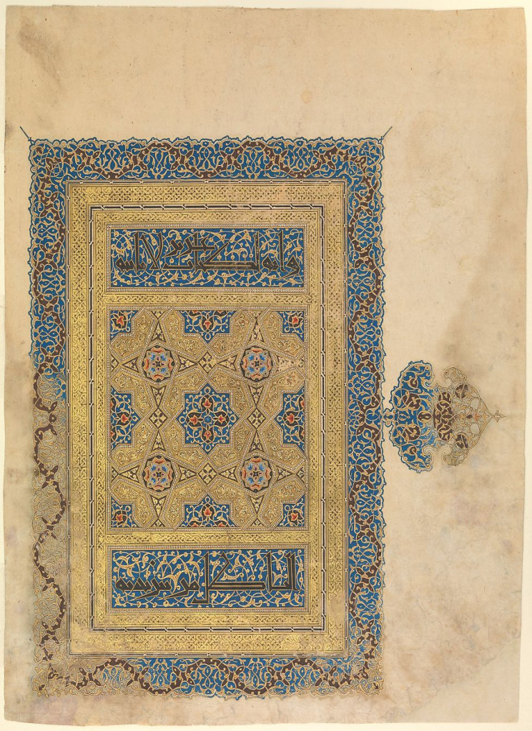
Vegetal patterns employed alone or in combination with the other major types of ornament—calligraphy, geometric pattern, and figural representation—adorn a vast number of buildings, manuscripts, objects, and textiles produced throughout the Islamic world. Unlike calligraphy, whose increasingly popular use as ornament in the early Islamic
Arab lands represented a new development, vegetal patterns and the motifs they incorporate were drawn from existing traditions of Byzantine culture in the eastern Mediterranean and Sasanian Iran.
vegetal designs

Slide 9
Islamic patterns
Islamic patterns consists of four units: geometric, vegetal, animal based and calligraphy.
Islamic patterns are divided into two main types: geometric and biomorphic.
Islamic geometric patterns: are very logical, mathematical and fit in perfectly on a plane. They always start from a circle and are traditionally made with a compass and straight edge.
Islamic biomorphic patterns: are the vegetal patterns that are either used as a filler for the geometric patterns or used on their own as the main focus.
Biomorphic patterns have a number of names that are more common like Arabesque, nbati, islimi, rumi and khatei.

Slide 10
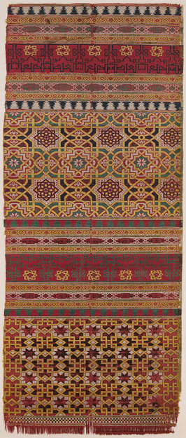
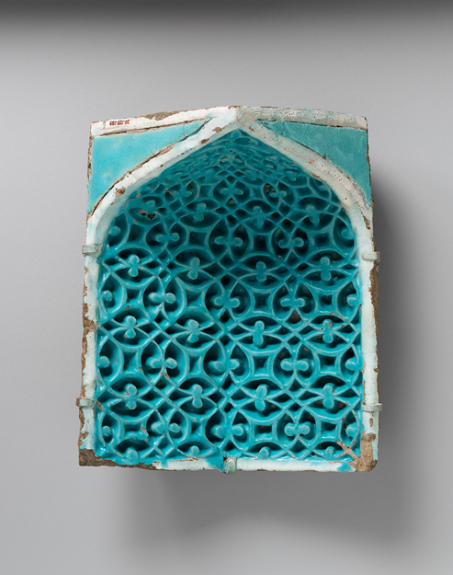
Islamic Geometric Art (Patterns)

Slide 11
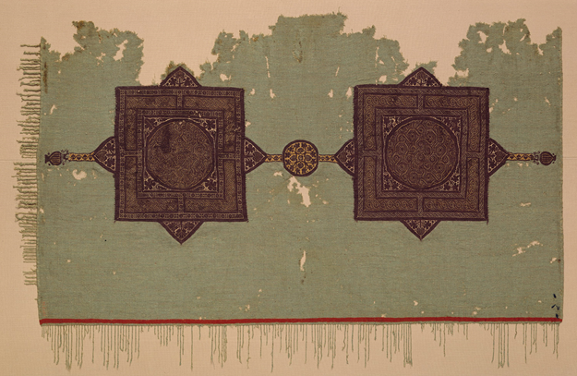

Slide 12
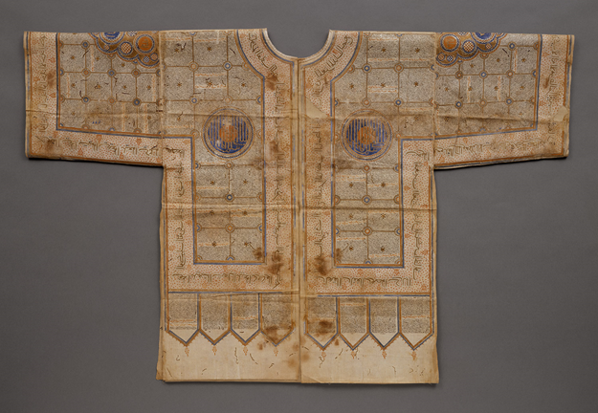
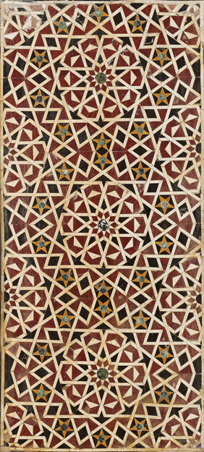
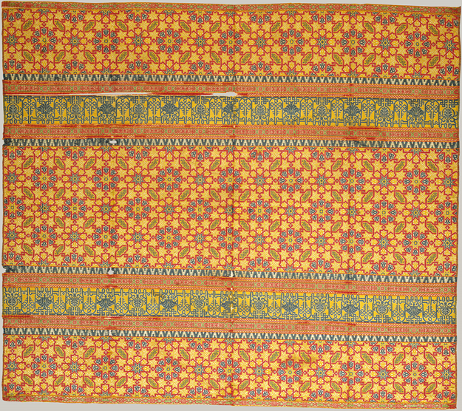

Slide 13
