Slide 1
Cables and IP

Slide 2
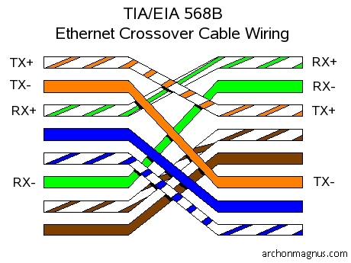

Slide 4
