Slide 1
Business Plan

Slide 11
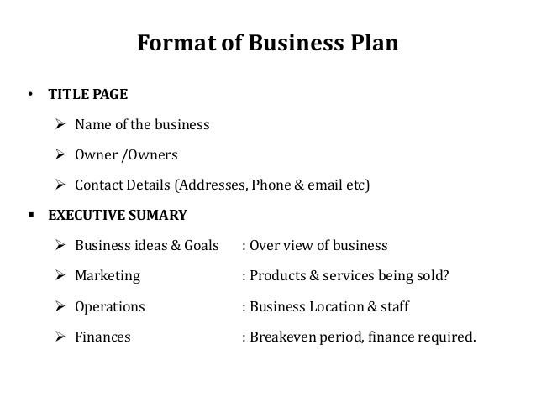

Slide 13
