Slide 1
HORT 308
MEDICINAL AND AROMATIC PLANTS

Slide 2
Holy Basil

Slide 3
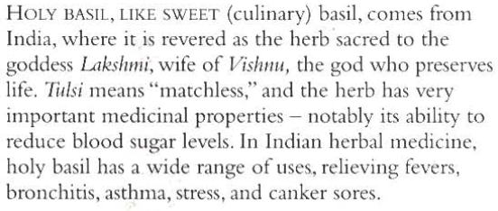
B.N Ocimum sanctum Family: Labiatae

Slide 4
Habitat & Cultivation
Native to India & other tropics of Asia
Extensively grown in Central & Southern America

Slide 5
Key Constituents
Volatile Oil 1% (Eugenol 70-80%, methyl chavicol, methyl eugenol, caryophyllene)
Flavonoids
Triterpene
Ursolic acid

Slide 6
Key Actions
Lower blood sugar
Antispasmodic
Analgesic
Lower Blood Pressure
Reduce fever

Slide 7
Research
Proved against certain types of diabetes
Lowers B.P
Anti-inflammatory
Analgesic
Inhibit sperm production

Slide 8
Traditional & Current Uses
Tonic
Invigorating
Improve vitality
Insect stings
Fevers
Heat & Stress
Adaptogenic
Diabetic remedy
Respiratory problems

Slide 9
Parts Used
Areal Parts (Fresh & Dry)

Slide 10
Key Preparations
Juice
Decoction
Powder

Slide 11
Ginseng

Slide 12
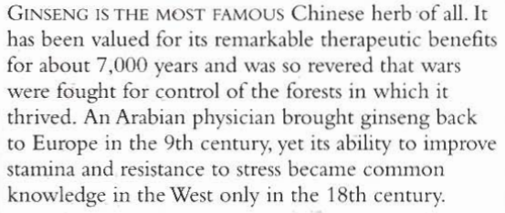
B.N Panax ginseng Family: Araliaceae

Slide 13
Habitat & Cultivation
Native to North-Eastern China, Eastern Russia & North Korea
Now extremely rare in wild
It’s cultivation requires great skill
4 years to mature, roots washed, steamed & then dried

Slide 14
Key Constituents
Triterpenoid saponins
Ginsenosides
Acetylenic compounds
Panaxans
Sesquiterpenes

Slide 15
Key Actions
Adaptogenic
Tonic

Slide 16
Research
Confirmed adaptogenic
Hunger
Immune functions
Resistant to infections
Support Liver functions

Slide 17
Traditional & Current Uses
Adaptogenic
Stimulating effect in young people
Tonic
Male aphrodisiac
Tonic for old age

Slide 18
Parts used
Dried Root

Slide 19
Key Preparations
Capsules
Tincture
Soup

