Slide 1
Cereals

Slide 2
True cereal: All cereals are members of the grass family, Gramineae, and are similar in possessing the characteristic fruit of that family, the karyopsis.
In this fruit the wall of the seed is fused with the ripening ovary wall to form the husk.
There are six true cereals in the world today, which are Wheat, Rye, Rice, Oats and maize.
The millets, sorghums and even buckwheat are often referred to as cereals, but they belong to a different classification.
Cereals contain a higher percentage of carbohydrates than any other food plants as well as a considerable amount of protein and some fats. There are even vitamins present.
Major Cereals

Slide 3
Wheat
There are some indications that highlands in Syria and Palestine might be the place of origin, but the Central Asian plateau and the Tigris and Euphrates valleys might be included.
Archeological evidence indicates that wheat had already been cultivated by earlier than 4,000 B.C.
Kinds of Wheat
Eight principal kinds of wheat were differentiated as species by some taxonomists: einkorn, Polish wheat, emmer, spelt common wheat, club wheat durum wheat and poulard wheat.
Modern classification has been on the basis of chromosome number with the most important species falling into three groups: Diploid (7 pairs) = Triticum monococcum; Tetraploid (14 pairs) = T. dicoccum, T. durum, T. polonicum, T. timopheevi and T. turgidum; Hexaploid (21 pairs) = T. compactum, T. aesticum and T. spelta.

Slide 4
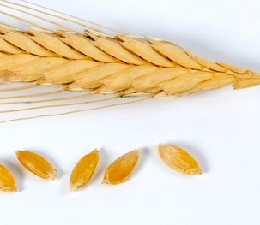
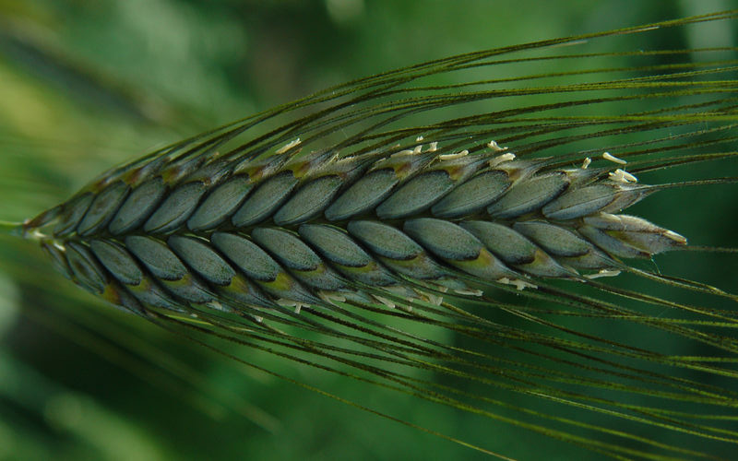
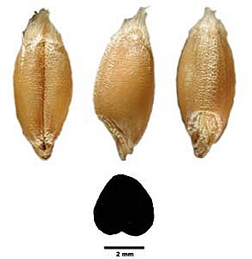
Einkorn Wheat
Triticum monococcum has been called “One-grained Wheat” because it has only one fruit in each spikelet.
It is one of the oldest species, dating back to the Stone Age.
It is not used much for baking but primarily for animal feed.
Emmer Wheat
Emmer, Triticum dicoccum, is also known as “Starch Wheat,” “Rice Wheat,” or “Two-grained Spelt.”
It is another very old type that was grown in Babylonia and by all the early Mediterranean civilizations and the lake Dwellers of Europe.
It is used for livestock and breakfast foods and in experimental breeding efforts.
Einkorn Wheat
Emmer Wheat

Slide 5
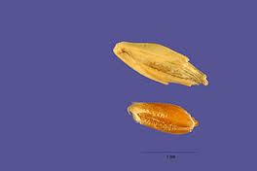
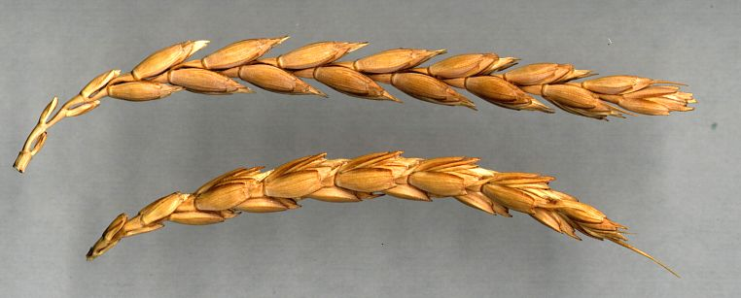
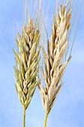
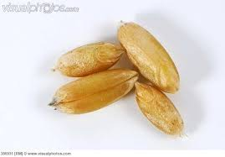
Spelt Wheat
Triticum spelta has been cultivated in the Mediterranean region for centuries and is still grown in Spain.
In North America is has been used as livestock feed.
Polish Wheat
Polish wheat, Triticum polonicum, or “Giant Rye” is species of comparatively recent origin.
It has been grown chiefly in Spain and Italy, Turkestan and Abyssinia.
Spelt Wheat

Slide 6
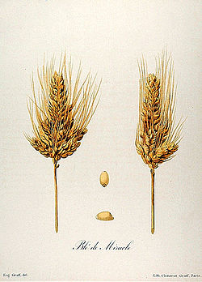
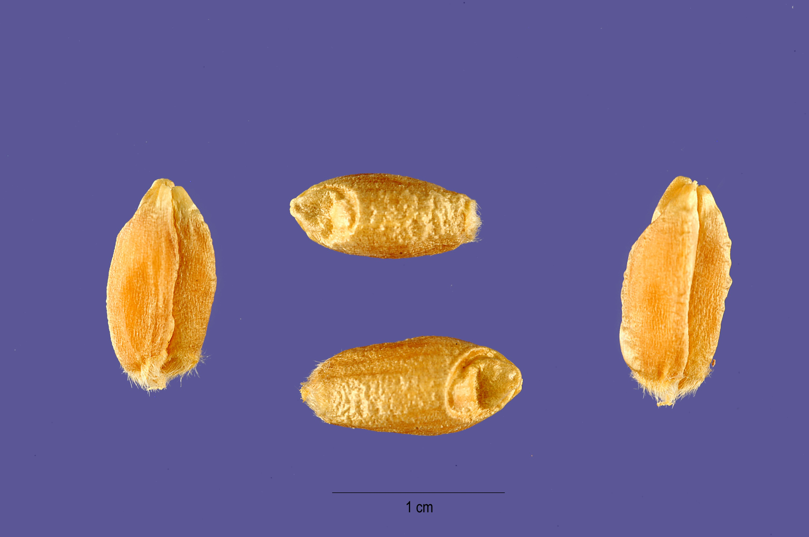
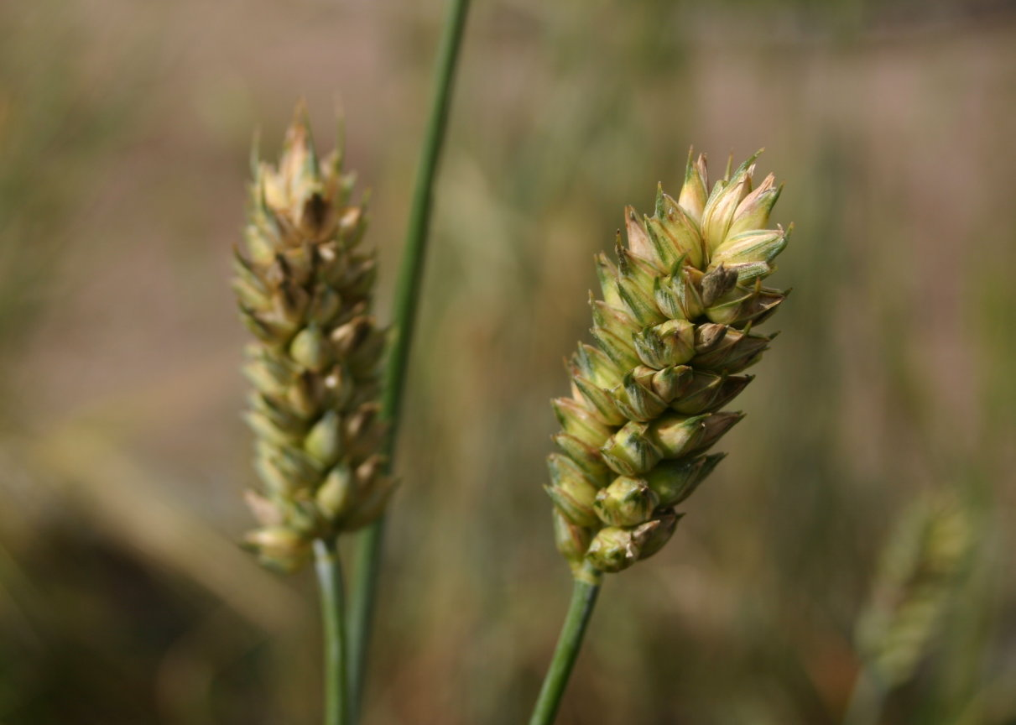
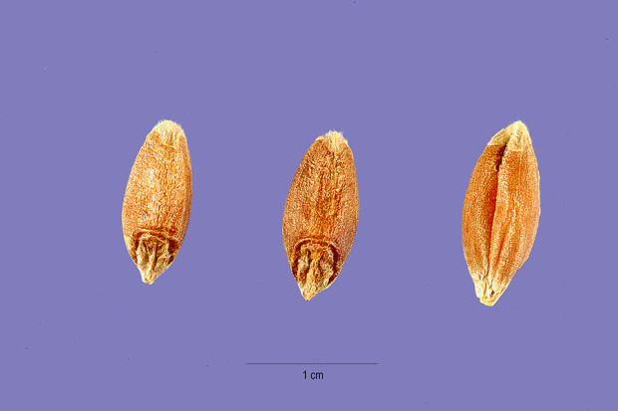
Poulard Wheat
Also known as “English Wheat” or “River Wheat”, Poulard Wheat, Triticum turgidum, is an old species that probably originated in dry portions of the southern Mediterranean region.
Club Wheat
Triticum compactum (tenax), also called “Dwarf Wheat” or “Hedgehog Wheat” is different from all other species in having short compact heads and small kernels.
Club Wheat is grown chiefly in the mountainous areas of Central Europe, Abyssinia and Turkestan.
The grains are soft and have low protein content, so the flour is not used for bread but rather for pastry flour.
Poulard Wheat
Club Wheat

Slide 7
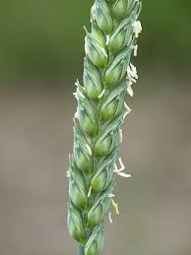
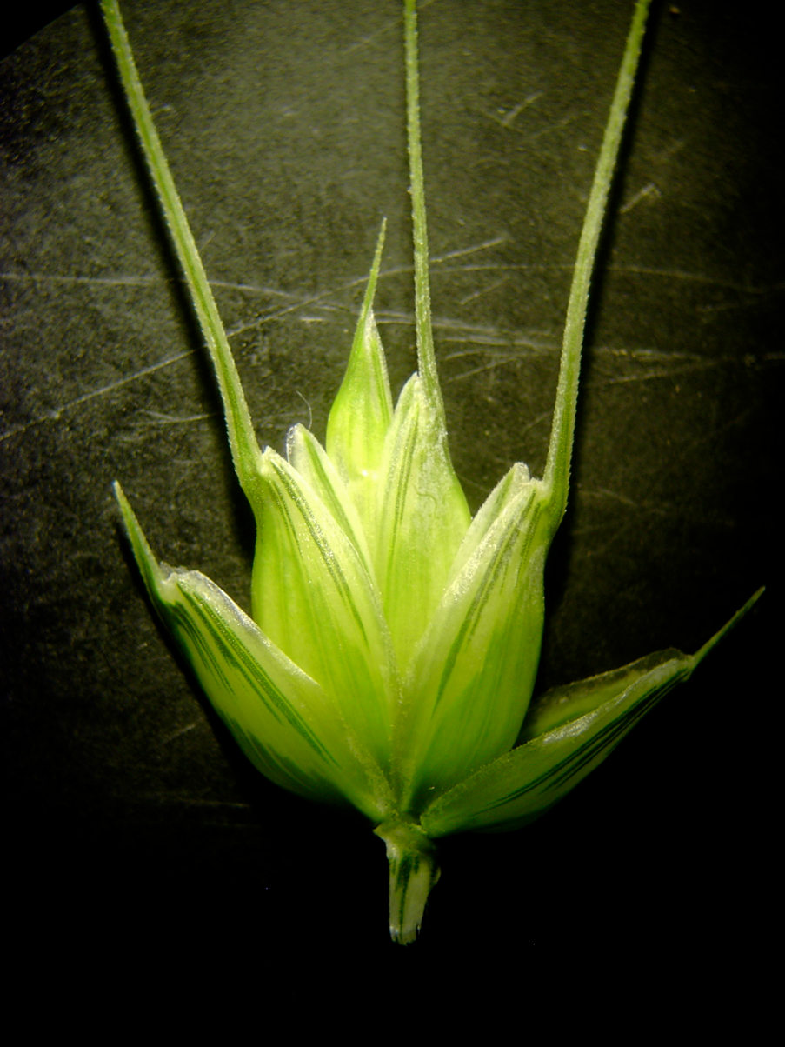
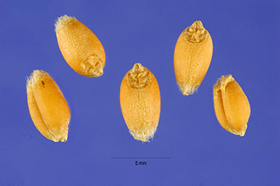
Common Wheat (Bread wheat)
Triticum aestivum is the principal source of bread flour.
Spring wheat is sown in the spring and harvested in late summer.
Winter wheat is planted in the autumn and develops a partial root system before the onset of cold weather.

Slide 8
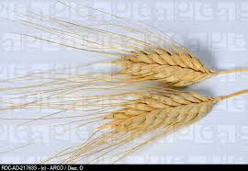
Timopheevi Wheat
Triticum timopheevi from Russia is especially resistant to disease and thus has been used in breeding programs with standard varieties.

Slide 9
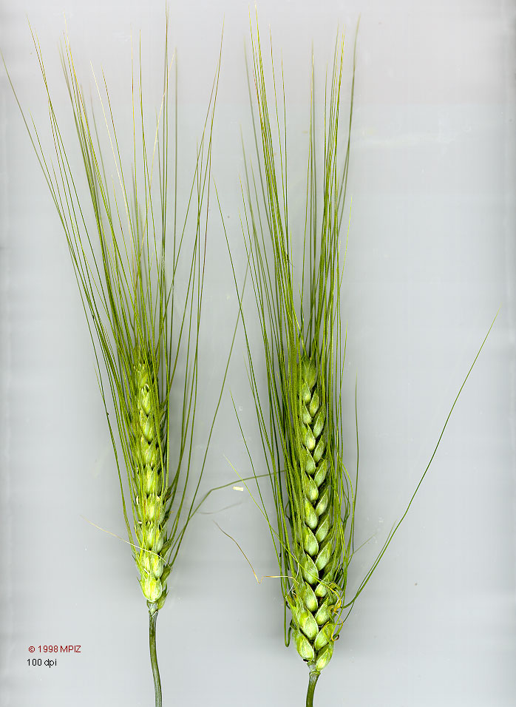
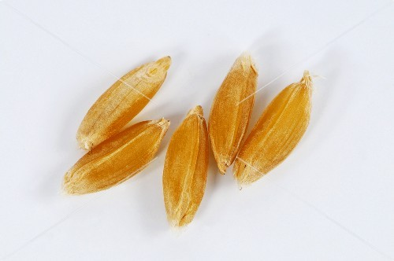
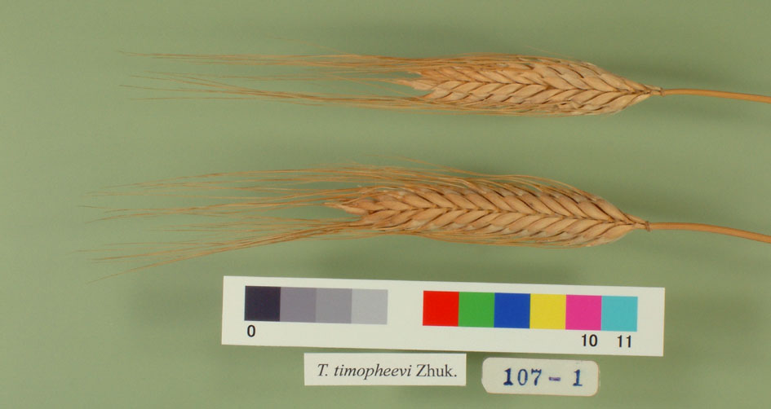
Durum Wheat
Triticum durum has a thick head with long stiff beards and large, hard, amber or red grains that are rich in gluten.
This species has been cultivated for a long time in the arid regions of the Old World.
Their high gluten content makes them especially suitable for macaroni, semolina and other types of pastas.
They are mixed with other flour in bread baking.
Red durum wheats are used for livestock.
Timopheevi Wheat
Triticum timopheevi from Russia is especially resistant to disease and thus has been used in breeding programs with standard varieties.
Durum Wheat
Timopheevi Wheat

Slide 10
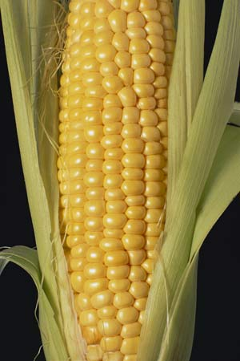
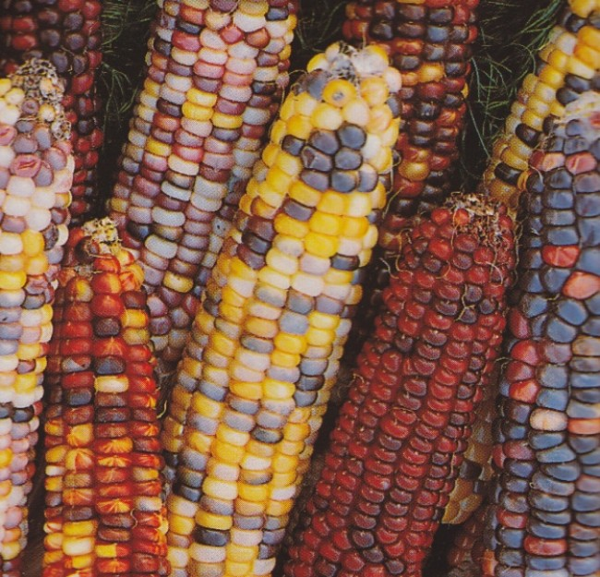
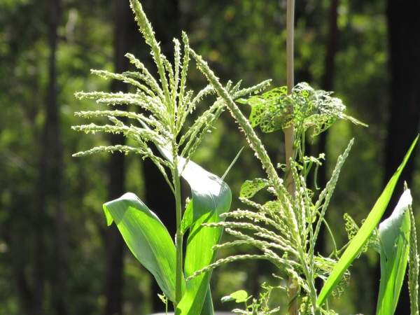
Maize
Indian corn or maize, Zea mays, is America’s main contribution to the important group of cereals.
Maize had been thought to have originated in a wild state in the lowlands of southern Mexico and Central America from which it spread to the Andes where its cultivation goes back to prehistoric time.
No cereal is used in so many ways as Maize.
About one-half the crop is used as a food for livestock.
The grain is very nutritious with a high percentage of easily digested carbohydrates, fats and proteins and very few deleterious substances.

Slide 11
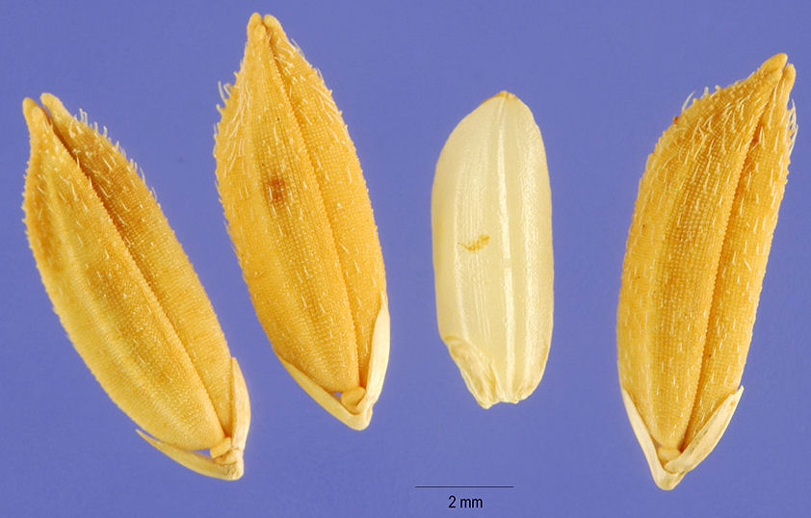
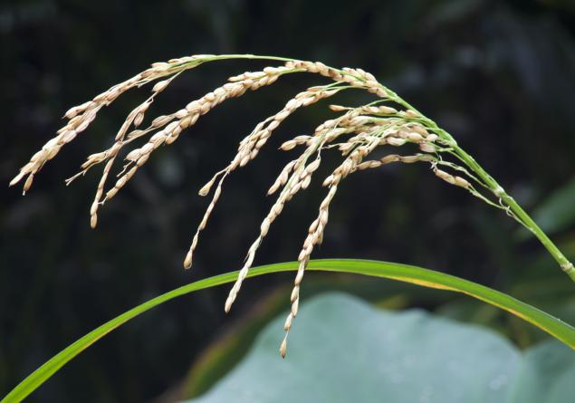
Rice
Rice, Oryza sativa, replaces all other cereals in tropical countries as the staff of life and dominates the economic and social structure.
Over half the world’s populations find rice as an indispensable food.
The plant originated somewhere in Southeastern Asia, but it has spread to every warm region of the world.
Rice is used mainly as a food by over half the world’s population.
It needs to be supplemented by legumes or some other food rich in proteins.
A diet of rice and soybeans constitutes the food of millions of people in Asia.
The polished rice, which reaches the world markets, is much less nutritious, but its use is widespread.
Rice starch is widely used in Europe.
Intoxicating beverages are made from rice in Japan and other areas.

