Slide 1
Definition of Research
RE-SEARCH: NOUN:
A detailed study of a subject, especially in order to discover (new) information or reach a (new) understanding.
(Cambridge Dictionaries Online, © Cambridge University Press 2003. )
The word "research" is used to describe a number of similar and often overlapping activities involving a search for information. For example, each of the following activities involves such a search; but the differences are significant and worth examining.

Slide 2
Research type | Essential characteristics
Find the population of each country in Africa or the total (in dollars) of Japanese investment in the U.S. in 2002. | A search for individual facts or data. May be part of the search for a solution to a larger problem or simply the answer to a friendly, or not so friendly, Concerned with facts rather than knowledge or analysis and answers can normally be found in a single source.
Find out what is known generally about a fairly specific topic. "What is the history of the Internet?" | A report or review, not designed to create new information or insight but to collate and synthesize existing information. A summary of the past. Answers can typically be found in a selection of books, articles, and Web sites.
Gather evidence to determine whether gang violence is directly related to playing violent video games. | Gathering and analyzing a body of information or data and extracting new meaning from it or developing unique solutions to problems or cases. This is "real" research and requires an open-ended question for which there is no ready answer.

Slide 3
SCIENTIFIC DEFINITION OF RESEARCH
The strict definition of scientific research is performing a methodical study in order to prove a hypothesis or answer a specific question. Finding a definitive answer is the central goal of any experimental process.
Research must be systematic and follow a series of steps and a rigid standard protocol. These rules are broadly similar but may vary slightly between the different fields of science.
Scientific research must be organized and undergo planning, including performing literature reviews of past research and evaluating what questions need to be answered.
Any type of ‘real’ research, whether scientific, economic or historical, requires some kind of interpretation and an opinion from the researcher. This opinion is the underlying principle, or question, that establishes the nature and type of experiment.
The scientific definition of research generally states that a variable must be manipulated, although case studies and purely observational science do not always comply with this norm.

Slide 4
What is the Definition of Research?
The definition of research includes any gathering of data, information and facts for the advancement of knowledge.
Sources:
Definition - http://www.merriam-webster.com/dictionary/research
Research is when someone tries to find out information in a systematic and orderly manner. Essentially, research is a quest for knowledge that everyone from students to scientists and historians has undertaken at some point
Source: http://answers.ask.com/Reference/Dictionaries/what_is_the_definit...

Slide 5
Definition of Research Report
Business reports are documents that present data and information to specific readers. Examples include data from customer service reviews, presentations of new marketing and promotion approaches, or a financial plan for the annual budget.
Source: http://wiki.answers.com/Q/What_is_the_definition_of_research_repo...

Slide 6
Definition of Marketing Research
Market research and marketing research are often confused. 'Market' research is simply research into a specific market. It is a very narrow concept. 'Marketing' research is much broader. It not only includes 'market' research, but also area.
Source: http://wiki.answers.com/Q/What_is_definition_of_marketing_researc...

Slide 7
Definition of Research Instrument
In concept research instruments are questionnaire and interview guidelines.
Source: http://wiki.answers.com/Q/What_is_the_definition_of_research_inst...

Slide 8
TYPES OF RESEARCH
Management research
Academic research
Experimental research
Deductive research
Inductive research

Slide 9
Management research
Management research can be broadly defined "as a form of systematic inquiry that contributes to knowledge in the field of management". It is also about searching systematically for solutions to management problems.
Source: http://wiki.answers.com/Q/What_is_the_definition_of_management_re...

Slide 10
Academic research
It is a research on scholar purpose, that is not client oriented.
Source: http://wiki.answers.com/Q/What_is_the_definition_of_academic_rese...

Slide 11
Experimental research
Experimental research is the research that you conduct while experiencing the results of it.
Source: http://wiki.answers.com/Q/What_is_the_definition_of_experimental_...

Slide 12
Deductive research
It refers to specific data obtained from a general theory. The theory leads to predictions about what is likely going on. For example, a hypothesis follows this as it is a theory-based prediction. A problem of deductive research is the bias.
Source: http://wiki.answers.com/Q/What_is_the_Definition_of_deductive_res...

Slide 13
Inductive research
It is a research that include thorough and proper preparation in regard to the perceptions.
Source: http://wiki.answers.com/Q/What_is_the_definition_of_inductive_res...

Slide 14
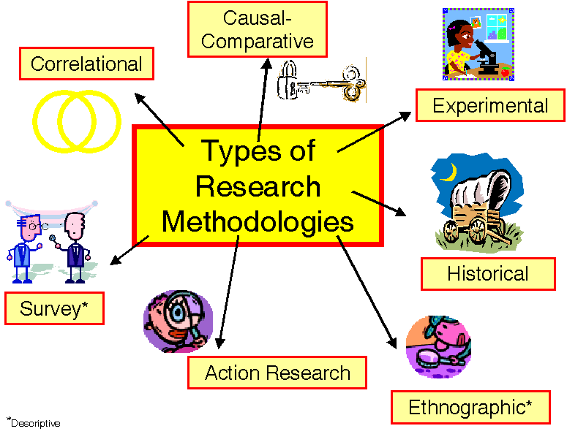

Slide 15
Aims Of Research
Observation and description
Prediction
Determination of the causes
Explanation
New direction

Slide 16
INTRODUCTION
The ultimate aims of research are to generate measurable and testable data, gradually adding to the accumulation of human knowledge.
Ancient philosophers believed that all answers could be achieved through deduction and reasoning, rather than measurement.
Science now uses established research methods and standard protocols to test theories thoroughly.
It is important to remember that science and philosophy are intertwined and essential elements of human advancement, both contributing to the way we view the world. Scientific research, however, allows us to test hypotheses and lay solid foundations for future research and study.
No theory or hypothesis can ever be completely proved or disproved, but research enables us to make valid assumptions about the universe.

Slide 17
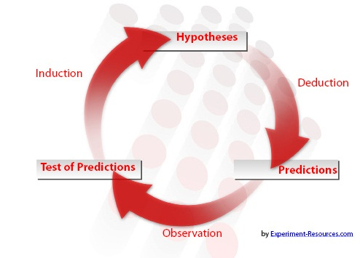
This gradual accumulation of knowledge dictates the overall direction of science and philosophy.

Slide 18
OBSERVATION AND DESCRIPTION
The first stage of any research is to observe the world around us and to ask questions about why things are happening.
Every phenomenon in the universe has a reason behind it, and the aims of research are to understand and evaluate what is happening.
However, simple the phenomenon or however, easy it appears to be to generate logical and intuitive answers, scientific research demands rigorous testing for a truth to be accepted.
Describing the overall behavior of the subject is the first stage of any research, whether it is a case study or a full-blown ‘true experimental design’.

Slide 19
PREDICTION
This stage is where you must make a statement of intent and develop a strong hypothesis. This must be testable, with aims of research being to prove or disprove this statement.
At this stage, you may express your personal opinion, favoring one side or the other. You must make a statement predicting what you expect the final answer to be.
You must, however, keep an open mind and understand that there is a chance that you may be wrong. Research is never about right or wrong, but about arriving at an answer, which improves our knowledge of natural processes.

Slide 20
DETERMINATION OF CAUSES
This is often the ‘business end’ for many areas of scientific research and is where one of the predictions is tested, usually by manipulating and controlling variables. The idea is to generate numerical data that can determine the cause with one of the many statistical tests.
For example, a small-scale global warming study might study Antarctic ice cores to determine the historical levels of carbon dioxide throughout history. In this experiment, time would be the manipulated variable, showing how levels of the greenhouse gas have changed over time.
Statistical procedures are then utilized to either prove or disprove the hypothesis and prediction.
Of course, very little research gives such a black and white answer, but opens up new areas of potential study, focusing on a specific direction.

Slide 21
EXPLANATION
After determining the causes, the next layer of the research process is to try to find possible explanations of ‘Why?’ and ‘How?’ things are happening.
For most areas, this stage involves sifting through and reviewing earlier studies about similar phenomena. Most research is built upon the work of previous researchers, so there should be a wealth of literature resources available.
If we look at a topical example, Global Warming is an area with which most of us are familiar, and has been the subject of thousands of studies. Intuitively, most of us would state that humanity pumping carbon dioxide into the atmosphere is responsible for a worldwide rise in temperatures.
The aims of research may be to establish ‘What are the underlying causes and relationships between the different processes fueling this trend?’ In most cases, it is necessary to review earlier research and try to separate the better quality sources from the inaccurate or poorly designed studies.
It is equally important to take into account any opposing points of view and accept that they may be equally valid. Explanation is about coming up with viable reasons, and you must try to be as objective and unbiased as possible.
For example, for global warming, there is an opposing view that temperature rises are natural, and that the effect of human society is making little difference.
At this stage, personal opinion must be put aside and both sides of the debate must be given equal credence.

Slide 22
NEW DIRECTIONS
Whatever the final answer, it can be used to promote a healthy debate and discussion about the validity of the results.
The aims of research can then be fine-tuned, or may serve to open up new areas of interest. Either way, the store of human knowledge has been enriched and increased.

Slide 23
