Slide 1
Gap junction:
Introduction:
Gap junctions were first defined morphologically as specialized contacts between cells that mediate the direct exchange of small molecules needed to coordinate behavior of multicellular systems.
As a functional entity, they have evolved independently three times, if one includes plasmodesmata in plants, which are structurally very distinct from gap junctions but mediate similar functions. The gap junctions of vertebrates and invertebrates are similar both in structure and function, but the former are composed off connexin family while the later are composed of topologically similar but unrelated family called the innexins.
Recently, however, three pannexin genes displaying distant homology to the innexins, but as yet unknown function, have been found in invertebrates

Slide 2
Definition:
'Gap junctions are aggregates of intercellular channels that permit direct cell-cell transfer of
ions and small molecules'
'Gap junctions are clusters of intercellular channels that allow direct diffusion of ions and small
molecules between adjacent cells'
They are initially described as low-resistance ion pathways joining excitable cells(nerve and muscle), gap junctions are found joining virtually all cells in solid tissues.
Their long evolutionary history has permitted adaptation of gap-junctional intercellular communication to a variety of functions, with multiple regulatory mechanisms.
Gap-junctional channels are composed of hexamers of medium-sized families of integral proteins: connexins in chordates and innexins in precordates.
The functions of gap junctions have been explored by studying mutations in flies, worms, and humans, and targeted gene disruption in mice. These studies have revealed a wide diversity of function in tissue and organ biology.

Slide 3
How are they formed?
These intercellular channels are formed by head-to-head docking of hexameric assemblies of tetraspan integral membrane proteins, the connexins(Cx).
These channels cluster into polymorphic maculae or plaques containing a few to thousands of units. The close membrane apposition required to allow docking between connexons sterically excludes most other membrane proteins, leaving a narrow 2nm extracellular 'gap' for which the junction is named.
Gap junction in prechordates are composed of innexins. In chordates, connexins arose by convergent evolution, to expand by gene duplication into a 21-member gene family. Three innexin related proteins, called pannexins, have persisted in vertebrates, although it is not clear if they form intercellular channels.

Slide 4
Formation and degradation:
Gap junctions form punctate 'plaques' at the interfaces between cells, although protein is often seen trapped in the ER and Golgi in some disease-associated mutants. Although not glycosylated, most connexins do pass through the Golgi, and oligomerize late in their biosynthesis.
There is also some evidence for non-Golgi transport of Cx26. Hexameric connexons, or hemichannels, are inserted into the membrane, where they remain in a predominantly closed state until recruited to the outside of existing plaques within the membrane.
Removal of old connexins can occur through 'budding-off' of whole pieces of plaques, to form annular gap junction vesicles within one cell. Both lysosomal and proteasomal degradation pathways for connexins have been reported. Surprisingly, connexins themselves are turned over very rapidly, with the half-life of 1-5 hours.

Slide 5
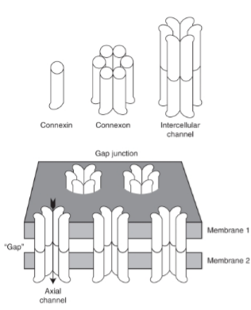
A diagram showing the multiple levels of gap junction structure. Individual connexins assemble intracellularly into hexamers, called connexons, which then traffic to the cell surface. There they dock with connexons in an adjacent cell, assembling an axial channel spanning two plasma membranes and a narrow extracellular 'gap'.

Slide 6
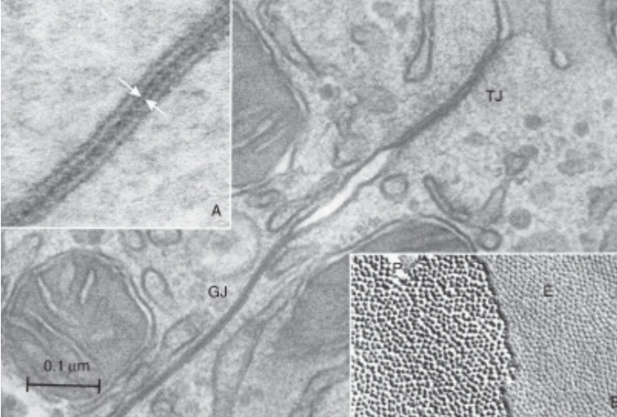
Electron microscopy of gap junctions joining adjacent hepatocytes in the mouse. The gap junction is seen as an area of close plasma membrane apposition, clearly distinct from the tight junction joining these cells.

Slide 7
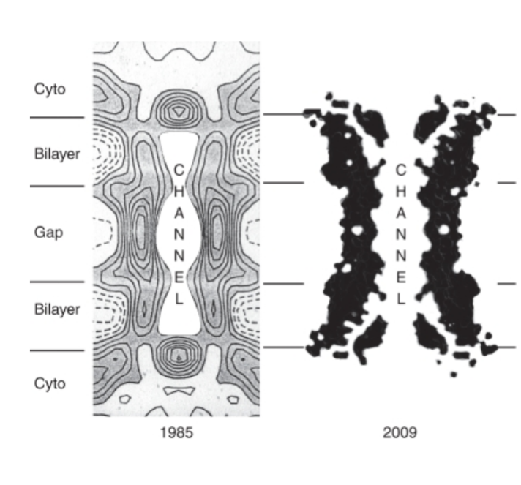
The 1985 data were acquired from gap junctions isolated biochemically from mouse liver. The 2009 data acquired from three-Dimensional crystals of recombinant Cx26.

Slide 8
Diverse functions:
The ubiquitous presence of gap junctions in the metazoa has suggested that they are essential for multicellular life. A conclusion that is supported by the array of different human diseases and mouse phenotype that arise from defects in these genes. Some of the diseases have a significant impact on the human population, with Cx26 mutations accounting for over 50% of the cases of inherited asymptomatic sensoneural deafness.
Among the phenotypic consequences of connexin loss, some appear to reflect the role of gap junctions as ion conductors, such as the loss of retinal rod signaling, cortical asynchrony (Cx36), partial conductance block (Cx40) and ventricular arrhythmias (Cx43) in the heart, and K+ recycling in the ear (Cx26 and Cx30). Others are likely to result from interruption of nutrient transfer between cells, as in the avascular eye lens (Cx46 and Cx50) and placental transfer to the fetus (Cx26 and Cx31). Yet other defects illustrate the probable role of gap junctions in meditating intercellular signaling, such as coordination of neural crest migration (Cx43), oocyte maturation (Cx37 and Cx43), myelin development (Cx32 and Cx47), coordination of hepatic sympathetic responses (Cx32) and morphogenesis of heart, blood, bone, vasculature (Cx43 and Cx45) and skin (Cx26, Cx30 and Cx30.3).

Slide 9
The ability of adjacent cells to share ions through low-resistance pathways is fundamental to the function of electrically excitable cells, such as neurons, heart, and smooth muscles. Indeed, gap junctions were first discovered in myocardium and nerve because of their properties of electrical transmission between adjacent cells. In these contexts, connecting cells with gap junctions provides both increased speed in synaptic transmission and the ability to synchronize groups of cells for coordinated electrical and mechanical output.
In addition to electrically excitable cells, virtually all cells in solid tissues are joined by gap junctions. A core function of GJIC is to share metabolic demands across group of cells and thereby buffer spatial gradients of nutrients or signaling molecules.
Gap junctions may also function as suppressors of somatic cell mutations so that loss of a critical metabolic enzyme or ion channel in one cell might be compensated by its neighbors. For example, Lesch-Nyhan syndrome results from impaired activity of hypoxanthine phosphoribosyltransferase (HGPRTase), a key enzyme in nucleotide salvage pathway.
Impaired HGPRTase results in an elevated concentration of phosphoribosyl pyrophosphate, a marked increase in the rate of purine biosynthesis, and an over production of urate. Mutant fibroblasts from patients with Lesch-Nyhan syndrome can be metabolically rescued in cell culture by gap junction formation with normal cells, a process called metabolic cooperation. So, the individuals are asymptomatic because of metabolic rescue of mutant cells by adjacent nonmutant cells.

Slide 10
Gap junctional intercellular channels are dynamically regulated:
Communication via intercellular channels is regulated at multiple levels. The most rapid timescales involve changing the unitary conductance of single channels or altering their probability of opening. Slower regulation is achieved by altering the number of channels present in membrane by changing rates of synthesis and assembly, post translational modification and protein degradation. The mechanism of regulation can overlap between these different time frames, for example, phosphorylation is involved both in changing single channel conduction and in protein trafficking to the cell surface and degradation. The different timescales will be considered in turn.
Rapid Regulation:
On the shortest time scale, it is known that gap-junction channels are gated by voltage and display multiple voltage-dependent conductance states. Voltage gating is the common property of connexins, although they show substantive differences in their sensitivities. Voltage-gating could explain rectifying neural synapsis observed in cray fish, Drosophila and hatchetfish, in which action potentials are permitted to pass orthodromically but not antidromically.

Slide 11
This behavior requires a structural asymmetry that could be most simply modeled by a hetero-dependent closure whereas the other did not. Indeed, rectification was observed in heterotypic junctions formed between connexins expressed in paired Xenopus oocytes, but the the time scalewas too slow to completely explain rectifying synapses.
In addition to rapid closure of a channel in response to postsynaptic depolarization, rectification at an electrical synapse could be achieved by opening channels in response to presynaptic depolarization. However, it requires at least 9.5ms to reopena closed Cx40 channel in this manner, which is also too slow to account for synaptic rectification.
Although rectifying synapses require near-instantaneous rectification of current, somewhat slower voltage inactivation may be functional in other contexts. For example, Cx45/Cx43 heterotypic junctions may rectify fast enough to influence dendro-dendritic interactions in the central nervous system or may modulate re-entry circuits in myocardium.

Slide 12
Slow Regulation:
A slower temporal level of regulation involves connexin biosynthesis and junctional plaque assembly and turnover. Connexin can show a remarkably rapid turnover rate for a membrane protein. For example, the in vivo half-life of Cx32 in gap junctional plaques from rodent hepatocytes is less than 5 hours and turnover of Cx43 in tissue culture cells is even faster.
Gap junctions also turnover by addition of subunits at the edges of pre-existing plaques could nothing more than lateral diffusion in the plasma membrane, but it is not at all clear how the selective removal of connexins or intercellular channels from the center of a plaque might be orchestrated.
Gap junctions are also removed from the cell surface by gross internalization of entire plaque, leaving large double-membrane vesicles in the cytoplasm. Studies suggest that internalization is a clathrin-mediated process. The relationship between the removal of connexins from the center of pre-existing junctional plaques and clathrin-dependent endocytosis of whole junctional plaques remains unclear.

Slide 13
Specialized functions revealed by connexin mutations:
Human Mutations:
In humans, mutations in Cx32 underlie X-linked Charcot-Marie-Tooth syndrome, a common peripheral demyelination neuropathy, and mutations in Cx47 result in a central demyelinating condition called Pelizaeus-Merzbacher-Like-Disease.
More than half of all profound hereditary deafness results from mutations in Cx26, which are often syndromic and involve skin disorders. Similarly, although usually less severe, disorders of the skin and auditory system accompany mutations in Cx31 and Cx30.
Familial cataracts are commonly associated with mutations in either Cx46 or Cx50, whose expression is largely restricted to the ocular lens. Finally, mutations in Cx43 give rise to oculodentodigital dysplasia, a pleomorphic, syndromic condition affecting a large number of cell types.

Slide 14
Targeted Mutations in Mice:
In mice, targeted mutations of connexins have uncovered a wide variety of gap-junction functions in various organs. In many of these cases, a given connexin occupies a particular niche, supplying an essential function that is not compensated by another connexin.
For example, Cx26 deletion is embryonic lethal because of a disruption of glucose transport between syncytiotrophoblast I and II in the labyrinth layer of the placenta, which are coupled by gap junctions. In contrast, the human placenta contains only one giant syncytiotrophoblast and so is not vulnerable to Cx26 mutations.
Cx45 deletions are also embryonic lethal, in this case likely the result of myocardial arrhythmia shortly after the heart begins to beat. Cx37 knockouts are female sterile from a failure of ovarian follicle development at the antral stage. Presumbly, loss of communication between oocyte and cumulus cells leads to premature resumption of meiosis and luteinization.
The loss of Cx40, prevalent in the His-Purkinje system, results in cardiac arrhythmias resembling right-bundle-branch block in humans.

Slide 15
Unique roles of connexins:
Unique roles played by some connexins have been shown by knockin experiments. The Cx43 coding sequence was replaced in three separate mouse lines with Cx32, Cx40, or Cx26 coding regions. All three animal lines showed new functional defects unique to each connexin, revealing that the three connexins were not able to substitute for Cx43 in all contexts.
Although none of the lines displayed the pulmonary outflow defects seen in the Cx43KO mouse, a knockin of Cx31 into the Cx43 locus did show the defect. Thus, connexins may have both unique and redundant functions

Slide 16
Channel Permeability Properties:
The primary function ascribed to gap junctions has been the transfer of metabolites and ions under about 1000 Da between cells in contact. Although this may seem to be a 'housekeeping' function, several recent studies have revealed a surprising diversity in the permeability properties of gap junctions composed of different connexins.
Ion substitution experiments show that the anion/cation preferences of connexins can differ by upto tenfold, while larger permeants, show exclusion limits that vary from 7 to 15Å, depending on the connexin composition of the channel.
Rates of dye flux through individual channels were 1-3 orders of magnitude higher than those predicted by diffusion, indicating a significant affinity between dyes and the pore wall. This is consistent with findings that different connexins can impart selectivity levels of 10-100 fold for natural permeants such as ATP, AMP, adenosine and glutathione, IP3 and even different cyclic nucleotides.

Slide 17
Hemichannels:
Prior to incorporation into gap junctions, hemichannels are typically kept closed through a combination of extracellular Ca++ and Vm gates. On docking with the compatible hemichannel in the other cell, intercellular channels are triggered to open. Sone hemichannels can be opened by membrane depolarization and reduced extracellular Ca++ concentration.
However, significant circumstantial evidence has implicated open hemichannels of other connexins in physiological processes as varied as extracellularly propagated Ca++ waves, inhibition of apoptosis in osteocytes and center surround inhibition of cones by horizontal cells.
Molecular Structure of the Pore:
Improved microscopic, biophysical and mutagenic strategies have led to recent advances in our understanding of the structural basis of gap junction function. Atomic force microscopy has provided a dynamic view of conformational changes in the hexameric channels during gating, but at limited resolution.
However, a major breakthrough in resolving the structure of the pore came with reconstruction of electron diffraction images of isolated Cx43 gap junctions.

Slide 18
All connexins have four transmembrane helices, two highly conserved extracellular loops that are held rigidly together by three disulphide linkages and three highly variable cytoplasmic domains. Systematic cysteine scanning mutagenesis of Cx32 has mapped the residues that contribute to the pore lining in open and closed states, which, surprisingly, revealed that the channel is lined with hydrophobic residues predominantly in M3, with some at the cytoplasmic end of M2.
Other mutagenesis studies have indicated that M1 and its flanking domains may contribute to the pore lining of hemichannels and are likely to serve as the voltage sensor of the channel. The cytoplasmic C-terminal domain serve as a 'ball' to close the channel in response to pH and phosphorylation, and contains a variety of targets and binding sites for various kinases, scaffolding and signaling proteins that have been most extensively mapped in Cx43.
The latter suggest that, like adhesive and tight junctions, gap junctions may be an important nexus for signaling beyond their role in selective exchanges of metabolites between cells.

