Slide 1
Ethical Dimensions of Social Policy

Slide 2
Introduction
What is ethics?
What is Socialpolicy?
How, and in what ways, are ethics and Social policy connected?
Is policy formulation the role of politicians or government servants?

Slide 3
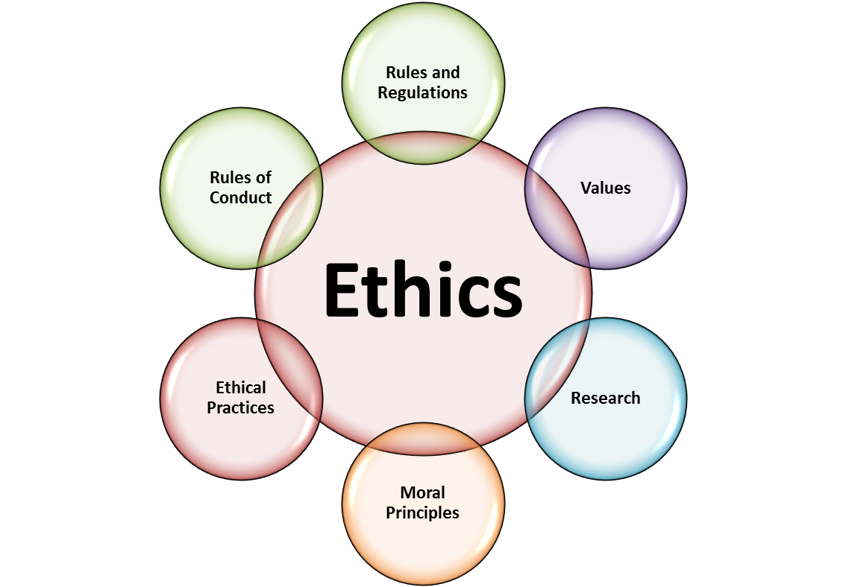

Slide 4
Ethics
Ethics is about what we ought to do or ought not to do
What is good and bad, right and wrong, just and unjust, or noble and ignoble,
Ethics are rules that guide the decision-making process
rooted in religion, morality, law, education, experience, and human strengths and weaknesses
no complete agreement about the ethical standards and behaviour that should apply in specific contexts

Slide 5
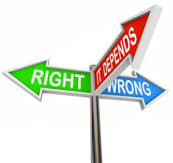

Slide 6
SocialPolicy
Social policy what governments choose to do and or not to do
Social policy is largely about deciding who gets what and who pays

Slide 7
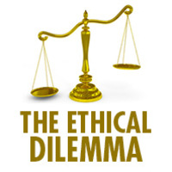

Slide 8
Ethical Dilemmas
What principles should guide decision making
Ethical dilemmas in social policy arise for two reasons:
resources are inadequate to meet all demands
When people are committed “to do the right thing” between conflicting demands and priorities
Notes:
ethics, culture, religion, and morality help to shape Social debate, policymaking, and policy execution.
In the execution of Social policy, it is impossible to do no harm to others;
often, Social policy requires the redistribution of resources, denial of rights or privileges, or promotion of one group at the expense of another

Slide 9
Ethics and Social Policy
Ethics
relevant to all aspects of the policy-making cycle
defining the problem
identifying and assessing the available options
decision making
Implementation
Evaluation
where justified – termination.
Notes:
at the heart of Social policy

Slide 10
Ethical Questions
What norms and values should guide the behavior of those involved in the policy process?
What procedures should be adopted in the event of conflicts of interest?
How should the need for secrecy – essential for frank and confidential discussions – be balanced against the desirability of openness and Social participation?
Notes:
For policy makers and their advisers serious ethical reflection on both the purpose of policies and how they should be designed is crucial.
But a range of other ethical issues also arise in policy-making contexts

Slide 11
Ethical Questions
To what extent is it legitimate for officials to challenge the priorities and policies of the government?
What are the boundaries of free and frank advice or loyal and obedient service?
Is it appropriate for officials to advocate for particular social, cultural, economic, or environmental outcomes within the performance of their Social duties?

Slide 12
Who makes Policy
Elected government
Bureaucracy

Slide 13
Process of PP in Pakistan - I
Under the Constitution, responsibility of policymaking with the executive branch
An elected government has a manifesto on the basis of which it is voted to power
The leadership should decide the priorities enshrined in the manifesto
Political government should then ask the concerned ministries to prepare a draft document
Draft policy document circulated among various stakeholders for their views
Notes:
with further division among the federal, provincial and local governments.
(In many countries, China, for example, each ministry has a research institute which helps in compiling data, carrying out analysis and preparing background material.)
that takes stock of the existing situation, diagnoses the problems, analyses the various options, outlines the preferred option, costs out its financial implications and spells out the action plan along with milestones and deadlines in draft document
some countries also hold Social consultations on critical policy documents.

Slide 14
Process of PP in Pakistan - II
Ministry concerned forwards the draft to the Economic Coordination Committee or the full cabinet
Approved policy may be supported with legislative instruments prepared by the law ministry
Steered though relevant committees of National Assembly and Senate and finally in the parliament
After approval of legislature entrusted with concerned ministry for execution with specified timelines and milestones
Progress reviewed periodically and monitored either by PM, cabinet or ECC.

Slide 15
Frameworks of PP
Building the good society - Virtue
Fairness and justice
The common good or the Social interest
Uphold the divine will or build the Kingdom of God
Utilitarian: achieve the greatest good for the greatest number
Rights based
Notes:
John Stuart Mill the need to maximise utility, happiness, or welfare or

Slide 16
Steps for each framework
Steps for each framework
Policymaker may have a preferred approach
one approach may not be appropriate or feasible for all types of dilemmas political leaders may face
Knowledge of a variety of approaches and how each can be applied to a given situation is necessary

Slide 17
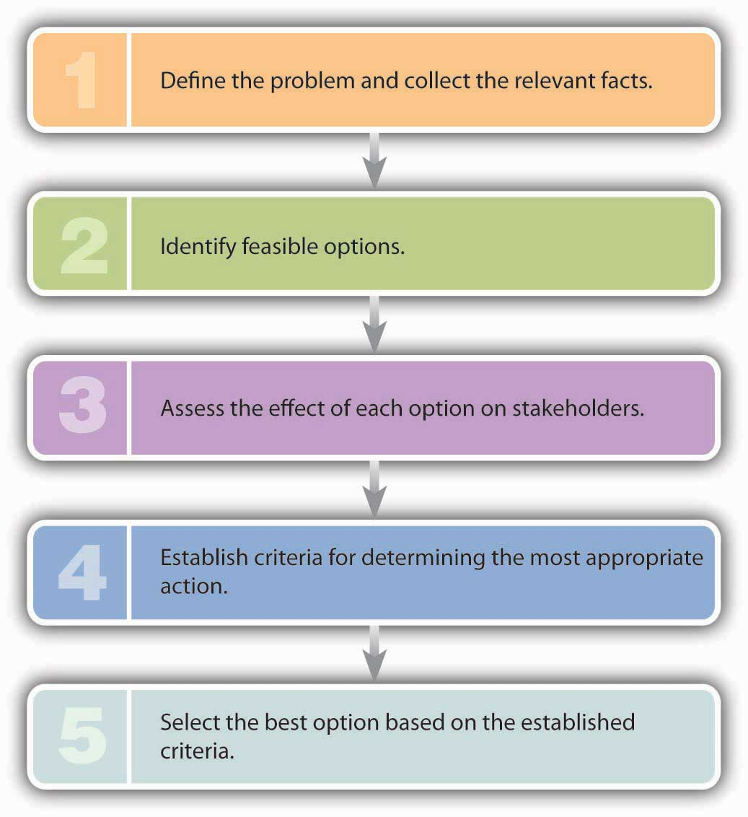

Slide 18
APPROACHES - I
Consequentialist approach:
to assess the goodness or otherwise of a policy solely on the basis of its consequences
Consequences of a policy often difficult to discern
May not be fully evident for many years or even decades
Notes:
From the perspective of moral philosophy two broad approaches

Slide 19
Approaches - II
Non-consequentialist or deontological approach
Assess a policy on whether it is consistent with certain agreed ethical principles
What particular principles should count
if there are conflicts between the relevant principles, how these should be resolved

Slide 21
Ethical Principles
Ethical principles that should guide policy analysts:
Integrity
Competence
Responsibility
Respect
Concern –for the lives of others.

Slide 22
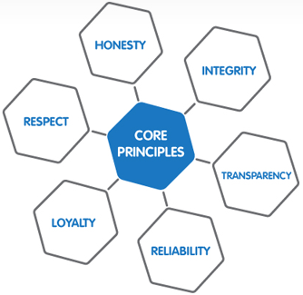

Slide 23
Process of Ethical Debate
First - decision-making processes must be transparent and reasons for decisions about ethical acceptability must be disclosed
Second - provide for chances to refine and rethink conclusions on ethical issues
Third - governments may choose to delegate some decision-making power, to provide a greater degree of independence, from political considerations
Fourth, democratic governments must exercise ethical leadership with respect to values that they consider to be sufficiently fundamental
Notes:
Recognition that ultimate decision-making power rests with governments.
Four points about the responsibilities and obligations of government

Slide 24
Ethical Values
Contrast between materialism and post-materialism in value change
Materialist values emphasize income, economic growth and social stability
Post-materialist values, emphasize personal fulfilment, quality of life, human rights and freedom of speech
Since end of World War II, post-materialist values more widespread in industrial societies,
Values, rather than distribution of economic pie, important in the political arena of industrialized countries

Slide 25
Ethical Values
The values that determine what is considered ethically acceptable change over time
A number of factors, among them culture and socialization, religion and mass media
Notes:
ethics” of our leaders have evolved over time. For instance, the Founding Fathers of the United States are often portrayed as highly moral men--yet, most of them were slave owners. What may have been considered ethical in previous decades is no longer considered ethical due to evolving cultural norms and societal mores.
Canadians are more sympathetic to concerns about the good of the community, somewhat more deferential toward authority, and willing to accept a larger role for governments in social and economic affairs.

Slide 26
Ethical Values
Poverty eradication to be justified ethically on the basis of considerations of global justice
More important ethical motivation for reducing poverty is ‘humanity’
Moral duty to alleviate severe suffering for its own stake
This goal of ‘humanity’ is distinct from considerations of justice
Ought to serve as a fundamental ethical driver of Social policy.

Slide 27
Essentials of PP
Policy analysts should be well connected to the communities that their policies affect and alert to the impacts of their work
Adopt principles to exercise moral judgment within imperfect democratic processes and institutions
Within a real-world context in which conflicts over facts and values, means and ends, are inescapable
Such an applied ethics requires the active cultivation of ‘moral competence in Social life’.
Notes:
what Kenneth Winston (2009) terms

Slide 28
According to Amartya Sen, the true measure of human development is the capabilities that an individual has to choose a life they have reason to value. … Capabilities allow an individual to fully function in society. They are not income and, while they include basic civil rights and political freedoms, they are not limited to ‘rights’.

