Slide 1
Farm Business Analysis (Physical Records)
By HANZALA ZULFIQAR

Slide 2
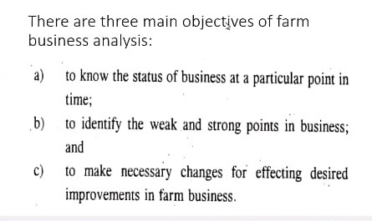

Slide 3
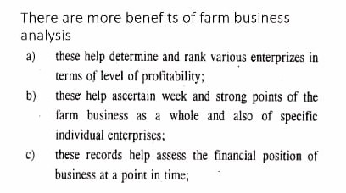

Slide 4
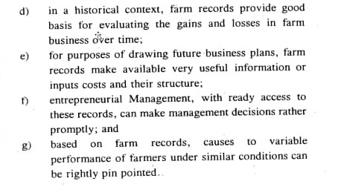

Slide 6
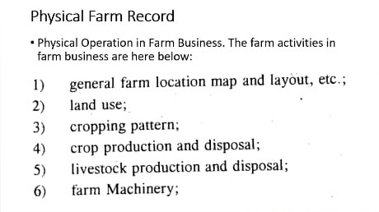
A.

Slide 7
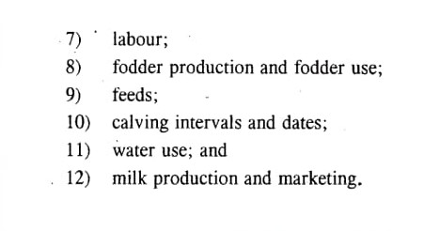

Slide 9
