Slide 1
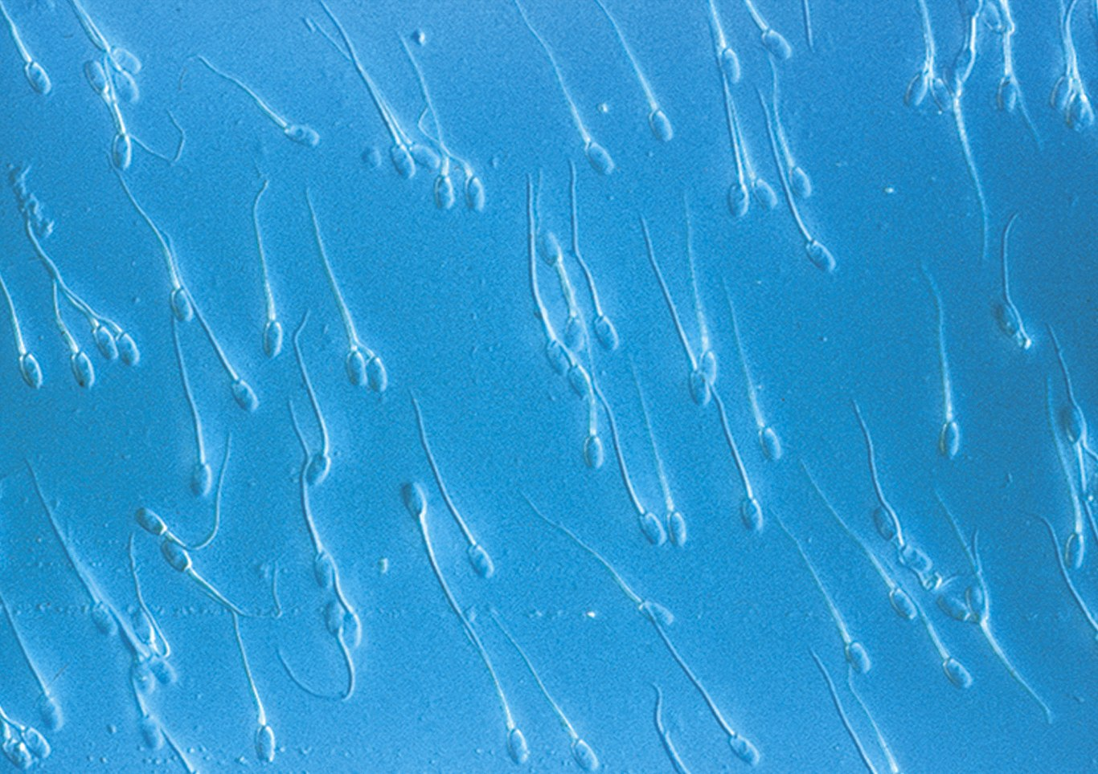
Cell Structure and Function

Slide 2
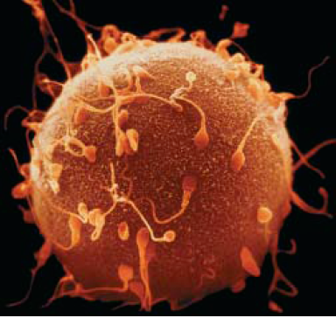
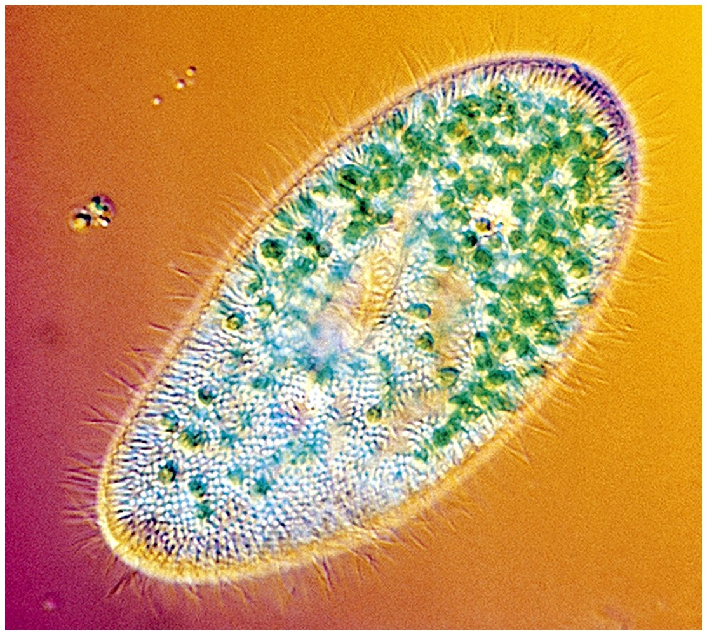
Cells
Smallest living unit
Most are microscopic
A single ~200 micrometer (m) cell, the human egg, withsperm, which are also single cells. From the union of an egg and sperm will arise the 10 trillion cells of a human body.

Slide 3
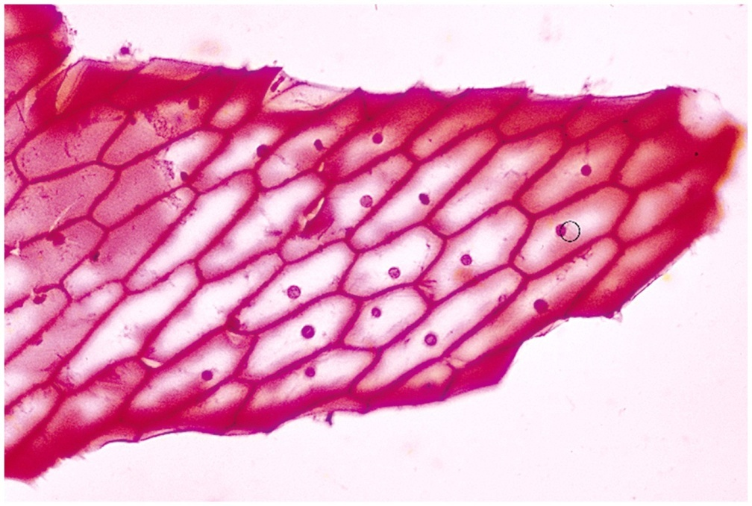
Discovery of Cells
Robert Hooke (mid-1600s)
Observed sliver of cork
Saw “row of empty boxes”
Coined the term cell

Slide 4
Cell theory
(1839)Theodor Schwann & Matthias Schleiden
“ all living things are made of cells”
(50 yrs. later) Rudolf Virchow
“all cells come from cells”

Slide 5
Principles of Cell Theory
All living things are made of cells
Smallest living unit of structure and function of all organisms is the cell
All cells arise from preexisting cells
(this principle discarded the idea of
spontaneous generation)

Slide 6
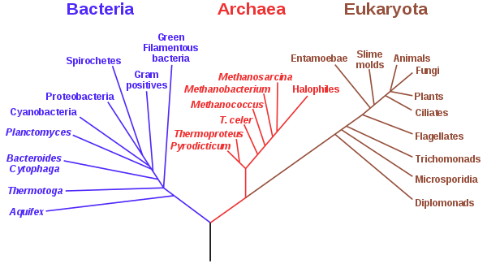

Slide 7
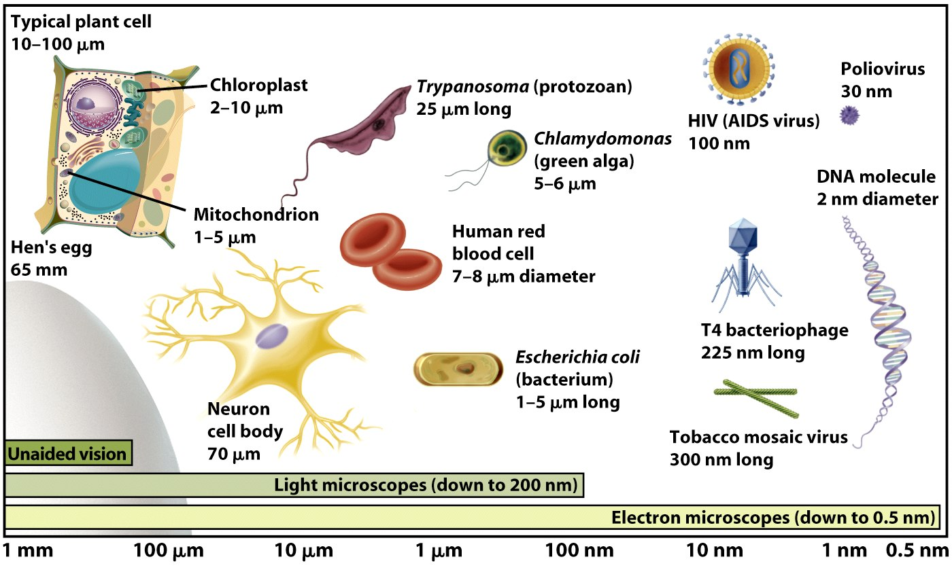
Cell Size

Slide 8
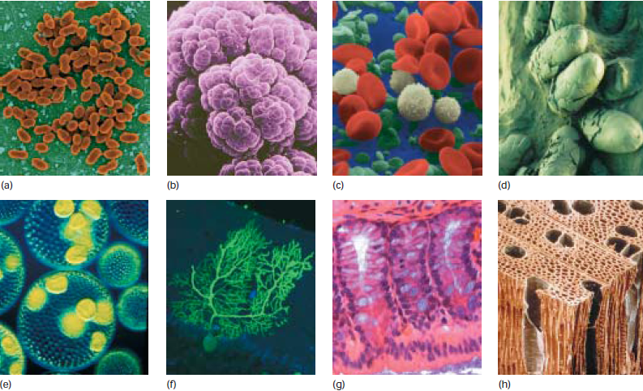
Notes:
(a) Eubacteria; note dividing cells. These are Lactococcus lactis, which are used
to produce cheese such as Roquefort, Brie, and Camembert.
(b) A mass of archaebacteria (Methanosarcina) that produce their
energy by converting carbon dioxide and hydrogen gas to
methane. Some species that live in the rumen of cattle give rise
to >150 liters of methane gas/day. (c) Blood cells, shown in false
color. The red blood cells are oxygen-bearing erythrocytes, the
white blood cells (leukocytes) are part of the immune system
and fight infection, and the green cells are platelets that provide
substances to make blood clot at a wound. (d) Large single cells:
fossilized dinosaur eggs. (e) A colonial single-celled green alga,
Volvox aureus. The large spheres are made up of many individual
cells, visible as blue or green dots. The yellow masses inside are
daughter colonies, each made up of many cells. (f) A single
Purkinje neuron of the cerebellum, which can form more than a
hundred thousand connections with other cells through the
branched network of dendrites. The cell was made visible by
introduction of a fluorescent protein; the cell body is the bulb at
the bottom. (g) Cells can form an epithelial sheet, as in the slice
through intestine shown here. Each finger-like tower of cells, a
villus, contains many cells in a continuous sheet. Nutrients are
transferred from digested food through the epithelial sheet to the
blood for transport to other parts of the body. New cells form
continuously near the bases of the villi, and old cells are shed
from the top. (h) Plant cells are fixed firmly in place in vascular
plants, supported by a rigid cellulose skeleton. Spaces between
the cells are joined into tubes for transport of water and food.

Slide 9
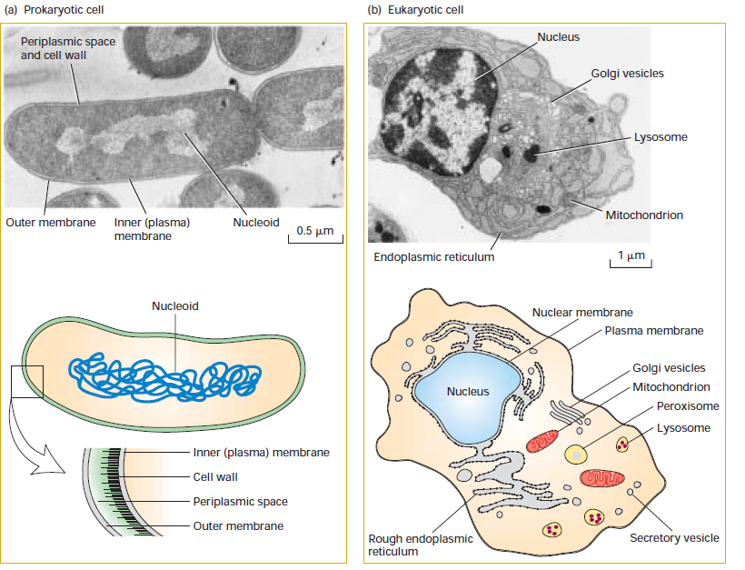

Slide 10
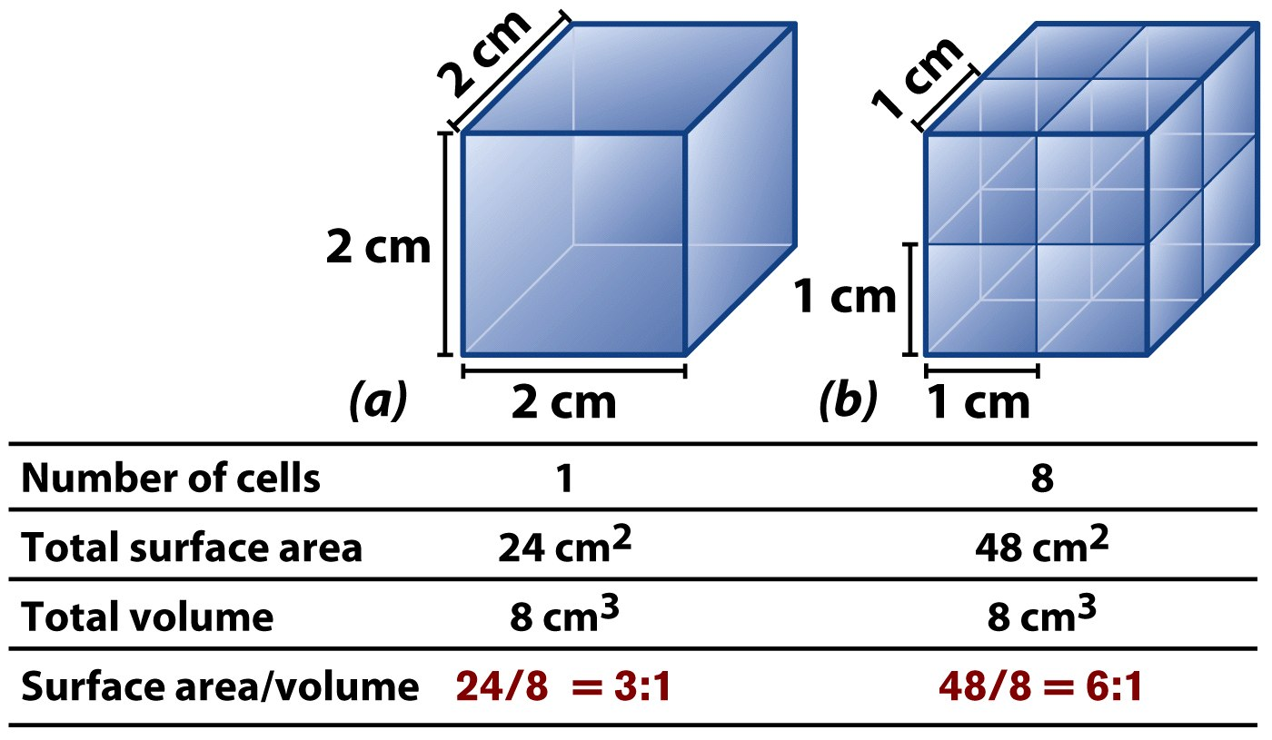
Cells Have Large Surface Area-to-Volume Ratio

Slide 11
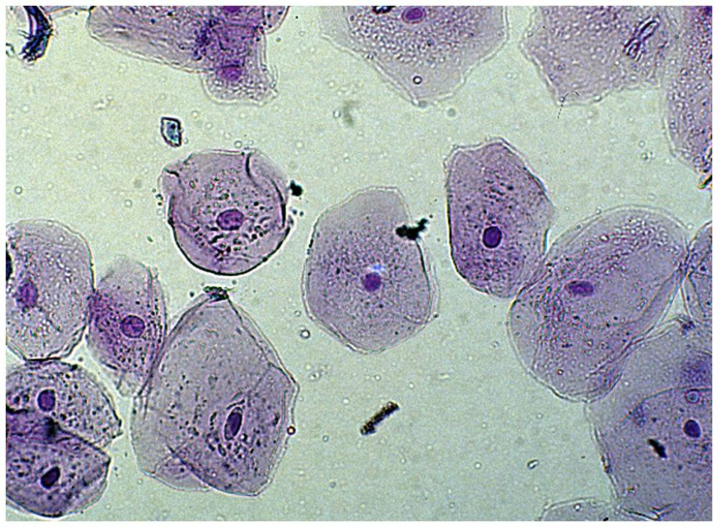
Characteristics of All Cells
A surrounding membrane
Protoplasm – cell contents in thick fluid
Organelles – structures for cell function
Control center with DNA

Slide 12
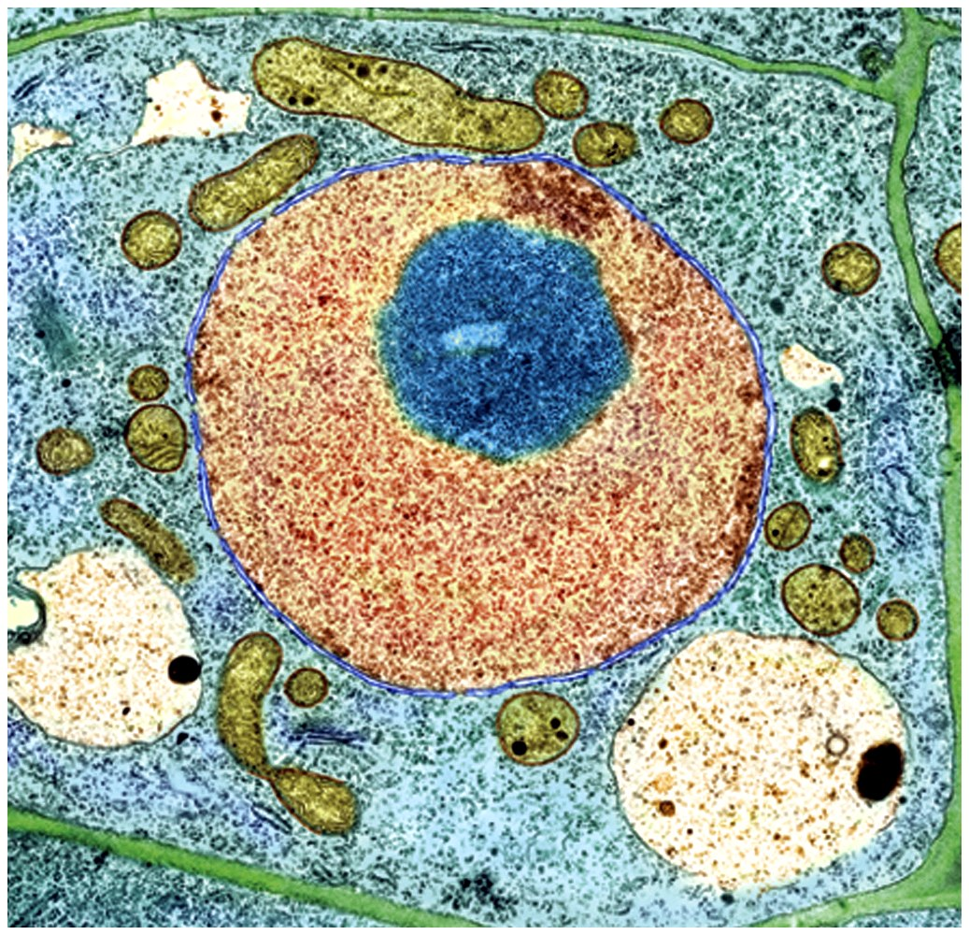
Cell Types
Prokaryotic
Eukaryotic

Slide 13
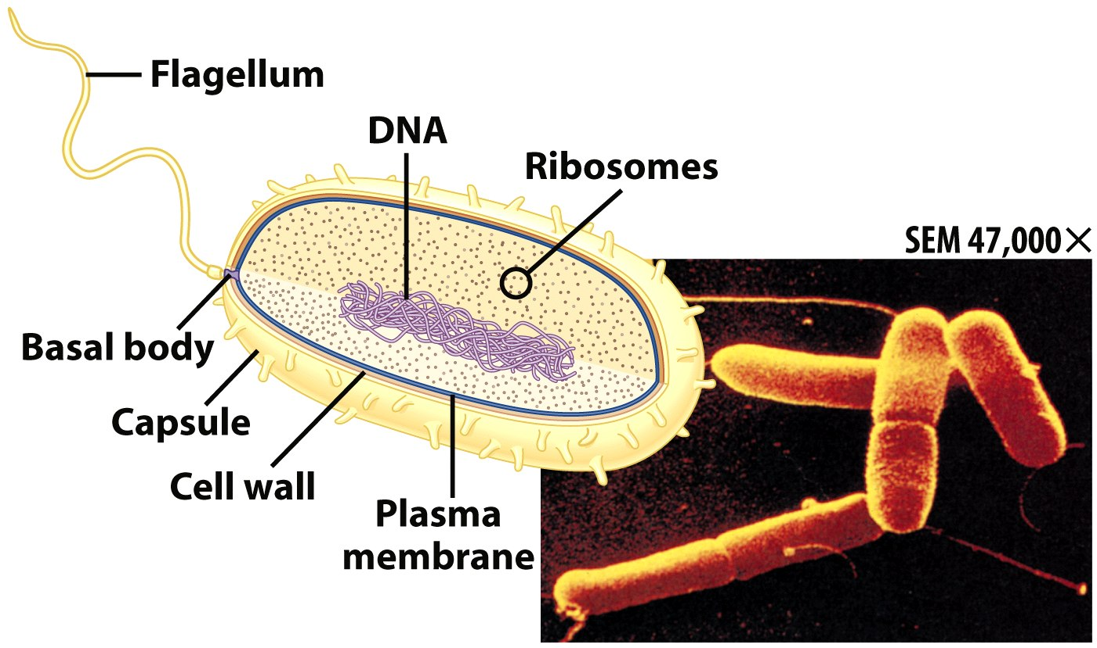
Prokaryotic Cells
First cell type on earth
Cell type of Bacteria and Archaea

Slide 14
Prokaryotic Cells
No membrane bound nucleus
Nucleoid = region of DNA concentration
Organelles not bound by membranes

Slide 15
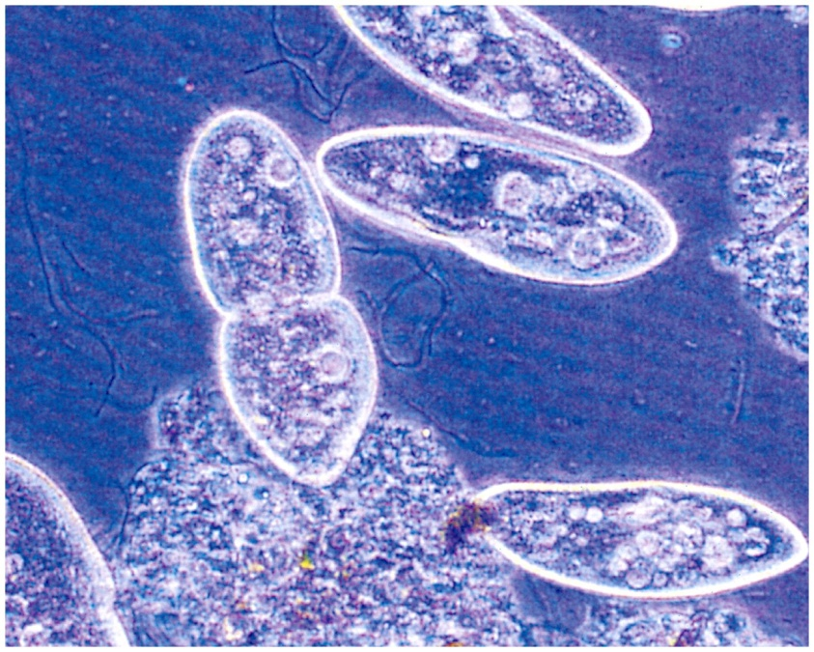
Eukaryotic Cells
Nucleus bound by membrane
Include fungi, protists, plant, and animal cells
Possess many organelles
Protozoan

Slide 16
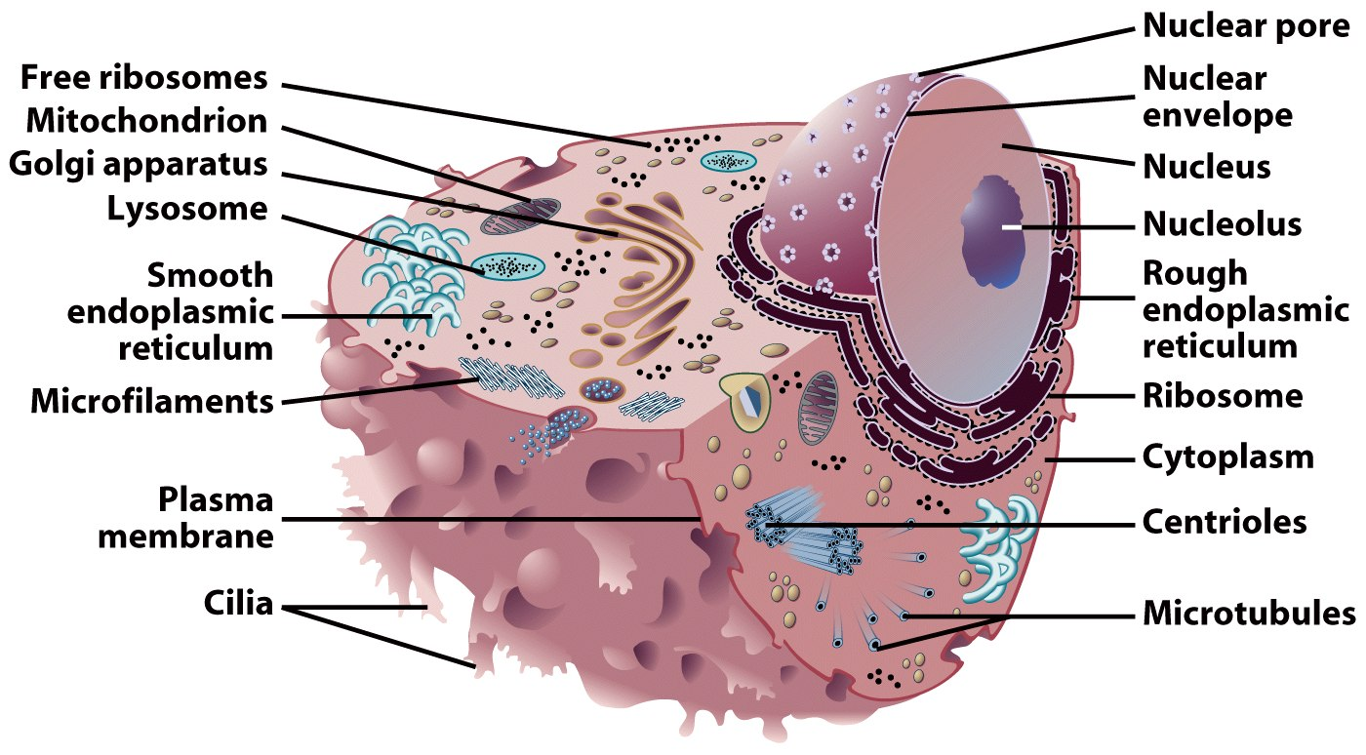
Representative Animal Cell

Slide 17
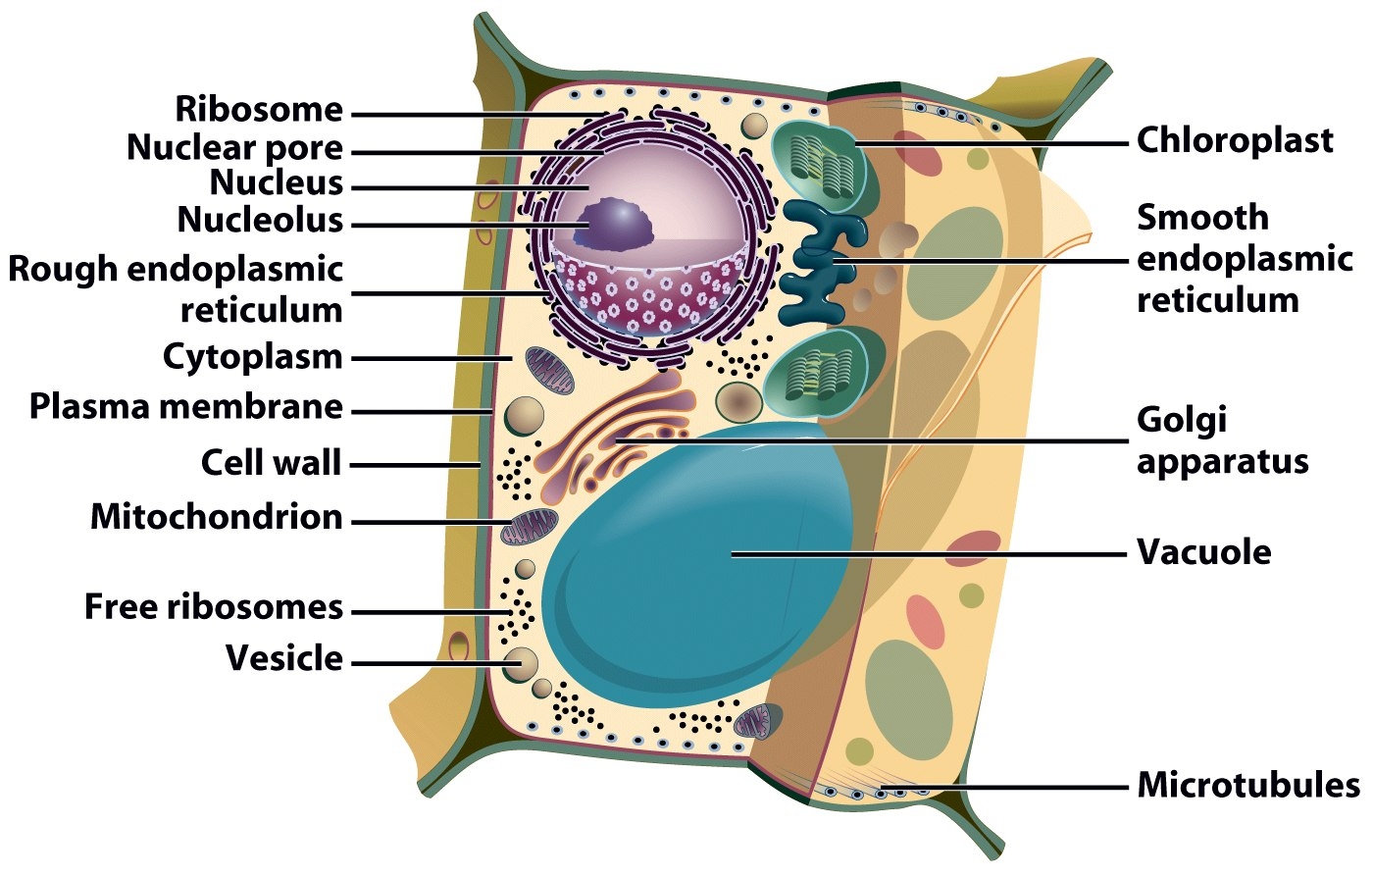
Representative Plant Cell

Slide 18
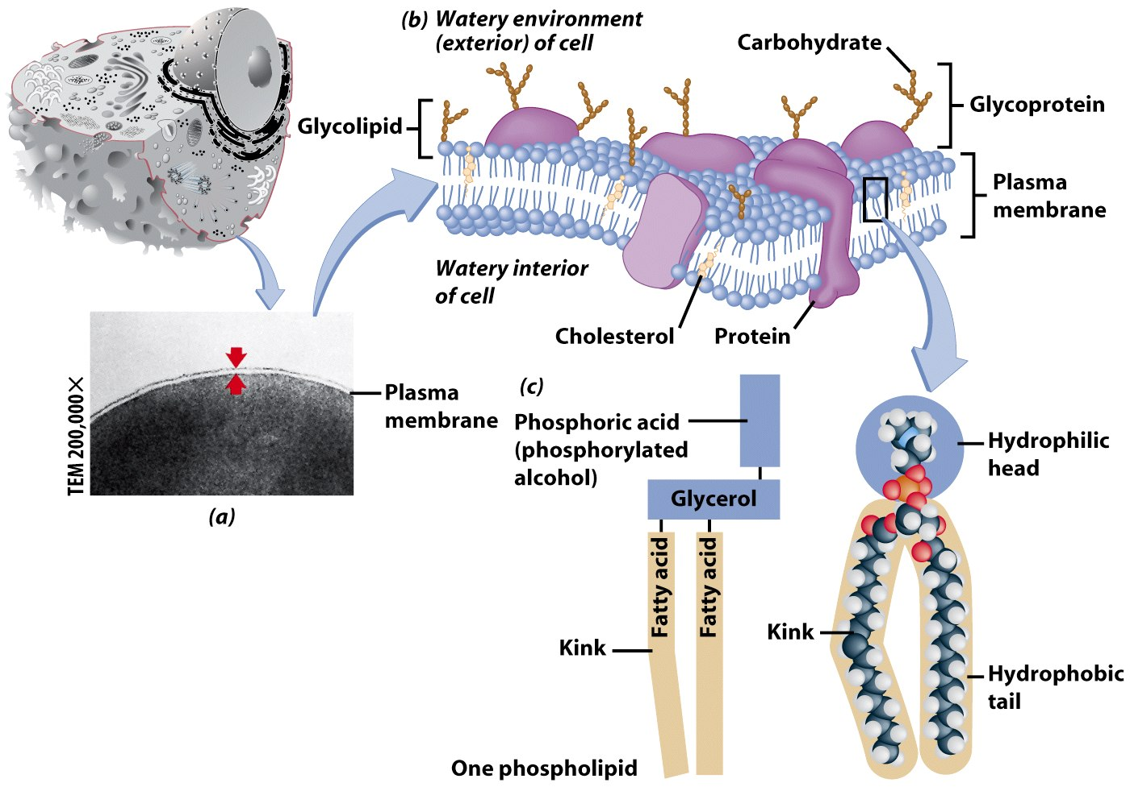
Plasma Membrane
Contains cell contents
Double layer of phospholipids & proteins

Slide 19
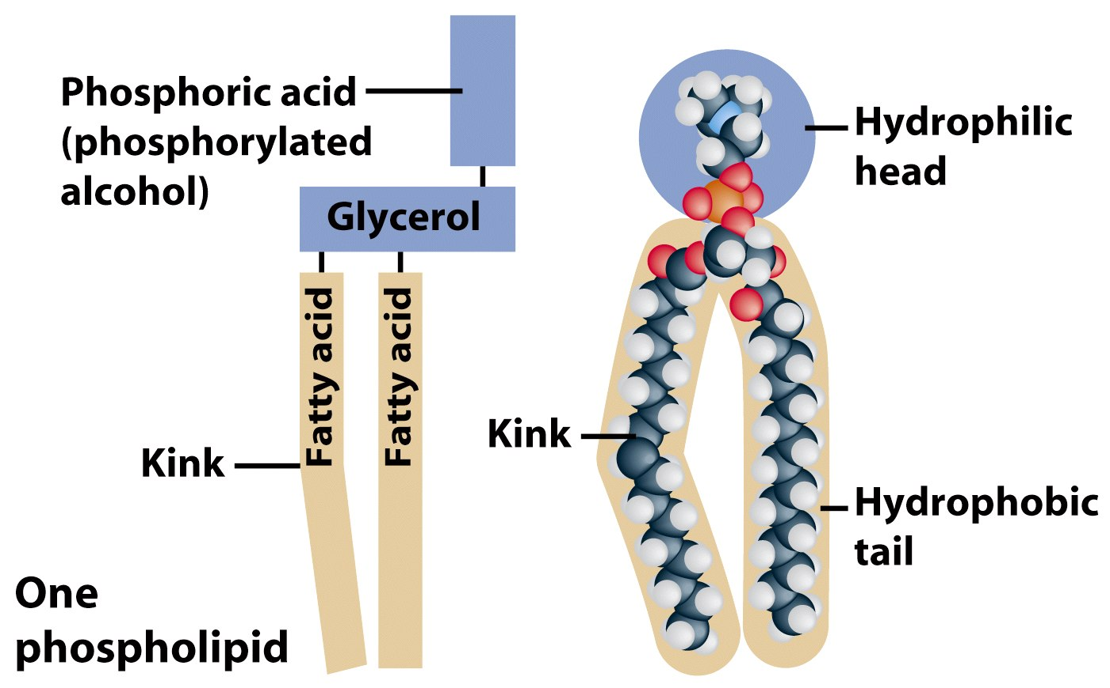
Phospholipids
Polar
Hydrophylic head
Hydrophobic tail
Interacts with water

Slide 20
Movement Across the Plasma Membrane
A few molecules move freely
Water, Carbon dioxide, Ammonia, Oxygen
Carrier proteins transport some molecules
Proteins embedded in lipid bilayer
Fluid mosaic model – describes fluid nature of a lipid bilayer with proteins

Slide 21
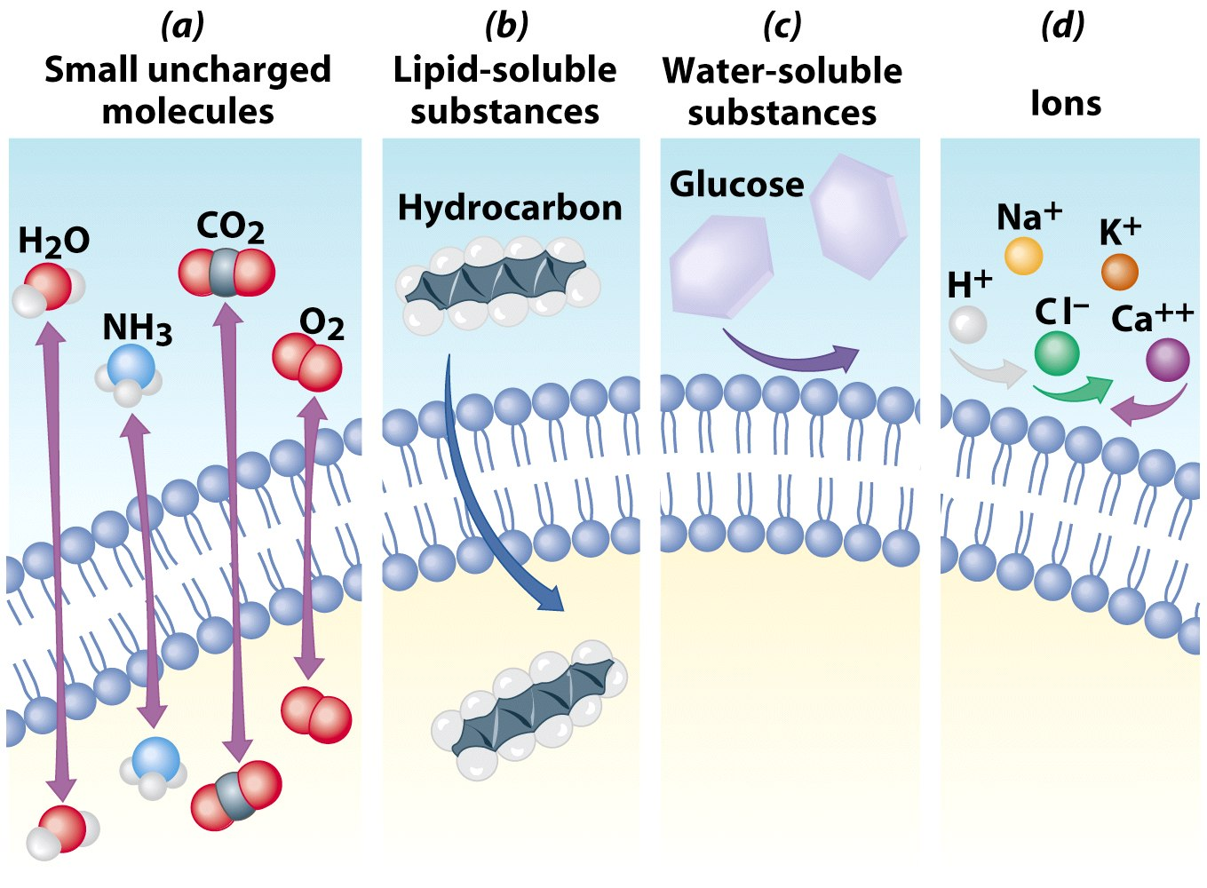

Slide 22
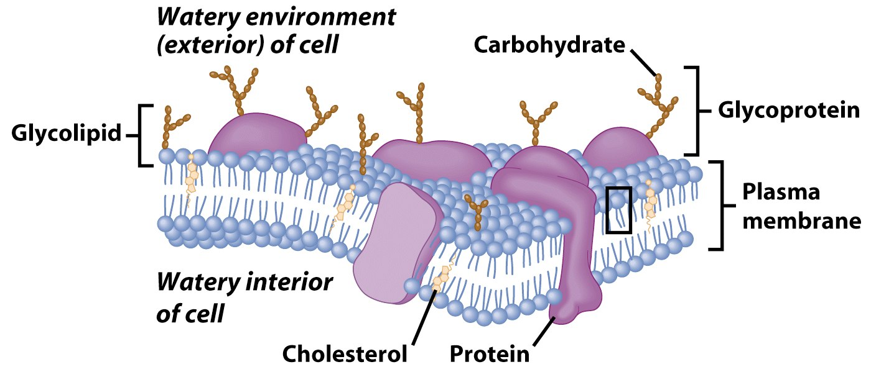
Membrane Proteins
1. Channels or transporters
Move molecules in one direction
2. Receptors
Recognize certain chemicals

Slide 23
Membrane Proteins
3. Glycoproteins
Identify cell type
4. Enzymes
Catalyze production of substances

Slide 24
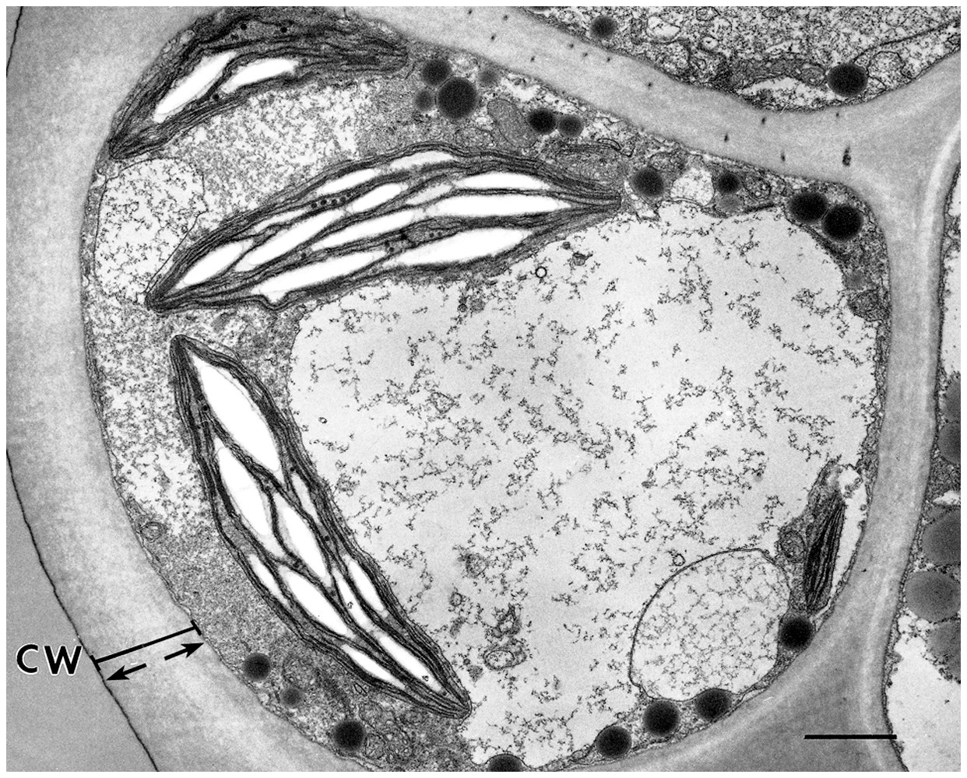
Cell Walls
Found in plants, fungi, & many protists
Surrounds plasma membrane

Slide 25
Cell Wall Differences
Plants – mostly cellulose
Fungi – contain chitin

Slide 26
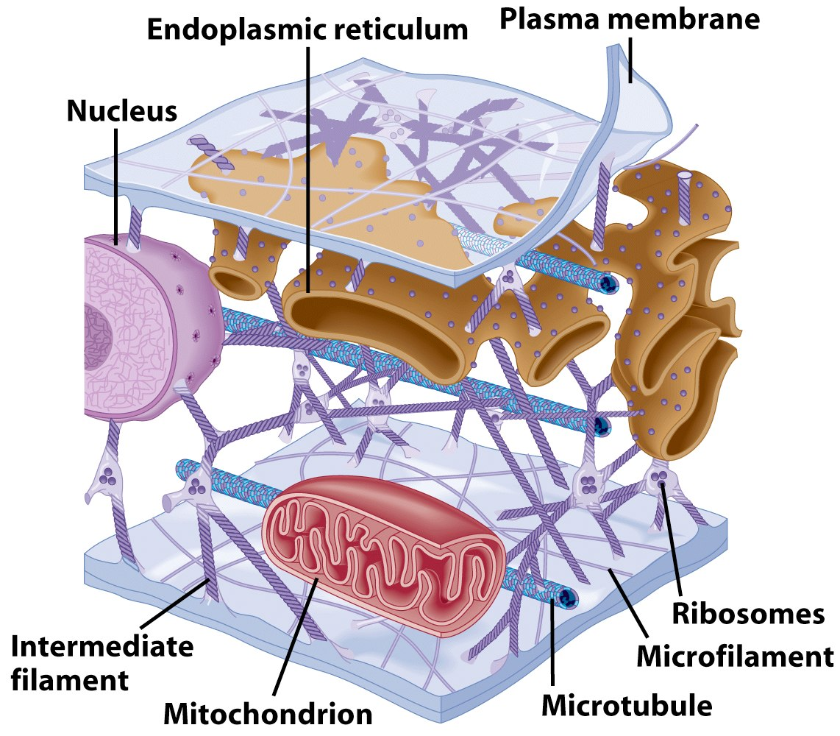
Cytoplasm
Viscous fluid containing organelles
components of cytoplasm
Interconnected filaments & fibers
Fluid = cytosol
Organelles (not nucleus)
storage substances

Slide 27
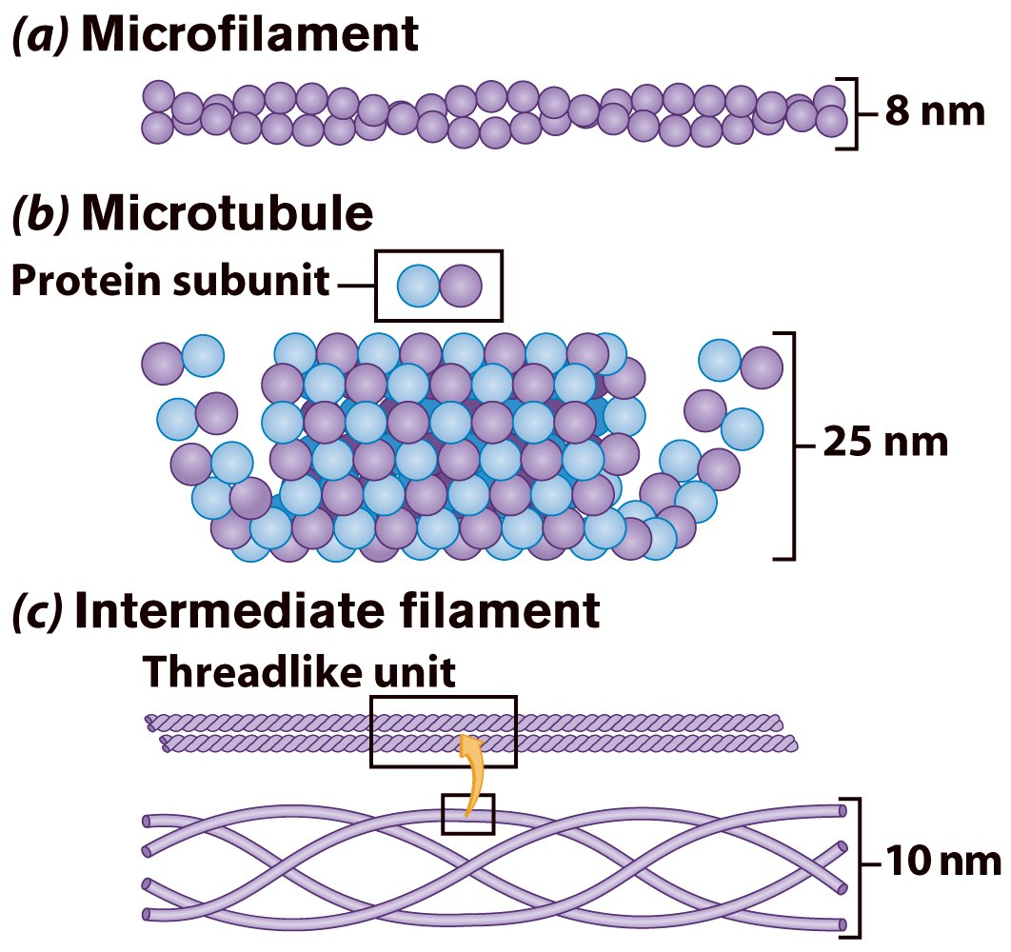
Cytoskeleton
Filaments & fibers
Made of 3 fiber types
Microfilaments
Microtubules
Intermediate filaments
3 functions:
mechanical support
anchor organelles
help move substances

Slide 28
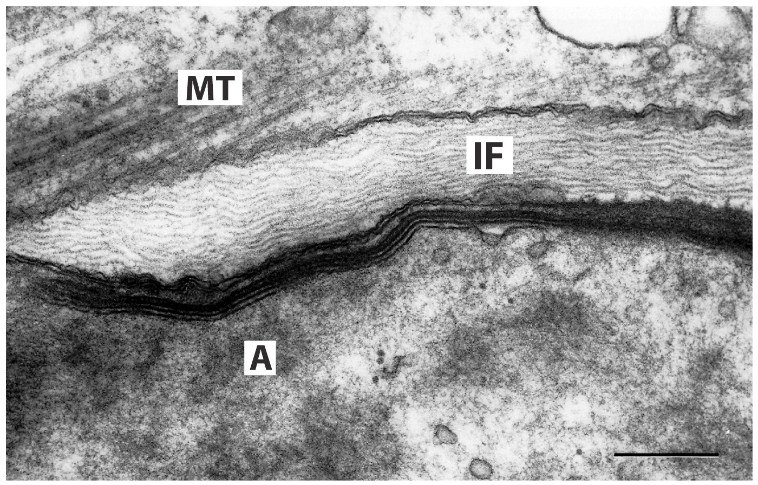
A = actin, IF = intermediate filament, MT = microtubule

Slide 29
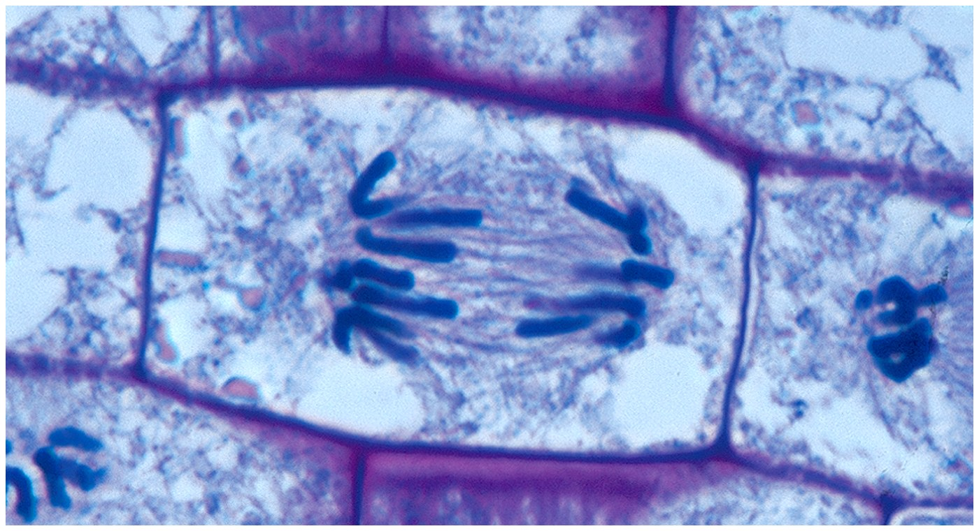
Centrioles
Pairs of microtubular structures
Play a role in cell division

Slide 30
Membranous Organelles
Functional components within cytoplasm
Bound by membranes

Slide 31
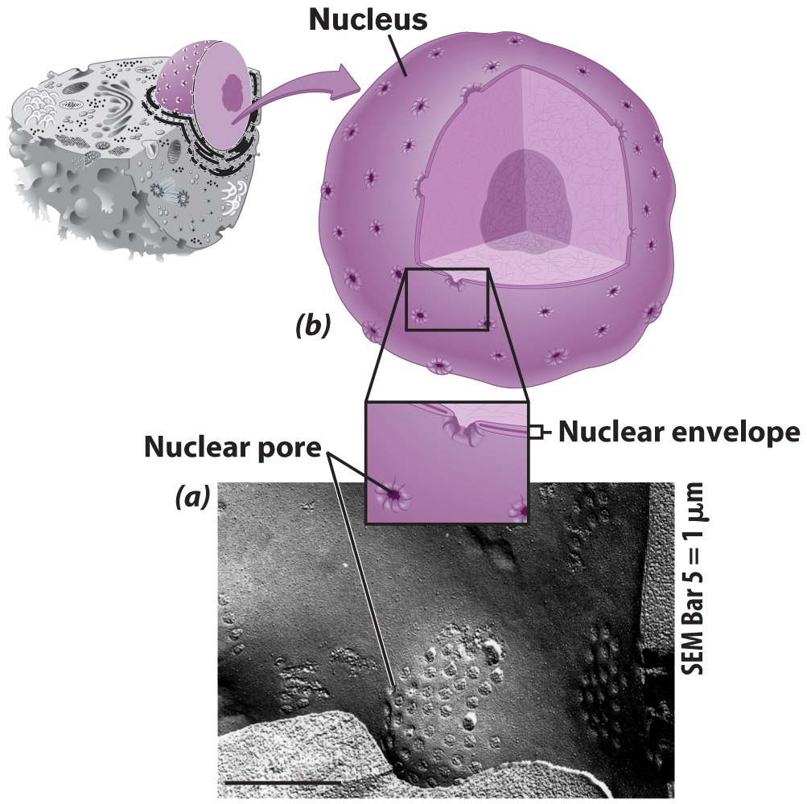
Nucleus
Control center of cell
Double membrane
Contains
Chromosomes
Nucleolus

Slide 32
Nuclear Envelope
Separates nucleus from rest of cell
Double membrane
Has pores

Slide 33
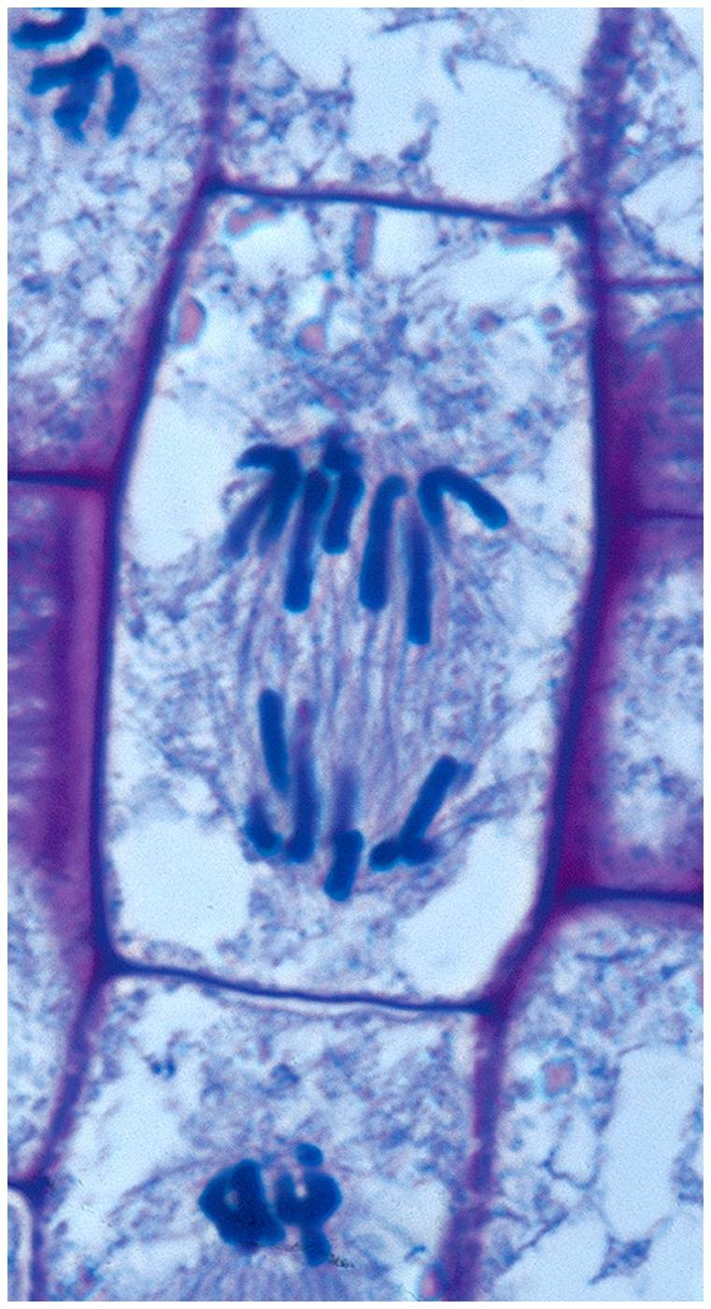
DNA
Hereditary material
Chromosomes
DNA
Protiens
Form for cell division
Chromatin

Slide 34
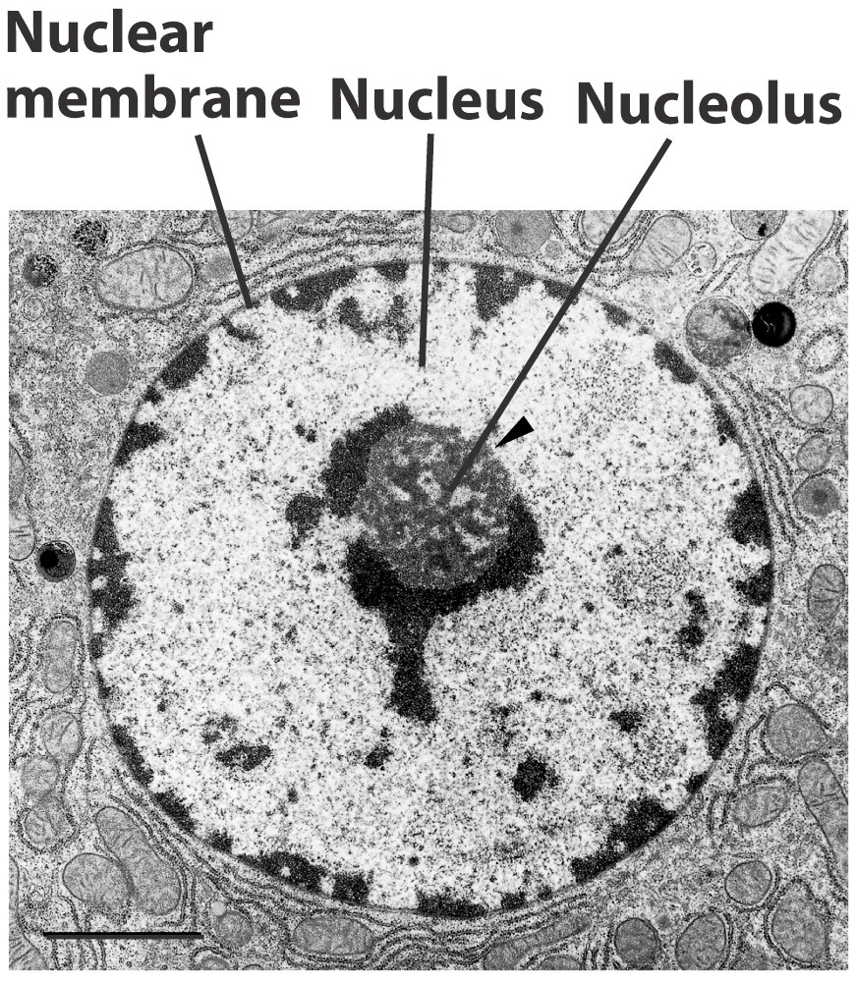
Nucleolus
Most cells have 2 or more
Directs synthesis of RNA
Forms ribosomes

Slide 35
Endoplasmic Reticulum
Helps move substances within cells
Network of interconnected membranes
Two types
Rough endoplasmic reticulum
Smooth endoplasmic reticulum

Slide 36
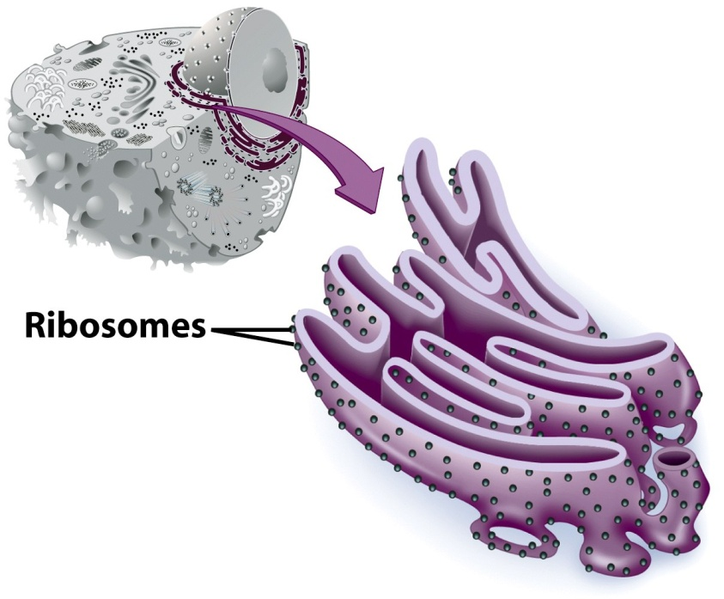
Rough Endoplasmic Reticulum
Ribosomes attached to surface
Manufacture protiens
Not all ribosomes attached to rough ER
May modify proteins from ribosomes

Slide 37
Smooth Endoplasmic Reticulum
No attached ribosomes
Has enzymes that help build molecules
Carbohydrates
Lipids

Slide 38
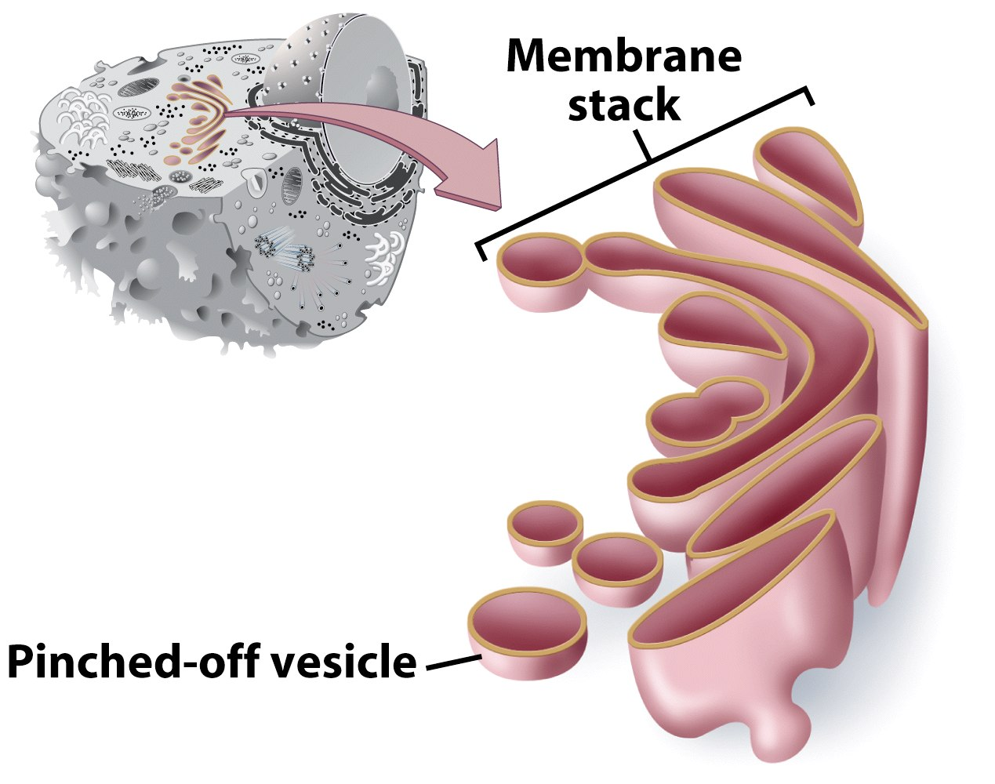
Golgi Apparatus
Involved in synthesis of plant cell wall
Packaging & shipping station of cell

Slide 39
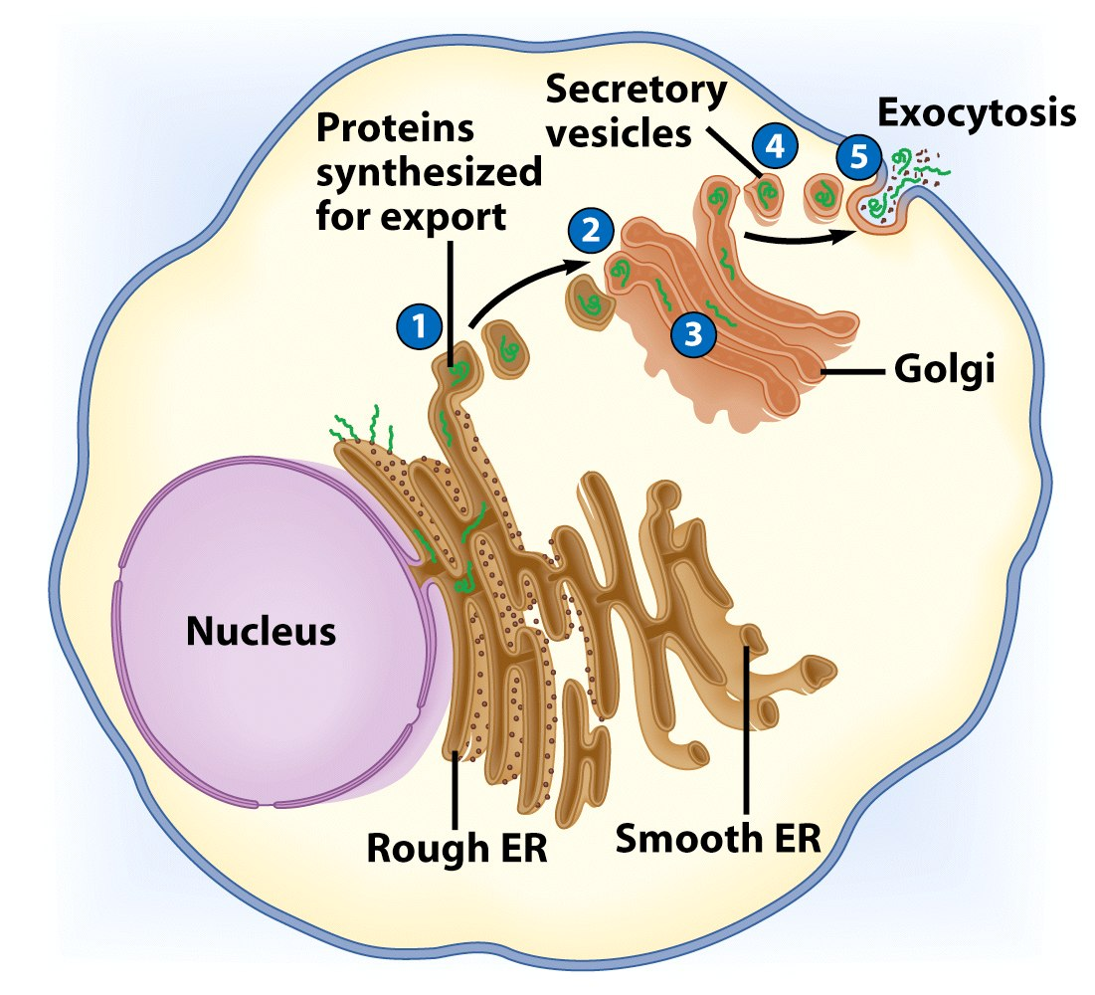

Slide 40
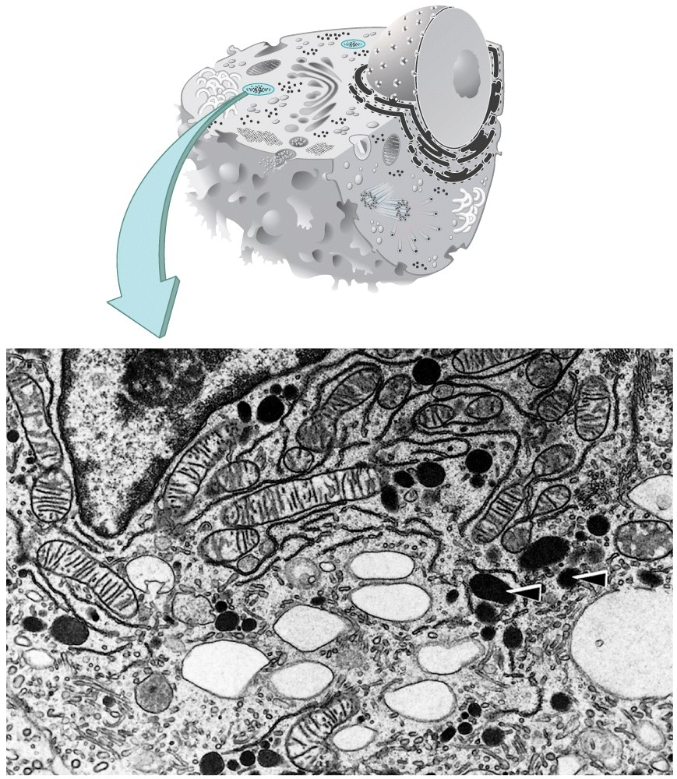
Lysosomes
Contain digestive enzymes
Functions
Aid in cell renewal
Break down old cell parts
Digests invaders

Slide 41
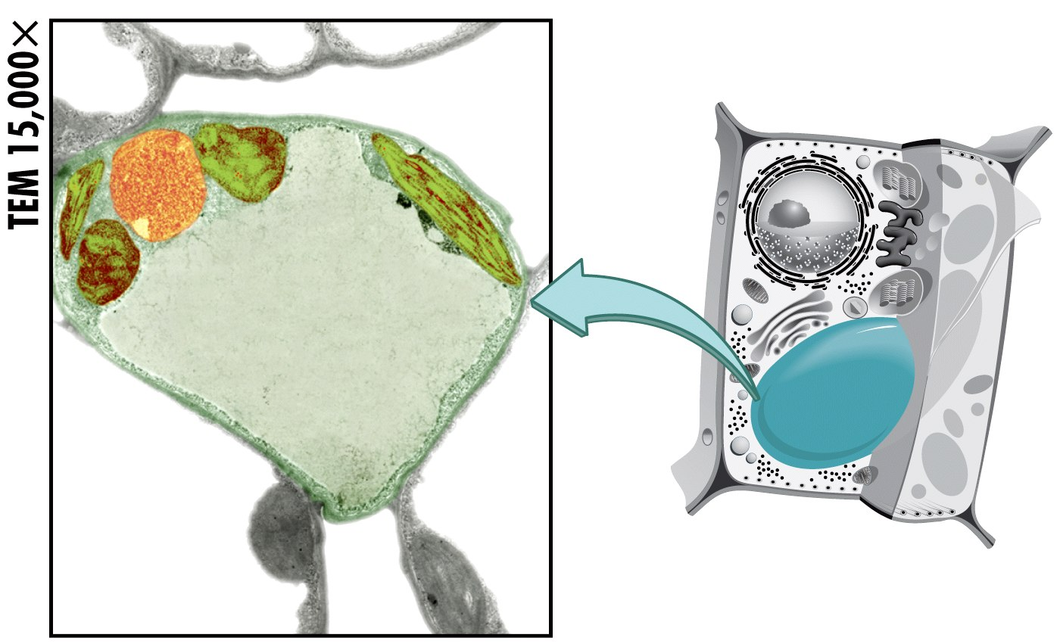
Vacuoles
Membrane bound storage sacs
More common in plants than animals
Contents
Water
Food
wastes

Slide 42
Bacteria-Like Organelles
Release & store energy
Types
Mitochondria
(release energy)
Chloroplasts
(store energy)

Slide 43
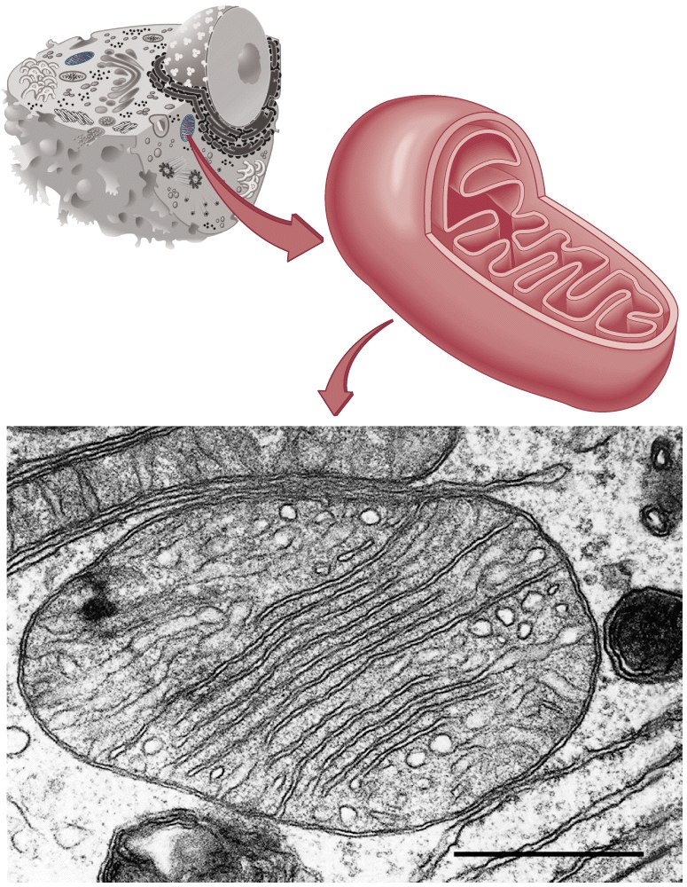
Mitochondria
Have their own DNA
Bound by double membrane

Slide 44
Mitochondria
Break down fuel molecules (cellular respiration)
Glucose
Fatty acids
Release energy
ATP

Slide 45
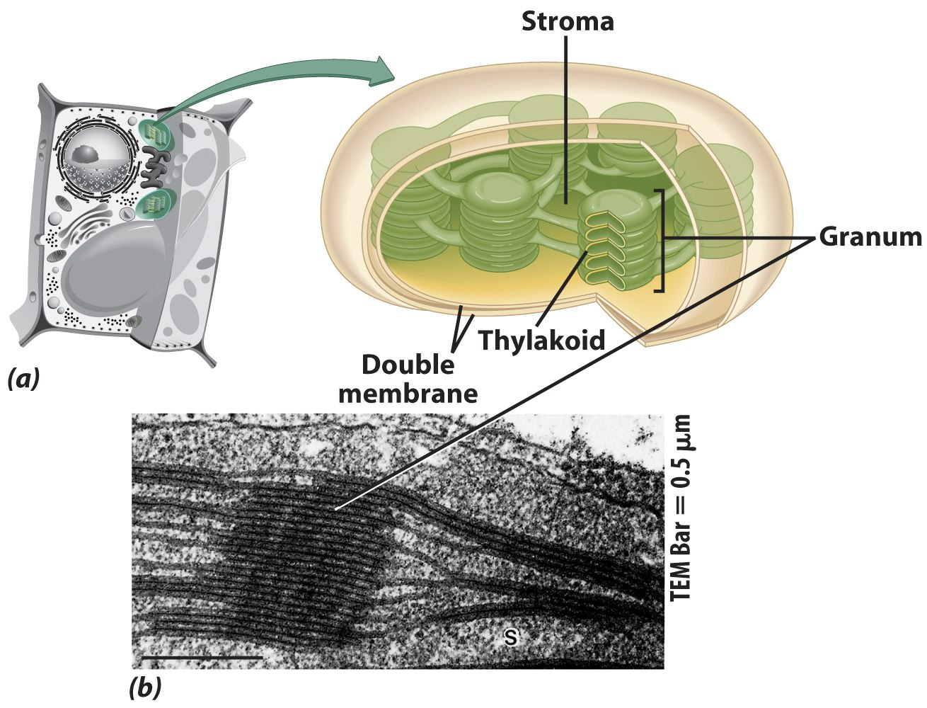
Chloroplasts
Derived form photosynthetic bacteria
Solar energy capturing organelle

Slide 46
Photosynthesis
Takes place in the chloroplast
Makes cellular food – glucose

Slide 47
Review of Eukaryotic Cells

Slide 48
Review of Eukaryotic Cells

Slide 49
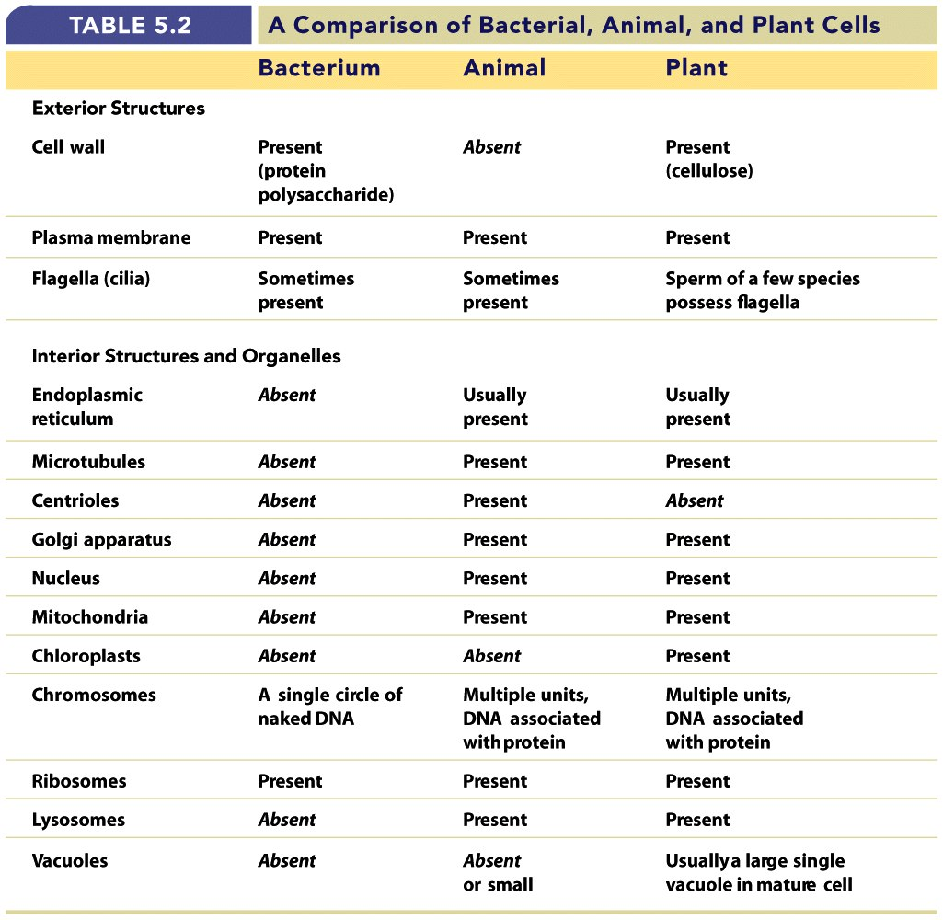

Slide 50
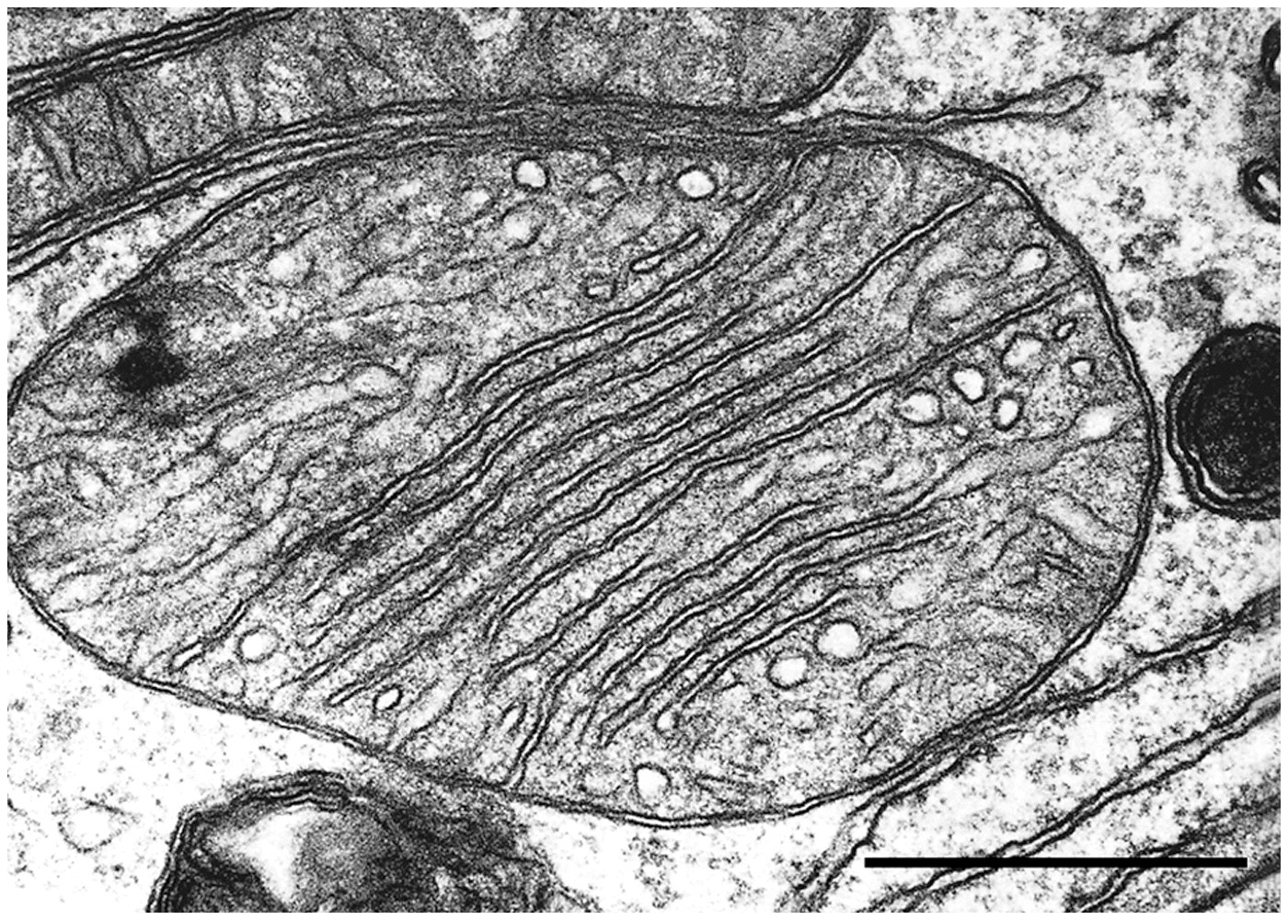
End Chapter 5

