Slide 1
Physical therapy Interventions in stroke patient

Slide 2
Strategies to Improve Motor Learning
Interventions to Improve Sensory Function
Interventions to Improve Hemianopsia and Unilateral Neglect
Interventions to Improve Flexibility and Joint Integrity
Interventions to Improve Strength
Interventions to Manage Spasticity
Interventions to Improve Movement Control
Strategies to Improve Upper Extremity Function
Strategies to Improve Lower Extremity Function
Interventions to Improve Functional Status
Interventions to Improve Postural Control and Balance
Interventions to Improve Gait and Locomotion
Interventions to Improve Aerobic Capacity and Endurance

Slide 3
Strategies to Improve Motor Learning
Patient engagement and motivation
Motor relearning program for stroke
Strategy development
Feedback
Practice
Mirror therapy
Mental practice
Contextual interference
Closed and open environment

Slide 4
Interventions to Improve Sensory Function
Sensory re-training program
Mirror therapy
Sensory stimulation intervention
Compression, weightbearing, mobilization, pneumatic compression, electrical, thermal and magnetic stimulation
Sensory –motor integrative treatment; functional activities with augmented sensory cues

Slide 5
Interventions to Improve Hemianopsia and Unilateral Neglect
Hemianopsia to anosognosia
Using paretic side
Conducive environment
Encourage awareness about the environment and about paralyzed side
Imagery

Slide 6
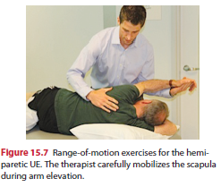
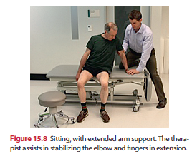
Interventions to Improve Flexibility and Joint Integrity
AROM
PROM
Positioning strategies
Protective devises. Resting splints
Overhead pulleys for self ROM is contraindicated??
Edema prevention

Slide 7
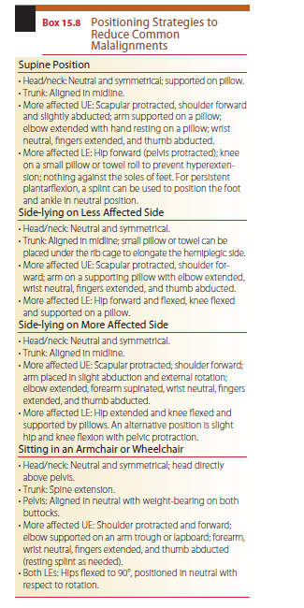

Slide 8
Interventions to Improve Strength
Progressive strengthening exercise
Combining resisted exercises with task oriented functional activities
Exercise precautions; safety and protection
Submaximal exercise
High intensity resisted exercise not recommended

Slide 9
Interventions to Manage Spasticity
Position and posture
Sustained stretching
Rhythmic rotations
Autogenic relaxation
Weight bearing exercise
Reciprocal inhibition
Ice, massage, FES
Orthotic devices

Slide 10
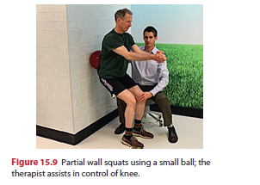
Interventions to Improve Movement Control
Disassociation
Out of synergy selective movements
PNF
Weightbearing activities

Slide 11
Strategies to Improve Upper Extremity Function
UE Weight-Bearing as a Postural Support
Task-Oriented Reaching and Manipulation
Constraint-Induced Movement therapy
Simultaneous Bilateral Training
Electromyographic Biofeedback
Neuromuscular electrical stimulation (NMES)
Robot-Assisted therapy
Management of Shoulder Pain
shoulder impingement syndrome
Adhesive capsulitis
Complex regional pain syndrome (CRPS)
Supportive Devices

Slide 15
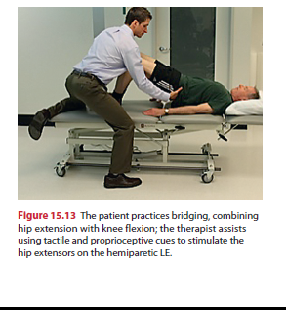
Strategies to Improve Lower Extremity Function
Preparation for standing and walking
Activation of hip, knee and musculature
PNF
Weight bearing

Slide 16
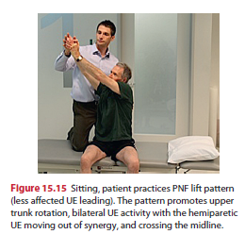
Interventions to Improve Functional Status
Bed mobility
Sitting
Sit to stand and sit down transfers
Standing
Transfers

Slide 18
Interventions to Improve Postural Control and Balance
Postural alignment
Static stability
Dynamic stability
Postural strategy training
Ankle strategy
Hip strategy
Stepping strategy
Force platform biofeedback (center-of-pressure biofeedback)
Ipsilateral Pushing (Pusher Syndrome)

Slide 19
Interventions to Improve Gait and Locomotion
Task-Specific Overground Locomotor Training
Locomotor Training using Body Weight Support and Motorized Treadmill Training
Robotic-Assisted Locomotor Training
Functional Electrical Stimulation
Orthotics and Assistive Devices (AFO)
Wheel chair

Slide 20
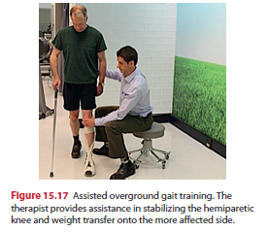

Slide 21
Interventions to Improve Aerobic Capacity and Endurance
Decreased levels of physical conditioning
The energy costs to complete many functional tasks are higher than normal
Concomitant cardiovascular disease
Exercise precaution
Lightheadedness or dizziness
Chest heaviness, pain, or tightness; angina
Palpitations or irregular heart beat
Sudden shortness of breath not due to increased activity
Volitional fatigue and exhaustion
Circuit class training (CCT) or circuit training physical therapy (CTPT)

Slide 22
PATIENT/CLIENT-RELATED INSTRUCTION
Stroke represents a major health crisis for patients and their families.
Ignorance about the cause of the illness or the recovery process and misconceptions concerning the rehabilitation program and potential outcomes can negatively influence coping responses and progress in rehabilitation.
Frequently the problems seem unmanageable and overwhelming for the family, especially when faced with alterations in the patient’s behavior, cognition, and emotion.
Patients may feel depressed, isolated, irritable, or demanding Families often demonstrate reactions that include initial relief and hope for full recovery, followed by feelings of entrapment, depression, anger, or guilt when complete recovery does not occur. These changes and feelings can strain even the best of relationships.
Therapists can often have a dramatic influence on this situation because of the high frequency of contact and the often close relationships that develop with patients and their families.

Slide 23
DISCHARGE PLANNING
Planning for discharge begins early in rehabilitation and involves the patient and family.
Potential placement (safe place of residence), level of family and community support, and need for continued medical and rehabilitation services should all be explored.
Family members should regularly participate in therapy sessions to learn exercises and activities designed to support the patient’s independence.
Discharge should be considered when reasonable treatment goals/outcomes are attained.
Indication of the attainment of a functional ceiling can be considered when there is lack of evidence of progress at two successive evaluations over a period of 2 weeks.
Home visits should be made prior to discharge to determine the home’s physical structure and accessibility.

Slide 24
Potential problems can be identified and corrective measures initiated.
Home adaptations, assistive devices, and supportive services should be in place before the patient is discharged to home.
Several trial home stays may be helpful in smoothing the transition from rehabilitation center to home.
Patients with residual impairments or functional limitations who will be receiving outpatient or home therapy should be given all the necessary information concerning these services.
Community services should be identified and information provided to the patient and family.
Long-term follow-up at regularly scheduled intervals should be initiated in order to maintain patients at their highest possible functional level.

Slide 25
RECOVERY AND OUTCOMES
Most patients with stroke regain their independent living status following discharge.
The Copenhagen Stroke Study, based on 1197 patients, revealed that 64 percent of patients were discharged to home, 15 percent were discharged to a nursing home, and 21 percent of patients died during their hospital stay.
After rehabilitation, 11 percent of survivors still exhibited severe or very severe deficits, 11 percent had moderate deficits, and 78 percent had mild or no deficits.
Functional recovery was completed within 12.5 weeks of stroke onset in 95 percent of patients.
Recovery of walking function occurred in 61 percent of survivors (50 percent were independent while 11 percent required assistance).
Only 30 to 60 percent of stroke survivors regain independence in ADL.
Major problems in stroke outcome studies include the heterogeneity of patients admitted for rehabilitation, lack of consistency in outcome measures, and differences in duration, type, and onset of rehabilitation programs.

Slide 26
Stroke with Poor outcome
advanced age
Severe motor impairments (prolonged paralysis, apraxia)
Persistent medical problems (incontinence)
Impaired cognitive function (decreased alertness, poor attention span, judgment, memory), severe language disturbances, and an inability to learn new tasks or follow simple commands
Severe visuospatial hemineglect
Other less well-defined social and economic problems

