Slide 1
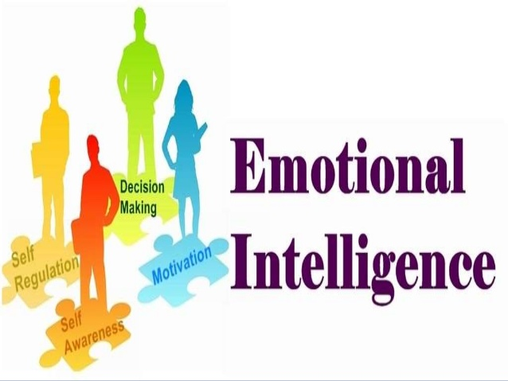

Slide 4
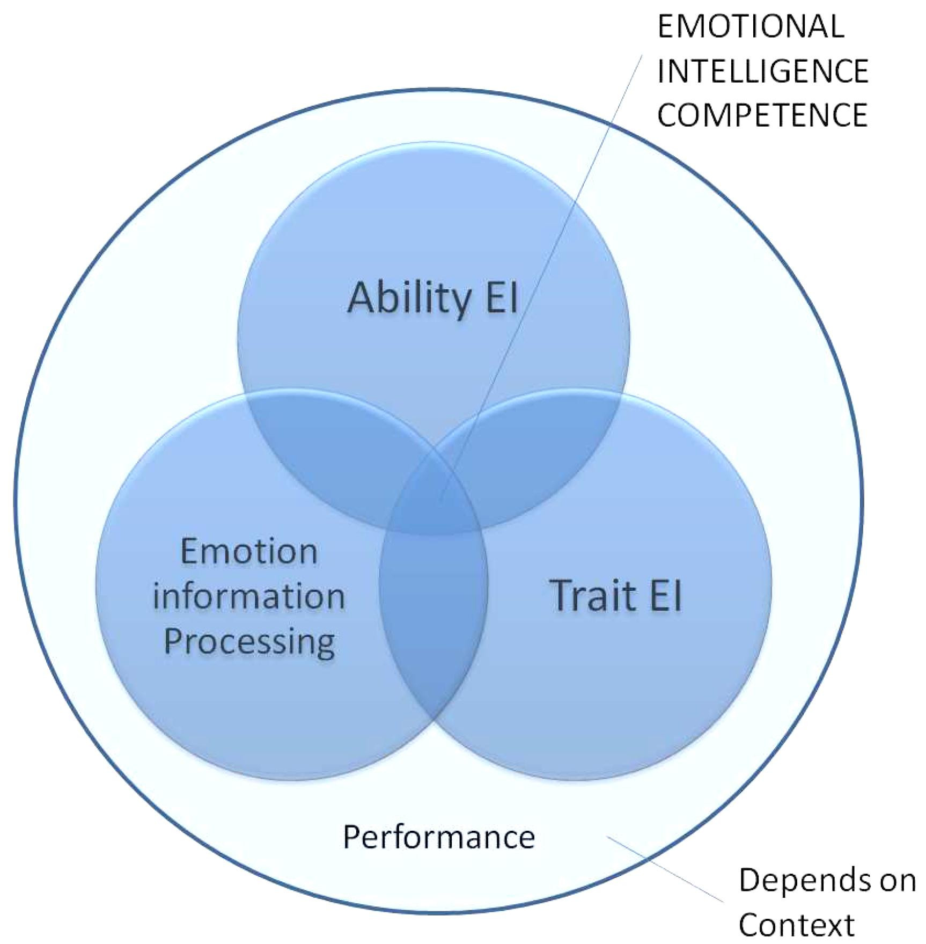
MODELS OF EI
Ability model
Trait EI model
Mixed EI model

Slide 5
Ability model
This model is proposed by Salovey and Mayer
Emotional intelligence is the ability to perceive emotion, integrate emotion to facilitate thought, understand emotions and to regulate emotions to promote personal growth.
The model talks of 4 types of emotional abilities:
Emotional perception
Emotional use
Emotional understanding
Emotional management

Slide 6
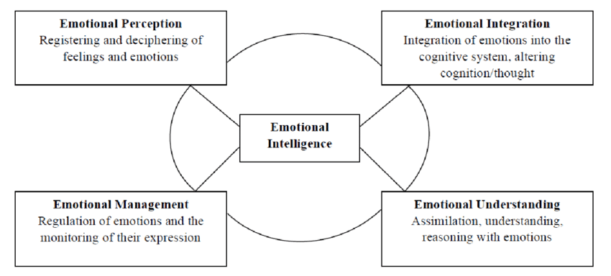

Slide 7
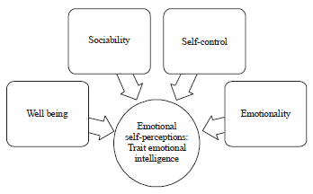
Trait EI model
This model was published in 2009 by PETRIDES.
This model of EI can be viewed in conjunction with personality.

Slide 8
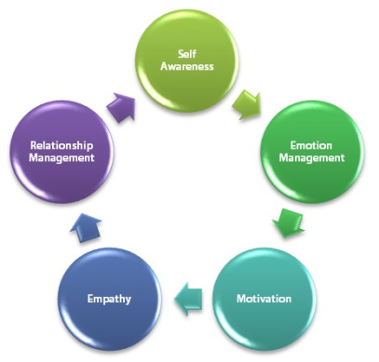
Mixed EI model
Mixed model was proposed by Daniel Goleman
Emotional competencies are learned capabilities.
Some major competencies like:
Self-awareness
Self-management
Social awareness
Relationship management

Slide 9
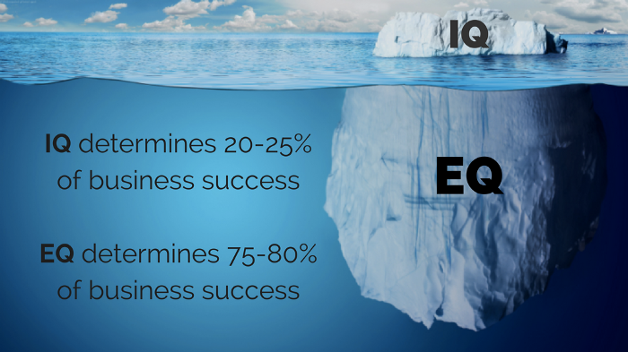
Why is Emotional Intelligence important for individuals?
Relevant to development of individuals and organizations.
New way of understanding and assessing behavior, management styles, attitudes, interpersonal skills, and potential of people.
Optimism and resilience are the characteristics of an emotionally intelligent person.
The higher the emotional intelligence, the better the social relations

Slide 10
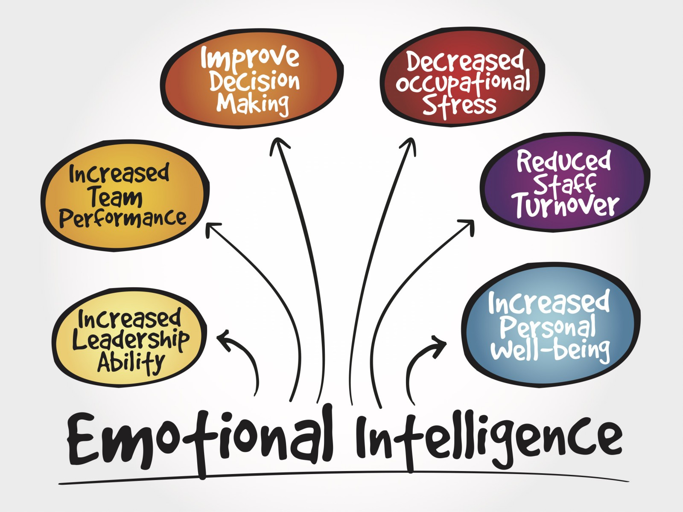
Emotional Intelligence within groups
Team members deal effectively and efficiently with their own and other member's emotional turmoil, using it as a source for developing team cohesion and trust.
Organization gains a reputation .
Role of team leaders and project managers in enhancing EI skills within their groups.

Slide 27
Bar-On is an Israeli psychologist and one of the leading pioneers, theorists and researchers in emotional intelligence.

Slide 38
Ways to increase ei
Utilize an assertive style of communicating
Respond instead of reacting to conflict.
Utilize active listening skills
Be motivated.
Practice ways to maintain a positive attitude
Empathize with others.
Take critique well.

Slide 39
Role of amygdala in emotions
Amygdala is collection of nuclei found in temporal lobe.
There are 2 amygdala one in each hemisphere
Term means almond because of almond like shape
Amygdala is part of limbic system (group of structures involve in processing of emotions)
Historically, it was considered to play role in processing fearful emotions
When the threatening stimulus is present in the Environment amygdala identify it as a threat and start fight-flight response
It is also involved in processing positive stimuli as well.
So, it is involved in assigning positive and negative values to stimuli and consolidation of these memories.

Slide 40
So
It has long been known that the amygdala, is related to emotion, particularly in processing of aversive information (e.g., LeDoux, 1996). However, accumulating evidence suggests that amygdala activation is also involved in processing pleasant information, as observed, for instance, in studies using reward-learning (e.g., Adolphs, 2010; Janak and Tye, 2015), episodic memory encoding (e.g., Hamann et al., 1999; Dolcos et al., 2004), pleasant scene or face perception (e.g., Sabatinelli et al., 2011) or mental imagery of pleasant experiences (e.g., Costa et al., 2010).

