Slide 1
Externalities
By Mam Sabeen Saif
BS -5th (Energy Economics

Slide 2
Market failure: A problem that violates one of the assumptions of the 1st welfare theorem and causes the market economy to deliver an outcome that does not maximize efficiency
Externality: Externalities arise whenever the actions of one economic agent directly affect another economic agent outside the market mechanism
Externality example: a steel plant that pollutes a river used for recreation
Not an externality example: a steel plant uses more electricity and bids up the price of electricity for other electricity customers
Externalities are one important case of market failure

Slide 3
Types of Externalities
Positive/negative: when an externality provides net benefits to others, it is considered as a positive externality. Scenic beauty of a private garden is an example of positive externality
Discomfort from smoking cigarettes to non-smokers is an example of negative externality.
Private (depletable)/public (undepletable):
idea of jointness of supply of the externality.
If an external effect is such that consumption by one leaves no external effect for others, then the effect is considered as private or depletable.

Slide 4
For example, if one’s dump trash in my neighbor's backyard, it is unlikely to be dumped to somewhere else. Therefore, it is depleted.
Most of the environmental externalities are of public variety. This means that consumption by one does not reduce the availability to others. For example, one’s smoking of polluted air does not reduce the amount of polluted air available to others. In this case, victims are jointly affected.

Slide 5
Spectrum of Goods
Public goods:
non-rival, consumption by one person doesn’t affect the consumption of others
Non-excludable – no restrictions on access
e.g. national defence, clean air, polite behaviour
Non-rejectable - it cannot be rejected by people, a good example is a nuclear defence system or flood defence projects.
There are relatively few examples of pure public goods. Examples include flood control systems, some of the broadcasting services provided by the BBC, public water supplies, street lighting for roads and motorways, lighthouse protection for ships and also national defence services.

Slide 6
Private goods
Excludability: its owners can exercise private property rights, preventing those who have not paid for it from using the good or consuming its benefits.
Rivalry: consumption by one necessarily prevents that of another.
A private good, as an economic resource is scarce, which can cause competition for it. e.g. food, clothing, cars etc
Rejectability: All private goods and services can be rejected by the final consumer should their tastes and preferences change.

Slide 7
Quasi-public goods have characteristics of both private and public goods, including partial excludability, partial rivalry, partial diminishability and partial rejectability. Examples include roads, tunnels and bridges.
These are goods which have an element of non-excludability and non-rivalry. Roads are a good example. ... However, when you use a road, the amount others can benefit is reduced to some extent, because there will be increased congestion (Congestion externalities)

Slide 8
The Free Rider Problem
Because public goods are non-excludable it is difficult to charge people for benefitting form a good or service once it is provided
The free rider problem leads to under-provision of a good and thus causes market failure
Unlike public goods, private goods are less likely to have the free rider problem, in which a person benefits from a public good without contributing towards it.

Slide 9
Examples of various types of goods include:
(a) Pure private goods: oil, gas, electricity, etc.;
(b) Pure public goods: air, national defence, police;
(c) Quasi private: fish stocks, ground water, oil reservoirs;
(d) Quasi public: private beach, etc.

Slide 10
More types of externalities
Network externalities e.g.:
Communications networks - the more users that join a communications network the better for the existing users/suppliers
benefits from being able to contact more users, economies of scale,
Locational (cluster) networks: IT firms locating together
Standards externalities
The more firms that use the same way of producing or servicing something (the standard) increases the market size for products built/serviced to this standard
E.g. use of a particular technology
.Open access goods/services (the tragedy of the commons)
ocean fisheries- leads to over fishing,
wild animals - extinction
rain forests –over harvesting

Slide 11
Inefficiency and externalities
When there are externalities the free market outcome is not efficient as private benefits/costs are not equal to social benefits/costs
When there are consumption externalities, marginal private consumer benefit is not the same as marginal social (total) benefit
When there are production externalities firm’s private marginal costs of production are not the same as the marginal social (total) costs of production
The free market outcome doesn’t equate marginal social benefits and marginal social costs
Implies market failures - suggests a role for 3rd party (e.g. government) intervention

Slide 12
EXTERNALITY THEORY: ECONOMICS OF NEGATIVE PRODUCTION EXTERNALITIES
Negative production externality: When a firm’s production reduces the well-being of others who are not compensated by the firm.
Private marginal cost (PMC): The direct cost to producers of producing an additional unit of a good
Marginal Damage (MD): Any additional costs associated with the production of the good that are imposed on others but that producers do not pay
Social marginal cost (SMC = PMC + MD): The private marginal cost to producers plus marginal damage

Slide 13
Example: steel plant pollutes a river but plant does not face any pollution regulation (and hence ignores pollution when deciding how much to produce).
If there is compensation or payment in return for damages, then the externality does not exist to the extent of compensation. It is considered to be internalised.
In other words, an externality is an unpriced, unintentional and uncompensated side effect of one agent’s action affecting another agent’s welfare

Slide 14
The existence of externalities creates a wedge between the private cost and the cost to the society. For any decision-making, economic agents rely on the private costs (i.e.costs borne by them). But when an economic activity generates an externality, the society bears the cost of its effects. As a result, the social costs are more than the private costs.

Slide 15
Economics of Negative Production Externalities:

Slide 16
As a competitive market will consider the private
costs of supplying a good, the equilibrium output will be Q0, whereas the output considering the social cost of supply will be Q *.
Correspondingly, the price in a competitive
market will be P0 whereas the price increases to P* when externality is considered.
Thus markets tend to use scarce resources in an inefficient way.

Slide 17
PRIVATE SOLUTIONS TO EXTERNALITIES
Government action is not always needed to solve the problem of externalities.
The Coase Theorem is a proposition that if private parties can bargain without cost over the allocation of resources, they can solve the problem of externalities on their own.
• Transactions Costs
Transaction costs are the costs that parties gain in the process of agreeing to and following through on a bargain.
Sometimes the private solution approach fails because transaction costs can be so high that private agreement is not possible.

Slide 18
PUBLIC POLICY TOWARD EXTERNALITIES
When externalities are significant and private solutions are not found, government may attempt to solve the problem through . . .
• command-and-control policies.
• market-based policies.

Slide 19
Command-and-Control Policies
• Usually take the form of regulations:
• Forbid certain behaviors.
• Require certain behaviors.
• Examples:
• Requirements that all students be immunized.
• Conditions on pollution emission levels set by the Environmental Protection Agency (EPA).
Market-Based Policies
• Government uses taxes and subsidies to align
private incentives with social efficiency.
• Pigovian taxes are taxes enacted to correct the
effects of a negative externality.

Slide 20
Market-Based Policies
• Tradable pollution permits allow the voluntary transfer of the right to pollute from one firm to another.
• A market for these permits will eventually develop.
• A firm that can reduce pollution at a low cost may prefer to sell its permit to a firm that can reduce pollution only at a high cost.

Slide 21
Examples of Regulation versus Pigovian Tax
• If the EPA decides it wants to reduce the amount of pollution coming from a specific plant. The EPA could…
• tell the firm to reduce its pollution by a specific amount (i.e. regulation).
• levy a tax of a given amount for each unit of pollution the firm emits (i.e. Pigovian tax).

Slide 22
The process of reaching the optimal or efficient solution in presence of an externality is called internalisation of externalities. This essentially requires correcting the price signal in the market so that the price is raised to P*. There are two basic economic approaches that could be followed to do this directly
(a) One is to impose a tax on per unit of emission and the other is to restrict the quantity of output to Q*. These options are shown in .The tax option is known as the Pigouvian tax, where a tax equal to the marginal external cost has to be imposed to correct the problem of negative externality. Similarly, a subsidy

Slide 23
equal to the marginal external benefit is required to resolve the positive externality problem.
(b) The quantity restriction can be imposed by imposing a cap on the output level.
While both the tax and quantity options will yield the same results, they have different practical implications. In the case of tax, the tax revenue goes to the government while in the case of quantity restrictions, the revenues from higher prices will accrue to the producer.

Slide 25
Externality Theory: Positive Externalities
Positive production externality: When a firm’s production increases the well-being of others but the firm is not compensated by those others.
Example: Beehives of honey producers have a positive impact on pollination and agricultural output
Positive consumption externality: When an individual’s consumption increases the well-being of others but the individual is not compensated by those others.
Example: Beautiful private garden that passers-by enjoy seeing

Slide 27
EXTERNALITY THEORY: ECONOMICS OF NEGATIVE CONSUMPTION EXTERNALITIES
Negative consumption externality: When an individual’s consumption reduces the well-being of others who are not compensated by the individual.
Private marginal cost (PMB): The direct benefit to consumers of consuming an additional unit of a good by the consumer.
Social marginal cost (SMB): The private marginal benefit to consumers plus any costs associated with the consumption of the good that are imposed on others
Example: Using a car and emitting carbon contributing to global warming

Slide 28
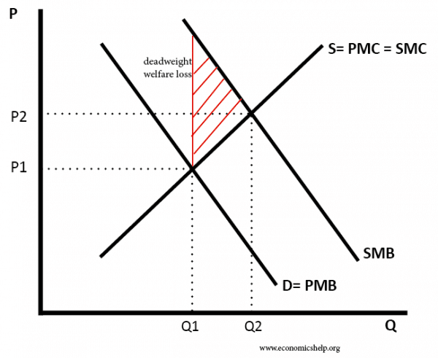
Diagram of positive consumption externality

Slide 29
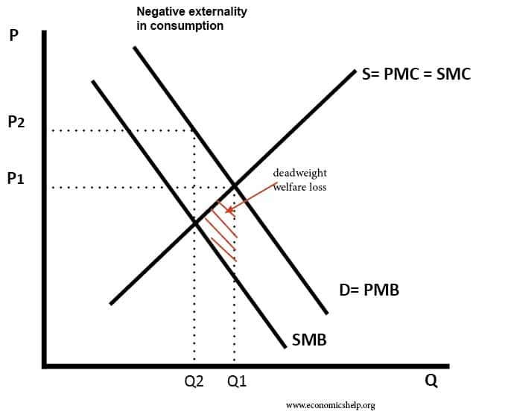

Slide 30
APPLICATION: The Externality of SUVs
The consumption of large cars such as SUVs produces three types of negative externalities:
1. Environmental externalities: Compact cars get 25 miles/gallon, but SUVs get only 20.
2. Wear and tear on roads: Larger cars wear down
the roads more.
3. Safety externalities: The odds of having a fatal
accident quadruple if the accident is with a typical
SUV and not with a car of the same size.

Slide 31
EXTERNALITY THEORY: ECONOMICS OF NEGATIVE CONSUMPTION EXTERNALITIES
Negative consumption externality: When an individual’s consumption reduces the well-being of others who are not compensated by the individual.
Private marginal cost (PMB): The direct benefit to consumers of consuming an additional unit of a good by the consumer.
Social marginal cost (SMB): The private marginal benefit to consumers plus any costs associated with the consumption of the good that are imposed on others
Example: Using a car and emitting carbon contributing to global warming

Slide 32
Applications
Consumption externalities
Health and education, transport (roads)
Mix of production and consumption externalities
Sport and exercise, sports sector
Production externalities
Pollution

Slide 33
Externality Theory: Market Outcome is Inefficient
With a free market, quantity and price are such that PMB = PMC Social optimum is such that SMB = SMC) Private market leads to an inefficient outcome (1st welfare theorem does not work)
Negative production externalities lead to over production
Positive production externalities lead to under production
Negative consumption externalities lead to over consumption
Positive consumption externalities lead to under consumption

