Slide 1
Welded joints

Slide 2
Welding
A welded joint is a permanent joint which is obtained by the fusion of the edges of the two parts to be joined together, with or without the application of pressure and a filler material. The heat required for the fusion of the material may be obtained by burning of gas (in case of gas welding) or by an electric arc (in case of electric arc welding).

Slide 3
Advantages of Welded Joints over Riveted Joints
The welded structures are usually lighter than riveted structures.
The welded joints provide maximum efficiency (may be 100%) which is not possible in case of riveted joints.
Alterations and additions can be easily made in the existing structures.
As the welded structure is smooth in appearance, therefore it looks pleasing.
A welded joint has a great strength. Often a welded joint has the strength of the parent metal itself.
Sometimes, the members are of such a shape (i.e. circular steel pipes) that they afford difficulty for riveting. But they can be easily welded.
The welding provides very rigid joints. This is in line with the modern trend of providing rigid frames.
It is possible to weld any part of a structure at any point. But riveting requires enough clearance.
The process of welding takes less time than the riveting.

Slide 4
Disadvantages of Welded Joints over Riveted Joints
Since there is an uneven heating and cooling during fabrication, therefore the members
may get distorted or additional stresses may develop.
It requires a highly skilled labour and supervision.
there is a possibility of cracks developing in it.
4. The inspection of welding work is more difficult than riveting

Slide 5
Welding Process
The welding processes may be broadly classified into the following two groups:
1. Welding processes that use heat alone e.g. fusion welding.
2. Welding processes that use a combination of heat and pressure e.g. forge welding.

Slide 6
Welding process
The fusion welding, according to the method of heat generated, may be classified as:
1. Thermit welding, 2. Gas welding
3. Electric arc welding.
Forge Welding
Electric resistance welding
Seam welding
Spot welding

Slide 7
Thermit welding

Slide 8
Gas Welding

Slide 9
Electric arc welding

Slide 10
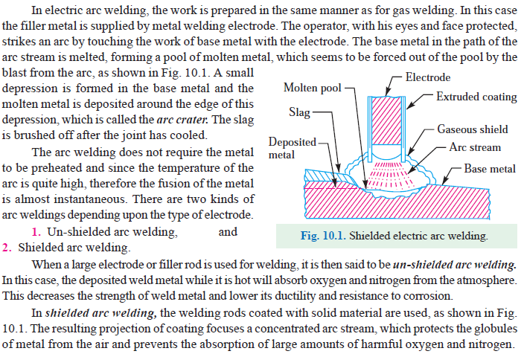
Electric Arc Welding

Slide 11
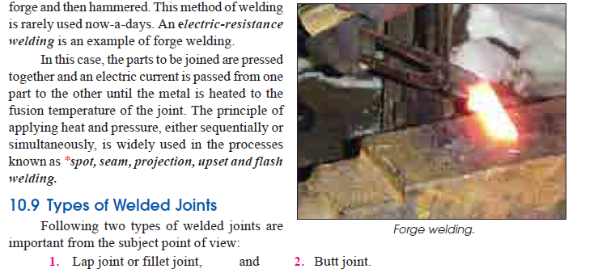
Forge Welding

Slide 12
Types of welded joint
Lap joint or fillet joint
Butt joint

Slide 13
Lap joint

Slide 14
Butt joint

Slide 17
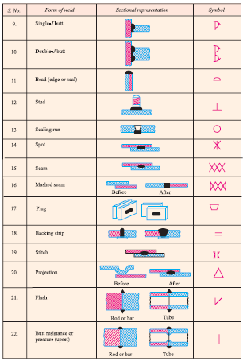

Slide 21
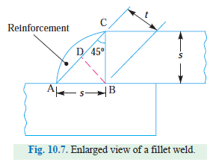
Strength of tranverse fillet weld

Slide 22
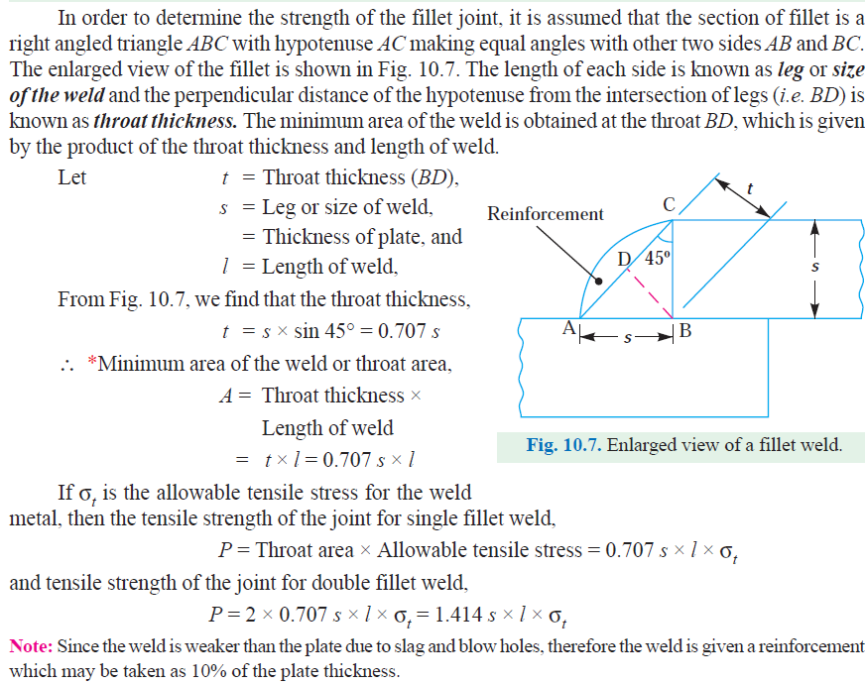

Slide 23
Strength of parallel fillet weld

Slide 25
Special Case of fillet weld
Polar moment of inertia is defined as a measurement of a round bar's capacity to oppose torsion

Slide 27
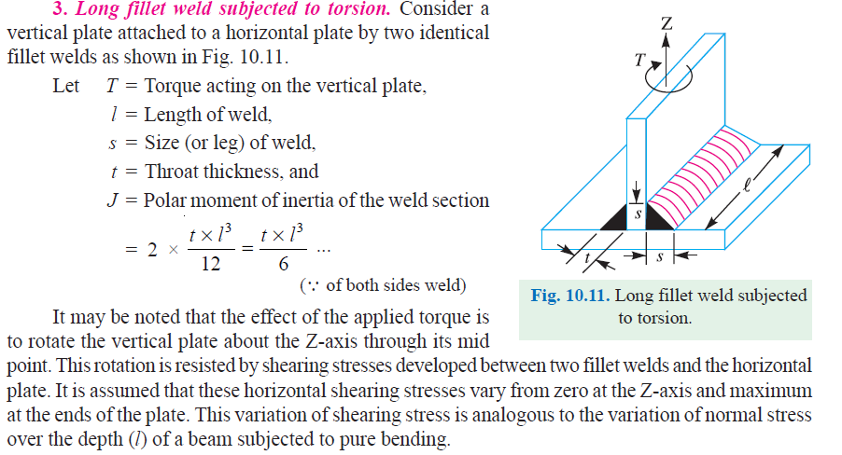
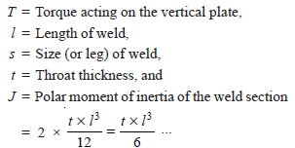
Long fillet weld subjected to torsion

Slide 29
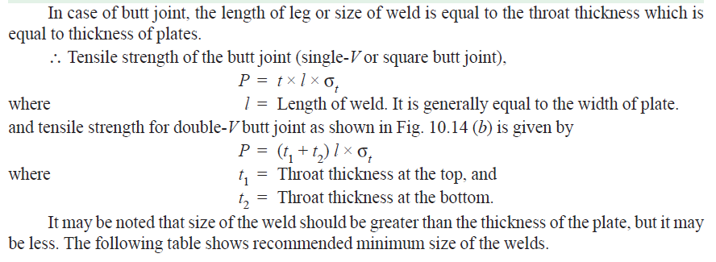
Strength of Butt joint

