Slide 1
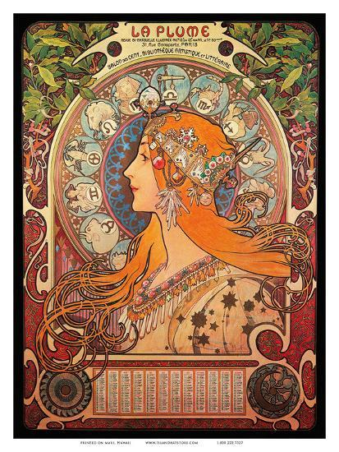
ART NOUVEAU

Slide 2
BIRTH OF ART NOUVEAU

Slide 3
INTRO:ART NOUVEAU

Slide 4
ORIGIN:

Slide 5
MAIN ASPECT OF FOCUS:

Slide 6
EMPHASIS:

Slide 7
ART NOUVEAU ARCHITECTURE

Slide 8
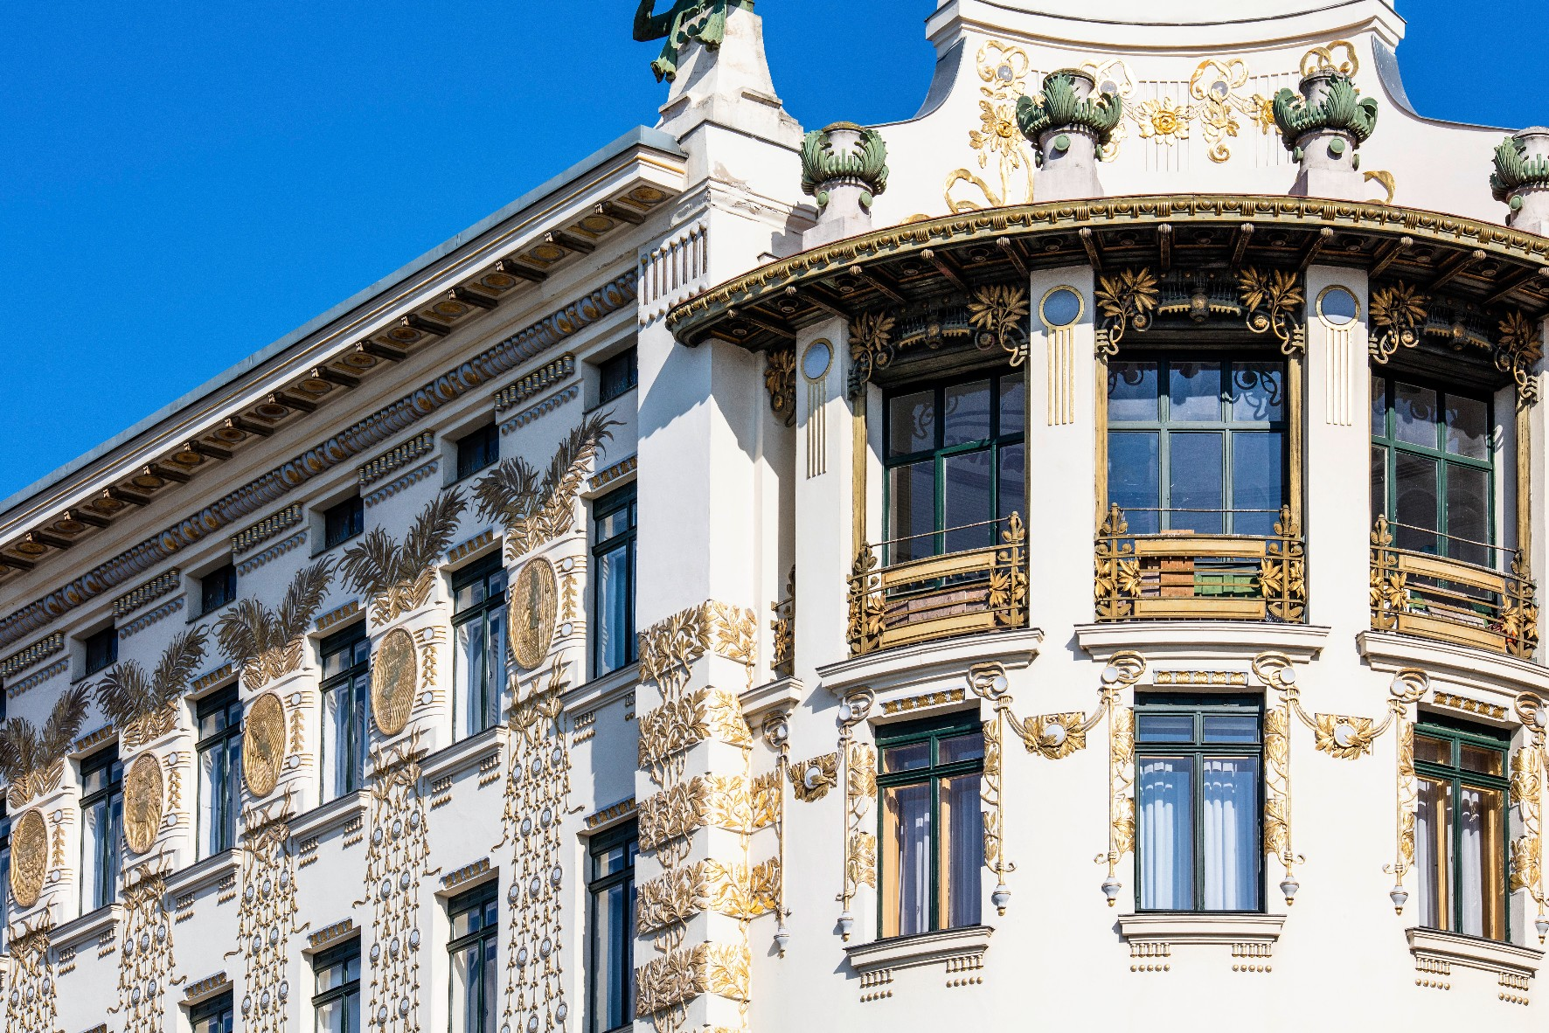
ART NOUVEAU ARCHITECTS AND THEIR WORKS

Slide 14
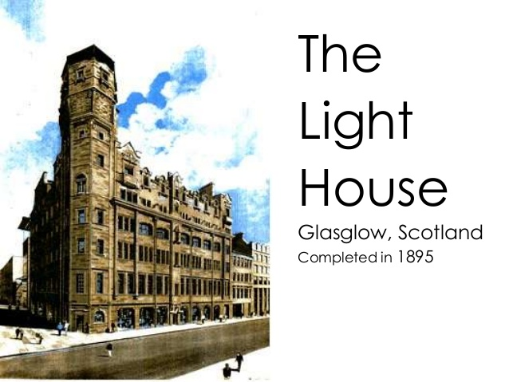

Slide 15
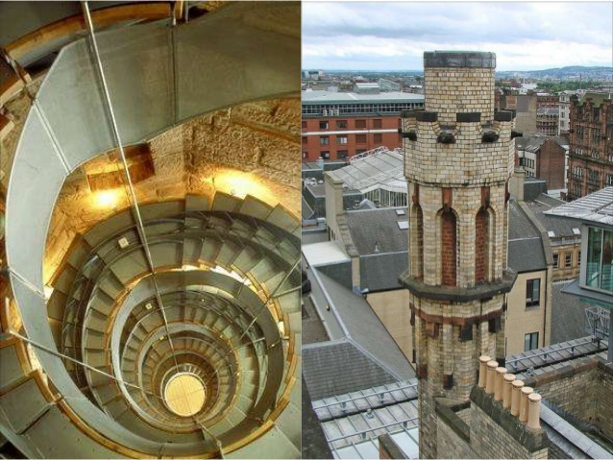

Slide 16
GRAPHICS AND DESIGN IN ART NOUVEAU
1890-1914
Art Nouveau is considered the first “modern” style. It was the first time that design was promoted through mass communication. It was the first self-conscious attempt by Western culture to create something new, Yet, at the turn of the century, artists and designers were looking forward to the future.

Slide 17
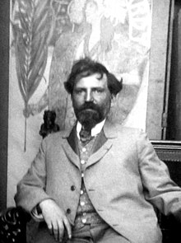
Alfons Maria Mucha ; 24 July 1860 – 14 July 1939), known internationally as Alphonse Mucha, was a Czech painter, illustrator and graphic artist, living in Paris during the Art Nouveau period, best known for his distinctly stylized and decorative theatrical posters, particularly those of Sarah Bernhardt. He produced illustrations, advertisements, decorative panels, and designs, which became among the best-known images of the period.

Slide 18
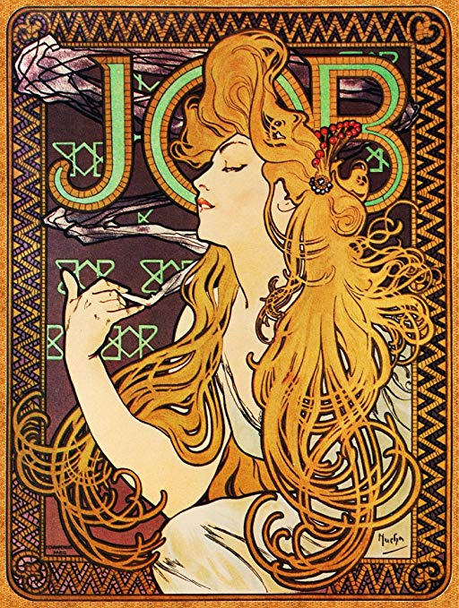
The Precious Stones:Ruby-Emerald-Amethyst-TopazAlphonse Mucha 1900

Slide 19
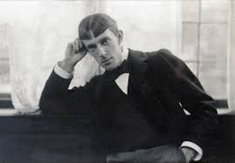
Aubrey Beardsley
Circumstances which gave rise to this style.The end of the nineteenth century is interesting. It’s when Western culture first began to exchange information and ideas through world trade. Some 500 million people attended international exhibitions during the life of Art Nouveau, and the Art Nouveau style was represented in every one of them.

Slide 20
It was also the first style that tried to deal with modern psychology and sexuality. One could say that Art Nouveau was an emotional style. It found world-wide appeal at the turn of the century with idea that one can have an erotic wardrobe, or a sexy chair, or a tragic book.

Slide 21
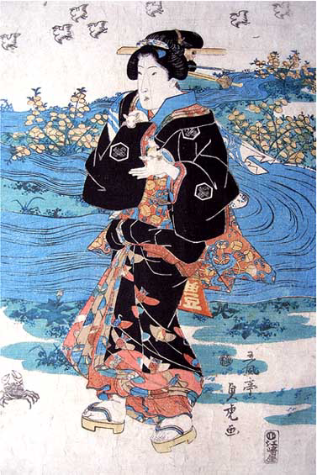
Ukiyo-e Japanese
: [u.ki.jo.e], is a genre of art that flourished in Japan from the 17th through 19th centuries. Its artists produced woodblock prints and paintings of such subjects as female beauties; kabuki actors and sumo wrestlers; scenes from history and folk tales; travel scenes and landscapes; flora and fauna; and erotica.

Slide 22
BEGINNING OF ART DECO

Slide 23
THE END

