Slide 2
Introduction of Ecology

Slide 3
What is Ecology?
Ecology is the scientific study of the interactions between organisms and their environment
It is the science that seeks to describe and explain the relationship between living organisms and their environment

Slide 4
Ecology is describing the relationships between living organisms and their environment.
Ecology comes from the Greek words
Oîkos= House
-λογία, -logia= Study of Life
Study of the “house/environment” in which we live

Slide 5
Factors of Ecology
There is two factors that Ecology study:
Abiotic Factors (non-living components):
Are those inert factors of the ecosystem, as the light, the temperature, the chemical products, the water and the atmosphere
Biotic Factors (living organisms):
Are all the living beings in an environment

Slide 6
Ecology is study of interactions between
non-living components in the environment…
light
water
wind
nutrients in soil
heat
solar radiation
atmosphere, etc.

Slide 7
AND…
Living organisms…
Plants
Animals
microorganisms in soil, etc.

Slide 8
Levels of Ecological Organization
Biosphere:
Earth & its atmosphere
Biome:
very large climatic regions
Ecosystem:
organisms and non-living things in one area

Slide 9
Community:
interacting organisms in one area
Population:
all members of one species in an area
Organism:
how they are adapted to their environments

Slide 10
Ernst Haeckel, a German zoologist coined the term Ecology in 1866.
After that….
Danish botanist, Eugenius Warming elaborate the idea of Ecology.

Slide 11
Classification of Ecology

Slide 12
Ecology is a broad discipline comprising many sub-disciplines.
Under this system the subjects studies:
Ecophysiology:
examines how the physiological functions of organisms influence the way they interact with the environment, both biotic and abiotic
Behavioral ecology:
examines the roles of behavior in enabling an animal to adapt to its environment

Slide 13
Population ecology:
studies the dynamics of populations of a single species.
Community ecology (or synecology):
focuses on the interactions between species within an ecological community.
Ecosystem ecology:
studies the flows of energy and matter through the biotic and abiotic components of ecosystems.

Slide 14
Systems ecology :
is an interdisciplinary field focusing on the study, development, and organization of ecological systems from a holistic perspective
Landscape ecology:
examines processes and relationship in a spatially explicit manner, often across multiple ecosystems or very large geographic areas.

Slide 15
Evolutionary ecology:
studies ecology in a way that explicitly considers the evolutionary histories of species and their interactions.
Political ecology:
connects politics and economy to problems of environmental control and ecological change.

Slide 16
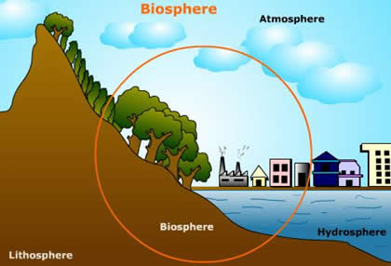

Slide 17
Biosphere

Slide 18
Definition of biosphere
Origin and use of the term biosphere
Biosphere concepts
Physical properties of biosphere
Factors effect on biosphere

Slide 19
Definition of biosphere
The biosphere: is the global sum of all ecosystems. It can also be termed the zone of life on Earth, a closed system (apart from solar and cosmic radiation and heat from the interior of the Earth), and largely self regulating

Slide 20
Origin of biosphere
Biosphere has a geological origin, it is an indication of the effect of both Charles Darwin and Matthew F. Maury on the Earth sciences
The biosphere's ecological context comes from the 1920s, preceding the 1935 introduction of the term "ecosystem" by Sir Arthur Tansley
Vernadsky defined ecology as the science of the biosphere

Slide 21
It is an interdisciplinary concept for integrating astronomy, geophysics, meteorology, biogeography, evolution, geology, geochemistry, hydrology and, generally speaking, all life and Earth sciences

Slide 22
Use of the term biosphere
The term "biosphere" was coined by geologist Eduard Suess in 1875, which he defined as:
The place on Earth's surface where life dwells

Slide 23
Concepts of biosphere
The biosphere concept: is common to many scientific disciplines including astronomy, geophysics, geology, hydrology, biogeography and evolution, and is a core concept in ecology, earth science and physical geography

Slide 24
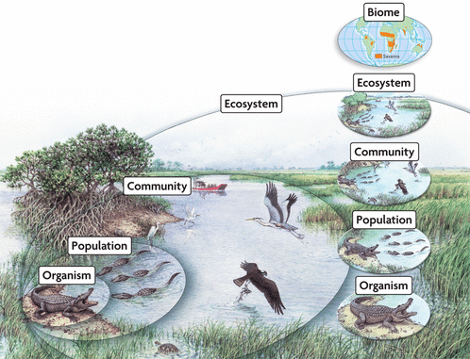
Levels of organization

Slide 25
Physical properties of biosphere
The physical properties of the biosphere in terms of its surface reflectance (albedo) and exchange of heat and moisture with the atmosphere are also critical for understanding global circulation of heat and moisture and therefore climate
Alterations in both the physics (albedo, heat exchange) and chemistry (carbon dioxide, methane, etc.) of earth systems by the biosphere are fundamental in understanding anthropogenic global warming

Slide 26
Factors effect on biosphere
Distance between the earth and the sun
Seasons and seasonal climate changes are direct results of the tilt of the Earth towards or away from the Sun
Summer months allow half of the planet to warm while the other half cools
Six months later, the temperatures shift in the opposite direction

Slide 27
Chemical erosion:
is a great example of a landscape changing one molecule at a time
Oxidation and reduction:
reactions change the composition of rocks and organic materials
There is also biological erosion

Slide 28
Tiny organisms, such as bacteria and fungi, are constantly working to break down organic and inorganic materials

