Slide 1
ARCH GARCH MODELS

Slide 2
Introduction
In the standard regression and time series models we have covered so far, many diagnostic checks were based on the assumptions that we imposed on the errors: independent, identically distributed with zero mean, and constant variance. In many practical cases and particularly in finance the constant variance assumption is often violated resulting in high volatility (i.e., changing variance). A linear trend model, an exponential smoother, or even an ARIMA model would have failed to capture this phenomenon, as all assume constant variance of the errors.

Slide 3
Introduction (cont.)
Volatility of the assumption of constant variance will in turn result in the underestimation of the standard errors calculated using OLS and will lead to erroneous conclusions. There are different ways of dealing with this situation. For example, if the changes in the variance at certain time intervals are known, weighted regression can be employed. However, it is often the case that these changes are unknown to the analyst. Moreover, it is usually of great value to the analyst to know why, when, and how these changes in the variance occur. Hence, if possible, modeling these changes (i.e., the variance) can be quite beneficial.

Slide 4
AR(p) model
Consider, for example, the simple AR(p) model
where e1 is the uncorrelated, zero mean noise with changing variance. Please note that we used e1 to distinguish it from our general white noise error E 1

Slide 5
ARCH(l) MODEL
Since we let the variance of e1 change in time, one approach is to modele~ as an AR(l) model as
where a₁ is a white noise sequence with zero mean and constant variance a,~. In this notation e1 is said to follow an autoregressive conditional heteroskedastic process of order l, ARCH(l).

Slide 6
ARCH(l) MODEL
To check for a need for an ARCH model, once the ARIMA or regression model is fitted, not only the standard residual analysis and diagnostics checks have to be performed but also some serial dependence checks for error should be made.

Slide 7
GARCH(l) MODEL
To further generalize the ARCH model, we will consider the alternative representation originally proposed by Engle [ 1982]

Slide 8
GARCH(l) MODEL (Cont.)
Let's assume that the error can be represented as
where w_{t} is independent and identically distributed with mean 0 and variance I, and

Slide 9
GARCH(l) MODEL (Cont.)
Hence the conditional variance of e_{t} is

Slide 10
GARCH(l) MODEL (Cont.)
We can also argue that the current conditional variance should also depend on the previous conditional variances as

Slide 11
GARCH(l) MODEL (Cont.)
In this notation, the error term e, is said to follow a generalized autoregressive conditional heteroskedastic process of orders k and l, GARCH(k, l),proposed by Bollerslev [1986]. In this equation the model for conditional variance resembles an ARMA model

Slide 12
GARCH(l) MODEL (Cont.)
Further extensions of ARCH models also exist for various specifications of v_{t} for example, Integrated GARCH (I-GARCH) by Engle and Bollerslev [1986], Exponential GARCH (E-GARCH) by Nelson [1991], Nonlinear GARCH by Glosten et al. [1993] etc.

Slide 13
EXAMPLE
Consider the weekly closing values for the S&P500 Index from 1995 to 1998 given in following table

Slide 14
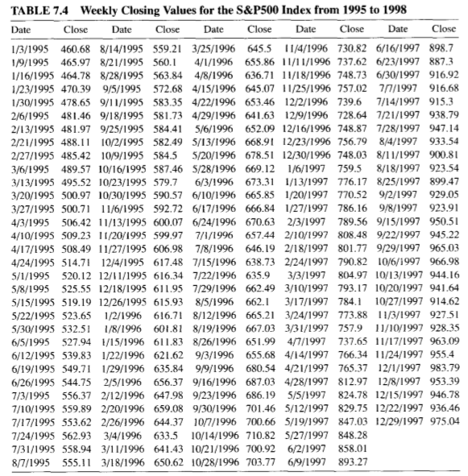

Slide 15
EXAMPLE(cont.)
Following figure shows that the data exhibits nonstationarity. But before taking the first difference of the data, we decided to take the log transformation of the data first. As the log transformation is sometimes used for financial data when we are interested, for example, in the rate of change or percentage changes in the price of a stock.

Slide 16
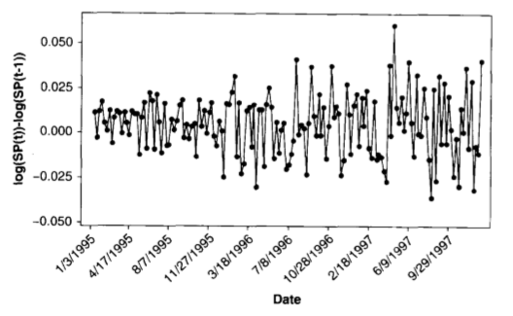

Slide 17
EXAMPLE(cont.)
The time series plot of the first differences of the log of the S&P500 shows that while the mean seems to be stable around 0, the changes in the variance are worrisome.

Slide 19
EXAMPLE(cont.)
The ACF and PACF plots of the first difference given in Figure suggest that, except for some borderline significant ACF values at seemingly arbitrary lags, there is no autocorrelation left in the data.
This suggests that the S&P500 Index follows a random walk process

Slide 20
EXAMPLE(cont.)
As, the time series plot of the differences does not exhibit a constant variance behavior. For that, we consider the ACF and PACF of the squared differences .

Slide 21
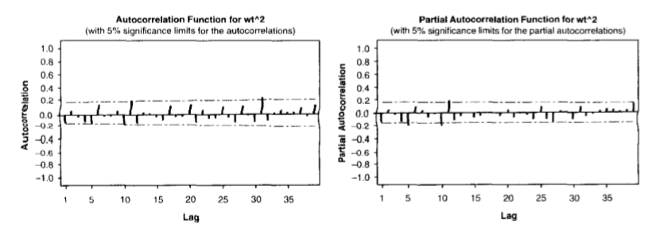

Slide 22
EXAMPLE(cont.)
the ACF and PACF of the squared differences suggests that an AR(3) model can be used. Thus we fit the ARCH(3) model for the variance.

