Slide 1
URBAN POLLUTION
UNIVERSITY OF SARGODHA, SARGODHA

Slide 2
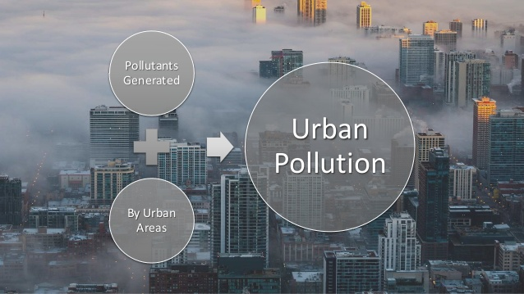

Slide 3
DEFINITION
“Urban pollution refers to the presence or introduction in cities and urban areas of poisonous or harmful substances”

Slide 4
CAUSE
Urban pollution may come from natural sources, but the most detrimental are those emissions related to human activities.

Slide 5
CAUSE OF URBAN POLLUTION
The two main causes of pollutants in urban areas
Transportation
Technologies such as the automobiles
Power production technologies such as industrial heating and cooling and coal-burning power plants.
Automobiles produce a large amount of carbon monoxides to the air we breathe in.

Slide 6
TYPES OF URBAN POLLUTION
Air Pollution.
Water/Freshwater, Marine, and Coastal Pollution.
Soil and Land Pollution.
Waste Pollution.
Noise Pollution.

Slide 7
AIR POLLUTION
“The presence in or introduction into the air of a substance which has harmful or poisonous effects”

Slide 8
CAUSE OF AIR POLLUTION
Air pollution is caused by solid and liquid particles and certain gases that are suspended in the air
Air pollution is caused by solid and liquid particles and certain gases that are suspended in the air
The solid and liquid particles suspended in our air are called aerosols.

Slide 9
TYPES OF AIR POLLUTION
Carbon Monoxide.
Lead.
Nitrogen Oxides.
Ozone.
Particulate Matter.
Sulfur Dioxide.
Other Air Pollutants.

Slide 10
EFFECTS OF AIR POLLUTION
Long-term health effects from air pollution include
heart disease,
lung cancer,
respiratory diseases such as emphysema.
Air pollution can also cause long-term damage to people's nerves, brain, kidneys, liver, and other organs.
Some scientists suspect air pollutants cause birth defects.

Slide 12
WATER POLLUTION
Water pollution is the contamination of water bodies, usually as a result of human activities.
Examples
lakes, rivers, oceans, aquifers and groundwater. Water pollution results when contaminants are introduced into the natural environment

Slide 13
CAUSE OF WATER POLLUTION
Discharge of domestic and industrial effluent wastes, leakage from water tanks, marine dumping, radioactive waste and atmospheric deposition are major causes of water pollution.

Slide 14
TYPES OF WATER POLLUTION
Groundwater pollution. ...
Microbiological pollution. ...
Nutrient pollution. ...
Oxygen-depletion pollution. ...
Surface water pollution.
Chemical pollution.
The most common type of water pollution

Slide 15
EFFECTS OF WATER POLLUTION
water pollution causes an algal bloom in a lake or marine environment, the proliferation of newly introduced nutrients stimulates plant and algae growth, which in turn reduces oxygen levels in the water.

Slide 16
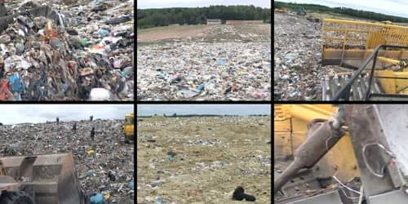
SOIL POLLUTION
“Soil contamination or soil pollution as part of land degradation is caused by the presence of xenobiotics (human-made) chemicals or other alteration in the natural soil environment.”

Slide 17
CONTI..
It is typically caused by industrial activity, agricultural chemicals or improper disposal of waste.
It is typically caused by industrial activity, agricultural chemicals or improper disposal of waste.

Slide 18
TYPES OF SOIL POLLUTANTS
Industrial waste. ...
Deforestation. ...
Excessive use of fertilizers and pesticides. ...
Garbage pollution. ...
Climate change. ...
Loss of soil fertility. ...
Impact on human health. ...
Reforestation.

Slide 19
CONTI..
Agricultural Practices. ...
Radioactive Pollutants. ...
Urban Waste. ...
Industrial Waste.

Slide 20
BIOLOGICAL AGENTS
Biological agents work inside the soil to introduce manures and digested sludge (coming from the human, bird and animal excreta) into the soil.

Slide 21
EFFECTS OF SOIL POLLUTION
Soil contamination also leads to an increase in algae production
fertilizers contain substances which support the growth of algae,
when these chemicals eventually end up in rivers and lakes, these water environments will face an increased production of algae.

Slide 22
CONTI..
Short term exposure to air pollution can irritate the
eyes
nose
throat
cause upper respiratory infections,
headaches
nausea and allergic reactions

Slide 23
CONTI
Long-term exposures can lead to
chronic respiratory disease,
lung cancer and
heart disease.

Slide 24
NOISE POLLUTION
“Noise pollution is generally defined as regular exposure to elevated sound levels that may lead to adverse effects in humans or other living organisms”

Slide 25
CONTI..
According to the World Health Organization, sound levels less than 70 dB are not damaging to living organisms, regardless of how long or consistent the exposure is.

Slide 26
CAUSE OF NOISE POLLUTION
Noise pollution impacts millions of people on a daily basis.
The most common health problem it causes is Noise Induced Hearing Loss (NIHL).
Exposure to loud noise can also cause
high blood pressure,
heart disease,
sleep disturbances, and stress.

Slide 27
TYPES OF NOISE POLLUTION
There are three types of noise pollution:
Transport Noise.
Neighbourhood Noise.
Industrial Noise.

Slide 28
EFFECTS OF NOISE POLLUTION
Respiratory Agitation
Racing Pulse
High Blood Pressure
Headaches
In case of extremely loud, constant noise,
Gastritis
Colitis
Even Heart Attacks

Slide 29
THANK YOU!

