Slide 1
Functions of Sets BS Education-V Teaching Mathematics (EDU-511)
Department of Education University of Sargodha

Slide 2
Functions of Sets Rimsha Fiaz(BSEDUF18M042) Teaching of Mathematics BS Education Semester 5
Department of Education
University of Sargodha, Pakistan
October 2020

Slide 3
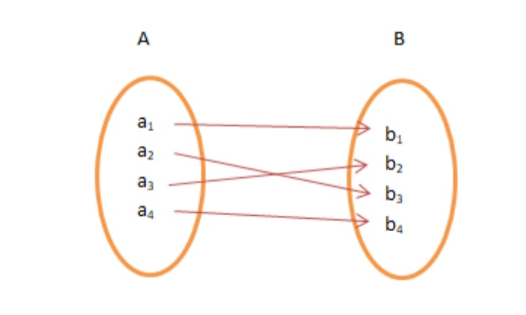
Functions of sets
One to One Function
A function f: A → B is One to One, if for each element of A there is a distinct element of B. It is also known as Injective.
Consider, if a1 ∈ A and b1 ∈ B, f is defined as f: A → B such that f (a1) = f (a2)

Slide 4
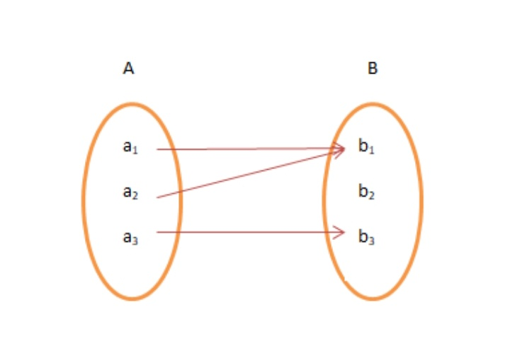
Many to One Function
It is a function which maps two or more elements of A to the same element of set B. Two or more elements of A have the same image in B.

Slide 5
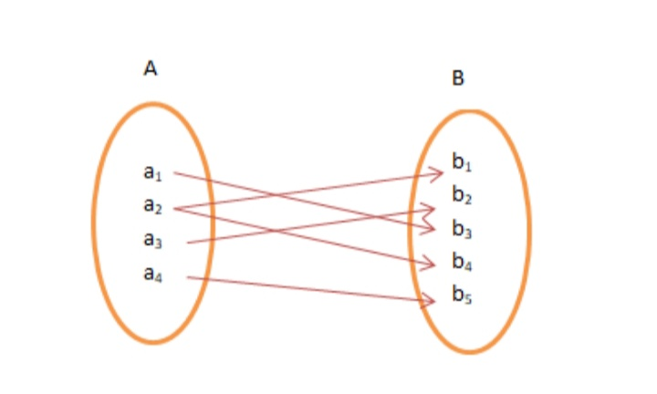
Onto Function
If there exists a function for which every element of set B there is (are) pre-image(s) in set A, it is Onto Function. Onto is also referred as Surjective Function.

Slide 6
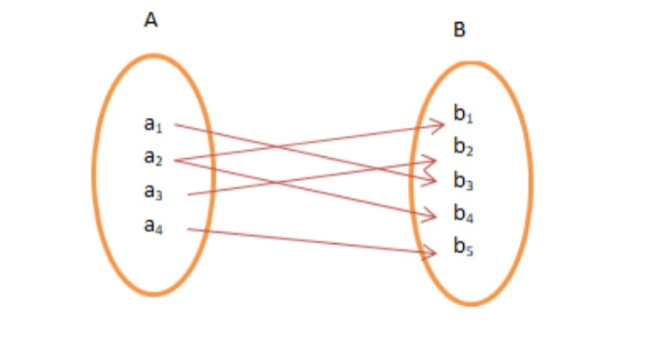
Onto Function
If there exists a function for which every element of set B there is (are) pre-image(s) in set A, it is Onto Function. Onto is also referred as Surjective Function.

Slide 7
One – One and Onto Function
A function, f is One – One and Onto or Bijective if the function f is both One to One and Onto function. In other words, the function f associates each element of A with a distinct element of B and every element of B has a pre-image in A.

