Slide 1
MANAGING CONTRACTS

Slide 2
Contents
Introduction
What is a contract
Types of Contracts
Fixed Type Contract
Time and Material Contract
Fixed Price per Unit Delivered Contracts
Stages in contract placement
Typical Terms of a Contract
Contract Management
Acceptance

Slide 3
Introduction
During software development, such situations usually occur, where external resources are required. These could be in the form of
Services---for example staff on short term contracts carrying out some project tasks.
Goods----a contract for a complete software package could be placed. When a complete software package is acquired, it could be
A bespoke system
An off the shelf package
Customized off the shelf software

Slide 4
Introduction
Whenever the resources are acquired externally, there arises the need of some agreement or more specifically a contract.

Slide 5
What is a Contract
A contract is an agreement between two or more persons creating rights & duties and which is enforceable by law.
A contract is a promise or set of promises that are legally enforceable and, if violated, allow the injured party access to legal remedies.
An agreement between persons which obliges each party to do or not to do a certain thing.

Slide 6
Types of Contract
There are three basic types of contracts
Fixed price contracts
Time and material contracts
Fixed price per unit delivered contracts

Slide 7
Fixed Price Contracts
A price is fixed when the contract is signed.
Customer knows that if there are no changes in the contract terms, this is the prices they pay on completion.
For this to be effective, the customer’s requirement has to be fixed at the outset.
Once the development is under way, the customer cannot change their requirements without renegotiating the price of contract.

Slide 8
Fixed Price Contracts
Advantages
Known customer expenditure
Supplier motivation
Disadvantages
Higher prices to allow for contingency
Difficulties in modifying requirements
Upward pressure on the cost of changes
Threat to system quality.

Slide 9
Time and Material Contracts
The customer is charged at a fix rate per unit of effort, e.g. per staff hour.
The supplier may provide an initial estimate of the cost based on their current understanding of the customer’s requirement, but this is not the basis for the final payment.
The supplier usually invoices the customer for work done at regular intervals, say each month.

Slide 10
Time and Material Contracts
Advantages
Ease of changing requirements
Lack of price pressure
Disadvantages
Customer liability
Lack of incentives for supplier

Slide 11
Fixed Price Per Unit Delivered Contracts
This type of contract is associated with Function Point (FP) counting.
Size of the system to be delivered is calculated or estimated at the outset of the project in FPs.
A price per unit (per FP) is also quoted.
The final price is then the unit price multiplied by total number of units.

Slide 12
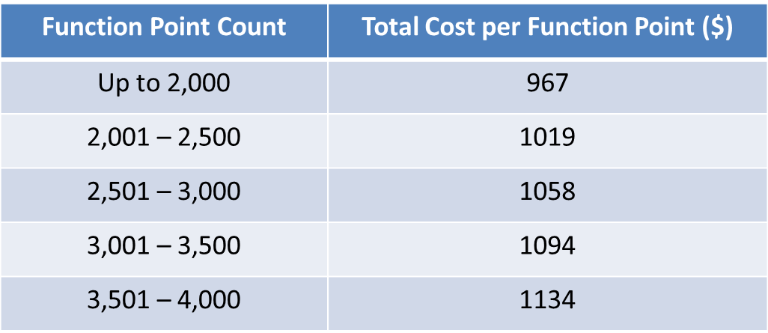
Fixed Price Per Unit Delivered Contracts
For example if the estimated system size is 2,600 FPs, Price will be
(2000 FPs x $967) + (500 FPs x $1,019) +
(100 FPs x $1,058) = $2,549,300

Slide 13
Activity 1
What would be charge for 3,200 FPs?

Slide 14
Fixed Price Per Unit Delivered Contracts
Advantages
Customer understanding
Comparability
Emerging functionality
Supplier efficiency
Life-cycle range
Disadvantages
Difficulties with software size measurement
Changing requirements

Slide 15
Stages in contract placement
Contract placement requires following four stages
Requirements analysis
Evaluation plan
Invitation tender
Evaluation of proposal

Slide 16
Requirements analysis
Before approaching potential suppliers, one must have a clear set of requirements.
The requirements should carefully define
The functions of the new application
Inputs and outputs for those functions
Any standards that should be applied during development
Existing system with which the new system should be compatible

Slide 17
Requirements analysis
Each requirement needs to be identified as either Mandatory or Desirable.
Activity 2: Identify one mandatory and one desirable requirement in the case of brightmouth college payroll system.

Slide 18
Evaluation plan
After documenting requirements list, its now time to think of a plan that how the proposal are to be evaluated.
Initially the ways of checking that the mandatory requirements are met, need to be identified.
The next consideration is, how to evaluate the desirable requirements.
The final evaluation plan should describe how each proposal will be checked against the selection criteria.

Slide 19
Invitation to Tender
Having produced the requirements and evaluation plan, it is now time to issue the “invitation to tender” to prospective suppliers.
“Invitation to tender” is essentially the requirement document with a supporting letter containing information about how the responses are to be lodged.
A deadline is also specified.

Slide 20
Evaluation of Proposals
An evaluation plan is already designed to ensure that all the proposals are treated consistently.
A software application could be bespoke, off-the-shelf or customized off-the-shelf, therefore different approaches would be needed.
In the case of OTS packages, the software itself could be evaluated.
With bespoke development, it would be the proposal that will be evaluated.

Slide 21
Evaluation of Proposals
Evaluation of COTS usually involves elements of both.
The process of evaluation may include
Scrutiny of the proposal document
Interviewing supplier's representatives
Demonstrations
Site visits
Practical tests

Slide 22
Typical Terms of a Contract
A project manager cannot be expected to be a legal expert, but he must ensure that contract reflect true requirements and expectations of supplier and client.
Therefore some basic knowledge of common contract terms is beneficial.
Some of the common and typical terms used in a contract are provided in this section.

Slide 23
Typical Terms of a Contract
Definitions
The terminology used in the contract document may need to be defined e.g. who is meant by the word ‘client’ and ‘supplier’.
Form of Agreement
Is it a contract of sale, lease and license.

Slide 24
Typical Terms of a Contract
Goods and Services to be supplied
Goods means software and services would cover such things
Training
Documentation
Installation
Maintenance agreements
Ownership of the Software
Who has the ownership of the software
Whether the customer can sell the software to others.
Whether the supplier can sell the software to others.

Slide 25
Typical Terms of a Contract
Customer commitments
Acceptance procedures
Standards
Timetable
Price and payment method

Slide 26
Contract Management
After a contract is finalized and signed, it is a general practice to left the contractor to get on with work.
However it is desirable that at certain decision points, the customer wish to examine the work already done and make decision about the future direction of the project.
For each decision point, the deliverables from the suppliers, the decisions to be made by the customer and the possible outcomes need to be defined.
The decision points have added significance if they are the basis for payment to the contractor.

Slide 27
Acceptance
When the work has been completed, the customer needs to arrange acceptance testing.
Part or all of the payment to the supplier should depend on this acceptance testing.
There may also be a period of warranty during which the supplier should fix any error found for no change.

Slide 28
Reading
[Chapter#10]“Software Project Management by Bob Hughes and Mike Cotterell, McGraw-Hill Education; 6th Edition (2009). ISBN-10: 0077122798”
https://en.wikipedia.org/wiki/Contract

