Slide 1
Advanced Analysis of Algorithms
Dr. Qaiser Abbas
Department of Computer Science & IT,
University of Sargodha, Sargodha, 40100, Pakistan
qaiser.abbas@uos.edu.pk

Slide 2
Floyd-Warshall Algorithm
Bellman-Ford and Dijkstra's algorithms provide a means to find the shortest path from a given source. However often we may wish to find the shortest paths between all pairs of vertices.
One way to accomplish this would be to simply run Bellman-Ford or Dijkstra's algorithm for each vertex in the graph. Thus the run times for these strategies would be (for dense graphs where |E| ≈ |V|²):
Bellman-Ford:
|V| O(VE) ≈ O(V⁴)
Dijkstra
|V| O(V² + E) ≈ O(V³)
|V| O(V lg V + E) ≈ O(V² lg V + VE)
In the case of dense graphs an often more efficient algorithm (with very low hidden constants) for finding all pairs shortest paths is the Floyd-Warshall algorithm.

Slide 3
Floyd-Warshall Algorithm
The Floyd-Warshall algorithm works based on a property of intermediate vertices of a shortest path. An intermediate vertex for a path p = <v₁, v₂, ..., v_{j}> is any vertex other than v₁ or v_{j}.
If the vertices of a graph G are indexed by {1, 2, ..., n}, then consider a subset of vertices {1, 2, ..., k}. Assume p is a minimum weight path from vertex i to vertex j whose intermediate vertices are drawn from the subset {1, 2, ..., k}.

Slide 4
Floyd-Warshall Algorithm
If we consider vertex k on the path then either:
k is not an intermediate vertex of p (i.e. is not used in the minimum weight path)
⇒ all intermediate vertices are in {1, 2, ..., k-1}
k is an intermediate vertex of p (i.e. is used in the minimum weight path)
⇒ we can divide p at k giving two subpaths p₁ and p₂ giving v_{i} ↝ k ↝ v_{j}

Slide 5
Floyd-Warshall Algorithm

Slide 6
Floyd-Warshall Algorithm
For D⁰_{ij} matrix entries, if i=j, then D⁰_{ij}= 0 and if i≠j, then D⁰_{ij} = ∞ if there is no any edge.
Thus if we define a quantity d^{(k)}_{ij} as the minimum weight of the path from vertex i to vertex j with intermediate vertices drawn from the set {1, 2, ..., k} the above properties give the following recursive solution
Thus we can represent the optimal values (when k = n) in a matrix as

Slide 7
Floyd-Warshall Algorithm
There are a variety of different methods for constructing shortest paths in the Floyd- Warshall algorithm.
One way, is to compute the matrix D of shortest-path weights and then construct the predecessor matrix Π from the D matrix.
Alternatively, we can compute the predecessor matrix Π while the algorithm computes the matrices D^{(k)}. Specifically, we compute a sequence of matrices Π⁽⁰⁾, Π⁽¹⁾, … , Π^{(n)},where Π = Π^{(n)} and we define π_{ij}^{(k)} as the predecessor of vertex j on a shortest path from vertex i with all intermediate vertices in the set from {1,2,…k}

Slide 8
Floyd-Warshall Algorithm
We can give a recursive formulation of π_{ij}^{(k)} When k=0, a shortest path from i to j has no intermediate vertices at all. Thus,
For k ≥ 1, if we take the path i → k → j, where k ≠ j, then the predecessor of j we choose is the same as the predecessor of j we chose on a shortest path from k with all intermediate vertices in the set {1,2,…k}. Otherwise, we choose the same predecessor of j that we chose on a shortest path from i with all intermediate vertices in the set {1,2,…k-1}. Formally, for k≥1
.

Slide 9
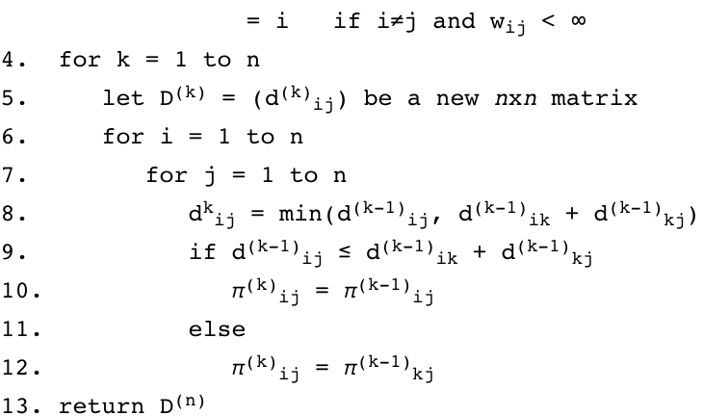
Floyd-Warshall Algorithm

Slide 10
Floyd-Warshall Algorithm
Basically the algorithm works by repeatedly exploring paths between every pair using each vertex as an intermediate vertex.
Since Floyd-Warshall is simply three (tight) nested loops, the run time is clearly O(V³).

Slide 11
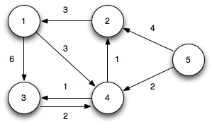
Floyd-Warshall Algorithm
Example:

Slide 12
Floyd-Warshall Algorithm
Example:
Initialization: (k = 0)

Slide 13
Floyd-Warshall Algorithm
Example:
Iteration 1: (k = 1) Shorter paths from 2 ↝ 3 and 2 ↝ 4 are found through vertex 1

Slide 14
Floyd-Warshall Algorithm
Example:
Iteration 2: (k = 2) Shorter paths from 4 ↝ 1, 5 ↝ 1, and 5 ↝ 3 are found through vertex 2

Slide 15
Floyd-Warshall Algorithm
Example:
Iteration 3: (k = 3) No shorter paths are found through vertex 3

Slide 16
Floyd-Warshall Algorithm
Example:
Iteration 4: (k = 4) Shorter paths from 1 ↝ 2, 1 ↝ 3, 2 ↝ 3, 3 ↝ 1, 3 ↝ 2, 5 ↝ 1, 5 ↝ 2, 5 ↝ 3, and 5 ↝ 4 are found through vertex 4

Slide 17
Floyd-Warshall Algorithm
Example:
Iteration 5: (k = 5) No shorter paths are found through vertex 5

Slide 18
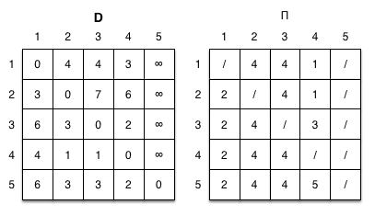
Floyd-Warshall Algorithm
Example:
The final shortest paths for all pairs is given by

Slide 19
Transitive Closure
Floyd-Warshall can be used to determine whether or not a graph has transitive closure, i.e. whether or not there are paths between all vertices.
Assign all edges in the graph to have weight = 1
Run Floyd-Warshall
Check if all d_{ij} < n
This procedure can implement a slightly more efficient algorithm through the use of logical operators rather than min() and +.

Slide 20
Johnson's Algorithm
While Floyd-Warshall is efficient for dense graphs, if the graph is sparse then an alternative all pairs shortest path strategy known as Johnson's algorithm can be used.
This algorithm basically uses Bellman-Ford to detect any negative weight cycles and then employs the technique of reweighting the edges to allow Dijkstra's algorithm to find the shortest paths. This algorithm can be made to run in O(V² lg V + VE).

Slide 21
Johnson's Algorithm
The problem is to find shortest paths between every pair of vertices in a given weighted directed Graph and weights may be negative.
We have discussed Floyd Warshall Algorithm for this problem. Time complexity of Floyd Warshall Algorithm is (V³). Using Johnson’s algorithm, we can find all pair shortest paths in O(V²log V + VE) time.
Johnson’s algorithm uses both Dijkstra and Bellman-Ford as subroutines.

Slide 22
Johnson's Algorithm
If we apply Dijkstra’s Single Source shortest path algorithm for every vertex, considering every vertex as source, we can find all pair shortest paths in O(V*VLogV) time.
So using Dijkstra’s single source shortest path seems to be a better option than Floyd Warshell, but the problem with Dijkstra’s algorithm is, it doesn’t work for negative weight edge.
The idea of Johnson’s algorithm is to re-weight all edges and make them all positive, then apply Dijkstra’s algorithm for every vertex.

Slide 23
Johnson's Algorithm
How to transform a given graph to a graph with all non-negative weight edges? One may think of a simple approach of finding the minimum weight edge and adding this weight to all edges. Unfortunately, this doesn’t work as there may be different number of edges in different paths (See next slide for an example).
In a weighted graph, assume that the shortest path from a source ‘s’ to a destination ‘t’ is correctly calculated using a shortest path algorithm. Is the following statement true?
If we increase weight of every edge by 1, the shortest path always remains same.
(A) Yes (B) No Answer: (B) (Explanation is on next slide)

Slide 24
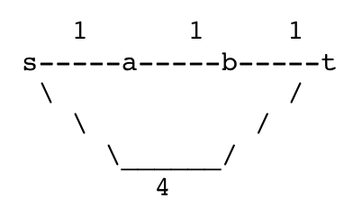
Johnson's Algorithm
Explanation: See the following counterexample.
There are 4 edges s-a, a-b, b-t and s-t of wights 1, 1, 1 and 4 respectively. The shortest path from s to t is s-a, a-b, b-t. IF we increase weight of every edge by 1, the shortest path changes to s-t.
So, If there are multiple paths from a vertex u to v, then all paths must be increased by same amount, so that the shortest path remains the shortest in the transformed graph.

Slide 25
Johnson's Algorithm
The idea of Johnson’s algorithm is to assign a weight to every vertex. Let the weight assigned to vertex u be h[u].
We reweight edges using vertex weights. For example, for an edge (u, v) of weight w(u, v), the new weight becomes w(u, v) + h[u] – h[v].
The great thing about this reweighting is, all set of paths between any two vertices are increased by same amount and all negative weights become non-negative.
Consider any path between two vertices s and t, weight of every path is increased by h[s] – h[t], all h[] values of vertices on path from s to t cancel each other.

Slide 26
Johnson's Algorithm
How do we calculate h[] values?
Bellman-Ford algorithm is used for this purpose. Following is the complete algorithm. A new vertex is added to the graph and connected to all existing vertices. The shortest distance values from new vertex to all existing vertices are h[] values.

Slide 27
Johnson's Algorithm
Theory of Algorithm
1) Let the given graph be G. Add a new vertex s to the graph, add edges from new vertex to all vertices of G. Let the modified graph be G’.
2) Run Bellman-Ford algorithm on G’ with s as source. Let the distances calculated by Bellman-Ford be h[0], h[1], .. h[V-1]. If we find a negative weight cycle, then return. Note that the negative weight cycle cannot be created by new vertex s as there is no edge to s. All edges are from s.
3) Reweight the edges of original graph. For each edge (u, v), assign the new weight as “original weight + h[u] – h[v]”.
4) Remove the added vertex s and run Dijkstra’s algorithm for every vertex.

Slide 28
Johnson's Algorithm

Slide 29
Johnson's Algorithm
How does the transformation ensure nonnegative weight edges?
The following property is always true about h[] values as they are shortest distances.
h[v] <= h[u] + w(u, v) The property simply means, shortest distance from s to v must be smaller than or equal to shortest distance from s to u plus weight of edge (u, v).
The new weights are w(u, v) + h[u] - h[v]. The value of the new weights must be greater than or equal to zero because of the inequality "h[v] <= h[u] + w(u, v)".

Slide 30
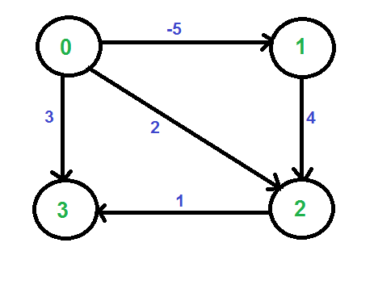
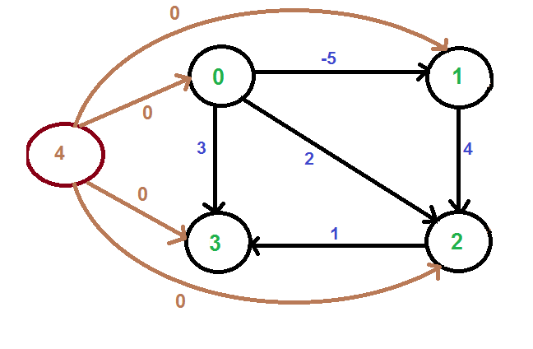
Johnson's Algorithm
Example:
Let us consider the following graph.
We add a source s and add edges from s to all vertices of the original graph. In the following diagram s is 4.

Slide 31
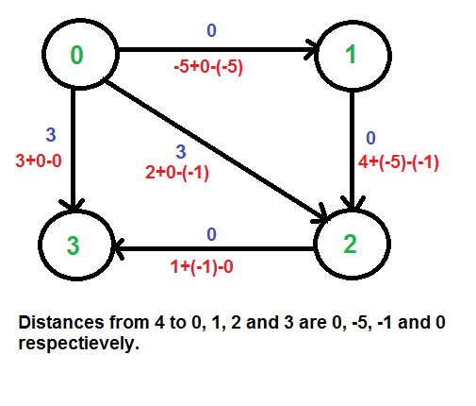
Johnson's Algorithm
We calculate the shortest distances from 4 to all other vertices using Bellman-Ford algorithm.
The shortest distances from 4 to 0, 1, 2 and 3 are 0, -5, -1 and 0 respectively, i.e., h[] = {0, -5, -1, 0}.
Once we get these distances, we remove the source vertex 4 and reweight the edges using following formula. w(u, v) = w(u, v) + h[u] - h[v].
Since all weights are positive now, we can run Dijkstra's shortest path algorithm for every vertex as source.

Slide 32
Johnson's Algorithm
Time Complexity: The main steps in algorithm are Bellman Ford Algorithm called once and Dijkstra called V times.
Time complexity of Bellman Ford is O(VE) and time complexity of Dijkstra is O(VLogV). So overall time complexity is O(V²log V + VE).
The time complexity of Johnson's algorithm becomes same as Floyd Warshell when the graphs is complete (For a complete graph E = O(V²). But for sparse graphs, the algorithm performs much better than Floyd Warshell.

