Slide 1
Introduction to Computer (Comp-201)

Slide 2
Output
The data that has been processed into useful information is called output. The output can be in two forms
Soft copy output
Hard copy output

Slide 3
Output
Soft copy output
The output shown on display screen is called soft copy. Soft copy output is not tangible. It means that it cannot be touched.
Hard Copy output
The output printed on paper is called hard copy. The common devices to produce hard copy output are printers and plotters.

Slide 4
Output Devices
The hardware component that are used to receive information from the computer are called output devices.
Output devices take information from the computer and convert it into a form that is understandable by the users.

Slide 5
Output Devices
Some common output devices are
Display devices
Printers
Plotters
Data Projectors
Interactive Whiteboards
Audio Output Devices

Slide 6
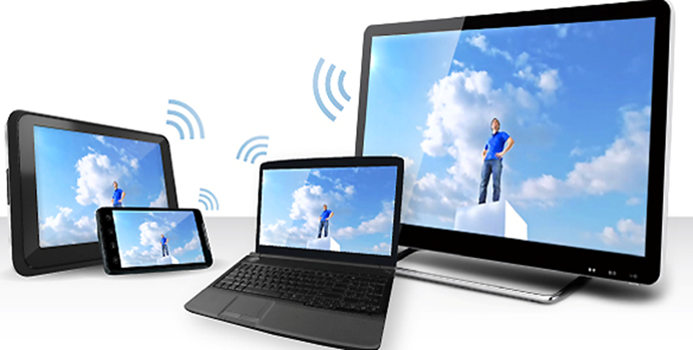
Display devices
A display device is an output device that displays text, graphics and videos.
The display for a desktop is typically a monitor that is a separate physical device.
Mobile computers and devices normally integrate the display in their same physical case.
Some display have touch screens.
Display devices are available in a wide variety of sizes.

Slide 7
Features of Display devices
Display devices can be distinguished on the basis of following features
Size and aspect ratio
Color
Resolution
Refresh Rate

Slide 8
Features of Display devices
Size and aspect ratio
Aspect ratio is the ratio of the width to the height.
Most of the current displays are wide screen which means they use a 16:9 or 16:10 aspect ratio.
Display screens are measured diagonally from corner to corner, desktop computer monitors range from 17 to 30 inches.
Notebooks typically have 10 inch displays.
Tablet screens are between 7 and 10 inches.

Slide 9
Features of Display devices
Color
The display devices can be monochrome or color.
The monochrome display screens display output in single color, however they are able to display different shades of one color.
The number of shades of one color that a monitor can display is referred to as gray scale.
Monochrome display screens show images in a single color usually white, green, blue and red.

Slide 10
Features of Display devices
Color
The color display screens display output in multiple colors.
The color display screens are called RGB monitors.
The number of colors a monitor can display is called color depth or bit depth.
The RGB display screens can create 256 colors and thousads of variations of these colors.

Slide 11
Features of Display devices
Resolution
It is the total number of pixels displayed on the screen.
Pixels are the dots or picture elements that form pictures on the screen.
Resolution determines the amount of information that can be displayed at one time and is expressed as the number of horizontal pixels by the number of vertical pixels.
A high resolution provides sharper and clearer images.
Notes:
For example 1600*900

Slide 12
Features of Display devices
Refresh Rate
It is the speed with which a monitor redraws the image on the screen and is measured in hertz.
It indicates the number of times, screen is refreshed in one second.
The image on the screen appears more solid and flicker less if the refresh rate is high.
Common monitors have refresh rates between 75 and 85 Hz.

Slide 13
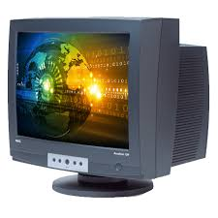
CRT
A CRT monitor is a desktop monitor that contains a cathode-ray tube.
A cathode-ray tube (CRT) is a large, sealed glass tube. The front of the tube is the screen. A CRT’s viewable size is the diagonal measurement of the actual viewing area provided by the screen in the CRT monitor.
A 21-inch monitor, for example, may have a viewable size of 20 inches.

Slide 14
Printers
A printer is an output device that prints characters, symbols and graphics on paper.
The printed output is called hard copy.
Printers can be classified into two main categories
Impact printers
Non-impact printers

Slide 15
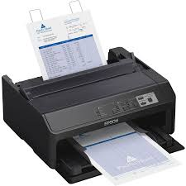
Impact printers
An impact printer works like a type writer.
It prints characters or images by striking a print hammer or set of pins against an inked ribbon.
The ink is then pressed from the ribbon on the paper to produce the output.

Slide 16
Impact printers
Impact printers are the oldest print technologies.
They are used where low cost printing is required.
Three most common forms of impact printers are dot matrix printers, daisy wheel printer and line printer.

Slide 17
Non-Impact printers
A non-impact printer prints characters and graphics on paper without striking paper.
The characters are printed on paper with different means such as laser.
Some printers use spray ink while others use heat and pressure to create images.
These printers are faster but costly than impact printers.

Slide 18
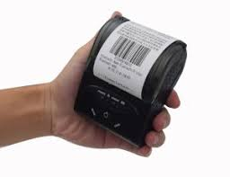
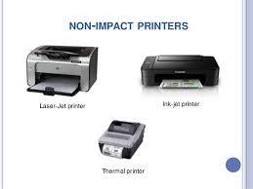
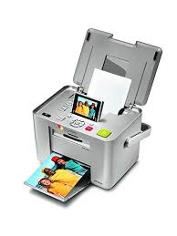
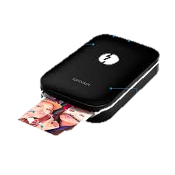
Non-Impact printers
Their quality is better than impact printers and they produce no noise during printing.
Different kind of non-impact printers are laser printer, inkjet printer, thermal printer, photo printer and portable printer.

Slide 19
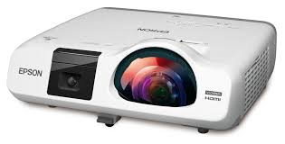
Data Projectors
Data projector is an output device that projects the output of computer screen onto a larger screen.
The output projected by data projectors can be viewed by a number of people very clearly.
Data projectors are used in classes to deliver lectures to many students.
Two common types of data projectors are LCD Projector and DLP projector.

Slide 20
Audio Output Devices
Audio output devices are the components that produce voice, music and other audible sounds.
The most commonly used audio output devices are speakers, headphones, headsets and earbuds.

Slide 21
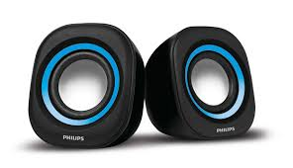
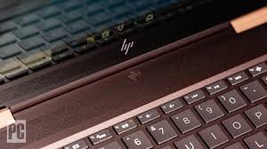
Audio Output Devices
Speaker is the most common type of audio output device.
It connects to a sound card in the system unit and provides audio output for computer games, music, video clips and other applications.
The speakers for some desktop computers are built directly into the monitor while portable computers and mobile devices typically have speakers integrated into the device.

Slide 22
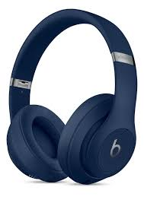
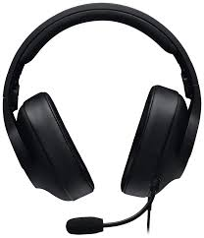
Audio Output Devices
Headphones are used instead of speakers so that other people are not disturbed at places such as public library.
Headset is a headphone with a built-in microphone.
It is often used when making telephone calls or participating in web conferencing using computer.

Slide 23
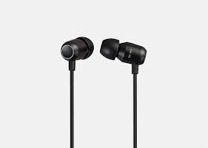
Audio Output Devices
Earbuds are often used with portable digital media players, handheld gaming devices and other mobile devices.
Both headphones and earbuds usually include noise-cancelling technology to reduce interference of sounds from surrounding environment.

