Slide 1
Sociology ^{BBA} Semester: 3rd ^{Lecture No. 10} ^{Instructor: Mumtaz Hussain} University of Sargodha Sb Campus ^{Bhakkar}

Slide 5
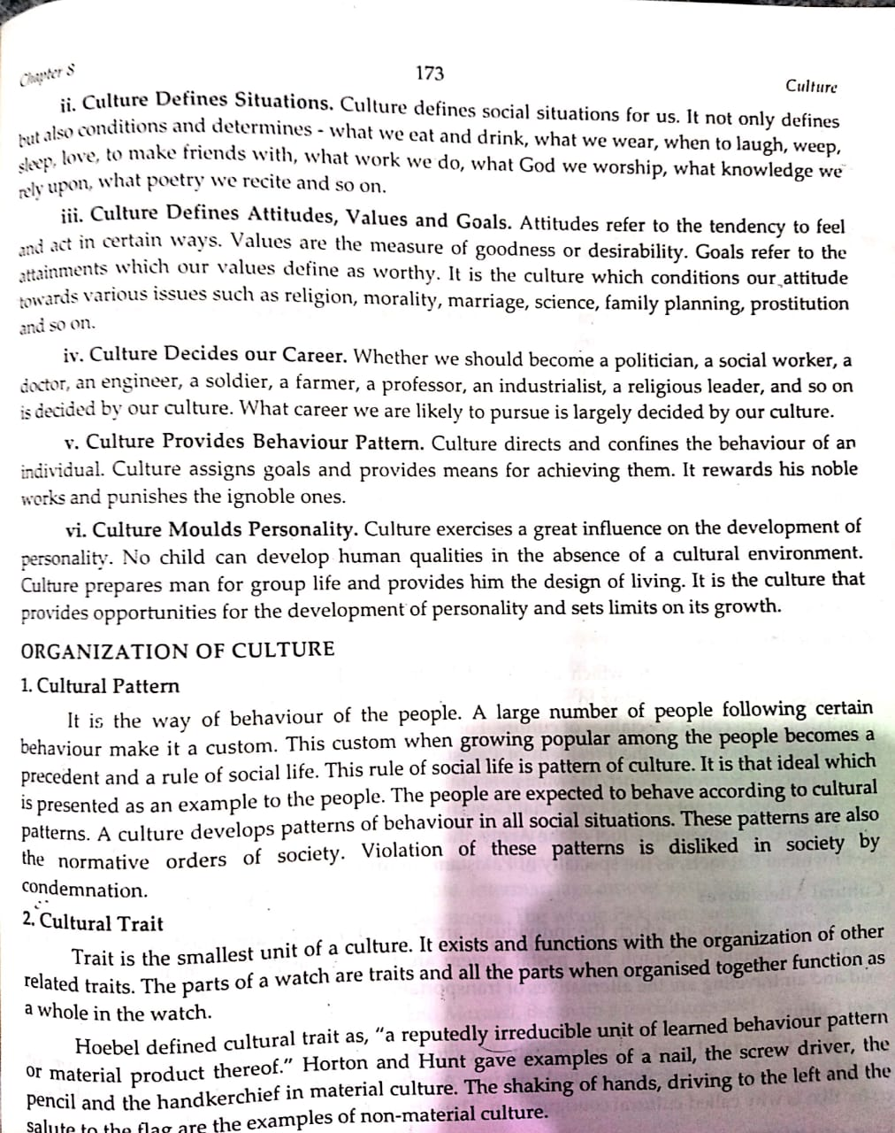

Slide 6
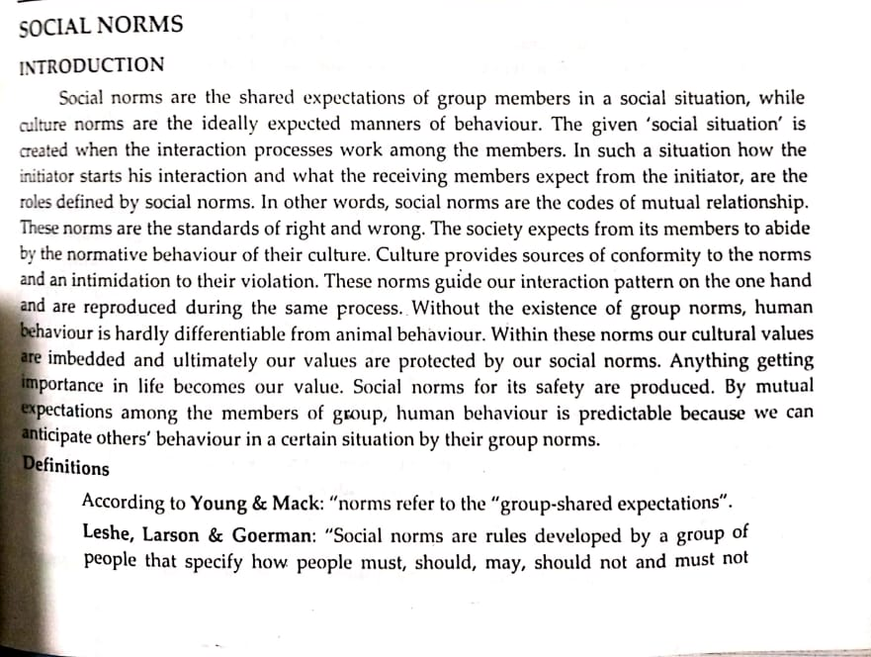

Slide 10
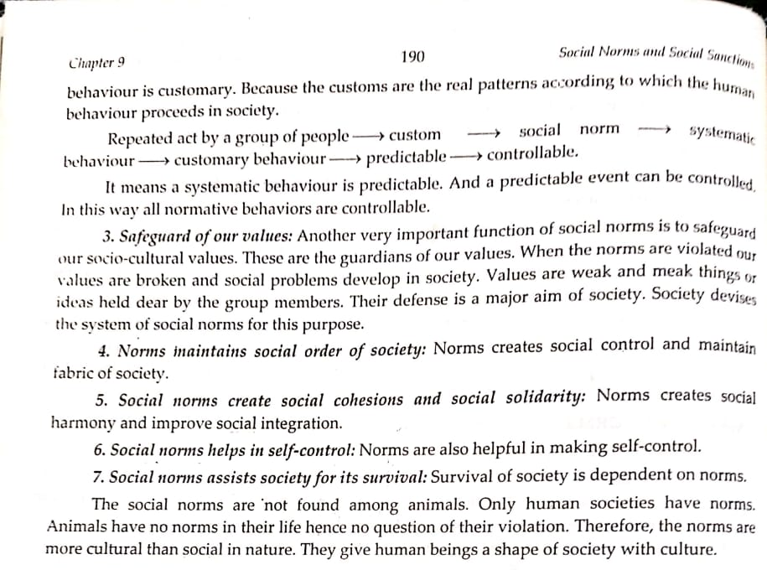

Slide 11
Thank You

