Slide 1
Enterprise Architecture & Integration A General Overview
Topic:
Lecture 1

Slide 3
What is enterprise architecture?
A method for managing your business or enterprise:
A decision making tool
A change management tool
The knowledgebase of your business or enterprise

Slide 4
Scope of Enterprise Architecture?
The scope of enterprise architecture includes the enterprise’s
People,
Processes,
Information,
Technology,
their relationships to each other,
And the external environment

Slide 5
Who is Enterprise Architect?
Enterprise architects are the people who:
create the solutions to address the business challenges
and support the enterprise in implementing those solutions.

Slide 6
Enterprise architecture is not…
Focused on Information Technology
(IT is only a part or subset of enterprise architecture)

Slide 7
In the Information Age…
How do you manage the increasing complexity of your enterprise?
How do you manage the increasing rate of change?
How do you meet the demands of your customers quicker and more efficiently?
Notes:
A Governor candidate runs on the platform “I am going to transform government” or “I am going to make government more citizen friendly”
How do you meet the demands with decreasing budgets

Slide 8
In the Information Age…
When someone leaves your enterprise, do you retain their knowledge?
For Example:
As of 1/4 the state of Montana has 35% of its workforce eligible for retirement
551 employees with 30+ years
An additional 3,444 employees with 25 – 30 years

Slide 9
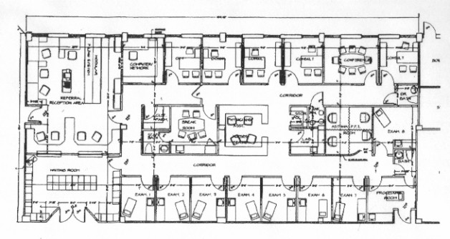
Thousands of years of history would suggest the only known strategy for addressing complexity and change is architecture.

Slide 10
If it gets so complex you can’t remember how it works, you have to write it down…
Architecture
Complexity
Change
If you want to change how it works, you start with what you have written down…

Slide 11
Why is Enterprise Architecture Needed?
System Complexity :
Information systems and business processes are complex and will become increasingly complex in the future.
As system complexity increases, the costs to build and maintain those systems increase and take more of an organizations resources in time, money, and personnel.

Slide 12
Why is Enterprise Architecture Needed?
Poor business alignment:
It is becoming harder for organizations to make sure that IT systems and spending are aligned with business needs
IT costs are increasing while the value they bring to an organization is decreasing if the IT and business goals are not aligned.

Slide 13
Why is Enterprise Architecture Needed?
A method for writing things down
develop blueprints
The impact of “moving a wall”
complexity and change
Plan on how to “move the wall”
change management
Retain employee knowledge
becomes knowledgebase of enterprise
If you don’t have architecture, you change by trial and error (which is high risk)

Slide 14
Why Enterprise Architecture...?
Notes:
Rationalize: attempt to explain or justify (behaviour or an attitude) with logical reasons, even if these are not appropriate.
Seamless: without any interruptions or problems. : perfect and having no flaws or errors
Lean: The core idea is to maximize customer value while minimizing waste. Simply, lean means creating more value for customers with fewer resources. applied in the context of IT, is the elimination of waste, where waste is work that adds no value to a product or service.

Slide 15
Enterprise architecture
EA gets you there(destiny) with Confidence

Slide 16
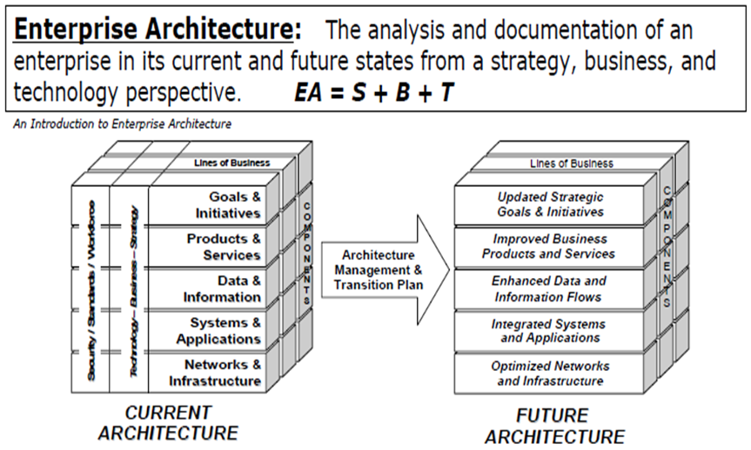
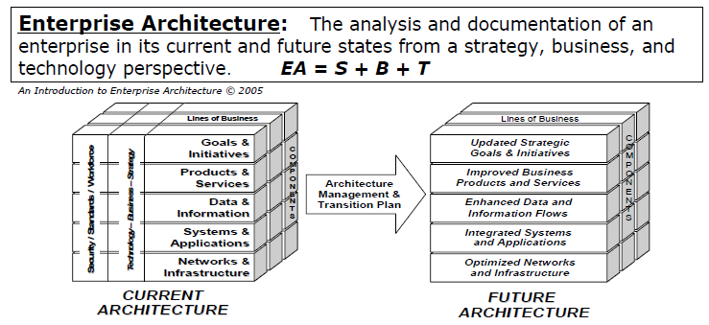
The Concept Of Enterprise Architecture

Slide 17
Scope of enterprise architecture
Current perspectives, or beliefs, with regards to the meaning of the enterprise architecture, typically fall towards one or a hybrid of three schools of thought:
Enterprise IT design – According to this school, the purpose of enterprise architecture is the greater alignment between IT and business concerns.
The main purpose of enterprise architecture is to guide the process of planning and design the Information System capabilities of an enterprise, in order to meet desired organizational objectives.

Slide 18
Scope of enterprise architecture
Enterprise integrating – According to this school, the purpose of EA is to achieve greater coherency between the various concerns of an enterprise (HR, IT, Operations, etc.) including the linking between strategy formulation and execution.
Enterprise ecological adaptation – According to this school, the purpose of enterprise architecture is to foster and maintain the learning capabilities of enterprises so that they may be sustainable. Consequently, a great deal of emphasis is put on improving the capabilities of the enterprise to improve itself, to innovate.

Slide 19
Benefits of enterprise architecture
The benefits of enterprise architecture are achieved through its direct and indirect contributions to organizational goals, in the following areas:
Organizational design - Enterprise architecture provides support in the areas related to design and re-design of the organizational structures during general organizational change.
Organizational processes and process standards - Enterprise architecture helps enforce discipline and standardization of business processes, and enable process linking, reuse and integration.
Project portfolio management - Enterprise architecture supports investment decision-making and work prioritization.
Project management - Enterprise architecture enhances the collaboration and communication between project stakeholders.

Slide 20
Benefits of enterprise architecture
Requirements Engineering - Enterprise architecture increases the speed of requirement elicitation and the accuracy of requirement definitions, through publishing of the enterprise architecture documentation.
IT management and decision making - Enterprise architecture is found to help enforce discipline and standardization of IT planning activities and to contribute to reduction in time for technology-related decision making.
IT value - Enterprise architecture helps reduce the systems implementation and operational costs, and minimize duplication of IT infrastructure services across business units.

Slide 21
Benefits of enterprise architecture
IT complexity - Enterprise architecture contributes to reduction in IT complexity, association of data and applications, and to better interoperability of the systems.
IT risk management - Enterprise architecture contributes to reduction of business risk from system failures and security breaches. Enterprise architecture helps reduce risks of project delivery.

Slide 22
Enterprise Architect
Enterprise architects are practitioners of enterprise architecture;
Enterprise architects work with stakeholders, both leadership and subject matter experts,
to build a holistic view of the organization's strategy, processes, information, and information technology assets.
The role of the enterprise architect is to take his knowledge and ensure that the business and IT are in alignment.

Slide 23
Enterprise Architect
The enterprise architect links the business mission, strategy, and processes of an organization to its IT strategy,
that show how the current and future needs of an organization will be met in an efficient, sustainable and adaptable manner.

Slide 24
Skills of Enterprise Architect
Systems thinking - the ability to see how parts interact with the whole (big picture thinking)
Knowledge of the business for which the enterprise architecture is being developed
Interpersonal and leadership skills - servant leadership, collaboration, facilitation, and negotiation skills
Communication skills, both written and spoken and ability to explain complex technical issues in a way that non-technical people may understand

Slide 25
Skills of Enterprise Architect
Knowledge of IT, governance and operations
Comprehensive knowledge of hardware, software, application, and systems engineering
Project and program management planning and organizational skills
Knowledge of financial modeling as it pertains to IT investment
Customer service orientation
Time management and prioritization

Slide 26
Repository-Based EA

Slide 27
Standalone Documents

Slide 28
Framework of EA

Slide 29
Common Repository & Framework

Slide 30
Architecture Framework
Architecture Framework Provides:
Integration
Organization
Classification
“A place for everything and everything in its place”
Knowing where to put thing
Knowing where to find them

Slide 31
Enterprise Architecture Terms

Slide 32
Key enterprise architecture terms
Primitives vs. Composites
Integration vs. Interfacing
Alignment vs. Discontinuity
Nature of Complexity

Slide 33
Primitives vs. Composites
Data elements “primitives” versus “composites”
Primitive models are architecture…modules
Composite models are implementations… integrated

Slide 34
Integration vs. Interfacing
Integration:
If you start with primitive models, integration is easy
Single source data (or integration) is optimal
Interfacing:
Data interfacing is better than nothing, but not optimal
Increases complexity
Has maintenance issues

Slide 35
Integration vs. Interfacing
Integration:
Reuse, not re-create
If you really want integration and not just interfacing, the products (systems) have to be engineered that way
Interfacing:
Prevents change
Increases costs
Interfacing is a short term strategy, not a long term solution

Slide 36
How do you achieve perfect alignment?
First, build row 1 models
Next, build row 2 models
Next, build row 3 models
Next, build row 4 models
Next, build row 5 models
Ensuring that the intent of each row is successfully represented (transformed) in the succeeding row

Slide 37
Perfect alignment in face of change?
When change happens or is needed, go back to your blueprints (models) and change them first
Transform the change through the rest of the framework
Net impact of the change will be your gap analysis
Nothing will be left out of the impact if your models are accurate

Slide 38
Discontinuity
Means lack of alignment somewhere in the framework (not following standards)
Translates to unhappy users and dissatisfied management
Any time you have duplication, you have discontinuity
Reduce discontinuity by reducing redundant systems and redundant data

Slide 39
Discontinuity
Interfacing causes discontinuity – Compensate in the short term to mix pieces
Integrating provides alignment – Reengineer to take out the discontinuity long term

Slide 40
Nature of Complexity
If there is a certain amount of complexity built into any enterprise, product or service?
Three change models for complexity without architecture
Trial and error – Just do it
Reverse engineer – Takes time and costs a lot of money
Scrap and start over
Or you can engineer the change with your architectural blueprints

Slide 41
Nature of Complexity
If you don’t deal with the complexity within the enterprise, it gets pushed to the customer

Slide 42
Lessons Learned Through EA
Goal is to isolate the change, estimate the impact, and provide a tool for managing the change for optimal success
It is a model to come up with balanced problem solving
Discontinuity in the framework causes dissatisfaction among management and customers

Slide 43
Lessons Learned Through EA
Every person (and their job function) in the organization will be on the framework somewhere

Slide 44
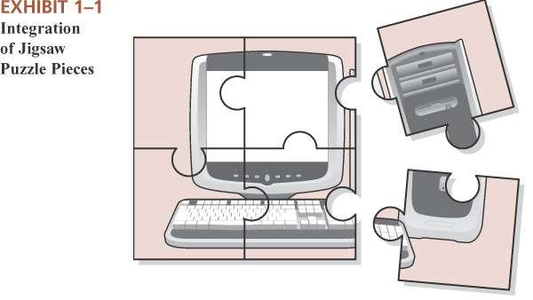
Integrated Enterprise Information Systems?
Enterprise
A business, an industrious effort, especially one directed toward making money
Information System
An Information System (IS) is a system composed of people and computers that processes or interprets information.
Integrated
Joined together, united, made into a whole by having brought all parts together

Slide 45
Enterprise Engineering
An Enterprise is a complex system of cultural, process, and technological components that interact to accomplish strategic goals.
People
Processes
Accomplish
Organizational
Goals
Technology

