Slide 1
CKD
CHORONIC KIDNEY DISEASE

Slide 2
What is CKD?
CKD is defined bythe
–presence of kidney damageor decreased kidneyfunction
–forthree or moremonths,
–irrespective of thecause.

Slide 3
What is CKD?
The persistence of the damage or decreased Function for at least three months is necessary to distinguish CKD from acute kidney disease.
Kidney damage refers to pathologic abnormalities, whether established via:
1.renal biopsy or
2.imaging studies, or
3.inferred from markers such as
a)urinary sediment abnormalities or
b)increased rates of urinary albumin excretion

Slide 4
What is CKD?
Chronic kidney disease is defined based on the presence of either kidney damage or decreased kidney function for three or more months, irrespective of cause.
Criteria:
Duration ≥3 months, based on documentation or inference
Glomerular filtration rate (GFR) <60 mL/min/1.73 m2
Kidney damage, as defined by structural abnormalities or functional abnormalities other than decreased GFR

Slide 5
Duration≥3 months, based on documentation or inference
Duration is necessary to distinguish chronic from acute kidney diseases.
1.Clinical evaluation can often suggest duration
2.Documentation of duration is usually not available in epidemiologic studies

Slide 6
Glomerular filtration rate (GFR) <60 mL/min/1.73m2
GFR is the best overall index of kidney function in health and disease.
1.The normal GFR in young adults is approximately 125 mL/min/1.73 m2; GFR <15 mL/min/1.73 m2 is defined as kidney failure
2.Decreased GFR can be detected by current estimating equations for GFR based on serum creatinine (estimated GFR) but not by serum creatinine alone
3.Decreased estimated GFR can be confirmed by measured GFR

Slide 7
Kidney damage, as defined by structural abnormalities or functional abnormalities other than decreased GFR
A) Pathologic abnormalities (examples). Cause is based on
underlying illness and pathology. Markers of kidney damage may reflect pathology.
1.Glomerular diseases (diabetes, autoimmune diseases,
systemic infections, drugs, neoplasia)
2.Vascular diseases (atherosclerosis, hypertension, ischemia, vasculitis, thrombotic micro angiopathy)
3.Tubulo interstitial diseases (urinary tract infections, stones,
obstruction, drug toxicity)
4.Cystic disease (polycystic kidney disease)

Slide 8
Kidney damage, as defined by structural abnormalities or functional abnormalities other than decreased GFR
B) History of kidney transplantation. In addition to pathologic abnormalities observed in native kidneys, common pathologic abnormalities include the following:
1.Chronic allograft nephropathy (non-specific findings of tubular atrophy, interstitial fibrosis, vascular and glomerular sclerosis)
2.Rejection
3.Drug toxicity (calcineurin inhibitors)
4.BK virus nephropathy
5.Recurrent disease (glomerular disease, oxalosis, Fabry disease)

Slide 9
Kidney damage, as defined by structural abnormalities or functional abnormalities other than decreased GFR
C) Albuminuria as a marker of kidney damage (increased glomerular permeability, urine albumin-to-creatinine ratio[ACR] >30mg/g).*
1.The normal urine ACR in young adults is <10 mg/g.
Urine ACR categories 10-29, 30-300 and >300 mg are termed "high normal, high, and very high" respectively.
Urine ACR >2200 mg/g is accompanied by signs and symptoms of nephrotic syndrome
2.Threshold value corresponds approximately to urine dipstick values of trace or1+
3.High urine ACR can be confirmed by urine albumin excretion in a timed urine collection

Slide 10
Kidney damage, as defined by structural abnormalities or functional abnormalities other than decreased GFR
D) Urinary sediment abnormalities as markers of kidney damage
1.RBC casts in proliferative glomerulo nephritis
2.WBC casts in pyelonephritis or interstitial nephritis
3.Oval fat bodies or fatty casts in diseases with proteinuria
4.Granular casts and renal tubular epithelial cells in many parenchymal diseases(non-specific)

Slide 11
Kidney damage, as defined by structural abnormalities or functional abnormalities other than decreased GFR
E) Imaging abnormalities as markers of kidney damage
(ultrasound, computed tomography and magnetic resonance imaging with or without contrast, isotope scans, angiography).
1.Polycystic kidneys
2.Hydronephrosis due to obstruction
3.Cortical scarring due to infarcts, pyelonephritis or vesico ureteral reflux
4.Renal masses or enlarged kidneys due to infiltrative diseases
5.Renal artery stenosis
6.Small and echogenic kidneys (common in later stages of CKD due to many parenchymal diseases)

Slide 12
PATHOPHYSIOLOGY OF CHRONIC KIDNEYDISEASE
Two broad sets of mechanisms of damage:
1.initiating mechanisms specific to the underlying etiology
2. a set of progressive mechanisms
-hyperfiltration and hypertrophy of the remaining viablenephrons

Slide 13
PATHOPHYSIOLOGY OF CHRONIC KIDNEYDISEASE
Increased intra renal activity of the renin-angiotensin axis appears to contribute both to:
initial adaptive hyper filtration the subsequent mal-adaptive
hypertrophy and sclerosis(TGF-β)

Slide 14
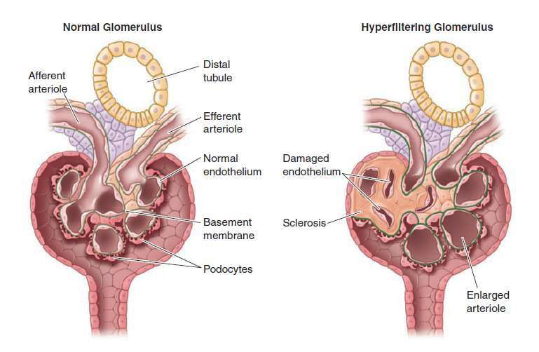
Left: Schema of the normal glomerular architecture. Right: Secondary glomerular changes

Slide 15
IDENTIFICATION OF RISK FACTORSAND STAGING OF CKD
Risk factors:
hypertension,
Diabetes mellitus,
Autoimmune disease,
Older age,
African ancestry,
a family history of renal disease,
a previous episode of acute kidney injury,
and the presence of
a. proteinuria,
b. abnormal urinary sediment , or
c. structural abnormalities of the urinary tract

Slide 16
Recommended Equations for Estimation of Glomerular Filtration Rate (GFR)Using (Serum Creatinine Concentration , Age, Sex, Race, and Body Weight)
Equation from the Modification of Diet in Renal Disease study∗(MDRD)

Slide 17
2) Cockcroft-Gaultequation

Slide 18
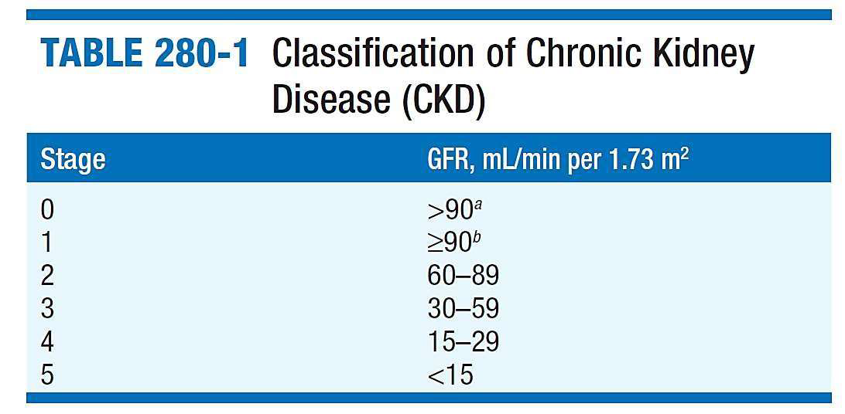

Slide 20
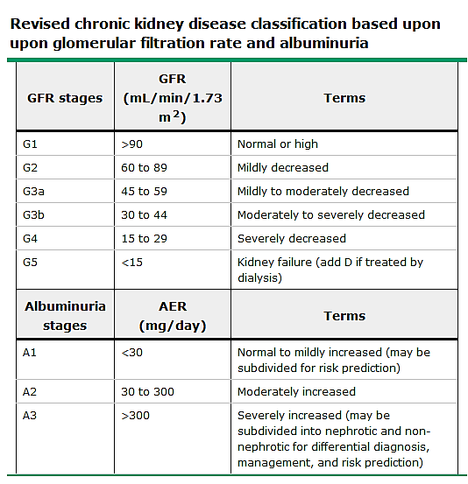

Slide 22
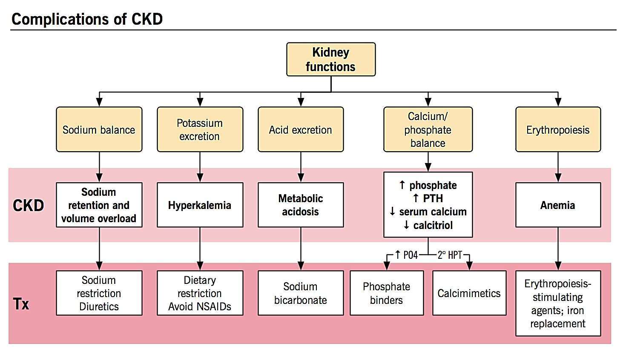

Slide 23
IDENTIFICATION OF RISK FACTORSAND STAGING OFCKD
Chronic renal damage
Persistence in the urine of >17 mg of albumin per gram of creatinine in adult males and 25 mg albumin per gram of creatinine in adult females

Slide 24
ETIOLOGY AND EPIDEMIOLOGY
Leading Categories of Etiologies of CKD∗
Diabetic glomerular disease
Glomerulonephritis
Hypertensive nephropathy
Primary glomerulopathy with hypertension
Vascular and ischemic renal disease
Autosomal dominant polycystic kidney disease
Other cystic and tubulo interstitial nephropathy

Slide 25
ETIOLOGY AND EPIDEMIOLOGY
Newly diagnosed CKD:
present with hypertension
CKD is often attributed to hypertension:
When no overt evidence for a primary glomerular or tubulo interstitial kidney disease process is present

Slide 26
ETIOLOGY AND EPIDEMIOLOGY
Two Categories:
1)patients with a silent primary glomerulopathy
2)patients in whom progressive nephrosclerosis and hypertension is the renal correlate of a systemic vasculardisease

Slide 27
Multiple Functions of Kidneys
1)Excretion of metabolic waste products and foreign chemicals
2)Regulation of water and electrolyte balances
3)Regulation of body fluid osmolality and electrolyte concentrations
4)Regulation of arterial pressure
5)Regulation of acid-base balance
6)Secretion, metabolism, and excretion of hormones
7)Gluco-neogenesis

Slide 28
PATHOPHYSIOLOGY AND BIOCHEMISTRY OF UREMIA
Elevated waste products: Hundreds of toxins, water-soluble, hydrophobic, protein-bound, charged, and uncharged compounds, guanidino compounds, urates and hippurates, products of nucleic acid metabolism, polyamines, myoinositol, phenols,benzoates and indoles
‘middlemolecules’

Slide 29
PATHOPHYSIOLOGY AND BIOCHEMISTRY OF UREMIA
A host of metabolic and endocrine functions normally performed by the kidneys is also impaired or suppressed:
anemia,
malnutrition,
and abnormal metabolism of carbohydrates, fats, and proteins

Slide 30
PATHOPHYSIOLOGY AND BIOCHEMISTRY OF UREMIA
Urinary retention, decreased degradation, or abnormal regulation of hormones
PTH, FGF-23,
insulin, glucagon,
steroid hormones including vitamin D and sex hormones,and prolactin

Slide 31
CLINICAL ANDLABORATORY MANIFESTATIONS OF CHRONIC KIDNEY DISEASE ANDUREMIA
CLINICAL ABNORMALITIES INUREMIA
1.Fluid and electrolyte disturbances
2.Endocrine-metabolic disturbances
3.Neuro muscular disturbances
4.Cardiovascular and pulmonary disturbances
5.Dermatologic disturbances
6.Gastro intestinal disturbances
7.Hematologic and immunologic disturbances

Slide 32
1.Fluid and electrolyte disturbances
a. Volume expansion(I)
b. Hypo-natremia(I)
c. Hyper-kalemia(I)
d. Hyper-phosphatemia(I)
(I) improves with an optimal program of dialysis and related therapy;
(P) persist or even progress, despite an optimal program;
(D) develops only after initiation of dialysis therapy.

Slide 33
2. Endocrine-metabolic disturbances
1.Secondary hyperparathyroidism (I or P)
2.Adynamic bone(D)
3.VitaminD–deficient osteo-malacia (I)
4.Carbohydrate resistance(I)
5.Hyperuricemia (I or P)
6.Hypertriglyceridemia (I or P)
7.Increased Lp(a) level(P)
8.Decreasedhigh-density
lipoprotein level(P)
9.Protein-energymalnutrition (I or P)
10.Impaired growth and development(P)
11.Infertility and sexual dysfunction(P)
12.Amenorrhea (I/P) 13.β2-Microglobulin
associated amyloidosis (P or D)

Slide 34
3. Neuro-muscular disturbances
1.Fatigue(I)b
2.Sleep disorders(P)
3.Headache(P)
4.Impaired mentation (I)b
5.Lethargy(I)b
6.Asterixis(I)
7.Muscularirritability
8.Peripheral neuropathy (I or P)
9.Restless legs
syndrome(I or P)
10.Myoclonus (I)
11.Seizures (I or P)
12.Coma(I)
13.Muscle cramps (P or D)
14.Dialysis disequilibrium syndrome(D)
15.Myopathy (P or D)

Slide 35
4. Cardiovascular and pulmonary disturbances
1.Arterial hypertension
(I or P)
2.Congestive heart failure or pulmonary edema(I)
3.Pericarditis(I)
4.Hypertrophic or dilated cardio myo-pathy (I, P, or D)
5.Uremic lung(I)
6.Accelerated
atherosclerosis (P or D)
7.Hypotensionand arrhythmias (D)
8.Vascular calcification
(P orD)

Slide 36
5. Dermatologic disturbances
1.Pallor (I)b
2.Hyperpigmentation (I, P, or D)
3.Pruritus(P)
4.Ecchymoses(I)
5.Nephrogenic fibrosing dermopathy (D)
6.Uremic frost(I)

Slide 37
6. Gastrointestinal disturbances
1.Anorexia(I)
2.Nausea and vomiting(I)
3.Gastroenteritis (I)
4.Peptic ulcer (I orP)
5.Gastrointestinal bleeding (I, P, orD)
6.Idiopathic ascites(D)
7.Peritonitis(D)

Slide 38
7. Hematologic and immunologic disturbances
1.Anemia (I)b
2.Lymphocytopenia (P)
3.Bleeding diathesis (I or D)b
4.Increased susceptibility to infection
5.(I or P)
6.Leukopenia (D)
7.Thrombocytopenia(D)

Slide 39
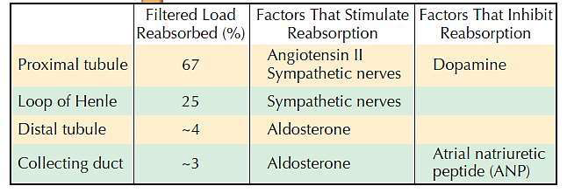
FLUID, ELECTROLYTE, AND ACID-BASE DISORDERS

Slide 40
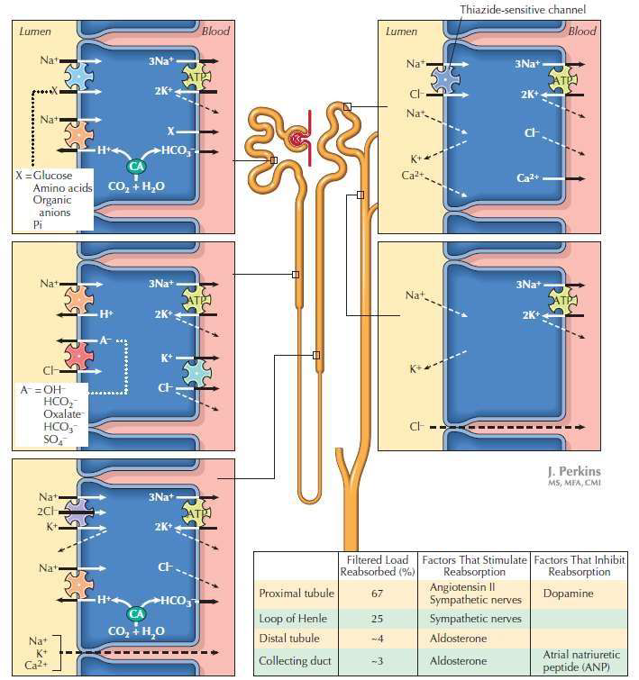

Slide 41
FLUID, ELECTROLYTE, AND ACID-BASE DISORDERS
Hypo-natremia –water restriction
ECFV – salt restriction
Thiazide : Little activity in CKD stage 3 and higher and Loop Diuretics are needed in higher doses
Metolazone : is combined with loop diuretics , which inhibits the sodium chloride co transporter in the distil convoluted tubule can help in the renal salt removal
S O D I U M

Slide 43
FLUID, ELECTROLYTE, AND ACID-BASE DISORDERS
HYPERKALEMIA
Precipitated by
increased dietary potassium intake,
protein catabolism,
hemolysis,
hemorrhage,
transfusion of stored red blood cells,
and metabolic acidosis
Medications

Slide 44
FLUID, ELECTROLYTE, AND ACID-BASE DISORDERS
Hypo-kalemia:
Not common in CKD
reduced dietary potassium intake
GI losses
Diuretic therapy
Fanconi’s syndrome
RTA
Hereditary or acquired Tubulointerstitial disease

Slide 45
FLUID, ELECTROLYTE, AND ACID-BASE DISORDERS
Metabolic acidosis
common disturbance in advanced CKD
combination of hyper-kalemia and hyper-chloremic metabolic acidosis is often present, even at earlier stages of CKD (stages 1–3)
Treat hyper-kalemia
the pH is rarely <7.35
usually be corrected with oral sodium bicarbonate supplementation

Slide 46
FLUID, ELECTROLYTE, AND ACID-BASE DISORDERS
Renal Control of Acid-Base Balance
Secretion of H+ and Reabsorption of HCO3 by the Renal Tubules
H+ is Secreted by Secondary Active Transport in the Early Tubular Segments
Filtered HCO3 is Reabsorbed by Interaction with H+ in the Tubules
Primary Active Secretion of H+ in the Intercalated Cells of Late
Distal and Collecting Tubules
Combination of Excess H+ with Phosphate and Ammonia Buffers in the Tubule Generates “New” HCO3
Phosphate Buffer System Carries Excess H+ into the Urine and
Generates New HCO3
Excretion of Excess H+ and Generation of New HCO3 by the Ammonia Buffer System

Slide 47
FLUID, ELECTROLYTE, AND ACID-BASE DISORDERS

Slide 48
To maintain euvolemia:
Adjustments in the dietary intake of salt
and use of loop diuretics, occasionally in combination with metolazone
Hyponatremia: water restriction
Hyperkalemia
responds to dietary restriction of potassium,
avoidance of potassium supplements
use of kaliuretic diuretics
potassium-binding resins, such as calcium resonium or sodium polystyrene
The renal tubular acidosis and subsequent anion- gap metabolic acidosis
alkali supplementation, typically with sodium bicarbonate

Slide 49
DISORDERS OF CALCIUM AND PHOSPHATE METABOLISM
The principal complications of abnormalities of calcium and phosphate metabolism in CKD
occur in the skeleton and
the vascular bed,
with occasional severe involvement of extraosseous soft tissues
Bone manifestations of CKD, classified as:
associated with high bone turnover with increased PTH levels
low bone turnover with low or normal PTH levels

Slide 50
DISORDERS OF CALCIUM AND PHOSPHATE METABOLISM
The patho-physiology of secondary hyper-parathyroidism:
1. Declining GFR leads to reduced excretion of phosphate
2. increased synthesis of PTH and growth of parathyroid
gland mass
decreased levels of ionized calcium, resulting from
diminished calcitriol production by the failing kidney

Slide 51
DISORDERS OF CALCIUM AND PHOSPHATE METABOLISM
Calcium, phosphorus, and the cardiovascular system:
Hyper-phosphatemia and hyper-calcemia are associated with increased vascular calcification calcification of the media in coronary arteries and even heart valves
ingested calcium cannot be deposited in bones with low turnover osteoporosis and vascular calcification
Hyper-phosphatemia can induce a change in gene expression in vascular cells

Slide 52
DISORDERS OF CALCIUM AND PHOSPHATE METABOLISM
other complications of abnormal mineral metabolism:
Calciphylaxis (calcific uremic arteriolopathy)
Other etiologies
use of oral calcium as a phosphate binder
Warfarin

Slide 53
Sevelamer and lanthanum –non calcium containing polymers
Calcitriol exerts a direct suppressive effect on PTH secretion and also indirectly suppresses PTH secretion by raising the concentration of ionized calcium
recommended target PTH level between 150 and 300pg/mL

Slide 54
CARDIO VASCULAR ABNORMALITIES
1) Ischemic vasculardisease
The CKD-related risk factors comprise
1.anemia,
2.hyperphosphatemia,
3.hyperparathyroidism,
4.sleep apnea.
5.Generalized inflammation
Cardiac troponin levels are frequently elevated in CKD without evidence of acute ischemia.

Slide 55
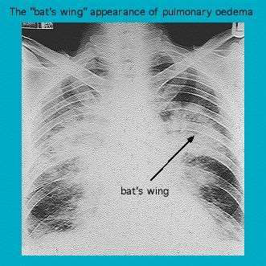
2) Heart-failure
“bat wing” distribution -form of “low-pressure” pulmonary edema

Slide 56
3) Hypertension and left ventricular hypertrophy
anemia and the placement of an arterio-venous fistula
low blood pressure actually carries a worse prognosis than does high blood pressure
Erythro-poiesis-stimulating agents

Slide 57
MANAGEMENT OF HYPERTENSION
Blood pressure should be reduced to 125/75
Salt restriction should be the first line of therapy
MANAGEMENT OF CARDIO VASCULAR DISEASE
Lifestyle changes, including regular exercise
Manage dyslipidemia

