Slide 2
CARDIOVASCULAR DISEASES

Slide 3
BY DR.MAZHAR

Slide 4
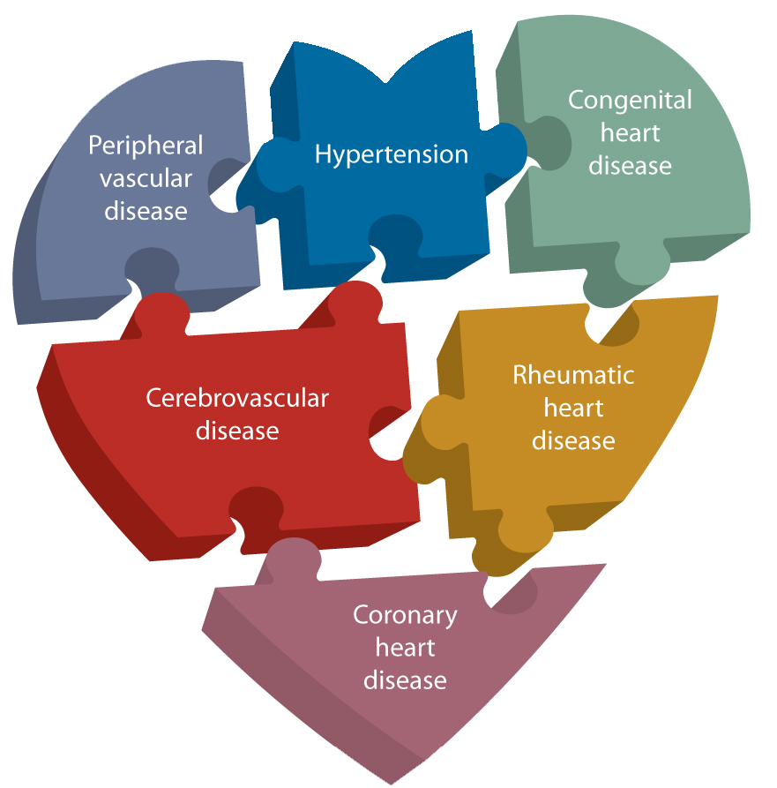
Cardiovascular diseases (CVD)
comprise of a group of diseases of the heart and
vascular system…..

Slide 5
Major conditions are
Ischemic heart disease
HTN
Stroke
Congenital heart disease
Rheumatic heart disease is an important problem in developing countries….

Slide 6
PROBLEM
STATEMENT

Slide 7
WORLD:
35million deaths non-communicable
diseases
17million CVD
More than one third of these deaths in middle
Aged adults…

Slide 8
In developed countries heart disease and stroke are 1st and 2nd leading cause of deaths for adults men and women.
These facts are familiar and hardly surprising.
However, surprisingly in some of developing countries, CVD have also become 1st and 2nd leading causes responsible for one-third of deaths.

Slide 9
Table1 shows the global estimates of mortality and burden of diseases in DALYs(disability adjusted life year) due to CVD for year 2004…

Slide 10
Table 1
Mortality and burden of disease in DALYs due to CVD ,global estimates for 2004
Region | Deaths | DALYs last (000)
AFRICA | 1,175 | 14,243
SEAR | 3,875 | 42,061
AMERICANS | 1,696 | 15,217
East Mediterranean | 1,163 | 13,095
EUROPE | 4,767 | 34,760
WESTERN PACIFIC | 4,094 | 31,759
WORLD | 17,073 | 1,51,377

Slide 11
The 4 pattern of CVD mortality at 4 different stages of epidemiological transition are shown in table 2…

Slide 12
STAGE | CVD Deaths (% of total) | Predominant CVD | Affected SEAR Population
1.Age of pestilence and famine | 5-10 | RHD ,Infectious and nutritional cardiomyopathy | Some rural areas
2.Age of receding pandemics | 10-35 | As above + HTN heart disease Hemorrhagic stroke | SEAR as a whole-rural population
3.Age of degenerative and man made diseases | 35-55 | All forms of stroke IHD at relatively young ages | Urban population
4.Age of delayed degenerative diseases | <50 | Stroke and IHD at older ages | _

Slide 13
CVDs are responsible for about 25% of DALYs lost due to non-communicable diseases in SEAR countries..
Of these IHD accounts for about 40% of DALYs lost, CVDs about 19%..
Rheumatic heart disease 6%
Inflammatory heart disease about 6%
Other conditions about 29%

Slide 14
The incidence of CVD is greater in urban areas than in rural areas………….
WHY???

Slide 15
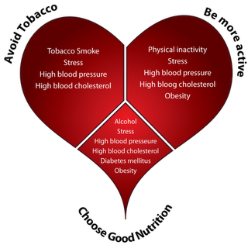
Reason is acquisition of several risk factors:
Tobacco consumption
Lack of physical activity
Unhealthy diet (today’s fast food habit)
Obesity

Slide 16
Ironically CVDs are now in decline in the industrialized countries 1st associated with them….
They seem to have crossed the peak of epidemic by now….
The decline is largely a result of the success of primary prevention and to a lesser extent, treatment….

Slide 17
The middle and low-income countries are at the mid-point of the emerging epidemic and will face its full impact in the coming years…
These countries can be benefitted from the strategy of primary prevention

Slide 18
The present mortality rates are the consequence of previous exposure to behavioural risk factors such as
Inappropriate nutrition
Insufficient physical activity
Increased tobacco
consumption
It is called the ”LAG-TIME”
effect of risk factors for CVD…

Slide 19
BIOLOGICAL FACTORS contributing principally increased risks are
Overweight
Central obesity
HTN
Dyslipidaemia
DM
Low cardio-respiratory fitness

Slide 20
It is now well established fact that a persistently high cholestrol can almost certainly precipitate a cardiac event...
Still most people do not have an idea of nutritional requirements and a balance diet…
Some of the dietary measures, on the strength of evidence on lifestyle factors and risk of developing CVD ,are summarized in table 3…

Slide 21
EVIDENCE | DECREASED RISK | NO RELATIONSHIP | INCREASED RISK
CONVINCING | Regular physical activity Linoleic acid Fish and fish oil Vegetables and fruits Potassium Low to moderate alcohol | Vitamin E supplements | Myristic and palmitic acid Trans fatty-acids High Na intake Overweight High alcohol intake
PROBABLE | @-Linolenic acid Oleic acid NSP Wholegrain cereals Nuts Plant sterols Folate | Stearic acid | Dietary cholesterol Unfiltered boiled coffee

Slide 22
EVIDENCE | DECREASED RISK | NO RELATIONSHIP | INCREASED RISK
POSSIBLE | Flavonoids Soy products |  | Fats rich in lauric acid Impaired fetal nutrition Beta-carotenes supplements
INSUFFICIENT | Calcium Magnesium Vitamin c |  | Carbohydrates Iron

Slide 23
SUMMARY:
The major CVD risk factors of tobacco use, inappropriate diet and physical inactivity explain at least 75-85% of new cases of coronary health disease….
In the absence of elevation of these risk factors ,
CHD is a rare cause of death…
Unfortunately, the vast majority of the populations in almost all countries are at risk of developing CVD because of higher than optimal levels of main risk factors…

Slide 24
ANY QUESTION??????

