Slide 1
Stroke 15
Vascular syndromes

Slide 2
Cerebral Blood Flow (CBF)
Auto regulation
Normal flow of 50 to 60 ml/100 g of brain tissue per minute.
High energy requirements and very little metabolic reserves.
Brain requires a continuous, rich perfusion of blood to deliver oxygen and glucose to the tissues.
Cerebral flow represents approximately 17 percent of available cardiac output.

Slide 3
Chemical regulation:
↑ PaCO2 or ↓PaO2 leads to Vasodilation and increased CBF.
↓ PaCO2 or ↑ PaO2 leads to vasoconstriction and decreased CBF.
A fall in pH (increased acidity) produces vasodilation, and a rise in pH (increased alkalinity) produces decrease in blood flow.
Neurogenic regulation
Metabolites
Blood pressure
ICP
Blood viscosity
Following stroke, auto regulatory mechanisms may be impaired.

Slide 4
Cerebral vascular anatomy is essential to understand the symptoms, diagnosis, and management of stroke.
Internal carotid artery
Vertebral artery (C6)
Basilar artery
Anterior cerebral artery
Middle cerebral artery
Posterior cerebral artery
Posterior communicating artery
Anterior communicating artery
Superior cerebellar artery
Inferior cerebellar artery
Anterior inferior cerebellar artery
Posterior inferior cerebellar artery

Slide 5
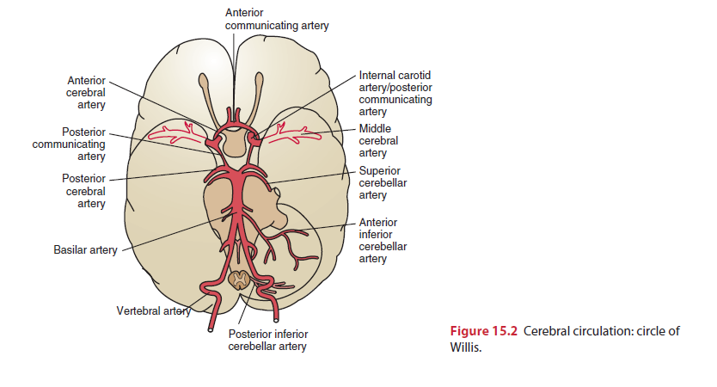

Slide 6
Vascular Syndromes
Anterior cerebral artery syndrome
Middle cerebral artery syndrome
Posterior cerebral artery syndrome
Lacunar syndromes
Internal carotid artery syndrome

Slide 7
Anterior Cerebral Artery Syndrome
It supplies the medial aspect of the cerebral hemisphere (frontal and parietal lobes) and subcortical structures, including the basal ganglia (anterior internal capsule, inferior caudate nucleus), anterior fornix, and anterior four fifths of the corpus callosum.

Slide 8
Because the anterior communicating artery allows perfusion of the proximal anterior cerebral artery from either side, occlusion proximal to this point results in minimal deficit. More distal lesions produce more significant deficits.
The most common characteristic of ACA syndrome is contralateral hemiparesis and sensory loss with greater involvement of the lower extremity because the so matotopic organization of the medial aspect of the cortex includes the functional area for the lower extremity.

Slide 9
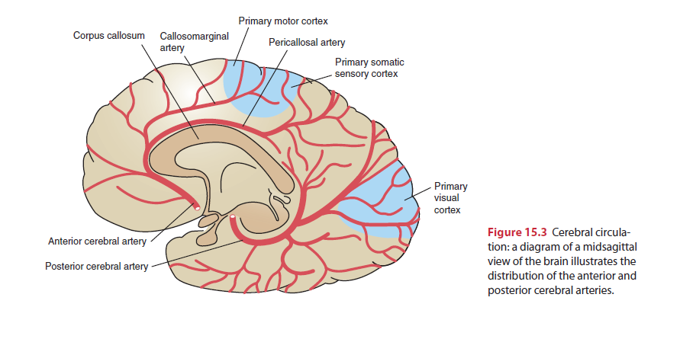

Slide 10
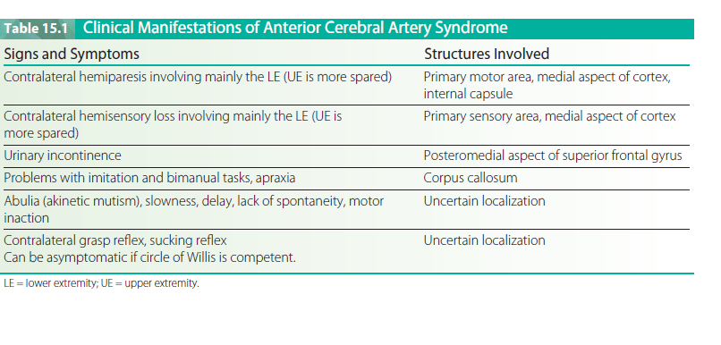

Slide 11
Middle Cerebral Artery Syndrome
Supplies the entire lateral aspect of the cerebral hemisphere (frontal, temporal, and parietal lobes) and subcortical structures, including the internal capsule (posterior portion), corona radiata, globus pallidus (outer part), most of the caudate nucleus, and the putamen.
Occlusion of the proximal MCA produces extensive neurological damage with significant cerebral edema.
Increased intracranial pressures typically lead to loss of consciousness, brain herniation, and possibly death.

Slide 12
The most common characteristics of MCA syndrome are contralateral spastic hemiparesis and sensory loss of the face, upper extremity (UE), and lower extremity (LE), with the face and UE more involved than the LE.
Lesions of the parieto-occipital cortex of the dominant hemisphere (usually the left hemisphere) typically produce aphasia.
Lesions of the right parietal lobe of the nondominant hemisphere (usually the right hemisphere) typically produce perceptual deficits (e.g., unilateral neglect, anosognosia, apraxia, and spatial disorganization).
Homonymous hemianopsia (a visual field defect) is also a common finding.
The MCA is the most common site of occlusion in stroke.

Slide 13
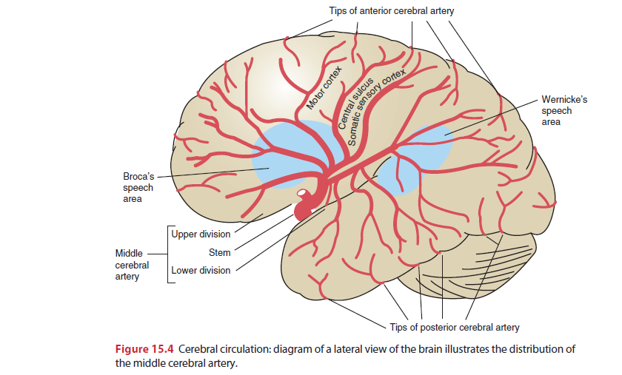

Slide 14
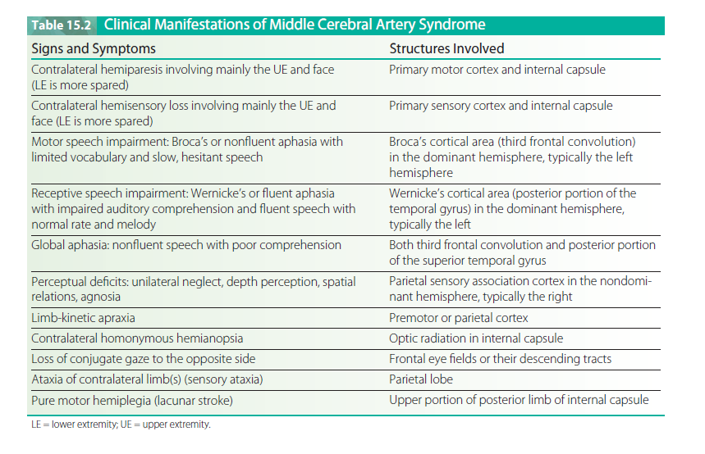

Slide 15
Posterior Cerebral Artery Syndrome
The two posterior cerebral arteries are terminal branches of the basilar artery and each supplies the corresponding occipital lobe and medial and inferior temporal lobe . It also supplies the upper brainstem, midbrain, and posterior diencephalon, including most of the thalamus.
Occlusion proximal to the posterior communicating artery typically results in minimal deficits owing to the collateral blood supply from the posterior communicating artery (similar to ACA syndrome).

Slide 16
Occlusion of thalamic branches may produce hemianesthesia (contralateral sensory loss) or central post-stroke (thalamic) pain.
Occipital infarction produces homonymous hemianopsia, visual agnosia, prosopagnosia, or, if bilateral, cortical blindness.
Temporal lobe ischemia results in amnesia (memory loss).
Involvement of subthalamic branches may involve subthalamic nucleus or its pallidal connections, producing a wide variety of deficits.
Contralateral hemiplegia occurs with involvement of the cerebral peduncle.

Slide 18
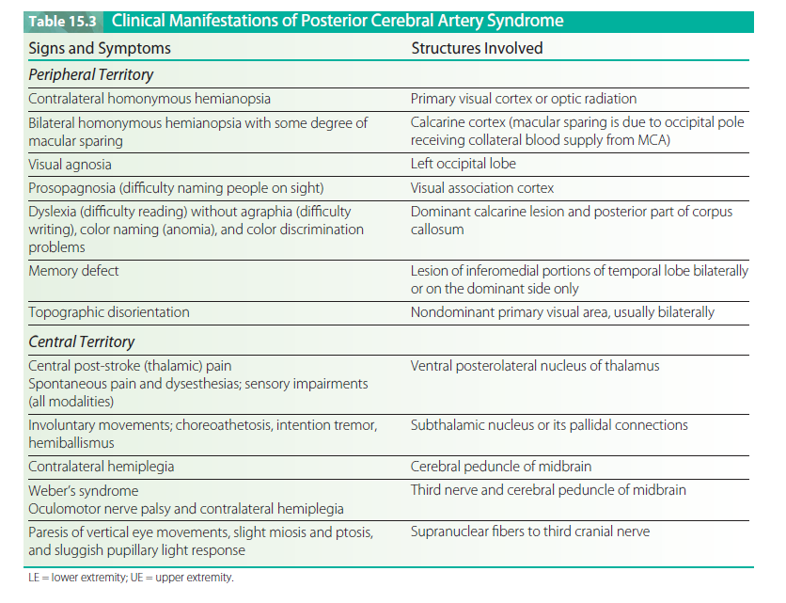

Slide 19
Internal Carotid Artery Syndrome
Occlusion of the internal carotid artery (ICA) typically produces massive infarction in the region of the brain supplied by the middle cerebral artery.
The ICA supplies both the MCA and the ACA.
If collateral circulation to the ACA from the circle of Willis is absent, extensive cerebral infarction in the areas of both the ACA and MCA can occur.
Significant edema is common with possible uncal herniation, coma, and death (mass effect).

Slide 20
Vertebrobasilar Artery Syndrome
The vertebral arteries arise from the subclavian arteries and travel into the brain along the medulla where they merge at the inferior border of the pons to form the basilar artery.
The vertebral arteries supply the cerebellum (via posterior inferior cerebellar arteries) and the medulla (via the medullary arteries).
The basilar artery supplies the pons (via pontine arteries), the internal ear (via labyrinthine arteries), and the cerebellum (via the anterior inferior and superior cerebellar arteries).
The basilar artery then terminates at the upper border of the pons giving rise to the two posterior cerebral arteries

Slide 21
Occlusions of the vertebrobasilar system can produce a wide variety of symptoms with both ipsilateral and contralateral signs, because some of the tracts in the brainstem will have crossed and others will not.
Numerous cerebellar and cranial nerve abnormalities also are present.
Locked-in syndrome (LIS) occurs with basilar artery thrombosis and bilateral infarction of the ventral pons. LIS is a catastrophic event with sudden onset.

Slide 22
Patients develop acute hemiparesis rapidly progressing to tetraplegia and lower bulbar paralysis (CN V through XII are involved).
Initially the patient is dysarthric and dysphonic but rapidly progresses to mutism (anarthria).
consciousness and sensation is preserved thus the patient cannot move or speak but remains alert and oriented.
Horizontal eye movements are impaired but vertical eye movements and blinking remain intact. Communication can be established via these eye movements.
Mortality rates are high (59 percent), and the survivers are left with severe impairments associated with brainstem injury.
Extracranial injuries to the vertebral arteries as they travel through the cervical spine can also produce vertebro-basilar signs and symptoms.
Forceful neck motions (e.g., whiplash or aggressive neck manipulations) are among the more common types of injuries.

Slide 23
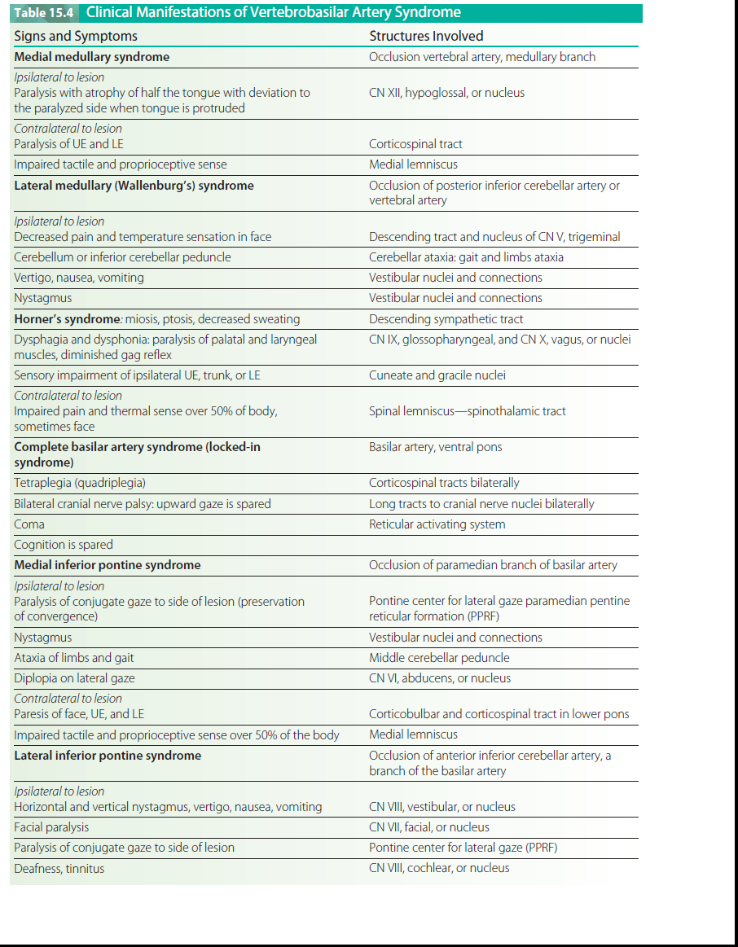

Slide 24
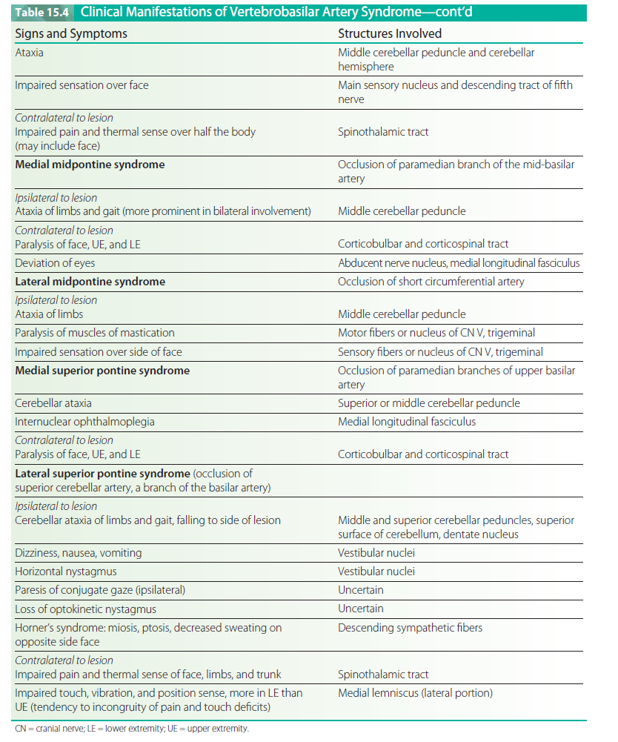

Slide 25
Lacunar Syndromes
Caused by small vessel disease deep in the cerebral white mater (penetrating artery disease).
Associated with hypertensive hemorrhage and diabetic microvascular disease.
Consistent with specific anatomic sites.
Pure motor lacunar stroke is associated with involvement of the posterior limb of the internal capsule, pons, and pyramids.
Pure sensory lacunar stroke is associated with involvement of the ventrolateral thalamus or thalamocortical projections.

Slide 26
Dysarthria/ clumsy hand syndrome (involving the base of the pons, genu of anterior limb or the internal capsule)
Ataxic hemiparesis (involving the pons, genu of internal capsule, corona radiata, or cerebellum), sensory/motor stroke (involving the junction of the internal capsule and thalamus), or
Dystonia/involuntary movements (choreoathetosis with lacunar infarction of the putamen or globus pallidus; hemiballismus with involvement of the subthalamic nucleus).
Deficits in consciousness, language, or visual fields are not seen in lacunar strokes as the higher cortical areas are preserved.
A hypertensive hemorrhage affecting the thalamus can also produce central post-stroke pain.

Slide 27
Thanks!

