Slide 1
Evidence Based Physical Therapy
What constitutes evidence

Slide 2
four important types of clinical question
Questions about the effects of
Intervention
Experiences
Prognosis
Diagnostic tests

Slide 3
What constitutes evidence about effects of interventions?
Clinical Observations
Theories about Mechanism
Clinical Research
Case series
Clinical trials
Non-randomized
Randomized

Slide 4
Placebo effect
The beneficial effect in a patient following a particular treatment that arises from the patient's expectations concerning the treatment rather than from the treatment itself.
A cure in mind.
placebo effect happens when you decide a therapy will make you better and your belief makes it so

Slide 5
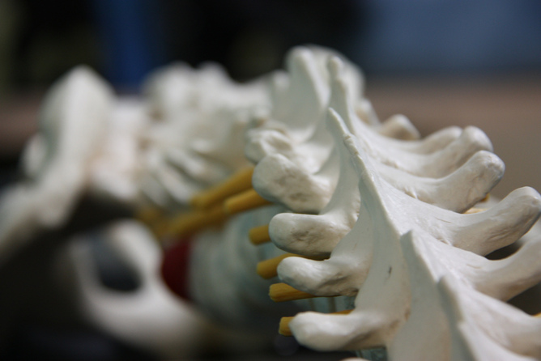

Slide 6
Case Series
Assessing patient with condition of interest
Application of intervention
Measuring outcomes/
If , On average, pt’s improves Intervention is effective

Slide 7
Case Series
Simple studies
Systematic recording of normal clinical practice
Involving accumulation of clinical observations
Prone to biasness b/c of extraneous factors
natural recovery
Statistical regression
placebo effects
polite patients

Slide 8
What you think .. Does case series studies/research provide a strong evidence regarding effects of intervention ???
weak evidence about the effects of intervention

Slide 9
One step ahead
Comparing subjects who do and don’t receive treatment
To check for better outcomes in those who receive treatment.
Better control of bias than case series
Control trials
Both groups face similar extraneous factors
Difference in outcome is credited to intervention rather…..

Slide 10
One group receives intervention and the other
group receives no intervention.
One group receives standard intervention and the other group receives standard intervention plus a new intervention.

Slide 11
A new problem..Are both group comparable?
when the groups are not comparable, differences between outcomes of the two groups cannot be assumed to reflect solely the effects of intervention.
This is called ‘allocation bias’
Controlled trials in which subjects self-select groups are particularly prone to allocation bias

Slide 12
Certain characteristics
Statistical procedures
What are /may be prognostic variables?
Approach of attempting to match groups of patients
is generally unsatisfactory because we can never be
satisfied that this will produce groups that are
comparable in all important respects
Randomization
Control allocation bias

Slide 13
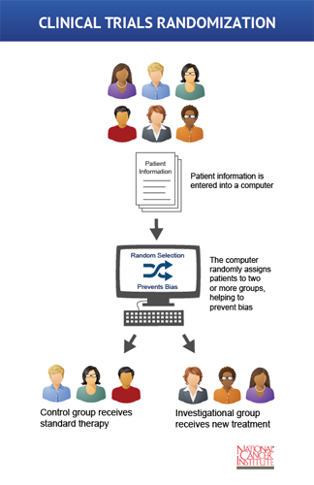

Slide 14
Randomized trials
Intervention or control group.
Computer based random process allocates into two above said groups.
After randomization we think that each group is comparable (preventing allocation bias).
We expect to get similar outcomes from whole group if all members get similar treatment.

Slide 15
While randomization ensures groups will be comparable, it does not ensure that they will be identical.
There will always be small random differences between groups, which means that randomized trials may underestimate or overestimate the true effects of intervention.
it is possible to determine how much uncertainty is associated with estimates of the size of the effects of intervention

Slide 16
Randomized vs. non-randomized
In book example of shockwave therapy impressive results in non randomized study but subsequent randomized trials neglect previous findings.
Randomized trials are usually be less biased than non-randomized trials.
The situation isn’t always same sometimes both show similar result.

Slide 17
Randomization produce expectation of comparable results
Randomized trials provide the only way of obtaining estimates of effects of interventions that can be expected to be unbiased

Slide 18
Randomized trials Simple design & Factorial trials…
Control | Trial
Control group | Trial group | Trial group

Slide 19
Factorial trials… (effects of more than 01 intervention)
van der Heijden et al (1999) randomized subjects with painful shoulders to receive either interferential or sham interferential therapy and ultrasound or sham ultrasound therapy.
This made it possible to assess the effects of both interferential therapy and ultrasound , and the combination of both in one trial.

Slide 20
Crossover trials & cluster randomized trials
In randomized crossover trials, all subjects receive both the treatment and control conditions in random order.
How one can prevent allocation bias?/?
By randomization

Slide 21
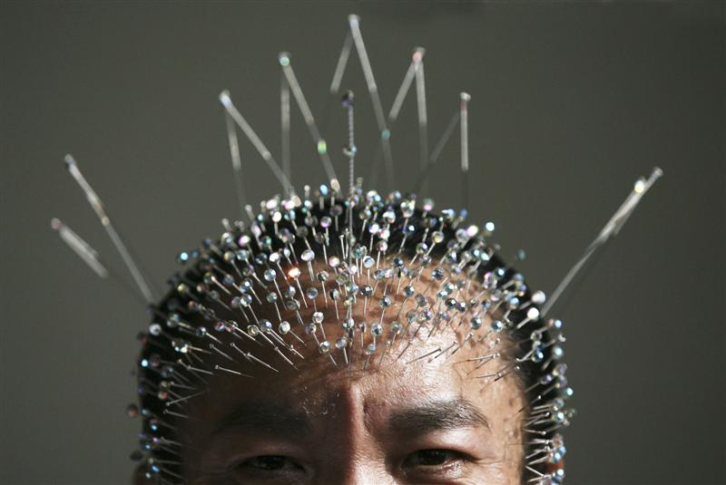

Slide 22
Types of questions?
Sources of getting information about effects of interventions.?
Clinical Research?

Slide 23
N-of-1 randomized trials
Randomized trials give us probabilistic answers about average effects of interventions: they tell us about the expectation of the effects of intervention. But most patients are uninterested in this technical point.
They want to know: ‘Will the treatment benefit me?’ Unfortunately, randomized trials cannot usually tell us what the effect of intervention will be on any individual patient.

Slide 24
Systematic Review
We are sometimes not convinced by any single study but with many researches/studies favoring or convincing any intervention.
Where available, relevant Cochrane systematic reviews often provide the best single source of information about effects of particular health interventions.

Slide 25
Meta analysis
Certain statistical procedures
May be a part of systematic or non-systematic review

Slide 26
Questions about experiences are best answered by qualitative methods.
Questions about prognosis are answered by longitudinal studies.
particular type of longitudinal study that involves observing representative samples of people with specific characteristics is called a ‘cohort’ study
cohort :a group of people with some shared characteristics
Prospective & retrospective
Cross-sectional studies for accuracy of diagnostic test

Slide 27
Finding evidence

