Slide 1
Vector Autoregressive Models (VAR)
Sadia Qamar

Slide 2
The Vector AutoRegressive (VAR) models , made famous in Chris Sims’s paper Macroeconomics and Reality, Econometrica, 1980, are one of the most applied models in the empirical economics.

Slide 3
Overview
Vector Autoregression (VAR) model is an extension of univariate autoregression model to multivariate time series data
VAR model is a multi-equation system where all the variables are treated as endogenous (dependent)
There is one equation for each variable as dependent variable. In its reduced form, the right-hand side of each equation includes lagged values of all dependent variables in the system, no contemporaneous variables

Slide 4
What is a VAR?
Every stationary univariate process has an autoregressive representation (see Wold decomposition):
Useful if the process can be modelled well using few lags, eg
must be small relative to x_{t} and be ‘well-behaved’ (eg white noise)

Slide 5
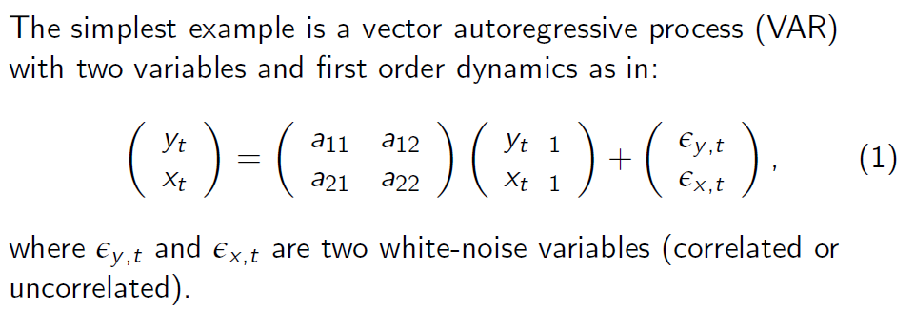
The Simplest VAR Model
Example: Bivariate VAR(1) Model with no intercepts

Slide 6
VAR Model
Example: Bivariate VAR(2) Model
Or:
y_{1t} = a₁ + b¹₁₁y_{1t-1} + b¹₁₂y_{2t-1} + b²₁₁y_{1t-2} + b²₁₂y_{2t-2} + ε_{1t}
y_{2t} = a₂ + b¹₂₁y_{1t-1} + b¹₂₂y_{2t-1} + b²₂₁y_{1t-2} + b²₂₂y_{2t-2} + ε_{2t}

Slide 7
Why do we need VAR?
Time-series data with autoregressive in nature (serially correlated)
VAR model is one of the most successful and flexible models for the analysis of multivariate time series
Especially useful for describing the dynamic behavior of economic and financial time series
Useful for forecasting

Slide 8
Applications of VAR
In economics, VAR is used to forecast macroeconomic variables, such as GDP, money supply, and unemployment
In finance, predict spot prices and future prices of securities; foreign exchange rates across markets

Slide 9
Applications of VAR
In accounting, predict different accounting variables such as sales, earnings, and accruals
In marketing, VAR can be used to evaluate the impact of different factors on consumer behavior and forecast its future change.

