Slide 1
What is CITES?
CITES is the Convention on International Trade in Endangered Species of Wild Fauna and Flora
It is also known as the Washington Convention, as it was concluded in Washington D.C.

Slide 2
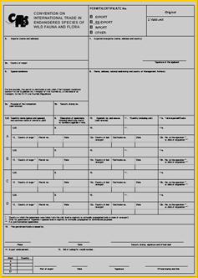
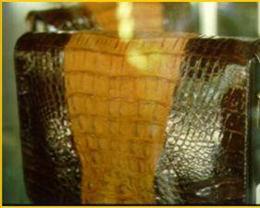
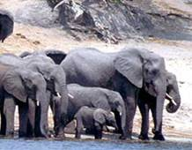
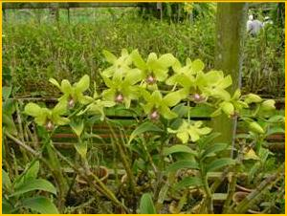
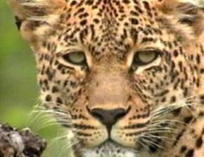
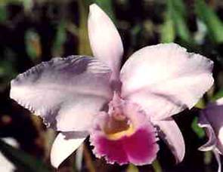
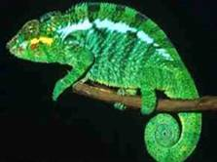
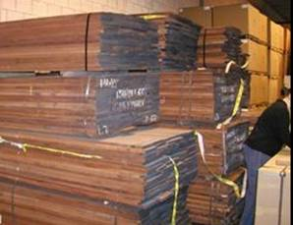
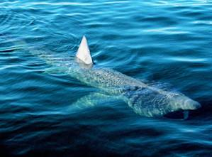
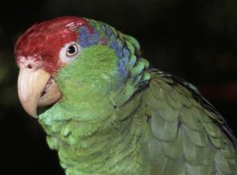
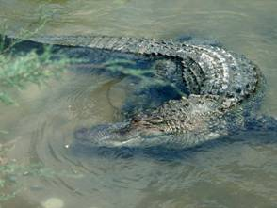
What is CITES?
CITES is an international convention that combines wildlife and trade themes with a legally binding instrument for achieving conservation and sustainable use objectives

Slide 3
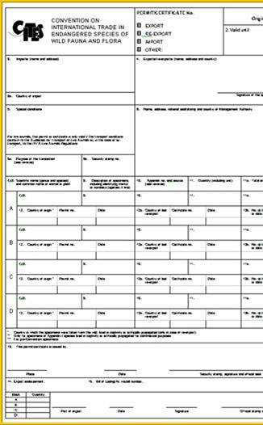
How CITES works
The Convention establishes an international legal framework with common procedural mechanisms for the prevention of international commercial trade in endangered species, and for an effective regulation of international trade in others
CITES regulates international trade on the basis of a system of permits and certificates

Slide 4
Wetlands of Pakistan
The Ramsar Convention on Wetlands
1

Slide 5
Wetlands
3
A wetland is a place where the land is covered by water, either salt, fresh or somewhere in between.
Marshes and ponds, the edge of a lake or ocean, mouth of a river, all of these are wetlands.
According to National Wetland Policy of Nepal (2003) those water bodies which are perennial and created by under- ground sources of water and or rainfalls are classified as wetlands.

Slide 6
Wetlands
4
They may be natural or man made.
Natural wetlands include rivers, streams, lakes, marshes, bogs and swamps etc.
Man-made wetlands include canals, ponds, paddy fields, fish farms etc.
They cover approximately six percent of surface area of the globe.

Slide 7
Natural
Wetland
5
Man-made Wetland

Slide 8
Valuable Functions
6
Wetlands are important source of food supply and they are biological supermarkets as they are reservoirs of plant and animal species .
They preserve bio-diversity and also are ascribed as kidneys of the landscape.
They store nutrients and are regarded as most productive ecosystems.

Slide 9
12

Slide 10
Ramsar Convention (Rc)
13
 International treaty.
 Held on 2nd Feb.1971,in Iran, Ramsar.
Purpose:-
Conservation & sustainable use of wetlands.
Stop the encroachment and loss of wetlands.
And wise use of wetlands and its resources for the benefit of mankind.
 Provide framework for National and International cooperation.

Slide 11
CONTI…
15
 The Convention uses a broad definition of wetlands.
 This includes all lakes and rivers, underground waters, swamps and marshes.

 Also include all human-made sites such as
fish ponds, rice paddies, reservoirs and salt pans.

Slide 12
Classification Of Wetlands
16
Inland wetlands
Marshes

Slide 13
CONTI…
17
Swamps
Rivers

Slide 14
CONTI…
18
Mangroves
Bogs

Slide 15
CONTI…
19
Coastal Wetlands

Slide 16
Human-made Wetlands
20
 Rice Paddy  Fish Ponds

Slide 17
Wetland Inventories Of
21
Pakistan
 USA’s fish and wildlife service (USFWS) has developed a
scheme of classification of the national wetlands inventory.
 According to this 225 wetlands are present in Pakistan… i.e.
Seasonally flooded agricultural land
Ponds—farm ponds, stock ponds, small tanks
Permanent water of estuaries and deltas

Slide 18
CONTI…
22
 Significant and globally wetlands in 1976, only 9.
 Afterwards 2001, no. raised from 9-16
 According to Ramcar site, currently 19
 From these 19 wetlands 7 are situated in Sindh province

Slide 19
23
Wetland Complexes of Pakistan

Slide 20
Wetland Complexes of
Pakistan
 The four major wetland complexes have been demarcated in Pakistan.
the North Western Alpine wetland complex.
the wetland complex of Salt Range.
the wetland complex of Central Indus Plain.
the wetland complex of Makran Coast.

Slide 21
Wetland Complexes of
Pakistan

Slide 22
The North Western Alpine
Wetland Complex
 Comprising an area of about 1760 sq km, 70 km long and 23 km wide.
 This important complex is situated in the upper Yarkhun River Valley at elevations ranging from 3,000 to 4,200 meters.
 It consists of a few of the highest wetlands on the globe that are biologically active.

Slide 23
Wetland Complexes of Pakistan
\\

Slide 24
The Wetland Complex Of
Salt Range
 The entire complex is 175 km long and runs from Jehlum in the east to Kalabagh in the west.
 Uchali wetland complex comprising Khabeki and Jahlar is of international importance recognized by RC Bureau.

Slide 25
The Wetland Complex Of
Salt Range
Sr
Name
Location Province
Location District
Status
1
Kallar Kahar
Punjab
Chakwal
Wild life sanctuary
2
Khabheki
Punjab
Khushab
Wild life sanctuary
3
Ucchali
Punjab
Khushab
Ramsar site
4
Jahlar
Punjab
Khushab
Not
protected
5
Namal lake
Punjab
Khushab
Wild life
sanctuary

Slide 26
The Wetland Complex Of
Central Indus Plain:
 Extending among the Chashma in the North and Sukkur city in the south, this complex lies along the main stem of Indus River.
 It includes various braided streams and oxbow lakes.
 It is 708 km long and 9-23 km wide and occupies an area of 9,700 km.
 Being home of Pakistan’s famous Indus Dolphin, the region depicts a picture of exhaustive use of resource to meet up survival oriented requirements of the people.

Slide 27
The Wetland Complex Of
Central Indus Plain:
Sr
Name
Location
Province
Location
District
Status
1
Akara Dam
Balochistan
Makran
Not Protected
2
Astola Island
Balochistan
Makran
Wild life sanctuary
3
Astola sea mount
Balochistan
Makran
Not Protected
4
Jiwany
Eustary
Balochistan
Makran
Not Protected
5
Kalmat Khor
Balochistan
Makran
Not Protected

Slide 28
The Wetland Complex Of
Makran Coast
 Astola island and Jiwani coastal wetlands are recognized as wetlands of international value.
 Astola island also known as Haft Talar is situated in south of the desert coast of Balochistan, and spreads over 5,000 hectors and 6 km in length.
 It is the most significant island in the north of Arabian Sea, and important for endemic reptiles as green turtles and hawksbill turtle which are the most endangered species of the island.

Slide 29
36
Wetland Degradation And Loss

Slide 30
Rate And Extent Of Wetland
Loss
 56% to 65% of existing wetland has been converted to intensive agricultural use in Europe and North America,
 27% in Asia,
 The rivers of Pakistan, has been regulated to a great extent
by constructing headwork, barrages and dams.

Slide 31
Rate And Extent Of Wetland
47
Loss
 Expansion of settlements, urbanization, drainage for agriculture, hunting and pollution appeared to be the top five major threats in the region.
 It has also been brought into the notice that aquatic weed invasions influence about 182,118 hectors of wetlands in Pakistan and badly affect the fish output (Gopal & Wetzel, 1995).

Slide 32
49
Sustainable Development And Management Of Wetlands In Pakistan

Slide 33
CONTI…
WWF Pakistan has established a wetland centre located in west of Karachi, are aimed to
 Conserve the wetlands of Pakistan,
 Identify the wetland complexes,enhance biodiversity
 Create awareness among the people
 Prepare and implement national wetland conservation strategies

Slide 34
Wetlands Of Pakistan

