Slide 1
Niacin

Slide 2
PROPERTIES
Niacin is a white crystalline substance. It is soluble in water & ethyl alcohol but is less soluble in ether & benzene. It is stable in air & heat. Nicotinamide, when pure, occurs as white needle like crystals.

Slide 3
STRUCTURE
Niacin (C6H5O2N) is simplest of all the known vitamins. It is pyridine derivative.

Slide 4
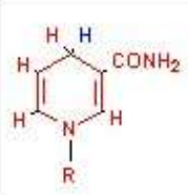
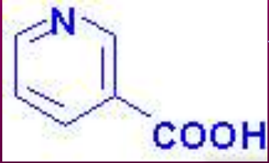
Nicotinamide (animal form) (reduced form)
Nicotinic Acid (Plant form)

Slide 5
CHEMISTRY
Precursor : Dietary tryptophan
The coenzymes of Niacin (NAD⁺ & NADP⁺)
can be synthesized by the essential amino acid tryptophan.
The term “Niacin” is used for Nicotinic acid.
The amide form of Niacin is known as niacinamide or nicotinamide.
The conversion of Niacin to niacinamide takes place in the kidney, brain slices and liver slices.

Slide 6
The conversion of tryptophan to nicotinic acid in the body takes place through a series of intermediate steps, which are represented below:
Tryptophan → Kynurenine → 3-
hydroxykynurenine → 3-
hydroxyanthranilic acid → …… →
Quinolinic acid → Nicotinic acid

Slide 7
Nicotinamide Adenine Dinucleotide

Slide 8
OCCURRENCE
Yeast (most abundantly)
Liver
Salmon
Red meat
Poultry
Vegetables & fruits (poor)
whole grains
Pulses & peanuts
Note: Milk & eggs contain very little or no Niacin, are good pellagra preventive foods because of their high content of Tryptophan.

Slide 9
Niacin Sources

Slide 10
RECOMMENDED DAILY ALLOWANCE (RDA)
Adult (men) 15-20 mg/day
Children 10-15mg/day
Adult (women) 13-15mg/day
NOTE : One Niacin Equivalent (NE) = 1 mg Niacin or 60 mg of Tryptophan.

Slide 11
BIOCHEMICAL FUNCTIONS
The coenzymes NAD⁺ and NADP⁺ are involved in a variety of “oxidation-reduction reactions”.
A large number of enzymes belonging to the class “oxidoreductase” are dependent on NAD⁺ or NADP⁺.
NAD⁺ and NADP⁺ participate in almost all the metabolisms (carbohydrate, lipid, protein etc).
Involved in electron transport chain to generate ATP.

Slide 12
Digestion and Absorption of Dietary Niacin
Coenzyme form in food
hydrolysis in small intestine to free vitamin
absorbed in duodenum
nicotinic acid protein bound in corn
requires alkali treatment (lime) to release niacin

Slide 13
Toxicity symptoms
Painful flush, hives, and rash (“niacin flush”)
Excessive sweating
Blurred vision
Liver damage, impaired glucose
tolerance

Slide 14
Thanks

