Slide 1
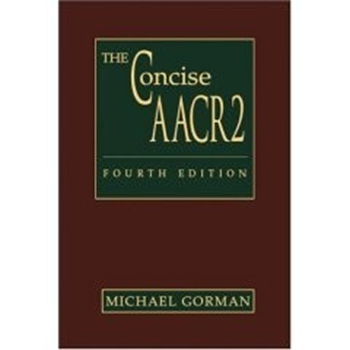
Area 3:
Special area for serials, maps, music
Rules 3A-3C2, pp. 27-30.

Slide 2
Area 3: Special area for serials, maps, music
Used for serials (i.e. magazines, journals, etc.):
Indicates numbering and year, and if the serial has ceased publication.
For maps
(ONLY if maps are the main content!):
To indicate scale and projection (Mercator, etc.).
For music:
To indicate the physical presentation (e.g. full score, miniature score, playing score).

Slide 3
An example for a map (actually, in this case 2 maps)

Slide 4
Area 4:
Publication, Distribution, etc. Area
Rules 4A-4E3, pp. 30-33.

Slide 5
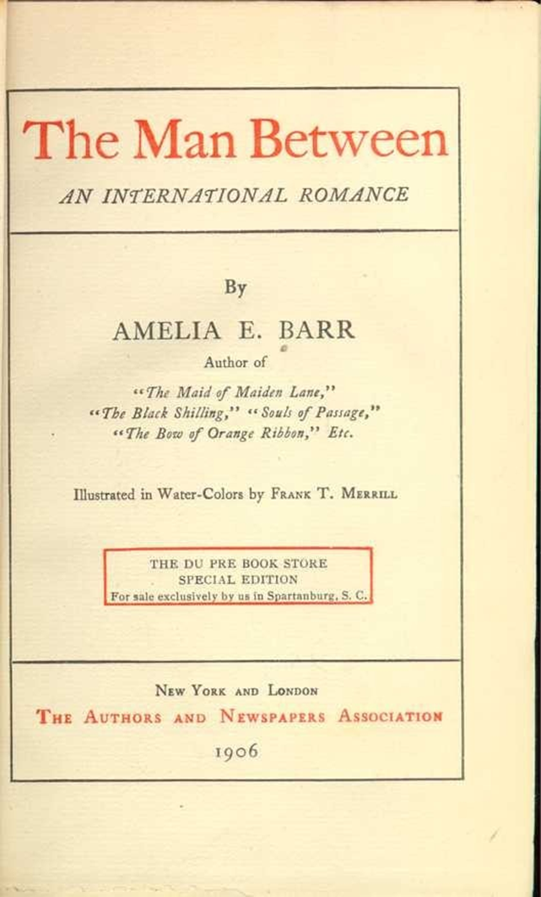
Example
The man between : an international romance / by Amelia E. Barr. -- Du Pre Book Store spec. ed. – New York ; London : The Authors and Newspapers Association, 1906.
– Note: Leave out the qualifications (“Author of , etc.”) (Rule 1F7) and the bit about “For sale exclusively, etc.” (this information might go in Notes if it’s considered important (see Rule 7A1).

Slide 6
In our simplified format

Slide 7
Area 5:
Physical Description Area
Rules 5A-5E2, pp. 34-43.

Slide 8
Area 5: Physical description (Rule 5)
Includes, where applicable:
The extent of the item (no. of volumes, no. of pages, etc)
Other physical data (color, type of illustrations, etc.)
Physical dimensions (size-generally in cm.)
Any accompanying materials (e.g. if there’s a cd that comes with a book, or a booklet with a cd, etc.)

Slide 9
Example
Edvard Grieg : the man and the artist = Edvard Grieg : mennesket og kunstneren / Finn Benestad ; Dag Schjelderup-Ebbe ; Translated by William H. Halverson and Leland B. Sateren . – Lincoln : University of Nebraska Press, 1988. -- 366 p., [1] leaf : ill., music ; 30 cm. + 1 sound disc (analog, 33 1/3 rpm, stereo. ; 7 in.).
A leaf is a page with print on one side only (in this case, there is one, and it is not numbered).
[This is partially a fictitious example: the English translation of the Norwegian original did not include the recording]

Slide 10
Example

Slide 11
Area 6:
Series Area
Rules 6A-6F, pp. 43-45.

Slide 12
Area 6: (Series information)
What is a Series?
According to the glossary of AACR2 a series is: “A group of separate items related to one another by the fact that each item bears, in addition to its own title proper, a collective title applying to the group as a whole.”
Series are titles used to group together items with similar characteristics. They might have in common a subject (history of monasteries in France), a format (reprints), a genre (poetry), or merely common publishing characteristics

Slide 13
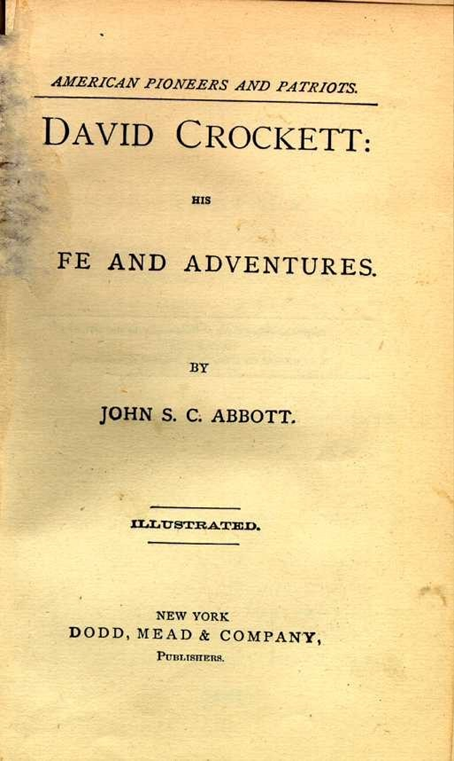
Example
David Crockett : his life and adventures / by John S. C. Abbott. – New York : Dodd, Mead, 1874. – viii, [7]-350 p. front., plates. 19 cm. – (American Pioneers and Patriots).
front.=frontispiece

Slide 14
Example

Slide 15
Area 7:
Note Area
Rules 7A-7B17, pp. 46-55.

Slide 16
Area 7: Note area
Why notes?
Several notes may be included in a cataloging record, not necessarily to further describe the item physically, but to indicate further details that might be helpful in identifying the item, or information of interest

Slide 17
Commonest uses for notes
To indicate that the item includes bibliography, index etc. (Rule 7B14)
To provide a summary of the content of a book (especially for children’s books) (Rule 7B13)
To provide information about the grade level, reading level, etc. (Rule 7b11)

Slide 18
Example

Slide 19
Another example for Notes

Slide 20
Area 8:
Standard Number Area
Rules 8A-8B2, pp. 55-56.

Slide 21
Area 8: Standard number
Rule:
“Give the International Standard Book Number (ISBN) or International Standard Serial Number (ISSN) or any other internationally agreed standard number of the bibliographic resource being described. Precede that number with the standards abbreviation ISBN, ISSN, etc.) and use standard hyphenation.”

Slide 22
Example

