Slide 1
EVIDENCE BASED PHYSICAL THERAPY

Slide 2
EVIDENCE BASED PRACTICE
Performing purposefully to obtain outcome
Practice is about making choices
Shall I perform a test?
Should I treat a patient ?
What should I treat them with ?

Slide 3
BACK PAIN
Reason
Clinical Tests
Patient Nature of
Job
Pt’s expectations
Treatment options

Slide 4
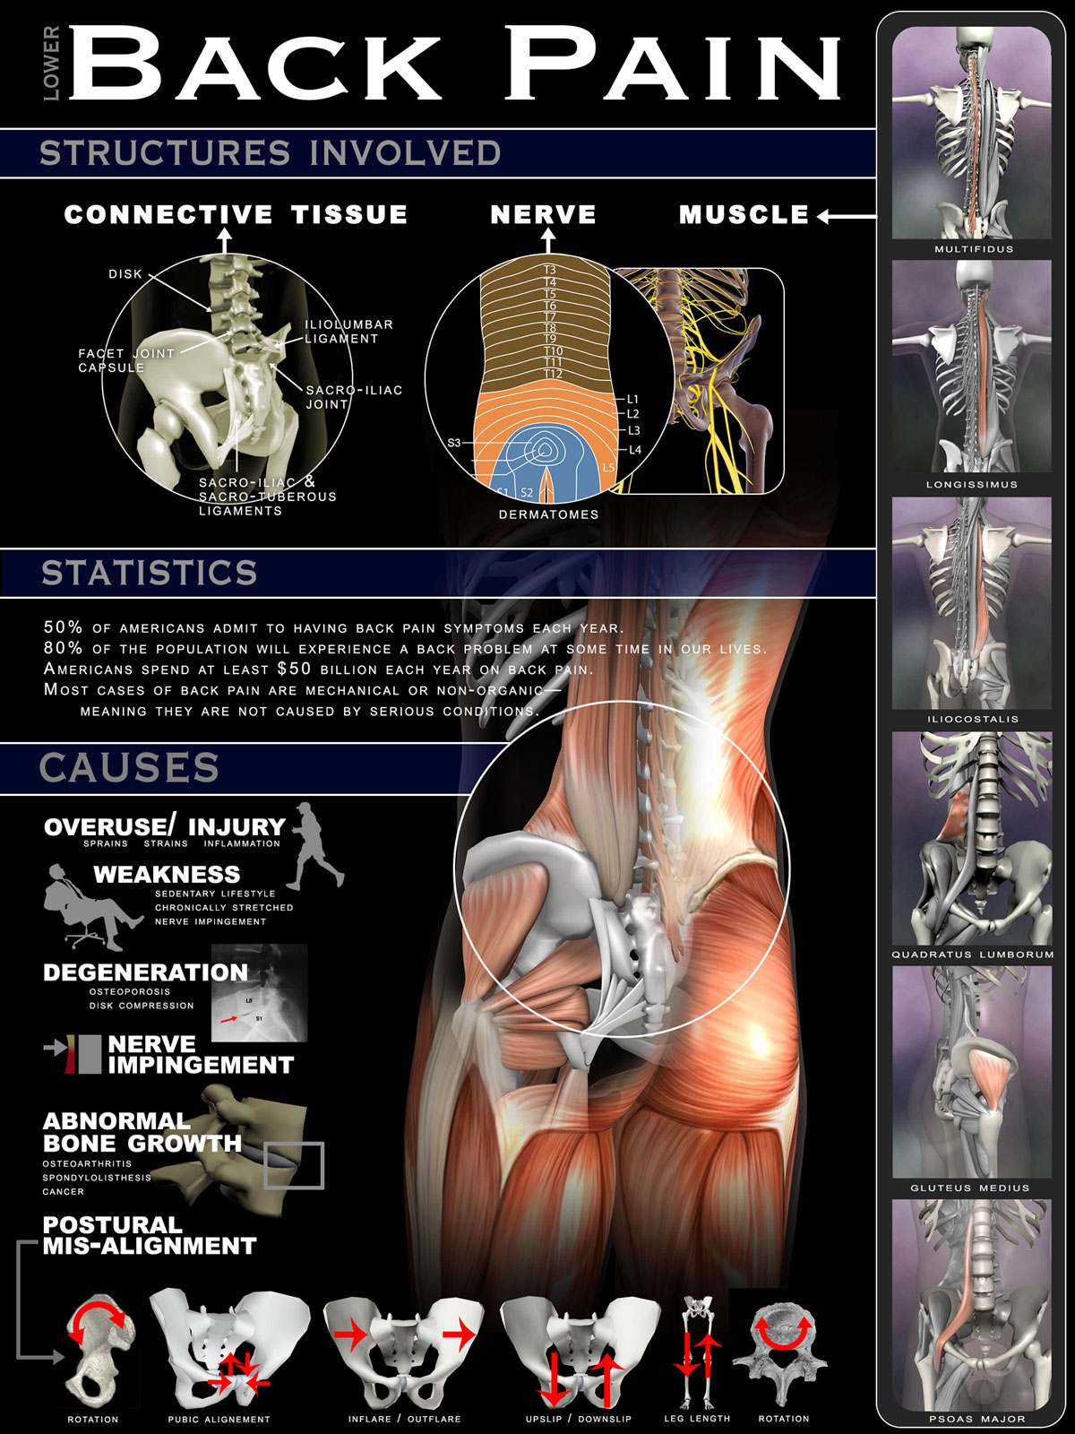

Slide 5
SCREENING

Slide 6
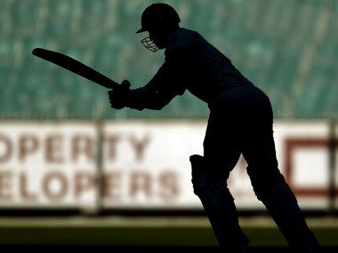
Job&Exp

Slide 7
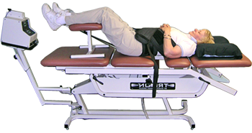
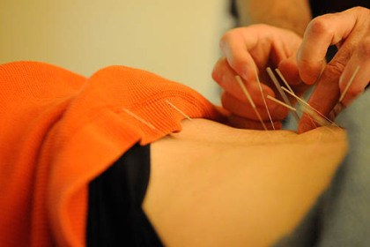
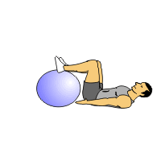
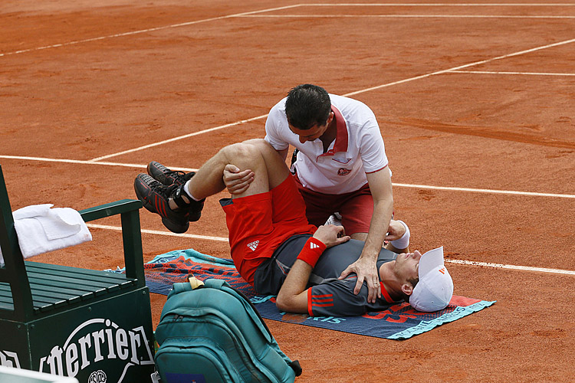
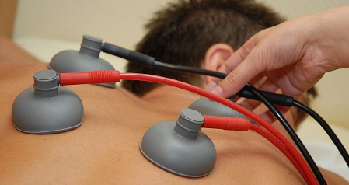
Treatment

Slide 9
PHYSICAL THERAPY WHICH IS INFORMED BY HIGH QUALITY CLINICAL RESEARCH

