Slide 1
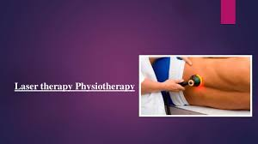
Laser therapy

Slide 2
introduction
LASER means
Light Amplification of Stimulated Emission of Radiation
It refers to the production of a beam of a radiation which differs from the ordinary light in several ways
Now a days , used in :
Laser light shows
Compact disc player
Surgical incision
Ophthalmology
Gynecology
Dermatology
Physical therapy

Slide 3
Properties of laser

Slide 4
Monochromatic
Coherence
Collimation

Slide 6
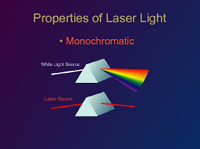
monochromaticity
Means laser light has single color
As laser are of single wavelength and thus definite frequency
Ordinary light ??

Slide 7
coherence
Coherence means_ similar or synchronous behaviour
Laser radiation are not only same wavelength but also has same phase
First , temporarily coherent, means, Photons are in same phase with crest meeting crest and troughs meeting troughs in time
Secondly, spatially coherent, means, the photons are unidirectional and stay in same phase over long distances and little spread of beam

Slide 8
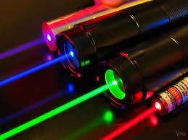
collimation
Means laser beam remain in parallel.
Do not diverge much and energy can be propagated over a larger distance

Slide 9
Production of lasers

Slide 10
Electrons as the cloud of negative charge around the nucleus
According to quantum theory electrons occupy certain energy levels around the nucleus
Under normal circumstances ,electrons of atoms remains in lowest energy levels i.e. At the resting or ground state
If enough energy is added, the electron gain energy n become negatively charge and nucleus become positively charge
Then electron tends to return to a lower energy stat. the quantum energy is expressed in electron volts
Greater the quantum energy ; lesser will be the wavelength
A large no. of atoms with the electrons in the excited state can lead to amplification since one photon release a second and these two can release more and so on.

Slide 11
Component for laser production
For the production of a laser radiation, the device must consist of the following component:
Lasing medium
Resonating chamber
Energy source

Slide 13
Lasing medium
The material which is capable of producing laser is known as lasing medium
It can absorb energy from the external source and then gives off its excess energy as photons of light
Lasing medium could be solid crystal, or semi conductor, liquid or gas.
The lasing medium in low intensity or cold laser are either helium-neon(He-Ne)
Or semiconductor, i.e. gallium-arsenide(Ga_As)

Slide 14
Resonating chamber
The resonating chamber contains the lasing medium which is surrounded by two parallel mirrors on either ends.
One of the mirror has 100% reflectance while the other has slightly less reflectance.
The mirror with slightly less reflectance serves as an output device which allows some of the photons to escape through it

Slide 15
Energy source
A flashgun is used to excite the electrons of the lasing medium.
The source of flashgun is usually current electricity

Slide 16
Types of laser

Slide 17
Various types of lasers are available now a days. The commonly used are
Ruby laser( or crystal laser)
Helium-neon laser( gas laser)
Diode laser( or semi conductor laser)

Slide 18
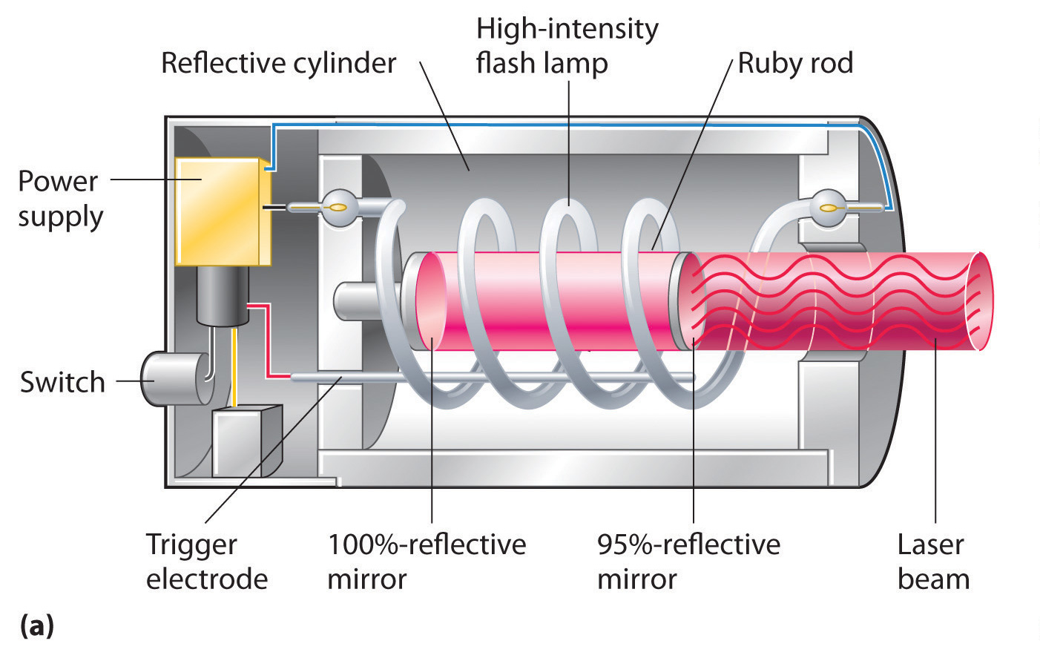

Slide 19
RUBY LASER( OR CRYSTAL LASER)
It contain synthetic laser as lasing material
Synthetic medium(aluminium oxide and chromium) are used rather than the natural one to ensure purity of the medium- ensures physical characteristics of laser
Aluminium oxide with the traces of chromium oxide forms a 10 cm long and 1 cm wide synthetic ruby rod
A helical electric discharge tube containing xenon tube is wound around the ruby rod
Both ends are made reflecting by silvering the surfaces with one end 100% reflection and other slightly less
The xenon tube is used to give intense flash of white light which excites the ruby molecules and raises the electron to a high energy levels

Slide 20
As the excited stat is unstable, the electron return to the ground by releasing a photon. This is known as spontaneous emission
The rate of supply of energy exceeds to a greater extent which leads to a large no of atoms at higher energy levels. This is known as population inversions
Atoms in their excited stat are encountered by photons and this leads to further stimulated emissions
This excited electron falls to its resting stat and gives off exactly same energy as that of photon which collide with it( photon of 694.3nm wavelength)
Hence a beam of red laser with a wavelength 694.3 nm is emitted

Slide 21
HELIUM-NEON LASER(GAS LASER)
Gas laser consist of a mixture of primary helium and neon in a low pressure tube
This low pressure tube is surrounded by flash gun which excites the atom to higher energy stat
Thus photons released by the spontaneous emission and have a wavelength of 632.8nm
These photons reflect to and fro to the tube and collide with the atoms of higher energy levels
This leads to stimulated emission with the release of similar photons
intense beam of light emerges from the narrow partially transmissive which is red in colour and has a wavelength of 632.8nm

Slide 23
DIODE LASER(OR SEMI CONDUCTOR LASER)
Gallium and arsenide are used as a diode or semiconductor to produce an infra-red invisible laser with a wavelength of 904nm
In these with an external electric potential, positively charged holes are thrown from the p type gallium-aluminium-arsenide layer into the active layer of gallium-arsenide
The negatively charged electron interact with the active layer and thus photon of light is released
The photons are reflected to and fro and emitted as a laser beam from one partially transparent end
By varying the ratio of gallium to aluminium, desired specific wavelengths are obtained.
The advantage of semi conductor laser diode is that these can either emit a continuous or pulse out put

Slide 24
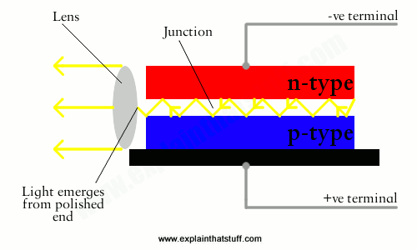

Slide 25
TECHNIQUES OF APPLICATION

Slide 26
TECHNIQUES OF APPLICATION
Methods of applications are quit simple. Generally laser energy is emitted by hand held applicator for therapeutic purposes. The gallium arsenide laser contain the semi conductor or diode element at the tip of the applicator, whereas the helium-neon laser contains their components inside the unit and delivers the laser light to the target area via a fiber optic tube. This causes the divergence of the beam
Two methods are generally used
Grid method
Scanning method

Slide 27
THE GRIDE METHOD
the treatment area is divided into a grid each of 1 cm2
the hand held applicator should be in light contact with the skin and directly perpendicular to the tissue
Each cm2 is stimulated for a specific period of time

Slide 28
THE SCANNING METHOD
No contact is made between the tip of laser and the patient’s skin
The tip of applicator is held at a distance of 5 to 10 mm
Since the divergence of beam occurs, there is decrease in the amount of energy applied as the distance

Slide 30
Dosage parameters

Slide 31
1. wavelength
Depends on lasing medium used
For superficial conditions like wounds and ulcers, visible red laser is used
For deep conditions of muscle and bone, infra red laser is used.
Cluster probe laser having several diodes are used for the larger area of soft tissues

Slide 32
2. power
The power output is measured in watts.
Since the power output used therapeutically is quit small, mW is generally used
Some times percentage of out put is generally used , i.e. 10%, 20%, or 30% of total power output

Slide 33
3. energy
The energy delivered to the treatment head is delivered to the treatment tissue is expressed in Jouls
Calculated by
Energy ( in Jouls)= Power(in watts)* Time (in seconds)
So time for specific treatment can be calculated id energy required is known

Slide 34
4. Power density
Power density decreases as the area between the tip of the applicator and the part to be treated increases
Power density is expressed as
Power density= Incident power / area in cm2
Total power used therapeutically is this calculated by inverse square law

Slide 35
5. Energy density
Calculated as
Energy density= power(W) . Time(sec) / Area(cm2)
Dosage in Laser therapy is calculated in terms of energy density applied , expressed in Jouls / cm2

Slide 36
Interaction of laser with body tissue
Used for non thermal effects
Visible rays remarkably absorbed in haemoglobin
Infra red absorbed in water
Absorption results in transfer of energy
Human body consist of 70% water,30% organic
Organic material , absorb VR , contains chromophres
Chromophores are molecular structures which get excited by the visible spectrum due to its configuration.
In human body, haemoglobin melanin contain chromophores and thus absorbs laser energy

Slide 37
Physiological effects and therapeutic uses of laser

Slide 40
Wound healing
Chemotactic activity
Vascular changes
Release of chemical mediators
Red light is effective
Increase tissue proliferation thus imp in, wounds of burns, surgical incisions, diabetic ulcers, pressure sores
Wound margins….. Dir contact 4 to 10 jouls/cm2
Wound bed noncontact…….. 1 to 5 jouls/cm2

Slide 41
Tensile strength scar tissues
Tensile strength of scar tissue treated with laser therapy is more.
Tensile strength______ increase level of collagen_________ fibroblast mediated functions______ laser
Wound treated with laser therapy_____ more epithelialisation _____ less exudate

Slide 42
Musculoskeletal conditions
Over use tendinitis
Acute conditions
Arthritic conditions

Slide 43
Pain relief
Acute
Chronic

Slide 44
Dangers and contraindications
Effects on eye
Effects on cancerous growth
Effects on pregnant uterus
Effects on infected tissue
Hemorrhagic areas or cardiac conditions-------

Slide 45
Thanks!!!!!!!!!

