Slide 1
Introduction to Genetic Material

Slide 2
The Nature of Genetic Material
Historical Background
Miescher isolated nuclei from pus (white blood cells) in 1869
Found a novel phosphorus-bearing substance = nuclein
Nuclein is mostly chromatin, a complex of DNA and chromosomal proteins
End of 19th century – DNA and RNA separated from proteins
Levene, Jacobs, et al. characterized basic composition of DNA and RNA

Slide 3
What is transformation?
Transformation is the genetic alteration of a cell resulting from the uptake, genomic incorporation, and expression of environmental genetic material (DNA).
Transformation occurs most commonly in bacteria, both naturally and artificially, and refers to DNA taken up from the environment through their cell wall.
Bacteria that are capable of being transformed are called competent.

Slide 4
The Chemical Nature of Polynucleotides
Biochemists determined the components of nucleotides during the 1940s
The component parts of DNA
Nitrogenous bases:
Adenine (A)
Guanine (G)
Cytosine (C)
Thymine (T)
Phosphoric acid
Deoxyribose sugar

Slide 5
Nucleobases of DNA and RNA
thymidine (T)
Adenine (A)
Guanine (G)
Cytosine (C)
DNA
Adenine (A)
Guanine (G)
Cytosine (C)
Uridine (U)
RNA

Slide 6
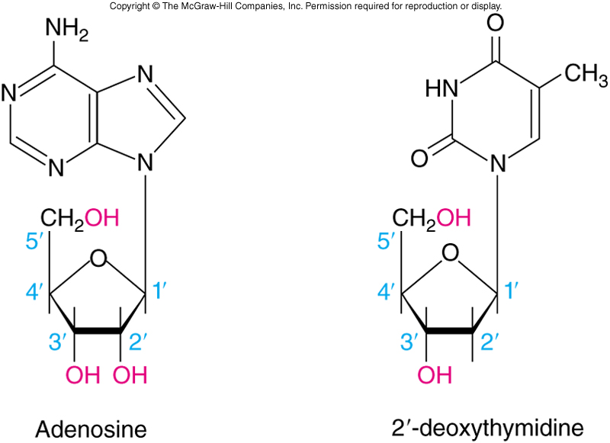
Nucleotides and Nucleosides
RNA component parts
Nitrogenous bases
Like DNA except Uracil (U) replaces Thymine
Phosphoric acid
Ribose sugar
Bases use ordinary numbers
Carbons in sugars are noted as primed numbers
Nucleotides contain phosphoric acid
Nucleosides lack the phosphoric acid

Slide 7
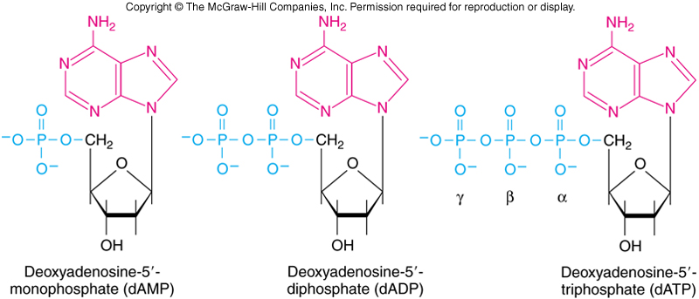
DNA Linkage
Nucleotides are nucleosides with a phosphate group attached through a phosphodiester bond
Nucleotides may contain one, two, or even three phosphate groups linked in a chain

Slide 8
DNA Structure
The Double Helix
Rosalind Franklin’s x-ray data suggested that DNA had a helical shape
The data also indicated a regular, repeating structure
DNA was believed to require an irregular sequence
Watson and Crick proposed a double helix with sugar-phosphate backbones on the outside and bases aligned to the interior

Slide 9
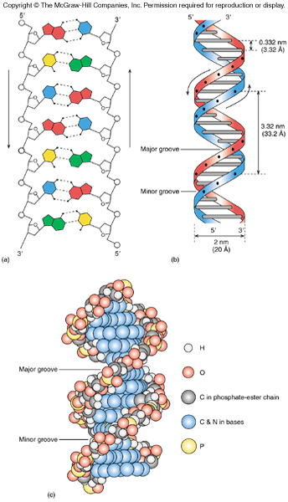
DNA Helix
Structure compared to a twisted ladder
Curving sides of the ladder represent the sugar-phosphate backbone
Ladder rungs are the base pairs
There are about 10 base pairs per turn
Arrows indicate that the two strands are antiparallel

Slide 10
Physical Chemistry of Nucleic Acids
DNA and RNA molecules can appear in several different structural variants
Changes in relative humidity will cause variation in DNA molecular structure
The twist of the DNA molecule is normally shown to be right-handed, but left-handed DNA was identified in 1979

Slide 11
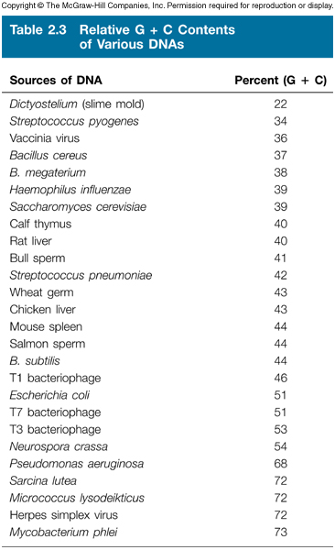
Variation in DNA between Organisms
Ratios of G to C and A to T are fixed in any specific organism
The total percentage of G + C varies over a range to 22 to 73%
Such differences are reflected in differences in physical properties

Slide 12
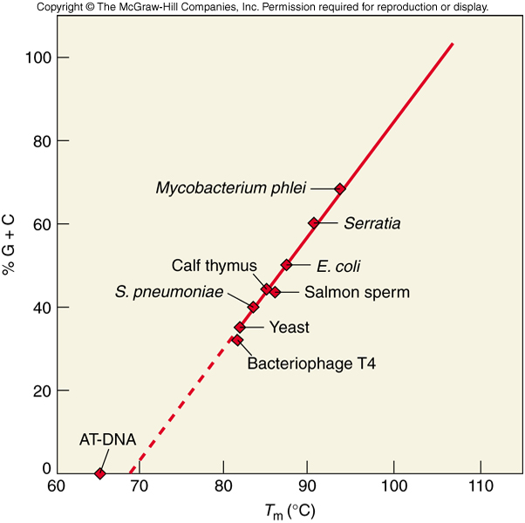
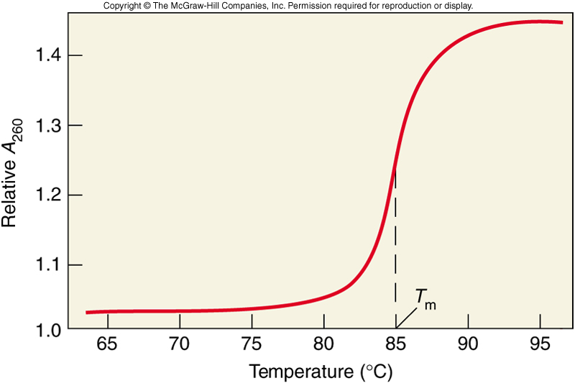
DNA Melting
With heating, noncovalent forces holding DNA strands together weaken and break
When the forces break, the two strands come apart in denaturation or melting
Temperature at which DNA strands are ½ denatured is the melting temperature or T_{m}
GC content of DNA has a significant effect on T_{m} with higher GC content meaning higher T_{m}

Slide 13
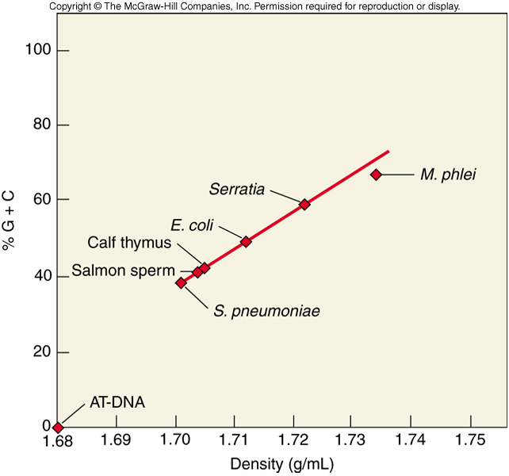
DNA Denaturation
In addition to heat, DNA can be denatured by:
Organic solvents
High pH
Low salt concentration
GC content also affects DNA density
Direct, linear relationship
Due to larger molar volume of an A-T base pair than a G-C base pair

Slide 14
DNA Renaturation
After two DNA strands separate, under proper conditions the strands can come back together
Process is called annealing or renaturation
Three most important factors:
Temperature – best at about 25 C below T_{m}
DNA Concentration – within limits higher concentration better likelihood that 2 complementary will find each other
Renaturation Time – as increase time, more annealing will occur

Slide 15
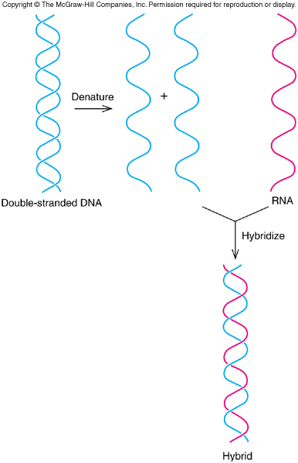
Polynucleotide Chain Hybridization
Hybridization is a process of putting together a combination of two different nucleic acids
Strands could be 1 DNA and 1 RNA
Also could be 2 DNA with complementary or nearly complementary sequences

Slide 16
PCR conditions for Full Length Template
1. 94C 30-60 s denaturation
2. 46-54C 30-90 s annealing
3. 72C 150 s elongation
4. repeat steps 1 – 3 29 times
5. 72C 15 min
6. 4-10C until subsequent processing

Slide 17
DNA Sizes
DNA size is expressed in 3 different ways:
Number of base pairs
Molecular weight – 660 is molecular weight of 1 base pair
Length – 33.2 Å per helical turn of 10.4 base pairs
Measure DNA size either using electron microscopy or gel electrophoresis

Slide 18
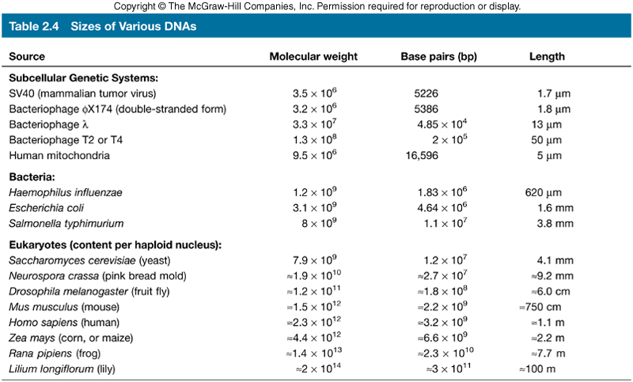
DNAs of Various Sizes and Shapes
Phage DNA is typically circular
Some DNA will be linear
Supercoiled DNA coils or wraps around itself like a twisted rubber band

Slide 19
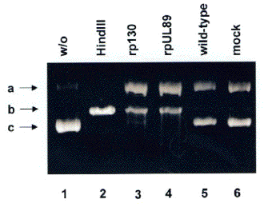
a: circular
b: linear
c: supercoiled

Slide 20
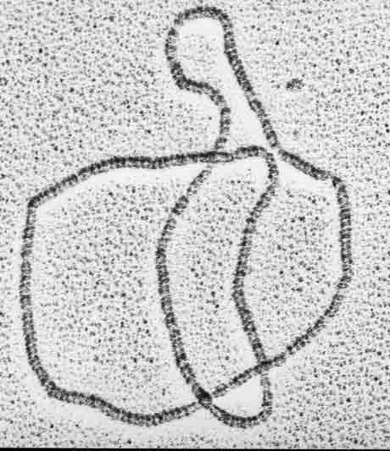
Circular DNA

Slide 21
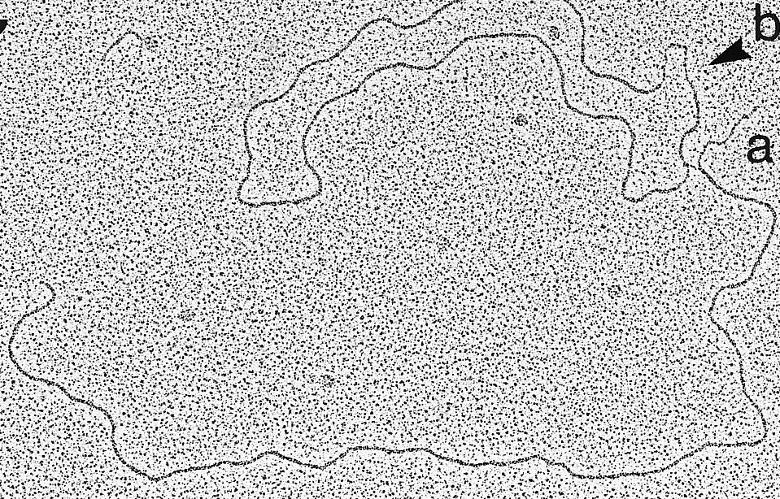
Linear DNA

Slide 22
Supercoiled DNA

Slide 23
DNA Size and Genetic Capacity
How many genes are in a piece of DNA?
Start with basic assumptions
Gene encodes protein
Protein is abut 40,000 D
How many amino acids does this represent?
Average mass of an amino acid is about 110 D
Average protein – 40,000 / 110 = 364 amino acids
Each amino acid = 3 DNA base pairs
364 amino acids requires 1092 base pairs

Slide 24
DNA Genetic Capacity
How large is an average piece of DNA?
E. coli chromosome
4.6 x 10⁶ bp/1092=
~4200 proteins
Phage λ (infects E. coli)
4.85 x 10⁴ bp/1092=
~44 proteins
Phage φx174 (one of smallest)
5375 bp/1092=
~5 proteins

Slide 25
Why does a DNA molecule consist of two strands?
Why does each base in DNA have a complementary base?

Slide 26
Protein Structure
Proteins are chain-like polymers of small subunits, amino acids
DNA has 4 different nucleotides
Proteins have 20 different amino acids with:
An amino group
A hydroxyl group
A hydrogen atom
A specific side chain

Slide 27
Protein Function
Proteins:
Provide the structure that helps give cells integrity and shape
Serve as hormones carrying signals from one cell to another
Bind and carry substances
Control the activities of genes
Serve as enzymes that catalyze hundreds of chemical reactions

Slide 28
Transcription
Transcription follows the same base-pairing rules as DNA replication
Remember U replaces T in RNA
This base-pairing pattern ensures that the RNA transcript is a faithful copy of the gene
For transcription to occur at a significant rate, its reaction is enzyme mediated
The enzyme directing transcription is called RNA polymerase

Slide 29
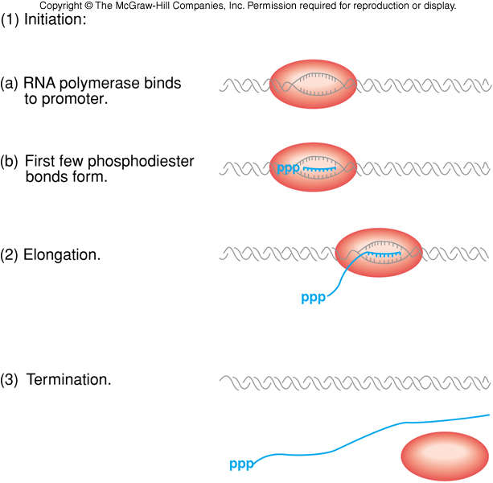
Transcription Phases
Transcription occurs in three phases:
Initiation
Elongation
Termination
Translation?

