Slide 1
Dr. Naila Farooq

Slide 2
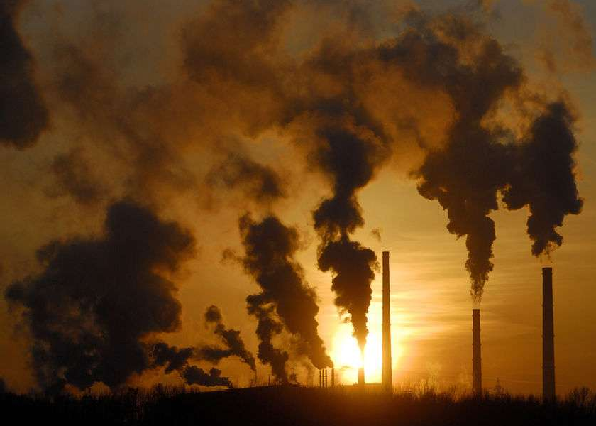

Slide 3
Over the past 10-15 years there has been growing concern over changes in the climate and the possibility that these changes are linked to human activity. Perhaps the peak in concern came during the summer of 1988 when the US experienced the worst summer in terms of heat and drought in its history. Globally, the 1980's were the warmest decade in recorded history. Atmospheric scientists are concerned that these climactic extremes are the result of a trend launched by CO2 emissions accompanying the industrial revolution. The impact of CO2 on the atmosphere has been to enhance the so-called "Greenhouse Effect." While the heavy debate that has accompanied discussions on global warming has led to as many questions as purported answers, one thing is not in question: The greenhouse effect is a real effect and is one of the firmer theories in atmospheric science.

Slide 4
Greenhouse gases are the collective chemicals that make up the Earth’s atmosphere that help keep the temperature of the Earth’s surface relatively constant. This is done by maintaining a balance between the sunlight that is reflected from the Earth’s surface and the infrared radiation that is absorbed by the greenhouse gases and trapped in our atmosphere. The process of absorption is what we refer to as the greenhouse effect.
Many gases contribute to the greenhouse
effect, some of them are naturally occurring such as water vapour, carbon dioxide, methane, nitrous oxide and ozone. Others are exclusively man-made such as chemicals from aerosols.

Slide 5
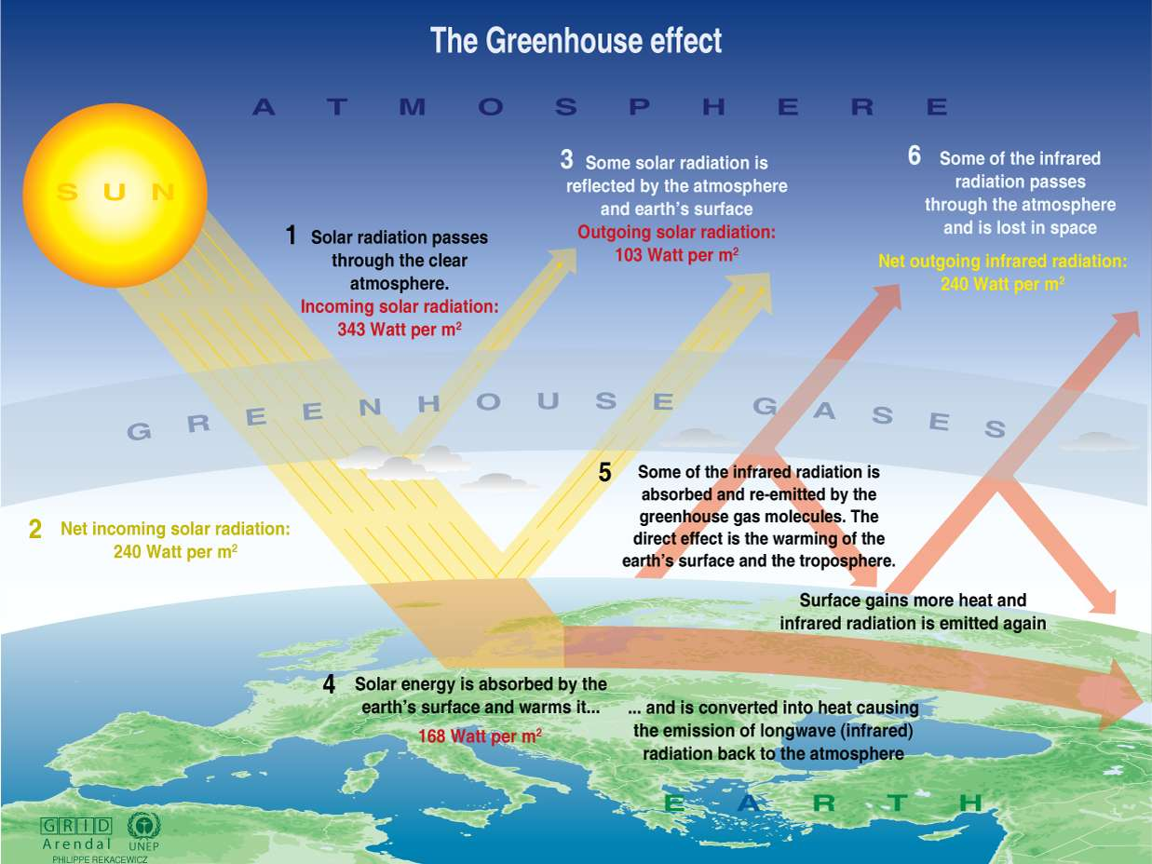

Slide 6
Listing some Greenhouse Gases:
Carbon Dioxide
Carbon Dioxide is the most prominent greenhouse gas in the Earth’s atmosphere. It has been made even more abundant through the human process of removing the naturally occurring carbon from the earth in the form of coal, oil and natural gas, and burning it for fuel, releasing it into the atmosphere in incredible quantities.
When we talk about anthropogenic carbon emissions we are referring to such things as burning fossil fuels (coal, oil, natural gas) and clearing of forests which removes large swathes of potential sources of photosynthesis…and human exhalation. At a time when it is becoming increasingly imperative that we reduce our carbon emissions, the evidence points to the fact that they are still increasing.

Slide 7
The Carbon Cycle
Levels of carbon dioxide in the atmosphere are controlled in nature by a process known as the “carbon cycle”. The movement of carbon is controlled between the air, land and water by natural processes such as photosynthesis, respiration and decay. While natural processes can handle some of the anthropogenic (caused by humans) carbon dioxide emissions produced each year, there is an estimated 3.2 billion metric tons added to the atmosphere annually. It’s this growing imbalance between emissions and absorption that is attributed to the increase in greenhouse gases in the atmosphere.

Slide 8
Methan e
Another greenhouse gas that is contributing to the problem of global warming is methane. High levels of methane are produced from landfills when open dumps and waste decomposes under anaerobic conditions. It is also released as part of the coal mining process when trapped methane is released into the atmosphere. Significant amounts of methane are also naturally produced by livestock as part of their digestive system. Rice cultivation produces quite high levels of methane due to the flooding process which promotes anaerobic decomposition or organic matter in the soil.
Each year around 350-500 million tons of methane from human related activities are released into the atmosphere adding to the greenhouse gases. The problem lies in the fact that methane is 20 times effective at trapping in heat than carbon dioxide.

Slide 9
Nitrous Oxide
Better known to most people as laughing gas, this is the stuff that we use as an anaesthetic but it’s a naturally occurring gas and one of our greenhouse gases. It is released naturally from the ocean and by bacteria in the soil. Humans add up to 15 million tons into the atmosphere through nitrogen-based fertilizers, sewerage treatment and car exhausts. Nitrous oxide emissions need to be reduced because it stays trapped in the Earth’s atmosphere for a long time.

Slide 10
Today, the increase in the Earth's temperature is increasing with
unprecedented speed. To understand just how quickly global warming is accelerating, consider this:
During the entire 20th century, the
average increased Celsius
temperature by about 0.6 degrees
global
(slightly more than 1
degree Fahrenheit).
Using computer climate models, scientists estimate that by the year 2100 the average global temperature will increase by 1.4 degrees to 5.8 degrees Celsius (approximately 2.5 degrees to 10.5 degrees Fahrenheit).

Slide 11
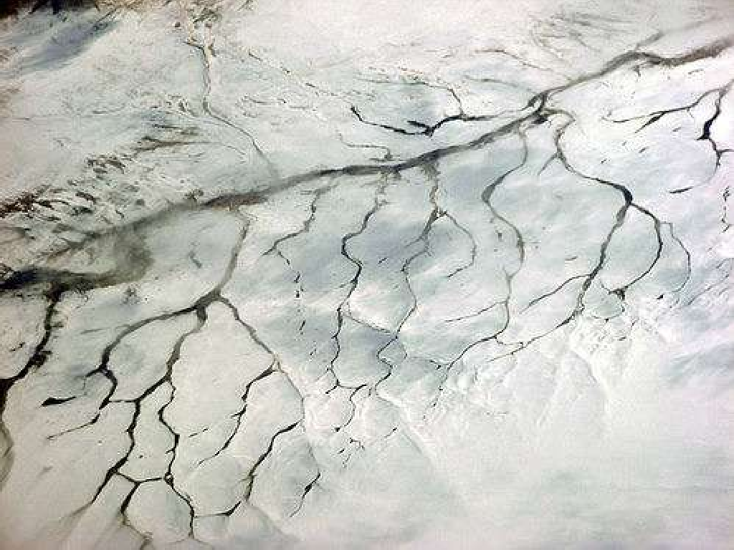

Slide 12
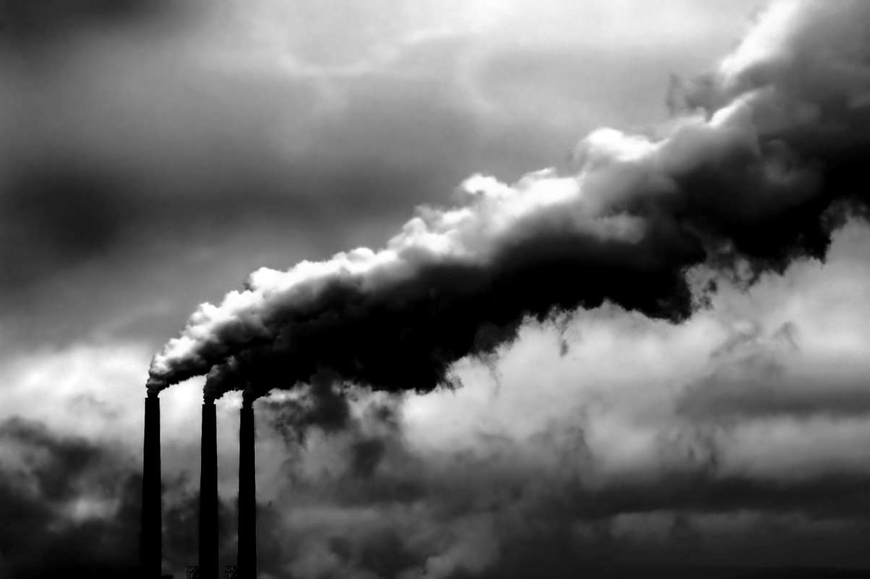

Slide 13
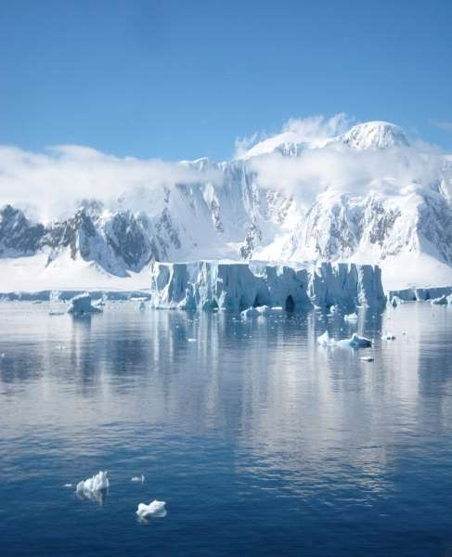
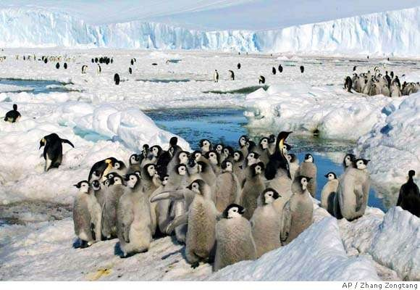
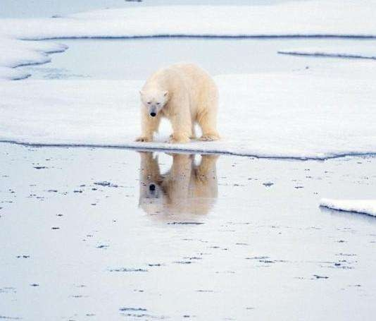

Slide 14
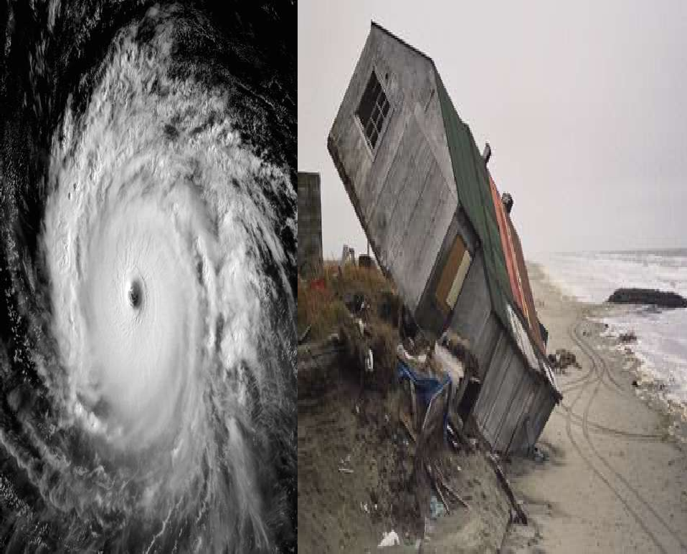

Slide 15
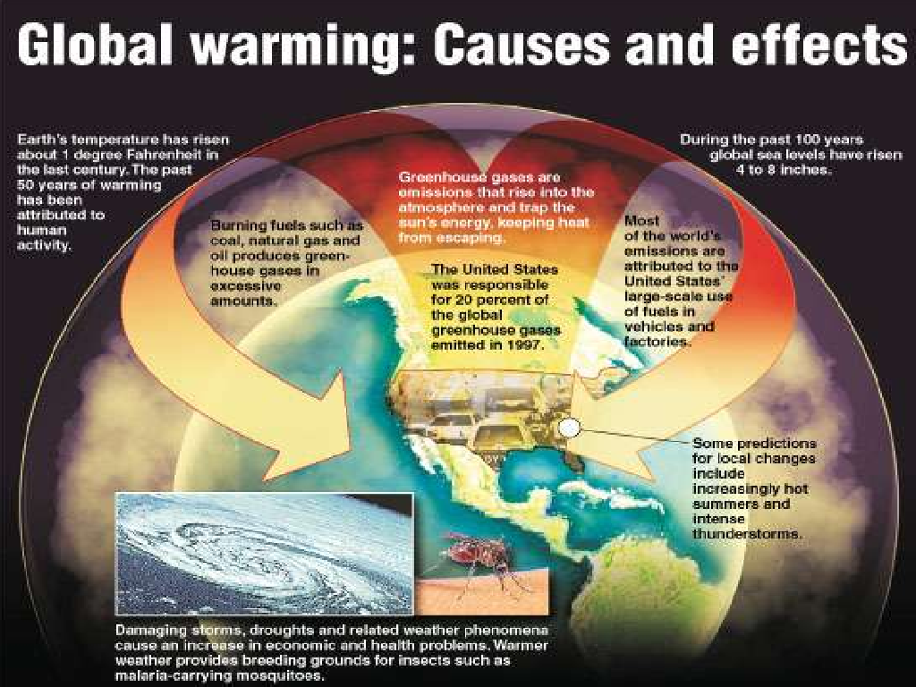

Slide 17
A carbon footprint is a measure of the impact our activities have on the environment, and in particular climate change. It relates to the amount of greenhouse gases produced in our day-to-day lives through burning fossil fuels for electricity, heating and transportation etc.
The carbon footprint is a measurement of all greenhouse gases we individually produce and has units of tonnes (or kg) of carbon dioxide equivalent.

Slide 18
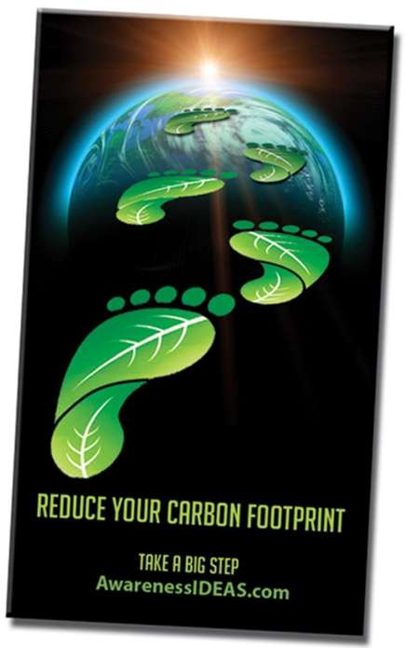
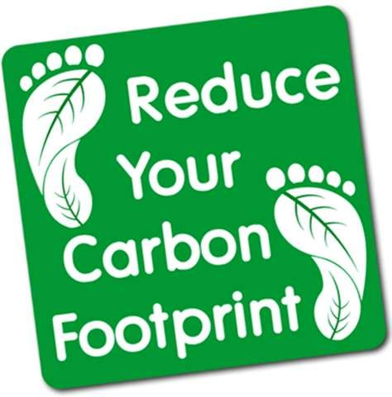

Slide 19
The Carbon Footprint specifically counts how much greenhouse you expel, minus how much you take back in, in your daily life. Here's a few tips :
General
Use vegetable-based and biodegradable products of all kinds: From plastics to bio-diesel, from soaps & detergents to computer parts & rail road ties, nearly everything can now be made from renewable resources at competitive/cheaper prices. Ask your merchants to find them for you!

Slide 20
At the Office
No more plastic disposable cups! Let everyone bring in a mug or a glass from their home, and wash it in the restroom.
Printouts are so 1990... Nothing should ever be printed anymore. Provide notebooks and pens for those who still feel like scribbling.
Power down when you leave, from lights to computers, everything should be off when you leave the office.

Slide 21
At Individual Level
Turn off lights, television, DVD player, computer etc. etc. when not in use.
Fill your dish washer and washing machine with a full load - this will save you water, electricity, and washing powder.
Fill the kettle with only as much water as you need.
Do your weekly shopping in a single trip.
Hang out the washing to dry rather than tumble drying it.

Slide 22
Transportation
Carpool - get a lift to school or work with a friend.
Use the bus or a train.
rather than your car.
For short journeys either walk or cycle.
Try to reduce the number of flights you take.
See if your employer will allow you to work from home one day a week.
Next time you replace your car - check out diesel engines. With one of these you can even make your own Biodiesel fuel.
When staying in a hotel - turn the lights and air-conditioning off when you leave your hotel room, and ask for your room towels to be washed every other day, rather than every day.

Slide 23
As well as your primary carbon footprint, there is also a secondary footprint that you cause through your buying habits.
Don't buy bottled water if your tap water is safe to drink .
Buy local fruit and vegetables, or even try growing your own.
Buy foods that are in season locally.
Don't buy fresh fruit and vegetables which are out of season, they may have been flown in.
Reduce your consumption of meat.
Try to only buy products made close to home (look out and avoid items
that are made in the distant lands).
Buy organic produce .
Don't buy over packaged products.
Recycle as much as possible .
Think carefully about the type of activities you do in your spare time. Do any of these cause an increase in carbon emissions? e.g. Saunas, Health clubs, restaurants and pubs, go-karting etc..

Slide 24
Around Your home
Reduce heat loss in your home
The picture below illustrates some of the main causes of heat loss in a typical house and provides some suggestions on how this can be reduced.
Through the roof - install loft insulation
Through walls - use cavity wall insulation
Through windows -
fit double glazing
Through gaps around doors -
fit draft excluders
Through the floor - fit
carpet with underlay

Slide 25
Reduce energy usage in your home
Within your home try to:
Reduce the use of electrical appliances
When replacing appliances, try to buy appliances which use less power and have a good energy rating
Turn things off when not in use
Replace standard light bulbs with their low energy equivalents

Slide 26
Recycling
Throwing things away is a waste of the energy and the resources taken to make the product. Reducing the number of things that need to be thrown away, reduces the amount of materials which have to be quarried and mined.
Reduce, Re-use, Repair and Recycle
Reduce
We should all avoid products with excessive packaging
The production of the packaging uses additional energy
The extra volume and weight will have to be transported (by lorries, aircraft, ships etc.)
The packaging will be thrown out and will need to be collected from your home by a large waste disposal truck
Packaging then takes more space at land fill sites

Slide 27
Re-use
Everyone should try and re-use products for as long as feasibly possible. It is amazing how often people buy certain products and use them only once or twice, even though they can be re-used many times. For instance can you think of some items of clothing you have worn only once?

Slide 28
Recycle
Recycling uses less energy and produces less
pollution than making things from scratch.
For example:-
Making Aluminium cans from old ones uses one twelfth of the energy to make them from raw materials.
For glass bottles, 315kg of CO2 is saved per tonne of glass recycled after taking into account the transportation and processing
Making bags from recycled polythene takes one third the Sulphur Dioxide and half the Nitrous Oxide, than making them from scratch.

Slide 29
Another form of recycling is composting household and garden waste.
Why compost?
it helps fertilize soil, making plants and vegetables grow better
using home made compost will minimise depletion of peat bogs
reduces the number of refuse collections needed
reduces the strain on land fill sites
you may be able to get a reduced price compost bin via the recycle now website
What can you compost?
Garden waste (fallen leaves, grass cuttings and prunings)
Kitchen waste (such as raw vegetables, fruit, crushed egg shells, tea leaves and tea bags)
In addition try, shredded paper and cardboard.

Slide 30
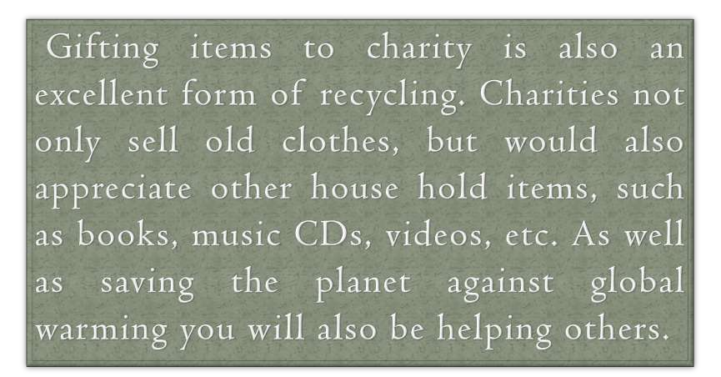

Slide 31
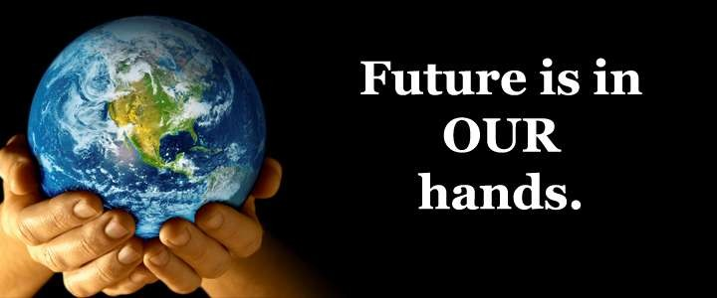

Slide 32
The End

Slide 33
Vivek Kumar Sinha

