Slide 1
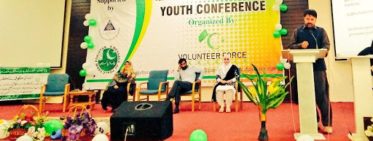
Rural youth in Pakistan
Notes:
This template can be used as a starter file for presenting training materials in a group setting.
Sections
Sections can help to organize your slides or facilitate collaboration between multiple authors. On the Home tab under Slides, click Section, and then click Add Section.
Notes
Use the Notes pane for delivery notes or to provide additional details for the audience. You can see these notes in Presenter View during your presentation.
Keep in mind the font size (important for accessibility, visibility, videotaping, and online production)
Coordinated colors
Pay particular attention to the graphs, charts, and text boxes.
Consider that attendees will print in black and white or grayscale. Run a test print to make sure your colors work when printed in pure black and white and grayscale.
Graphics, tables, and graphs
Keep it simple: If possible, use consistent, non-distracting styles and colors.
Label all graphs and tables.

Slide 2
Some Facts
39.2 million population of Pakistan is youth (aged 15-24 years)
20.4 million are male youth
18.8 million are female youth
Pakistan is ranked 22nd in Commonwealth Youth Development Index (YDI) out of 54 countries
YDI is based on 5 key indicators:
Education
Health & Well being
Employment
Civic participation
Political participation
Notes:
Give a brief overview of the presentation. Describe the major focus of the presentation and why it is important.
Introduce each of the major topics.
To provide a road map for the audience, you can repeat this Overview slide throughout the presentation, highlighting the particular topic you will discuss next.

Slide 3
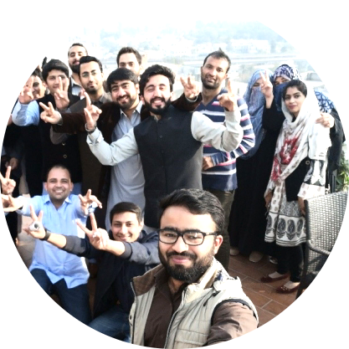
Youth in Pakistan: Key Issues

Slide 4
Key Issues
1
2
Migration
3
Marriages
Education
4
Health Information & Services
5
Political Participation & Empowerment
Notes:
This is another option for an overview slide.

Slide 5
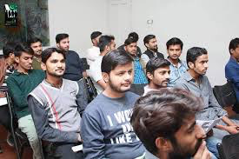
Youth in public policies & strategies
Youth inclusion in Vision-2025
Youth policies
Health strategies
Economic development strategies
Notes:
What will the audience be able to do after this training is complete? Briefly describe each objective and how the audience will benefit from this presentation.

Slide 6
Policies & Strategies
Notes:
Use a section header for each of the topics, so there is a clear transition to the audience.

Slide 7
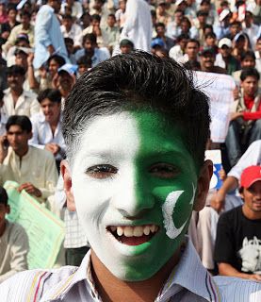
Policies & Strategies generally:
Focus on
Skill Development
Employment Opportunities
Education
Ignore
Marriage & rights
Life skills development
Health services
Gender equality
Civic & political engagement/ empowerment
Needs of poor, uneducated, & rural youth
Notes:
Add slides to each topic section as necessary, including slides with tables, graphs, and images.
See next section for sample table, graph, image, and video layouts.

Slide 8
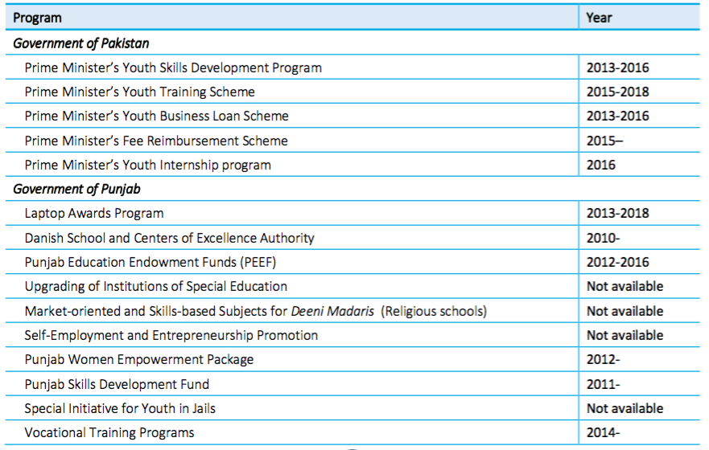
Youth Empowerment Initiatives of the Federal & Provincial Governments
Notes:
Keep it brief. Make your text as brief as possible to maintain a larger font size.

Slide 9
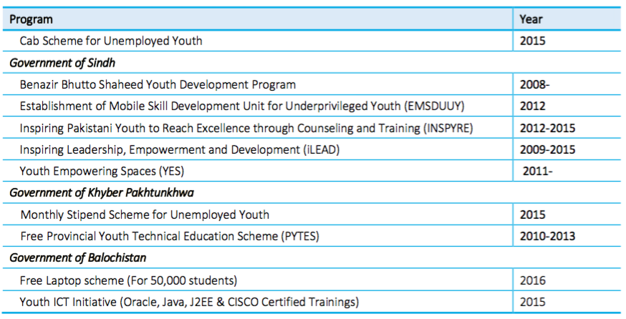
Continued…........
Notes:
Keep it brief. Make your text as brief as possible to maintain a larger font size.

Slide 10
Youth related donor investments in Pakistan
Agency | Area of funding | Duration | Focus | Partners
Australian Agency for International Development (AUSAID) | Education (36%) Health (26%) | 2011-2015 | Nation-wide, specifically under- privileged and remote areas | Government organizations, multilateral development organizations
Global Affairs Canada/Department of Foreign Affairs, Trade and Development (DFATD) | Youth protection (education &sustainable economic growth with focus on female empowerment) | 2011-2017 | Nation-wide | Government organizations, multilateral development organizations, donors, NGOs, academia, media, volunteers and the private sector.
European Union (EU) | Formal and vocational training | 2007-2013 | Countrywide – disaster-affected areas | Democracy Reporting International, World Bank, UNDP, Inter news, International Alert, Search for Common Ground, Community Appraisal and Motivation Programme Society – CAMP, PAIMAN Alumni Trust, International Foundation for Electoral Systems, Trust for Democratic Education and Accountability (TDEA) / Free and Fair Elections Network

Slide 11
Continued…...
Agency | Area of funding | Duration | Focus | Partners
Government of Norway | Education, gender equality and human rights | Funded till 2014 | Nation-wide specifically neglected areas (KP and GB) | National and local level development partners, the Unities nations (UN) system, e.g., United Nations office on Drugs and Crime (UNODC), United Nations office for the Coordination of Humanitarian Affairs (OCHA), National Disaster Management Authority (NDMA), and NGOs.
Government of Germany | Health (19%) and education/vocational training (4%) | 2015-2020 | Countrywide, with a focus on KP and FATA | Dept. of Education in KP, Islamabad, Azad Jammu and Kashmir (AJK), Balochistan, Punjab, Federally Administered Tribal Areas (FATA); National Vocational and Technical Training Commission (NAVTTC), Technical Education and Vocational Training Authority (TEVTA) in all provinces and regions. Health: Dept. of Health in KP, AJK, Gilgit Baltistan (GB) and FATA; National Planning Commission and national Ministry for Health; social security stakeholders, including Benazir Income Support Programme (BISP); civil society organizations.
Notes:
If there is relevant video content, such as a case study video, demo of a product, or other training materials, include it in the presentation as well.

Slide 12
Continued…...
Agency | Area of funding | Duration | Focus | Partners
Swiss Development and Cooperation (SDC) | Promotion of human rights and education of women and girls | 2012-2014; extended to 2016 | Countrywide, with focus on KP, FATA and Northern Areas | Local and national NGOs and public institutions; United Nations Development Program (UNDP), United Nations Children’s Fund (UNICEF), International Labour Organization (ILO and International Union for Conservation of Nature (IUCN); international financial institutions, e.g., World Bank, ADB; governments of KP and Pakistan; State Bank of Pakistan; commercial banks and leasing companies; donors focusing on microfinance
UK Department for International Development (DFID) | Education (31%) (sectoral reforms) | 2011-2019 | Nation-wide | Government entities at national, provincial/ regional and district levels, private sector, academia, media and local civil, society organizations in programme implementation, and strategic partnership with the World Bank
Government of the Netherlands* | Education (50%) | Funded till 2015 | Malakand Division of KP | UNICEF, Save the Children, World Vision and GIZ; provincial and district education government officials
Notes:
If there is relevant video content, such as a case study video, demo of a product, or other training materials, include it in the presentation as well.

Slide 13
Continued…...
Agency | Area of funding | Duration | Focus | Partners
US Agency for International Development (USAID) | Education (8%) and health (6%) | Funding till 2019 | Countrywide, especially underrepresented geographical areas, like Balochistan, Northern Areas, GB and AJK | Government organizations, NGOs, private sector (55 implementers)
Asian Development Bank | Education (2%) and health (3%) | 2013 -2019 | Nation-wide | Government, State Bank of Pakistan, Khushali Bank of KP, and NGOs involved in micro financing
Japan International Cooperation Agency (JICA) | Capacity development of technical and vocational institutes, non-formal education | Funded till 2014 | KP and Punjab | Provincial education departments
The World Bank | Education and skill development |  | Countrywide, including FATA | Federal ministries, autonomous bodies, provincial/regional departments throughout the country, local civil society organizations, private sector
Notes:
If there is relevant video content, such as a case study video, demo of a product, or other training materials, include it in the presentation as well.

