Slide 1
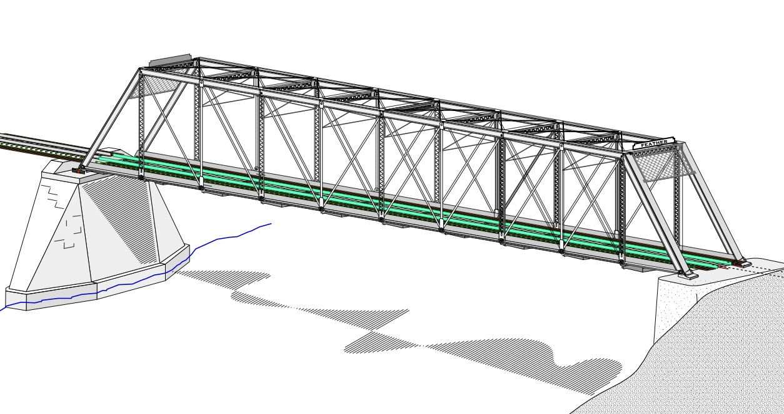
COLLEGE OF ENGINEERING AND TECHNOLOGY UNIVERSITY OF SARGODHA STEEL STRUCTURES (CT-313) (B.S TECHNOLOGY)
LECTURE-25, 26 & 27
COMPRESSION MEMBERS
Engineer Aqeel Ahmed
Lecturer, Civil Engineering Department
CET, UOS, Sargodha
15-01-2021

Slide 2
Column Theory……….
If the critical load is divided by the cross-sectional area, the critical buckling stress is obtained by:-
At this compressive stress, buckling will occur about the axis corresponding to r.
Buckling will take place as soon as the load reaches the value given by equation 4.3, and the column will become unstable about the principal axis corresponding to the largest slenderness ratio.
This axis usually is the axis with the smaller moment of inertia.
Thus the moment of inertia and radius of gyration of the cross-section should ordinarily be used in equations 4.3 and 4.4

Slide 3
Early researchers soon found out that Euler’s equation did not give reliable results for stocky, or less slender, compression members.
The reason is that smaller slenderness ratio for members of this type causes a large buckling stress, it can be seen from equation 4.4.
If the stress at which buckling occurs is greater than the proportional limit of the material, the relation between stress and strain is no longer linear and the modulus of elasticity E can no longer be used.
In Example 4.1, the stress at buckling is Pcr/A=278.9/14.6=19.10 Ksi, which is well below the proportional limit of any grade of structural steel.

Slide 4
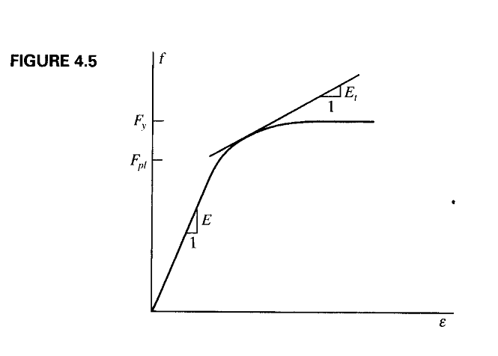

Slide 5
This difficulty was initially resolved by Friedrich Engesser, who proposed in 1889 the use of a variable tangent modulus, E_{t} in equation 4.3.
For a material with a stress-strain curve like the one shown in Figure 4.5, E is not a constant for stresses greater than the proportional limit Fpl.
The tangent modulus E_{t} is defined as the slope of the tangent to the stress-strain curve for values of f between Fpl and Fy. So the equation can be shown as equation 4.5
The equation 4.5 is identical to the Euler equation, except that E_{t} is substituted for E.

Slide 6
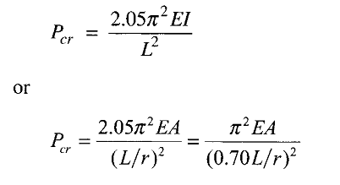
Effective Length
Both the Euler and tangent modulus equations are based on the following assumptions:
1. The Column is perfectly straight with no initial crookedness.
2. The Load is axial, with no eccentricity.
3. The Column is pinned at both ends.
• The first two conditions mean that there is no bending moment in the member before buckling.
For dealing with columns other than pinned end conditions, such as One end pinned and one end fixed as shown in figure-4.7. the Euler equation for this case can be derived as;

Slide 7
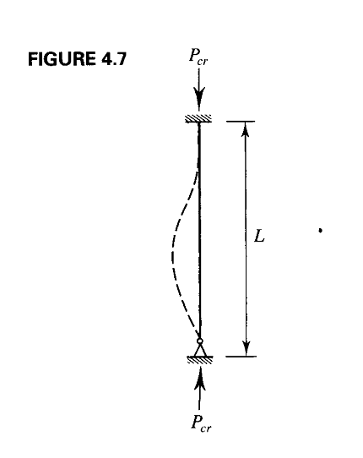
Effective Length…….

Slide 8
Effective Length
For convenience, the equations for buckling load will be written as:
Where KL is the effective length and K is the effective length factor.
The effective length factor for the fixed-pinned compression member is 0.70.
Values of K for these and other cases can be determined with the aid of Table C-C2.2 in the commentary of AISC Specification.

Slide 10
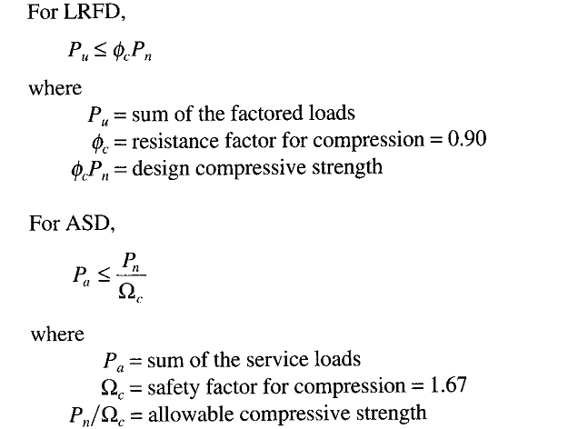
AISC Requirements

Slide 11
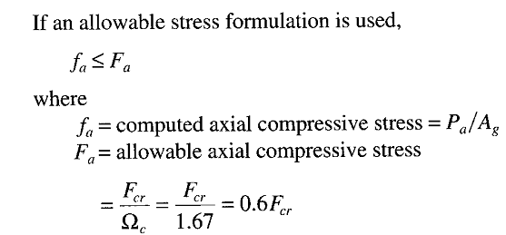
AISC Requirements………

Slide 12
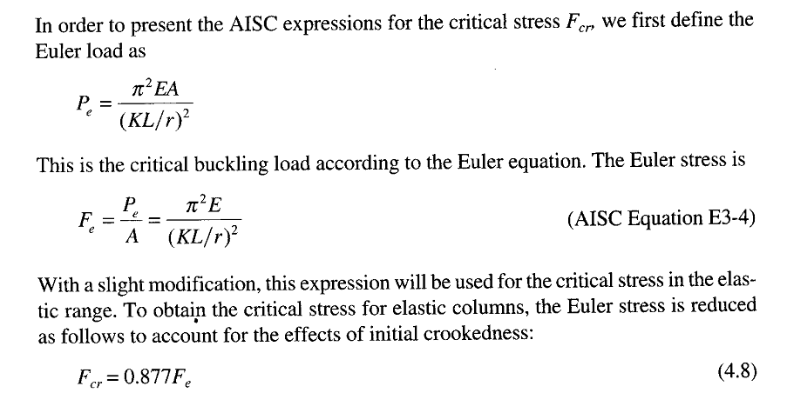
AISC Requirements………

Slide 13
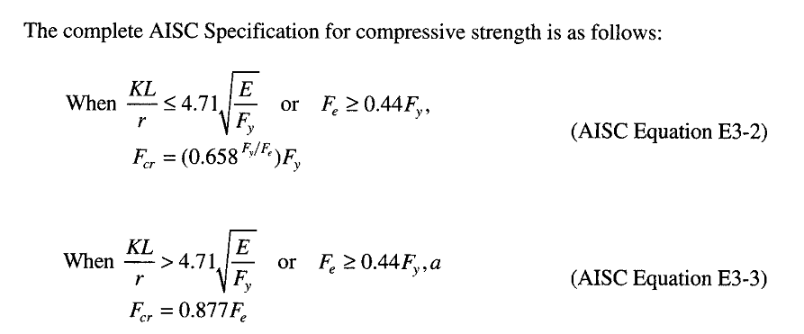
AISC Requirements……..

Slide 14
AISC Requirements……..

Slide 15
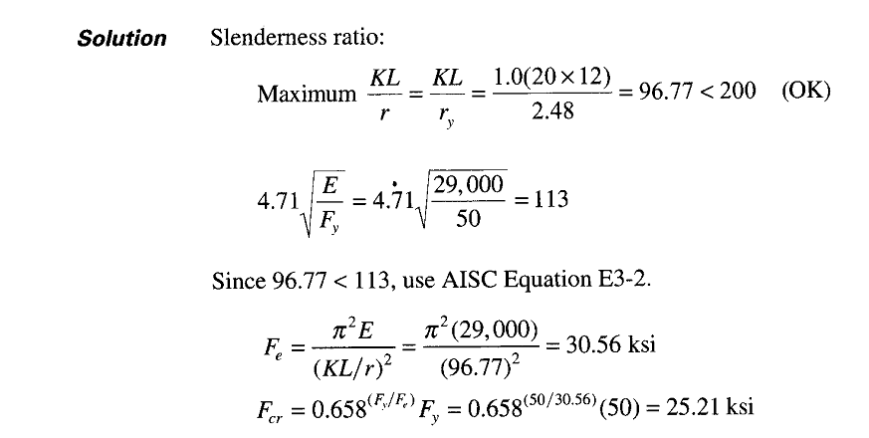

Slide 16
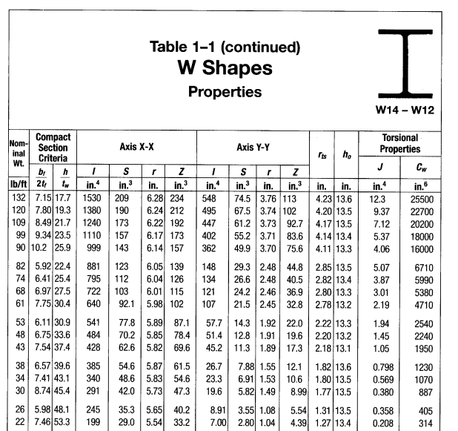

Slide 17
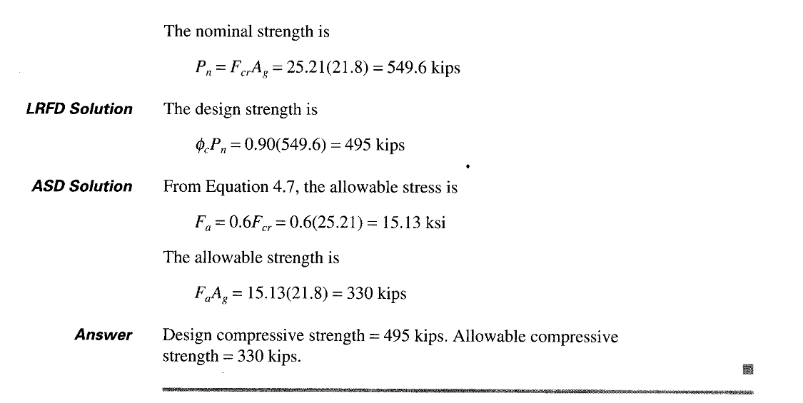

Slide 18
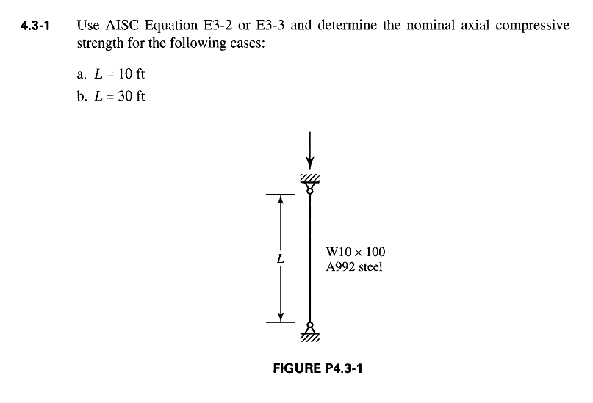

Slide 19
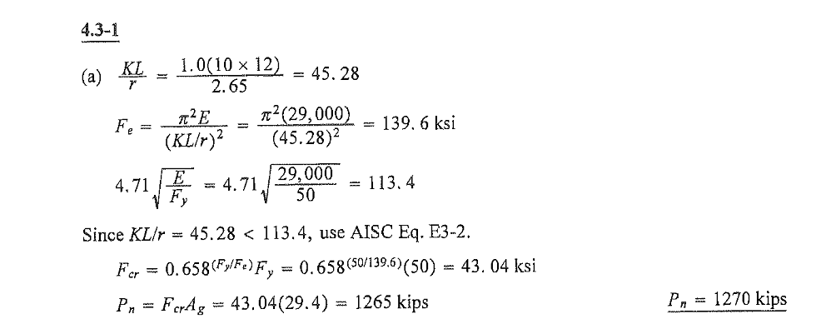

Slide 20
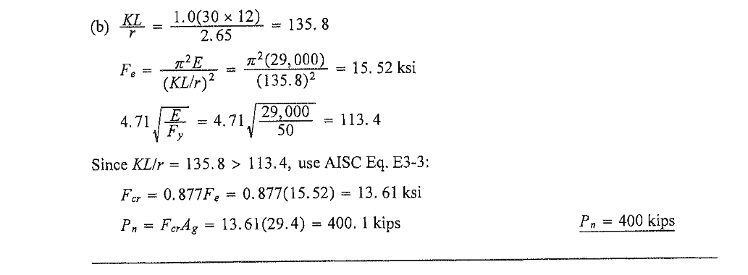

Slide 21
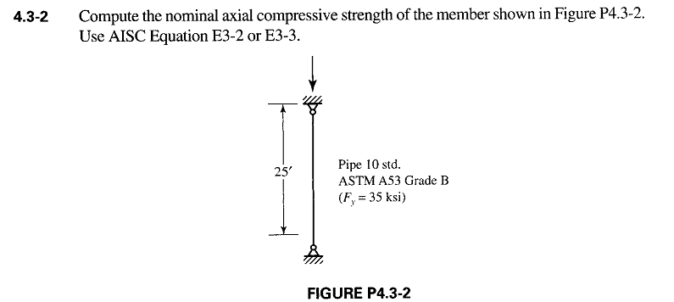

Slide 22
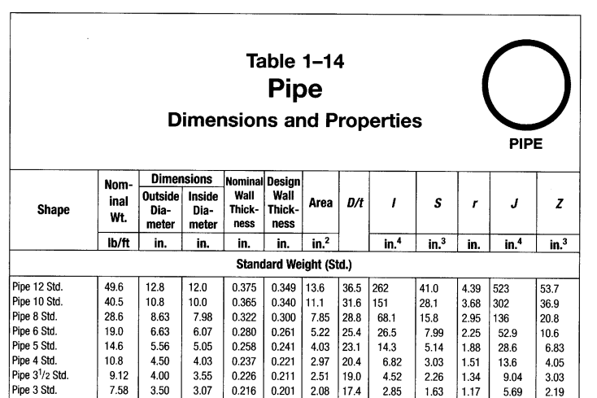

Slide 23
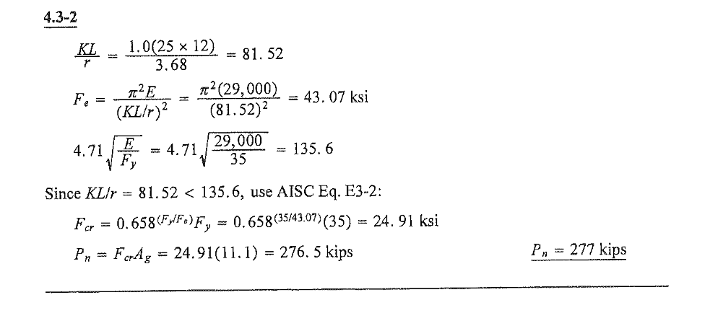

Slide 24
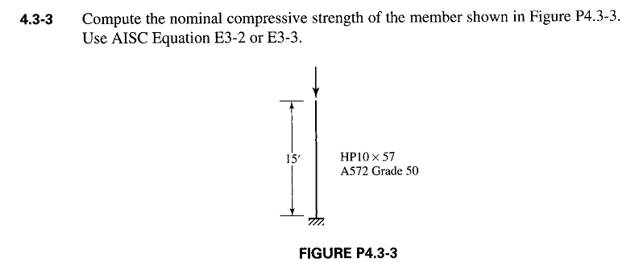

Slide 25
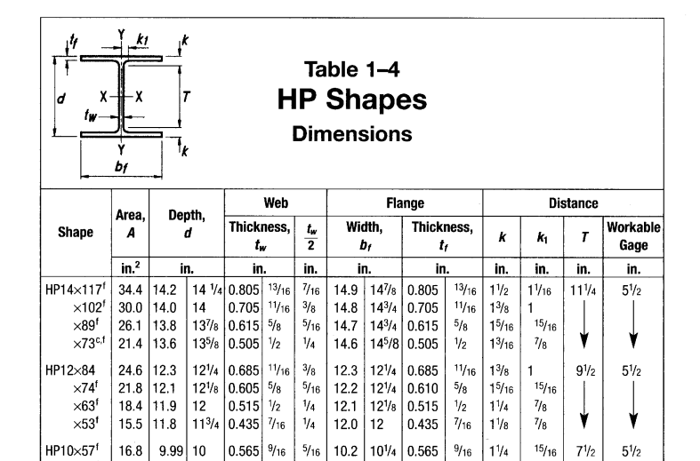

Slide 26
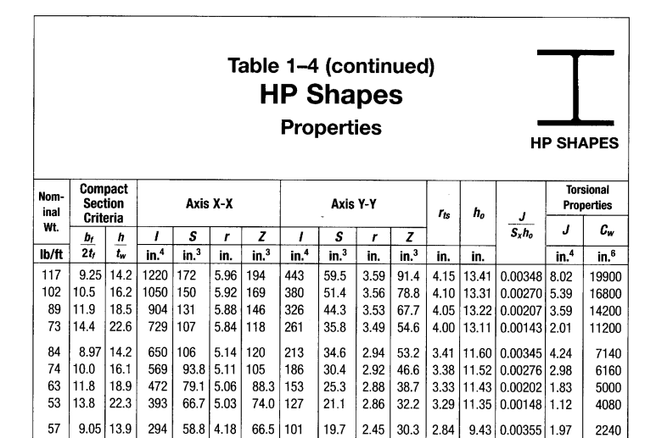

Slide 27
