Slide 1
NOISE POLLUTION

Slide 2
Noise pollution

Slide 3
Noise pollution
The word noise comes from the Latin word noxia meaning "injury" or "hurt" .” Noise is an unwanted, unpleasant and annoying sound caused by vibration of the matter.
Vibrations on the ear drum of a human or animal and setup a nervous disturbance, which we call sound. When the effects of sound are undesirable that it may be termed as “Noise”.

Slide 4
NOISE POLLUTION
Definition:
By definition, noise pollution takes place when there is either excessive amount of noise or an unpleasant sound that causes temporary disruption in the natural balance.
Sound, a normal feature of our life, is the means of communication and enter­tainment in most animals, including human beings. It is also a very effective alarm system. A low sound is pleasant whereas a loud sound is unpleasant and is commonly referred to as ‘noise’. Noise can be defined as an unpleasant and unwanted sound.

Slide 5
Noise is a physical form of pollution and is not directly harmful to the life sup­porting systems namely air, soil and water. Its effects are more directly on the receiver i.e. man. Noise pollution is the result of modern industrialized urban life and congestion due to over population.

Slide 6
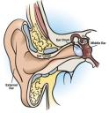
The human ear can detect sounds in the frequency range of about 20 to 20,000 Hz.
(The average is 200 - 10,000 Hz)

Slide 7
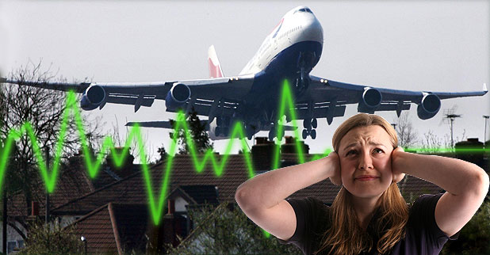
MEASUREMENT OF NOISE
“A decibel is the standard for the measurement of noise”
20 db is whisper.
40 db the noise in a quiet office.
60 db is normal conversation.
80 db is the level at which sound
becomes physically painful. And can
be termed as noise.

Slide 8
Causes of noise pollution
Industrialization:
Most of the industries use big machines which are capable of producing large amount of noise. various equipments like compressors, generators, exhaust fans, grinding mills also participate in producing big noise. Therefore, you must have seen workers in these factories and industries wearing ear plugs to minimize the effect of noise.

Slide 9
2. Poor Urban Planning:
In most of the developing countries, poor urban planning also play a vital role. Congested houses, large families sharing small space, fight over parking leads to noise pollution which may disrupt the environment of society.

Slide 10
3. Social Events:
Noise is at its peak in most of the social events. Whether it is marriage, parties, or place of worship. People play songs on full volume which makes the condition of people living nearby pretty worse. In markets, you can see people selling clothes via making loud noise to attract the attention of people.

Slide 11
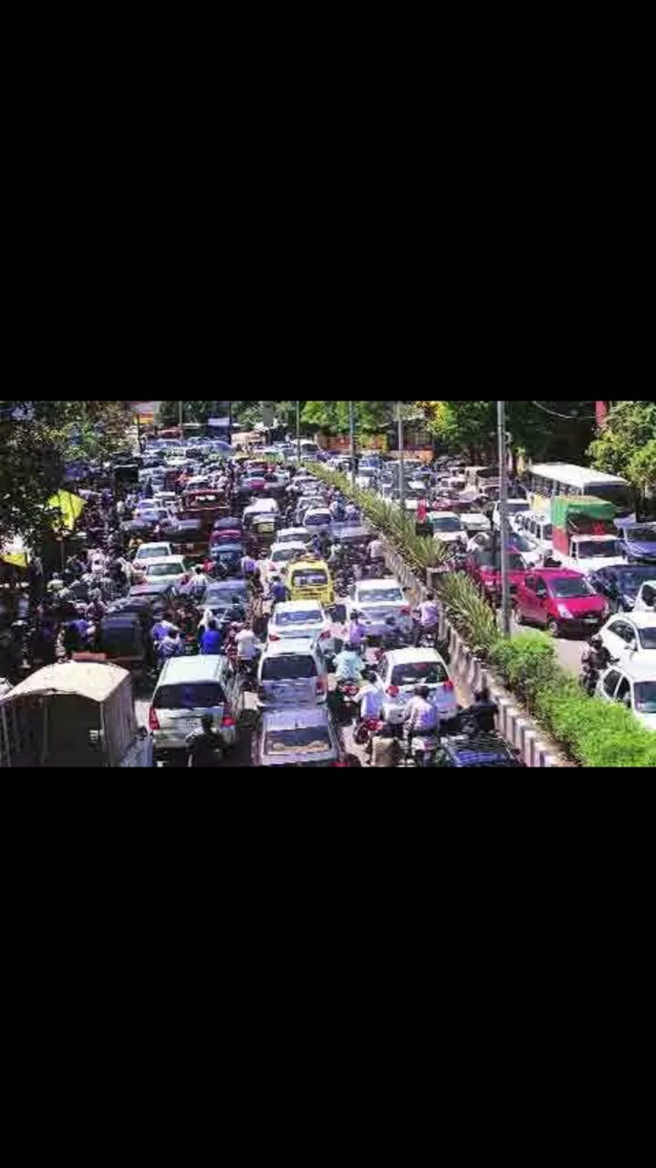
4.Transportation:
Large number of vehicles on roads, aeroplanes flying over houses, underground trains produce heavy noise. The high noise leads to a situation where a normal person lose the ability to hear properly.

Slide 12
5.Construction Activities:
Under construction activities like mining, construction of bridges, dams, buildings, stations, roads, take place in almost every part of the world. These construction activities take place everyday and are the cause of noise pollution.

Slide 13
6. Household Equipments:
We people are surrounded by gadgets and use them extensively in our daily life. Gadgets like TV, mobile , mixer grinder, pressure cooker, vacuum cleaners , washing machine and dryer, cooler, air conditioners are minor contributors to the amount of noise pollution.

Slide 14
7. Agricultural Machines:
Tractors, thrashers, harvesters, tube wells, etc. have all made agriculture highly mechanical but at the same time highly noisy. Noise level 90 dB to 98 dB due to running of farm machines have been recorded in the state of Punjab.

Slide 15
8. Defense Equipments:
A lot of noise pollution is added to the atmosphere by tanks, launching of rockets, explosions, exercising of military airplanes. Screams of jet engines and sonic booms have a deafening impact on the ears.

Slide 16
9. Miscellaneous Sources:
The automobile repair shops, construction-works, blasting, bulldozing, stone crushing etc. are other sources of noise pollution.

Slide 17
10.Other causes:
Plumbing equipment, boilers, air conditioners, fans and generators cause noise pollution to some extent. Noise created by people in public places and Loudspeakers used in public places are responsible for creating noise pollution.

Slide 18
Effects of Noise Pollution:
Hearing Problems:
Any unwanted sound that our ears have not been built to filter can cause problems within the body. Our ears can take in a certain range of sounds without getting damaged. Constant exposure to loud levels of noise can easily result in the damage of our ear drums and loss of hearing.

Slide 19
It also reduces our sensitivity to sounds that our ears pick up unconsciously to regulate our body’s rhythm.
Over time, some people experience hearing loss as a result of noise pollution. The loss of hearing occurs when structures of the inner ear are damaged, which could occur once noises reach or exceed about 85 decibels.

Slide 20
2. Headaches and migraines:
The most common short-term effect of noise pollution is a headache or migraine. The constant annoyance of noises can often lead to painful headaches, which can make focusing difficult for some people. In the case of migraines, people may also experience sensitivity to light or nausea as well.

Slide 21
3. Stress:
A potential short- or long-term effect of noise pollution cause stress. Some studies suggest that noise pollution coming from neighbors’ homes tends to be one of the biggest causes of noise pollution-related stress.

Slide 22
4. Hypertension:
In many cases, regular exposure to noise pollution has been shown to elevate blood pressure levels. This type of hypertension could be due to the adrenaline of being annoyed at the noises being heard or with stress associated.

Slide 23
5. Stroke:
Those who are exposed to road traffic regularly often display an increased risk of stroke. This was especially more apparent in individuals over the age of 65.

Slide 24
6. Child development:
Studies over the past several decades have shown with slowed mental and physical development in children. The cases reported in these studies typically involve children who live in homes near airports or other especially loud locations

Slide 25
7. Health Issues:
Excessive noise pollution in working areas such as offices, construction sites, bars and even in our homes can influence psychological health. Occurrence of aggressive behavior, disturbance of sleep, constant stress, fatigue and hypertension can be linked to excessive noise levels. These in turn can cause more severe and chronic health issues later in life.

Slide 26
8. Sleeping Disorders:
Loud noise can hamper your sleeping pattern and may lead to irritation and uncomfortable situations. Without a good night sleep, it may lead to problems related to fatigue and your performance may go down in office as well as at home.

Slide 27
9. Cardiovascular Issues:
Blood pressure levels, cardio-vascular disease and heart problems are rise. High intensity noise causes high blood pressure and increases heart beat rate as it disrupts the normal blood flow.

Slide 28
10. Trouble Communicating:
High decibel noise can put trouble and may not allow two people to communicate freely. This may lead to misunderstanding and you may get difficult understanding the other person.

Slide 29
11. Effect on Wildlife:
Wildlife faces far more problems than humans because noise pollution since they are more dependent on sound. Animals develop a better sense of hearing than us since their survival depends on it. The ill effects of excessive noise begin at home. Pets react more aggressively in households where there is constant noise.

Slide 30
EFFECT ON VEGETATION,POOR QUALITY OF CROPS
Now is well known to all that plants are similar to human being. They are also as sensitive as man. There should be cool & peaceful environment for their better growth. Noise pollution causes poor quality of crops in a pleasant atmosphere.

Slide 31
The psychological effects of noise pollution are:
(a) Depression and fatigue which considerably reduces the efficiency of a person.
(b) Insomnia as a result of lack of undisturbed and refreshing sleep
(c) Straining of senses and annoyance as a result of slow but persistent noise from motorcycles, alarm clocks, call bells, telephone rings etc.
(d) Affecting of psychomotor performance of a person by a sudden loud sound
(e) Emotional disturbance

Slide 32
depression: 58% | Stress: 65% | Public conflict: 71%
Irritation annoyance: 54% | Behavioral affects: 59% | Speech interference: 56%.
Hypertension: 87% | Muscle tension: 64% | Exhaustion: 48%
Low performance levels: 55% | Concentration loss: 93% | Hearing impairment: 69%
Headache: 74% | Cardiovascular issue: 71%

Slide 33
Solutions to control noise pollution:
Trees plantation:
Effective solution for noise pollution is to plant bushes and trees around the sound generating sources. Sound passage is blocked by the dense shrubs and trees. Trees can be planted in the surrounding area to live peacefully.

Slide 34
Soundproof buildings:
To block unwanted noise from outside soundproof doors and windows can be installed. If you stay in crowded city area these soundproof options are important for complete relaxation.

Slide 35
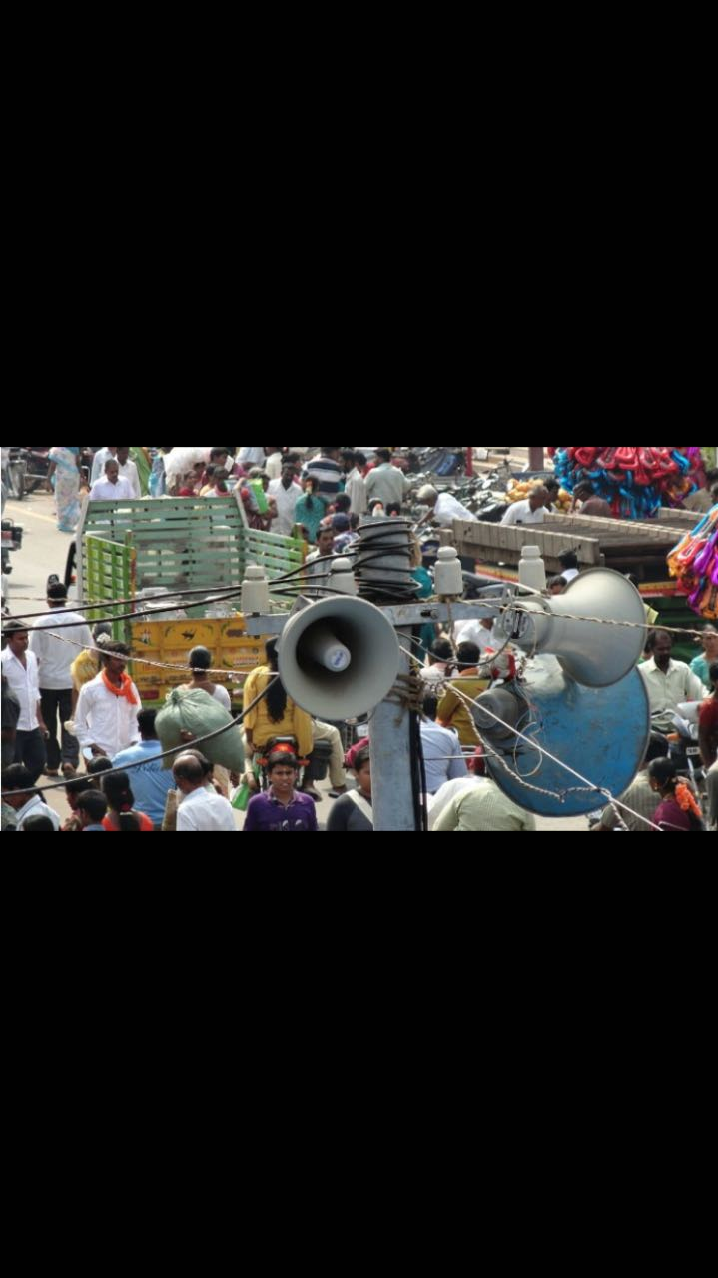
Loudspeaker inhibition:
The major cause of noise pollution in public areas is loudspeaker. For the welfare of the people it should be banned at any cost. Those who violate and play loudspeakers in crowded areas and public places strict laws should be imposed against them.

Slide 36
Factory location:
From the residential areas factories and industries should be located in far off places. Installation of sound detectors will help in analyzing the sound frequencies on a regular basis.

Slide 37
White noise machine:
For overcoming the effects of noise pollution the latest technology is using white noise machine. This device converts the unbearable noise into pleasant sound. A white noise machine is placed between the source of noise and the receptor. It produces soft sound like that of a waterfall, fan and soft music.

Slide 38
Machine quality:
The quality of machines should be optimized to reduce sound production. Lubrication of the machinery and servicing should be done to minimize noise generation.

Slide 39
Other solutions:
Noise pollution at home is caused by using music systems and television sets with high volumes. Instead of using these appliances with the high volume, it is better to keep it at a moderate level.
To wear ear protection while working in noisy conditions is an effective way to manage noise. Vehicles and factory machines need to be maintained properly and checked from time to time. Lack of maintenance will not only increase noise levels, but also decrease the efficiency of these machines.

Slide 40
Sound insulation at the top of the roof can reduce the aircraft noise.
Add a layer of wood to the dividing wall to protect yourself from the noise from neighbors.

Slide 41
Some of the well- known effects of noise on human beings and the relation of noise pollution level and its harmful effects are shown in Table.

Slide 42
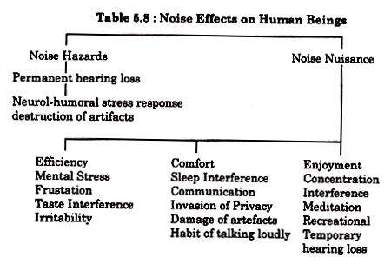

Slide 43
Level (in db) | Effects
Upto----------23 | No disturbance
30—60 | Stress, tension, psychological (illness, heart attact) effects especially at upper range.
60—90 | Damage to health, psychological effect and disturbance in stomach, pains in muscles, high blood pressure, disturbance in sleeping.
60—120 | Damages to health and ontological (ear diseases) dufghness.
Above120 | Painful effects in long run.

Slide 44
THE END

