Slide 1
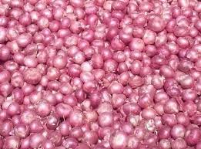
Post Harvest Technology of Onion
Prof. Dr. Sarfraz Hussain
FST 508

Slide 2
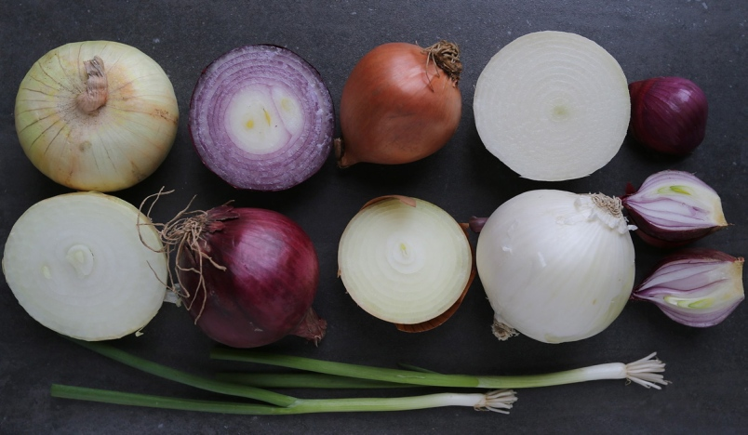
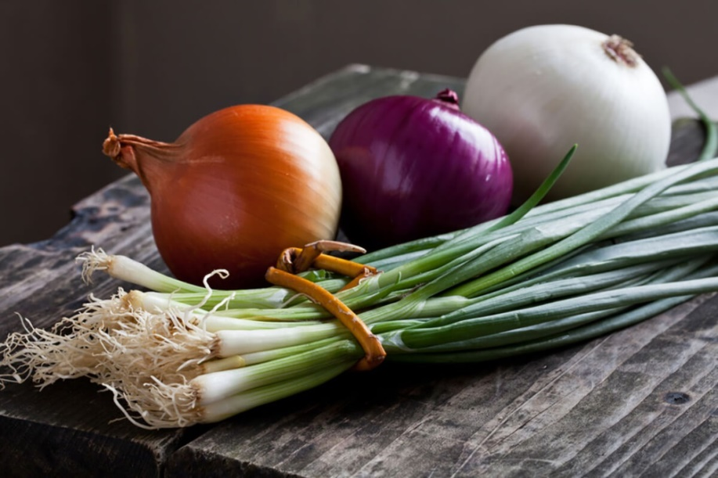
Introduction
The scientific name is Allium Cepa
Onion is a biennial of the Alliaceae family
Phulkara ,sultan ,nasarpuri ,white pearl are the verities of onions.

Slide 3
Onion Benefits
Onions contain antioxidants and compounds that fight inflammation, decrease triglycerides and reduce cholesterol levels — all of which may lower heart disease risk.
Their potent anti-inflammatory properties may also help reduce high blood pressure and protect against blood clots
Other than the onion paste, there are many other deep-processed onion products, such as dehydrated onion slices, onion powder, onion essential oil, onion juice and multi-flavor onions

Slide 4
Quality Characteristics and Criteria
High-quality onions have mature bulbs with good firmness and compactness of ﬂeshy scales
Size, shape, and the color of the dry skin should be typical for the variety
Onion should be free of mechanical or insect damage, decay, sunscald injury, greening of ﬂeshy scales, sprouting, bruising, doubles, bottlenecks (onions which have abnormally thick necks with only fairly well developed bulbs), and any other defects.

Slide 5
Horticultural Maturity Indices
Harvest maturity depends on the purpose for which the onions are grown
Onions intended for storage should be harvested when 50 to 80% of the tops have fallen over and bulbs are mature with a thin neck.
Yields are higher if they are harvested after the tops are completely dry, but then bulbs tend to have a shorter storage life.

Slide 6
Pre cooling conditions
Dry onion bulbs for long-term storage should be precooled to 0 °C (32 °F) immediately after drying, The precooling method affects storability
Rapid precooling inhibits rooting and sprouting during storage
Natural cooling (slow) has a positive effect on storability when onions have a long rest period and weather conditions are good for curing
Gradual cooling at 1 °C (1.8 °F) per day in storage is less effective at inhibiting sprouting and rooting than rapid cooling

Slide 7
Optimum Storage Conditions
Pungent dry onions can be stored for 6 to 9 weeks at 0 °C (32 °F) with 65 to 75% RH. High RH induces root growth, while high temperature induces sprouting
A combination of high temperature and high RH increases rotting and decreases quality.
Onions grown from seed store better than those grown from sets or transplants
Maleic hydrazide is applied 2 weeks before harvest, when bulbs are mature and 50% of tops are down, but onion plants must still have five to eight green leaves in order to absorb and translocate the sprout inhibit or to bulbs.

Slide 8
Continued . .
Onions intended for storage should be dried well and cured in the field, under sheds, or in storage. After 2 weeks of field drying, onions can be transferred to storage rooms for final drying and curing
Forced-air ventilation at 25 to 27 °C (77to 81 °F) using outside or heated air is commonly used to dry onions
Drying is complete when the onion neck is tight, outer scales are dry and make a rustling noise when touched, and the skin color is uniform
Weight loss of 3 to 5% can occur during drying

Slide 9
Continued . .
After drying and curing, the temperature should be lowered gradually to the normal seasonal temperature, or bulbs can be precooled in cold storage at 0 °C (32 °F)
In either case, condensation should be avoided as it encourages rot and changes the color of the dry skin.
Notes:
Refrigerated storage is used for onions that are to be marketed in late April to early July. For cold storage, onions are usually packed in crates or containers. Air circulation must be suffcient to maintain a constant temperature and remove moisture from inside storage containers. Onions packed in sacks can only be stored for a limited period, about 1 mo, since air movement through sacks is insuffcient to maintain proper storage conditions. onions should be thawed at 5 °C (41 °F) for 1 to 2 weeks before they are removed from storage. Rapid thawing damages onion bulbs.

Slide 10
Controlled Atmosphere
An atmosphere of 3% O₂ and 5% CO₂ inhibits rooting, sprouting ,and disease development
Onions stored in 3% O₂ and 10% CO₂ showed physiological disorders; high CO₂ caused injury, but neck rot (Botrytis spp.) was reduced

Slide 11
Retail Outlet Display Consideration
Onions should not be stored with fruits and vegetables that tend to absorb odors

Slide 12
Chilling Sensitivity
Onions are not sensitive to chilling and can be stored at -2 to -3 °C (28 to 27 °F), since the highest freezing point is -0.8 °C (31.6 °F). Storage at <-4 °C (25 °F) may cause freezing injury.
Ethylene production is very low i.e < 0.1 µL kg-1 h-1 at 20 °C and the sensitivity to ethylene is also low.

Slide 13
Post harvest pathology
A number of microorganisms attack onions postharvest.
Botrytis neck rot is indicated by watery decay, which begins at the neck and then attacks the entire bulb.
Black mold rot presents a black discoloration and shriveling at the neck and on outer scales caused by Aspergillus niger van Tiegh. Infection occurs in the feld, but the disease spread during postharvest.

Slide 14
Blue mold rot also produces watery soft rot of neck and outer scales, followed by formation of blue to blue-green mold of the fungus Penicillium spp.
Harvest of mature bulbs, proper curing, and storage at 0 °C (32 °F) with 60 to 70% RH minimizes blue mold problems

Slide 15
Continued . .
Bacterial soft rot, caused by Erwinia carotovora Jones, develops water-soaked individual scales, or the entire onion, with foul smelling, viscous, liquid-covered rotted areas
The disease progresses rapidly under warm, humid conditions
Harvesting at full maturity, proper drying, minimizing bruising, and maintaining optimum storage conditions prevent bacterial soft rot

Slide 16
Storage
The bulbs should be placed in well ventilated room
Pre harvest spray of maleic hydrazide (2000-2500ppm) prevents the rotting and sprouting of bulbs stored at room temperature

Slide 17
Transportation
Onions are packed in jute and gunny bags
Onion stocks are transported in carts, tractors, trucks for local markets
By railway for long distances within the country
Through ventilated ships, motor boats they are transported to gulf region and south east Asian countries

Slide 18
