Slide 1
Sociology ^{BBA} Semester: 3rd ^{Lecture No. 12} ^{Instructor: Mumtaz Hussain} University of Sargodha Sb Campus ^{Bhakkar}

Slide 3
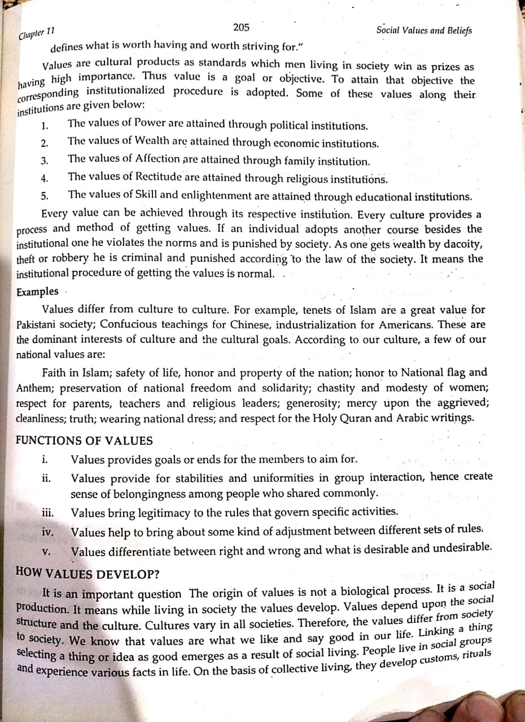

Slide 5
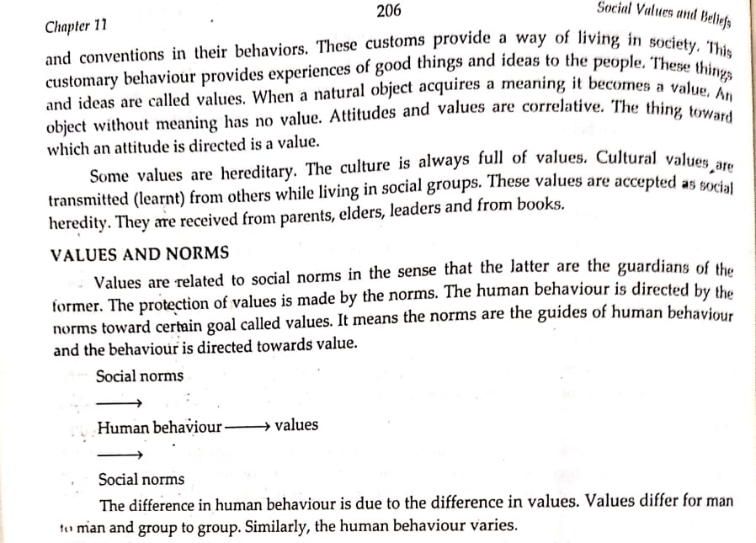

Slide 6
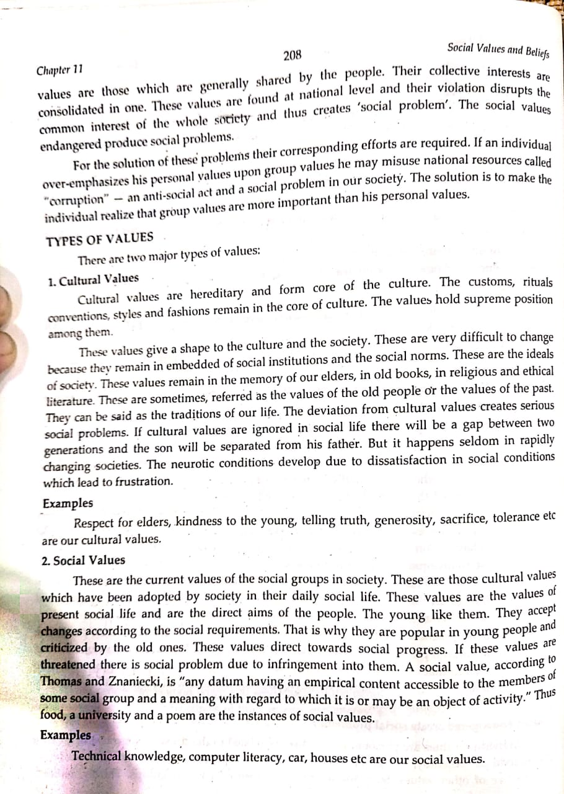

Slide 7
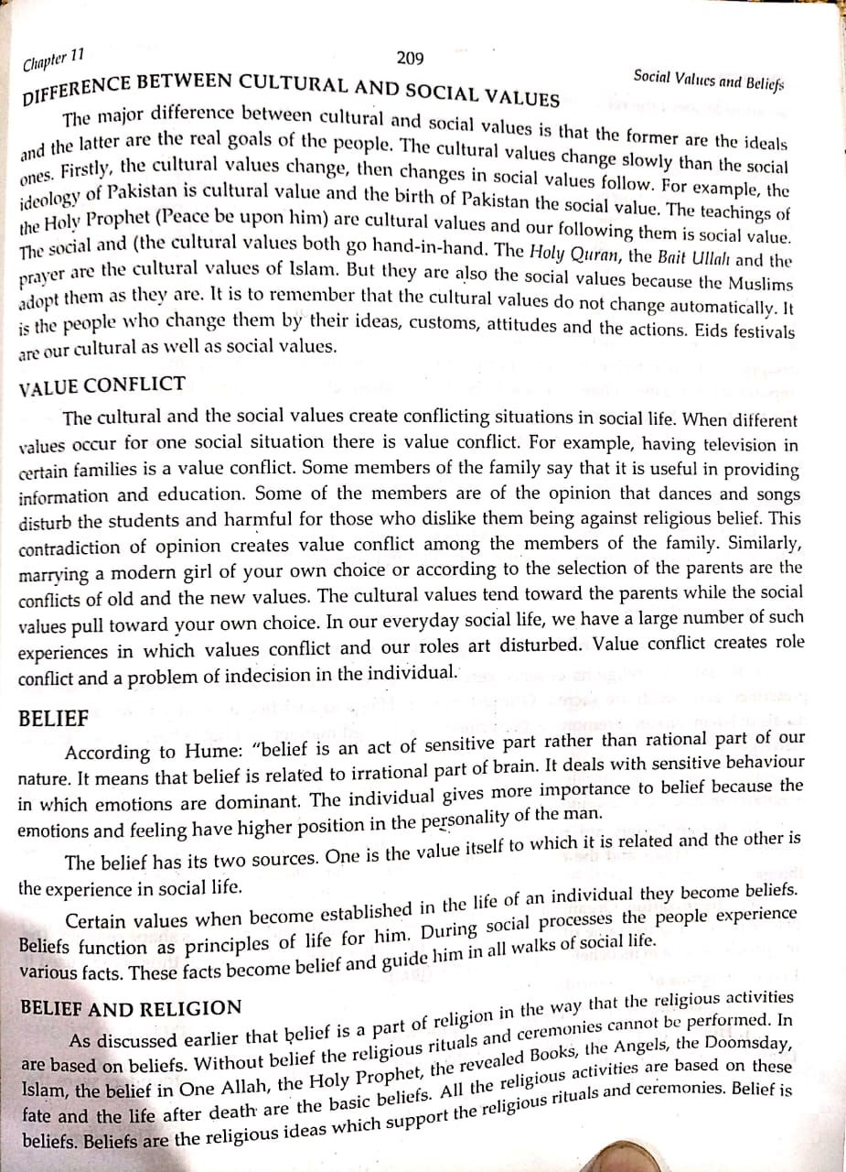

Slide 9
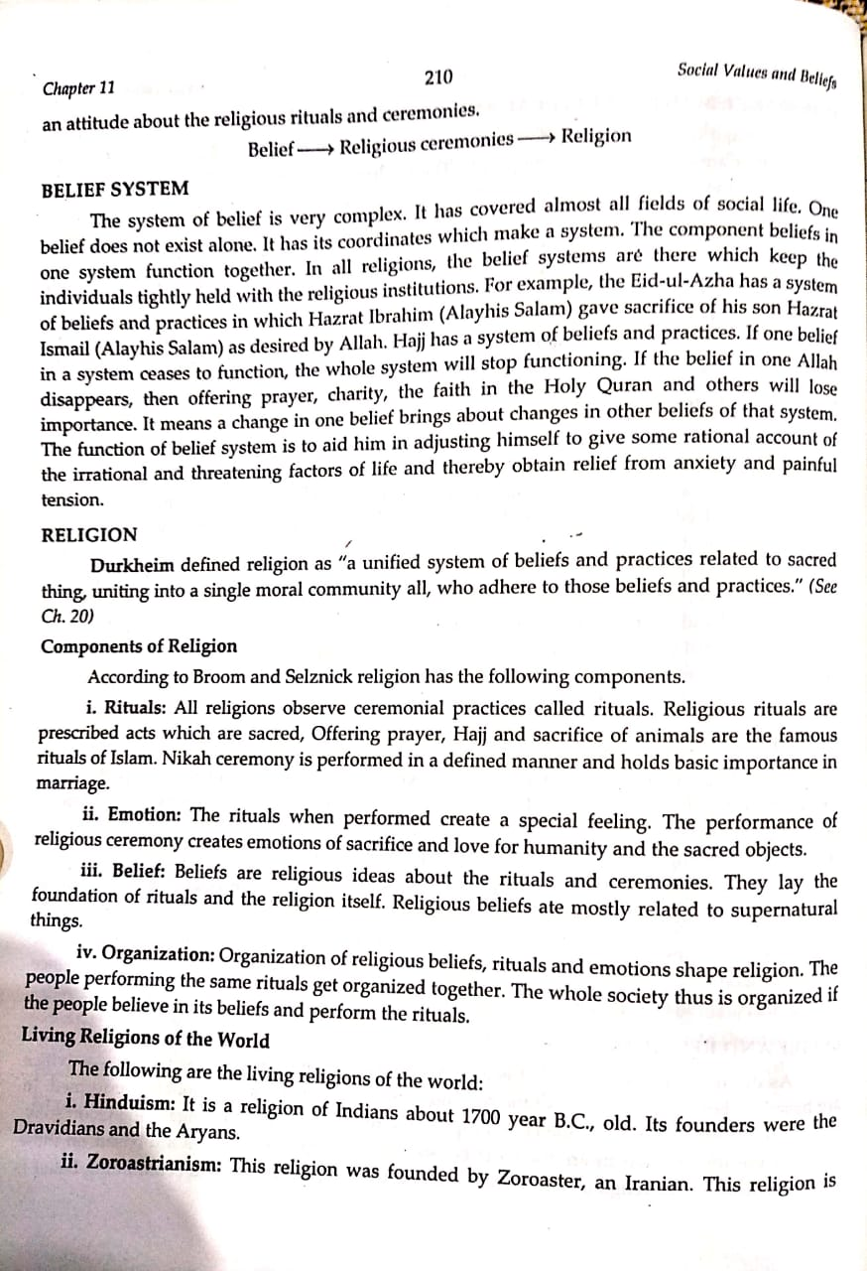

Slide 13
Thank You

