Slide 1
Drawing
Step by step

Slide 2
Elements?

Slide 4
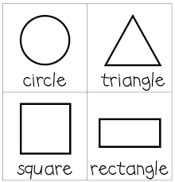
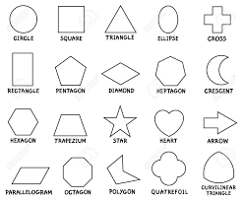
Basic shapes

Slide 5
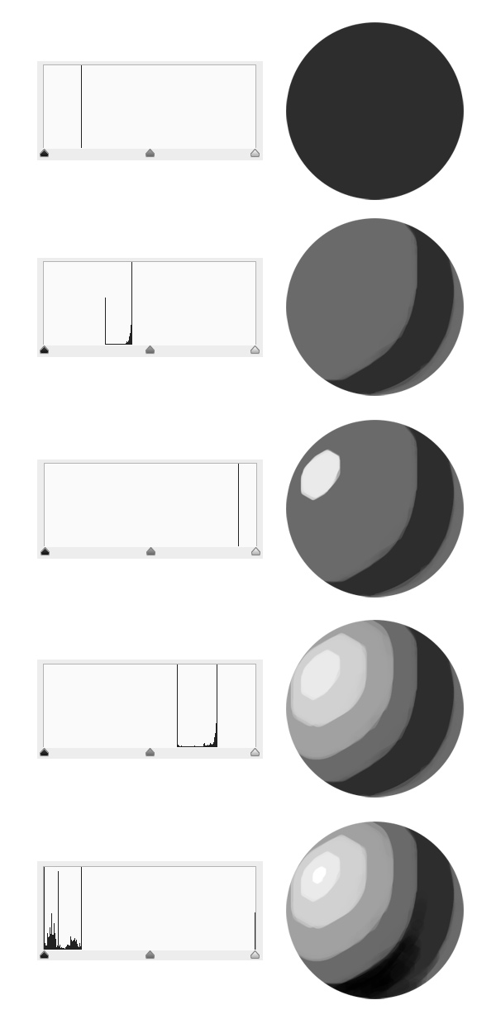
Tones

Slide 6
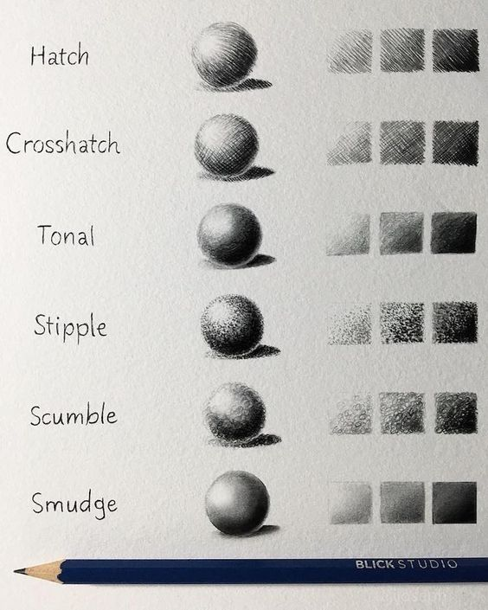
Strokes

Slide 7
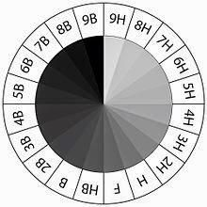
Pencils

Slide 8
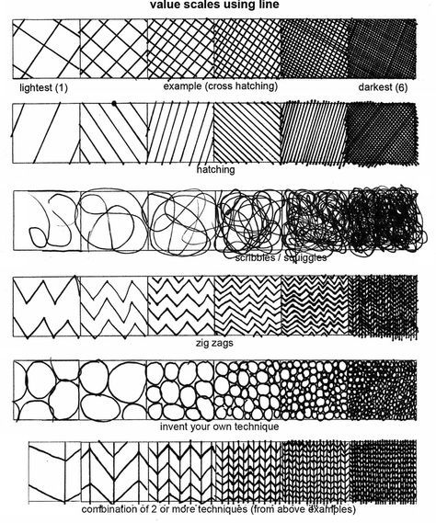
Values

Slide 9
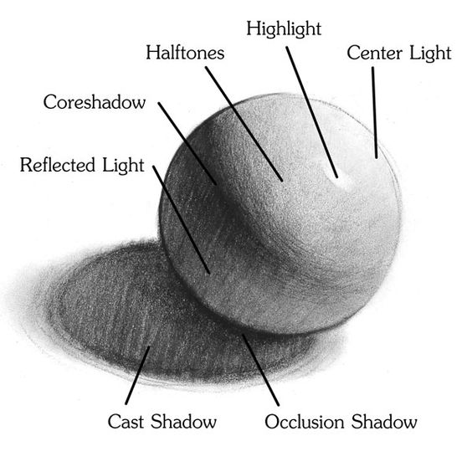
Making 3D

Slide 10
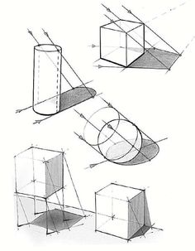
Locating shadow

Slide 11
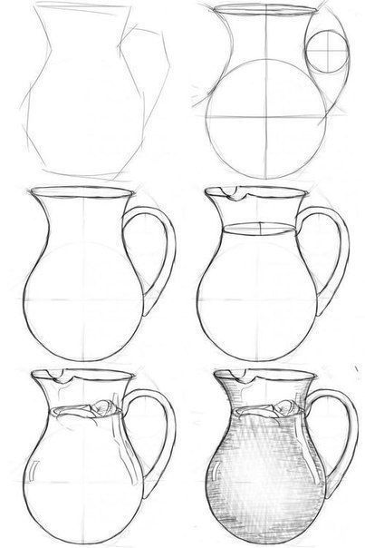
Steps

Slide 12
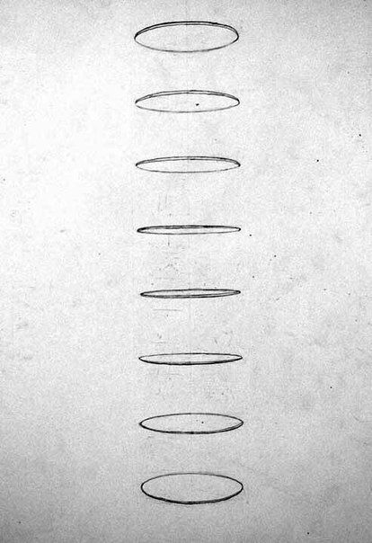
Perspective

Slide 13
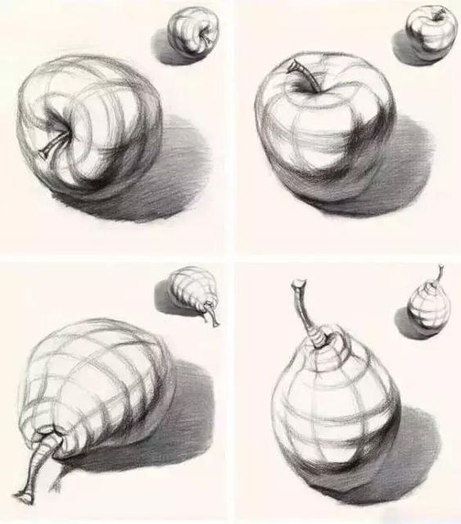
Shapes and angels

Slide 14
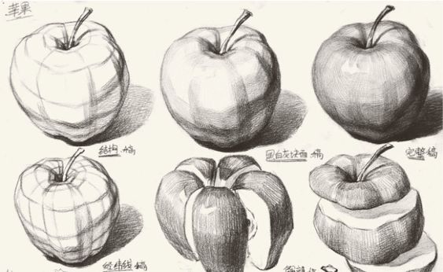

Slide 15
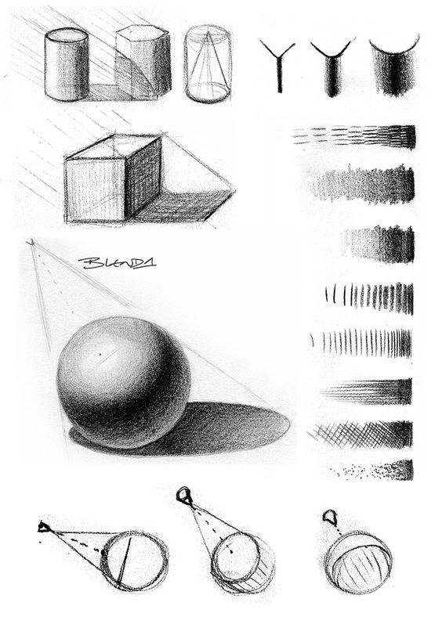
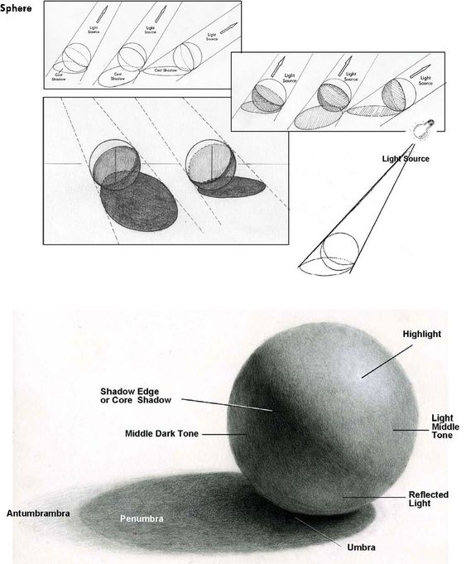
Recall

Slide 16
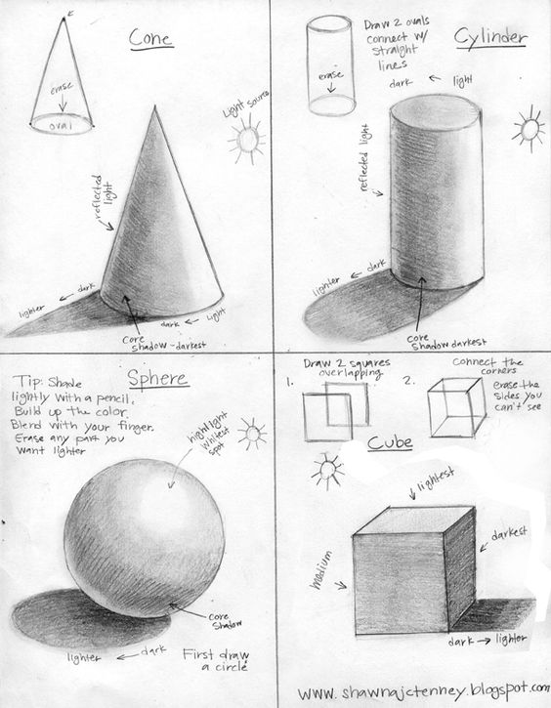
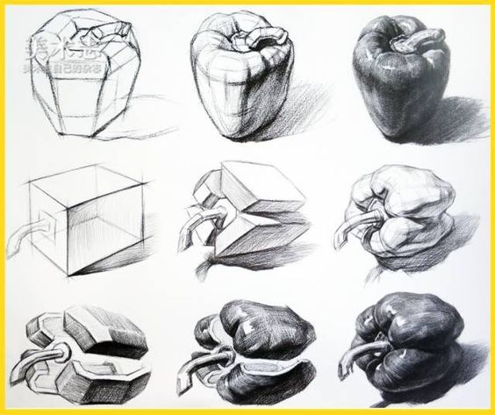
Basic shapes and shading

Slide 17
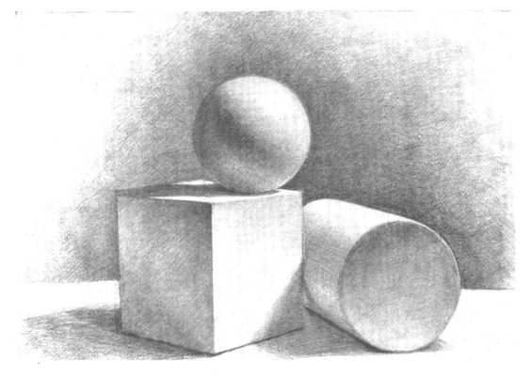

Slide 18
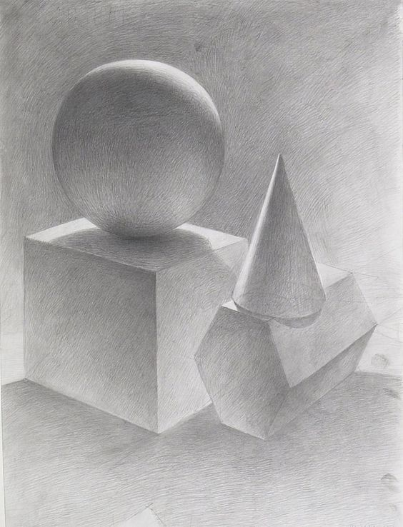
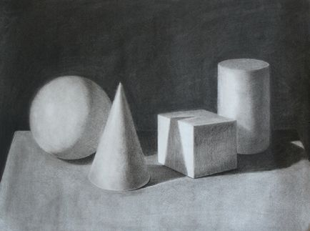

Slide 19
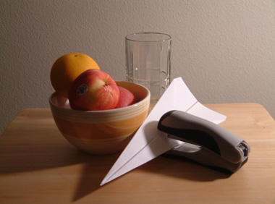
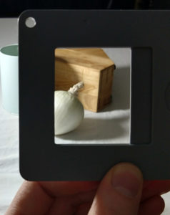
1. Make sure there’s a direct light source. 2. Use a viewfinder to set up your composition. This is the best way to start a drawing, and it’s pretty easy too. All you need to do is cut a rectangle out of a piece of cardboard (like a shoebox lid) and use it to visually crop your subject.
Before you start

Slide 20
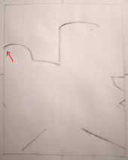
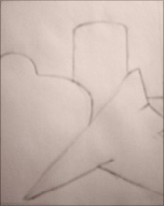
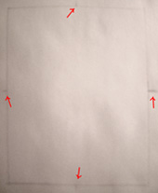
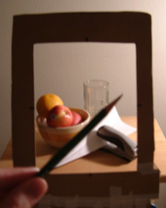
3. Start drawing objects that intersect the border. 4. Check line angles with your pencil. 5. Work around each edge and then move inward. 6. Draw the negative space around the objects. 7. Close one eye to flatten out the image. 8. Look back and forth as often as possible. 9. Erase when you see something wrong.

Slide 21
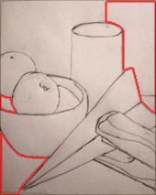
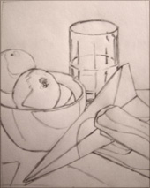
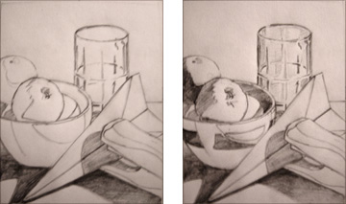
6. Draw the negative space around the objects. 7. Close one eye to flatten out the image. 8. Look back and forth as often as possible. 9. Erase when you see something wrong. 10. Shade from darkest to lightest.

Slide 22
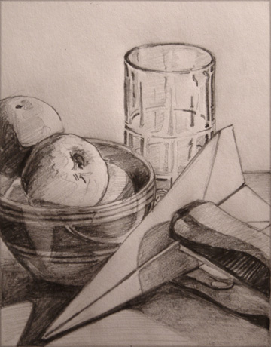
11. Include a full range of values. 12. Take a break before finishing.

Slide 23
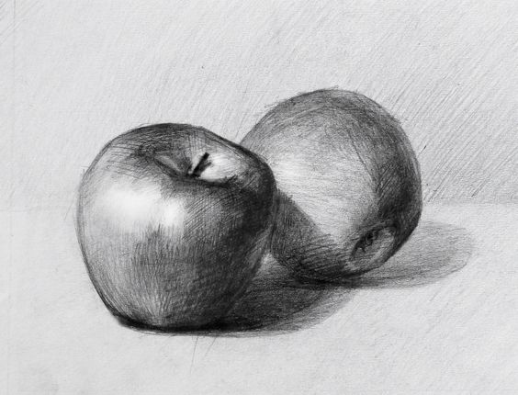
Some examples

Slide 24
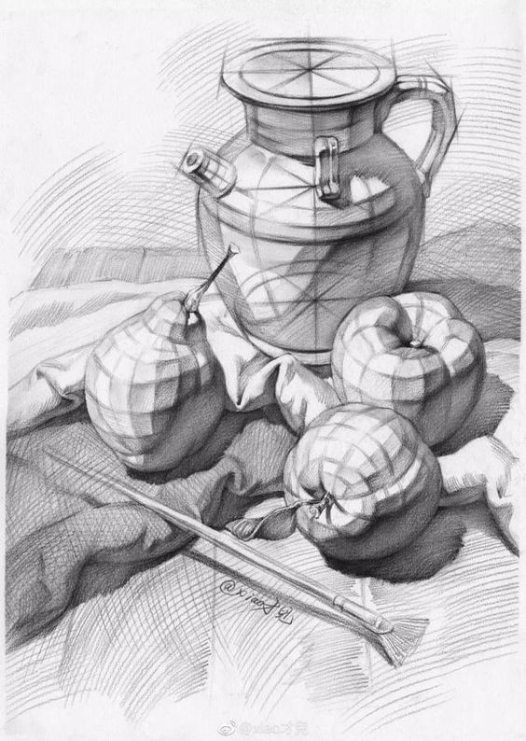

Slide 25
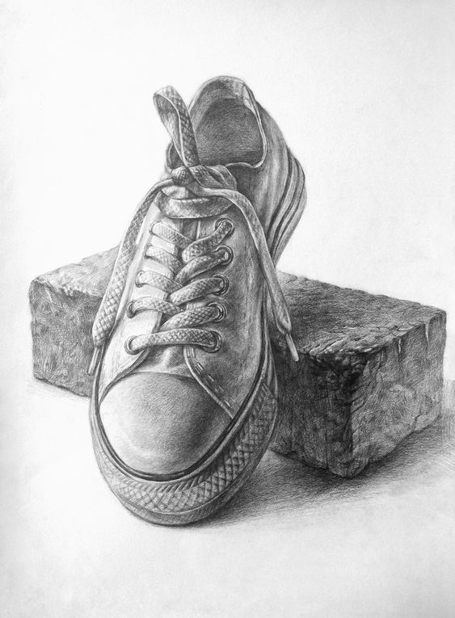

Slide 26
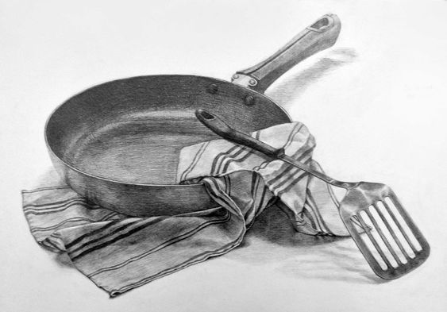

Slide 27
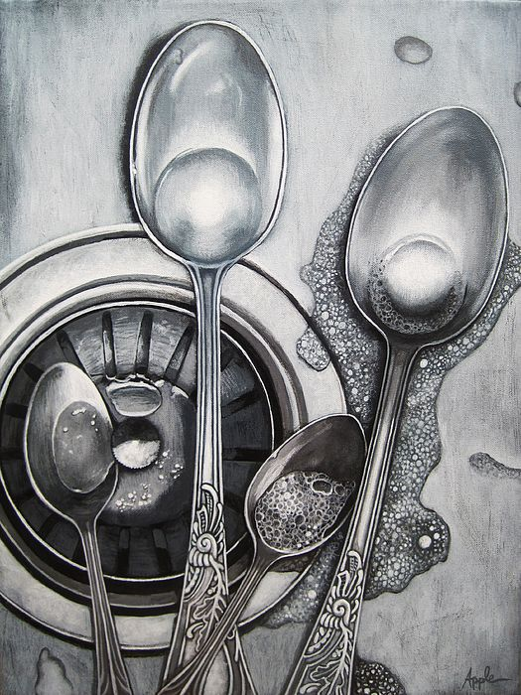

Slide 28
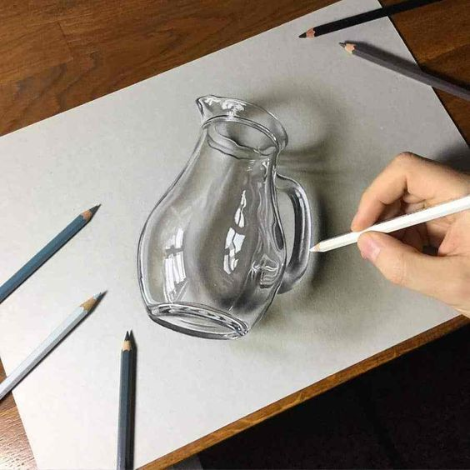

Slide 29
Your turn Have fun

