Slide 2
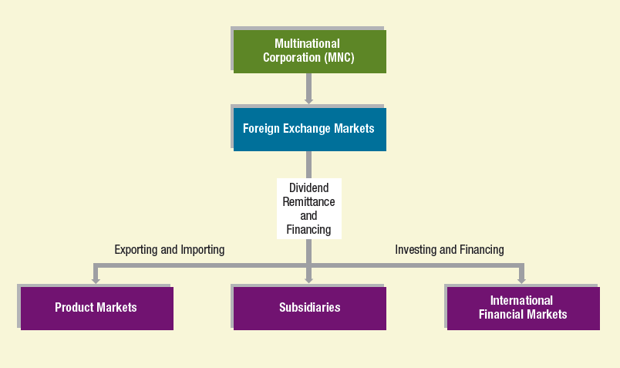
Part 1
The International Financial Environment
2

Slide 3
1
Multinational Financial Management: An Overview
Chapter Objectives
Identify the management goal and organizational structure of the Multinational Corporation (MNC).
Describe the key theories that justify international business
Explain the common methods used to conduct international business
Provide a model for valuing the MNC
3

Slide 4
Managing the MNC
Managers are expected to make decisions that will maximize the stock price.
Focus of this text: MNCs whose parents fully own foreign subsidiaries (U.S. parent is sole owner of subsidiary.)
Finance decisions are influenced by other business discipline functions:
Marketing
Management
Accounting and information systems

Slide 5
Agency Problems
The conflict of goals between managers and shareholders

Slide 6
Agency Costs
Definition: Cost of ensuring that managers maximize shareholder wealth
Costs are normally higher for MNCs than for purely domestic firms for several reasons:
Monitoring managers of distant subsidiaries in foreign countries is more difficult.
Foreign subsidiary managers raised in different cultures may not follow uniform goals.
Sheer size of larger MNCs can create large agency problems.
Some non-U.S. managers tend to downplay the short-term effects of decisions.

Slide 7
Control of Agency Problems
Parent control of agency problems
Parent should clearly communicate the goals for each subsidiary to ensure managers focus on maximizing the value of the subsidiary.
Corporate control of agency problems
Entire management of the MNC must be focused on maximizing shareholder wealth.
Sarbanes-Oxley Act (SOX)
Ensures a more transparent process for managers to report on the productivity and financial condition of their firm.

Slide 8
SOX Methods to Improve Reporting
Establishing a centralized database of information
Ensuring that all data are reported consistently among subsidiaries
Implementing a system that automatically checks for unusual discrepancies relative to norms
Speeding the process by which all departments and subsidiaries have access to all the data they need
Making executives more accountable for financial statements

Slide 9
Management Structure of MNC
Centralized (See Exhibit 1.1a)
Allows managers of the parent to control foreign subsidiaries and therefore reduce the power of subsidiary managers
Decentralized (See Exhibit 1.1b)
Gives more control to subsidiary managers who are closer to the subsidiary’s operation and environment

Slide 10
Exhibit 1.1a Management Styles of MNCs

Slide 11
Exhibit 1.1b Management Styles of MNCs

Slide 12
Why Firms Pursue International Business
Theory of Competitive Advantage: specialization increases production efficiency.
Imperfect Markets Theory: factors of production are somewhat immobile providing incentive to seek out foreign opportunities.
Product Cycle Theory: as a firm matures, it recognizes opportunities outside its domestic market.

Slide 13
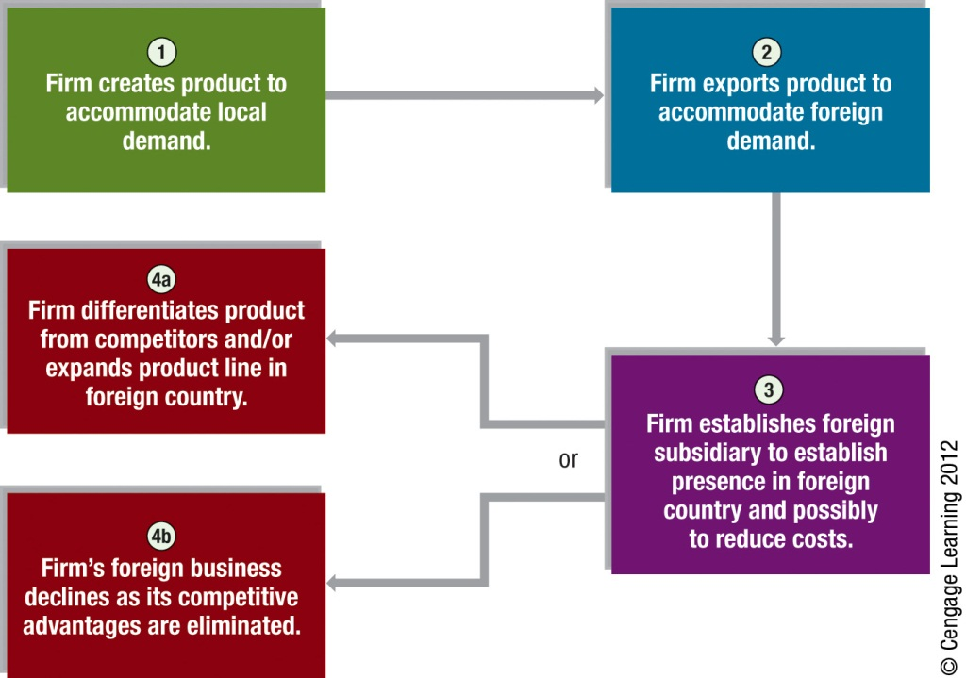
Exhibit 1.2 International Product Life Cycles
13

Slide 14
How Firms Engage in International Business
International trade
Licensing
Franchising
Joint Ventures
Acquisitions of existing operations
Establishing new foreign subsidiaries

Slide 15
International Trade
Relatively conservative approach that can be used by firms to
penetrate markets (by exporting)
obtain supplies at a low cost (by importing).
Minimal risk – no capital at risk
The internet facilitates international trade by allowing firms to advertise their products and accept orders on their websites.

Slide 16
Licensing
Obligates a firm to provide its technology (copyrights, patents, trademarks, or trade names) in exchange for fees or some other specified benefits.
Allows firms to use their technology in foreign markets without a major investment and without transportation costs that result from exporting
Major disadvantage: difficult to ensure quality control in foreign production process

Slide 17
Franchising
Obligates firm to provide a specialized sales or service strategy, support assistance, and possibly an initial investment in the franchise in exchange for periodic fees.
Allows penetration into foreign markets without a major investment in foreign countries.

Slide 18
Joint Ventures
A venture that is jointly owned and operated by two or more firms. A firm may enter the foreign market by engaging in a joint venture with firms that reside in those markets.
Allows two firms to apply their respective cooperative advantages in a given project.

Slide 19
Acquisitions of Existing Operations
Acquisitions of firms in foreign countries allows firms to have full control over their foreign businesses and to quickly obtain a large portion of foreign market share.
Subject to the risk of large losses because of larger investment.
Liquidation may be difficult if the foreign subsidiary performs poorly.

Slide 20
Establishing New Foreign Subsidiaries
Firms can penetrate markets by establishing new operations in foreign countries.
Requires a large investment
Acquiring new as opposed to buying existing allows operations to be tailored exactly to the firms needs.
May require smaller investment than buying existing firm.

Slide 21
Summary of Methods
Any method of increasing international business that requires a direct investment in foreign operations is referred to as direct foreign investment (DFI)
International trade and licensing usually not included
Foreign acquisition and establishment of new foreign subsidiaries represent the largest portion of DFI.

Slide 22
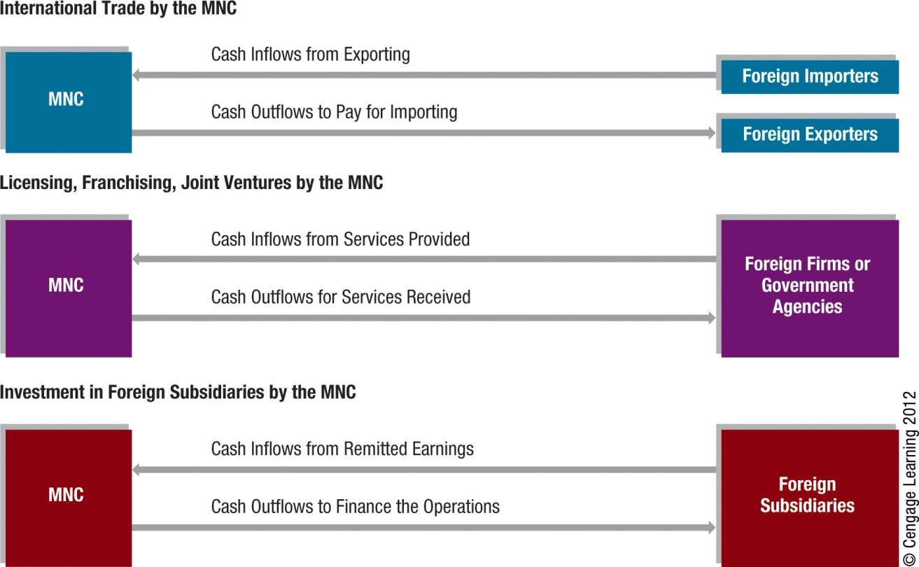
Exhibit 1.3 Cash Flow Diagrams for MNCs
22

Slide 23
Exhibit 1.3 Cash Flow Diagrams for MNCs
The first diagram reflects an MNC that engages in international trade. International cash flows result from paying for imports or receiving cash flow from exports.
The second diagram reflects an MNC that engages in some international arrangements. Outflows include expenses such as expenses incurred from transferring technology or funding partial investment in a franchise or joint venture. Inflows are receipts from fees.
The third diagram reflects an MNC that engages in direct foreign investment. Cash flows exist between the parent company and the foreign subsidiary.

Slide 24
Valuation Model for an MNC:
Domestic Model
Where
V represents present value of expected cash flows
E(CF_{$,t}) represents expected cash flows to be received at the end of period t,
n represents the number of periods into the future in which cash flows are received, and
k represents the required rate of return by investors.
24

Slide 25
Valuation Model for an MNC:
Multinational Model
Where
CF_{j,t} represents the amount of cash flow denominated in a particular foreign currency j at the end of period t,
S_{j,t} represents the exchange rate at which the foreign currency (measured in dollars per unit of the foreign currency) can be converted to dollars at the end of period t.
25

Slide 26
Valuation Model for an MNC
An MNC that uses two or more currencies
Derive an expected dollar cash flow value for each currency
Combine the cash flows among currencies within a given period
26

Slide 27
Uncertainty Surrounding MNC Cash Flows
Exposure to international economic conditions – If economic conditions in a foreign country weaken, purchase of products decline and MNC sales in that country may be lower than expected.
Exposure to international political risk – A foreign government may increase taxes or impose barriers on the MNC’s subsidiary.
Exposure to exchange rate risk – If foreign currencies related to the MNC subsidiary weaken against the U.S. dollar, the MNC will receive a lower amount of dollar cash flows than was expected.

Slide 28
How Uncertainty Affects the MNC’s cost of Capital
A higher level of uncertainty increases the return on investment required by investors and the MNC’s valuation decreases.

Slide 29
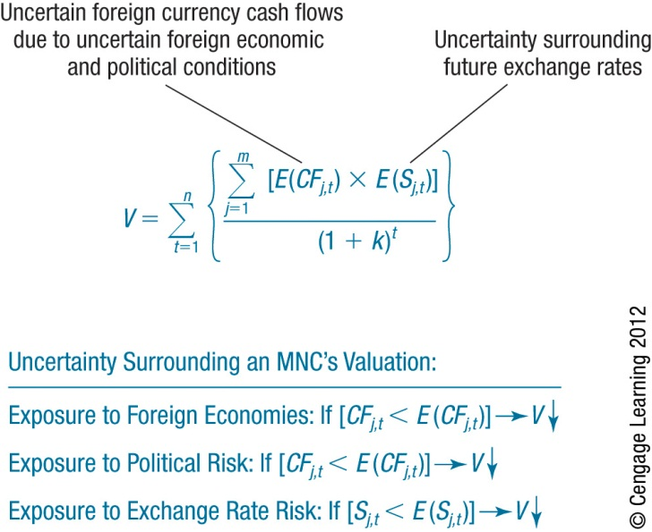
Exhibit 1.4 How an MNC’s Valuation is Exposed to Uncertainty

Slide 30
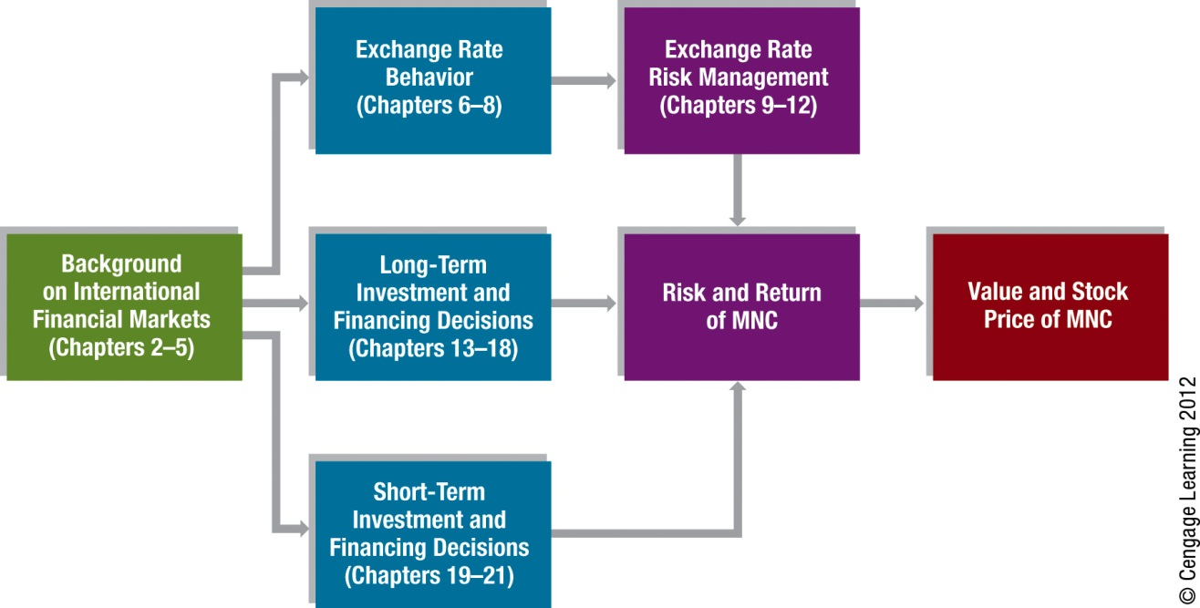
Exhibit 1.5 Organization of Chapters

Slide 31
Summary
The main goal of an MNC is to maximize shareholder wealth. When managers are tempted to serve their own interests instead of those of shareholders, an agency problem exists. MNCs tend to experience greater agency problems than do domestic firms. Proper incentives and communication from the parent may help to ensure that subsidiary managers focus on serving the overall MNC.

Slide 32
Summary
International business is justified by three key theories.
The theory of comparative advantage suggests that each country should use its comparative advantage to specialize in its production and rely on other countries to meet other needs.
The imperfect markets theory suggests that because of imperfect markets, factors of production are immobile, which encourages countries to specialize based on the resources they have.
The product cycle theory suggests that after firms are established in their home countries, they commonly expand their product specialization in foreign countries.

Slide 33
Summary
The most common methods by which firms conduct international business are international trade, licensing, franchising, joint ventures, acquisitions of foreign firms, and formation of foreign subsidiaries. Methods such as licensing and franchising involve little capital investment but distribute some of the profits to other parties. The acquisition of foreign firms and formation of foreign subsidiaries require substantial capital investments but offer the potential for large returns.

Slide 34
Summary
The valuation model of an MNC shows that the MNC’s value is favorably affected when its expected foreign cash inflows increase, the currencies denominating those cash inflows increase, or the MNC’s required rate of return decreases. Conversely, the MNC’s value is adversely affected when its expected foreign cash inflows decrease, the values of currencies denominating those cash flows decrease (assuming that they have net cash inflows in foreign currencies), or the MNC’s required rate of return increases.

