Slide 1
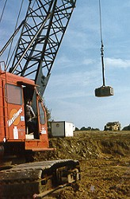
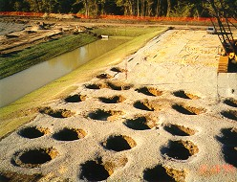
V Compaction
Courtesy of U.S. WICK DRAIN, INC.

Slide 2
Outline
Soil Improvement
Compaction
Theory of Compaction
Properties and Structure of Compacted Fine-Grained Soils
Field Compaction Equipment and Procedures
Field Compaction Control and Specifications
Estimating Performance of Compacted Soils
Suggested Homework
References

Slide 3
1. Soil Improvement

Slide 4
1.1 Methods for Soil Improvement
Ground
Reinforcement
Ground
Improvement
Ground
Treatment
Stone Columns
Soil Nails
Deep Soil Nailing
Micropiles (Mini-piles)
Jet Grouting
Ground Anchors
Geosynthetics
Fiber Reinforcement
Lime Columns
Vibro-Concrete Column
Mechanically Stabilized Earth
Biotechnical
Deep Dynamic Compaction
Drainage/Surcharge
Electro-osmosis
Compaction grouting
Blasting
Surface Compaction
Soil Cement
Lime Admixtures
Flyash
Dewatering
Heating/Freezing
Vitrification
Compaction
Shaefer, 1997

Slide 5
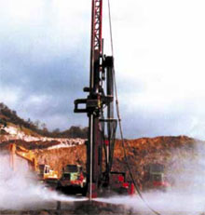
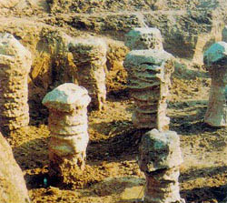
1.1 Methods for Soil Improvement- Jet Grouting
Courtesy of Menard-soltraitement

Slide 6
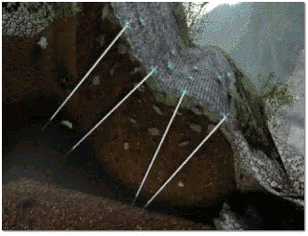
1.1 Methods for Soil Improvement-Soil Nailing
Courtesy of Atlas Copco Rock Drilling Equipment

Slide 7
1.2 Elephant and Compaction
Question?
The compaction result is not good. Why?
He He! I’m smart.
Heavy Weight

Slide 8
2. Compaction

Slide 9
2.1 Compaction and Objectives
Compaction
Many types of earth construction, such as dams, retaining walls, highways, and airport, require man-placed soil, or fill. To compact a soil, that is, to place it in a dense state.
The dense state is achieved through the reduction of the air voids in the soil, with little or no reduction in the water content. This process must not be confused with consolidation, in which water is squeezed out under the action of a continuous static load.
Objectives:
Decrease future settlements
Increase shear strength
Decrease permeability
(From Lambe, 1991; Head, 1992)

Slide 10
2.2 General Compaction Methods
dough
Coarse-grained soils
Fine-grained soils
Vibrating hammer (BS)
Falling weight and hammers
Kneading compactors
Static loading and press
Laboratory
Hand-operated vibration plates
Motorized vibratory rollers
Rubber-tired equipment
Free-falling weight; dynamic compaction (low frequency vibration, 4~10 Hz)
Field
Hand-operated tampers
Sheepsfoot rollers
Rubber-tired rollers
Vibration
Kneading
(Holtz and Kovacs, 1981; Head, 1992)

Slide 11
3. Theory of Compaction (Laboratory Test)

Slide 12
3.1 Laboratory Compaction
Origin
The fundamentals of compaction of fine-grained soils are relatively new. R.R. Proctor in the early 1930’s was building dams for the old Bureau of Waterworks and Supply in Los Angeles, and he developed the principles of compaction in a series of articles in Engineering News-Record. In his honor, the standard laboratory compaction test which he developed is commonly called the proctor test.
Purpose
The purpose of a laboratory compaction test is to determine the proper amount of mixing water to use when compacting the soil in the field and the resulting degree of denseness which can be expected from compaction at this optimum water
Impact compaction
The proctor test is an impact compaction. A hammer is dropped several times on a soil sample in a mold. The mass of the hammer, height of drop, number of drops, number of layers of soil, and the volume of the mold are specified.

Slide 13
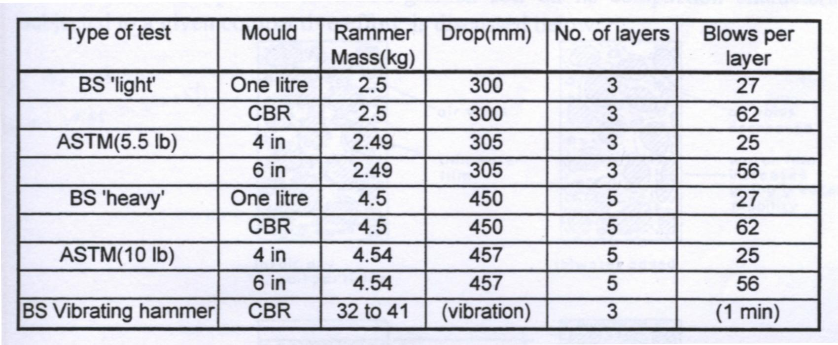
3.1.1 Various Types
Various types of compaction test
1
2
3
1: your test
2: Standard Proctor test
3: Modified Proctor test

Slide 14
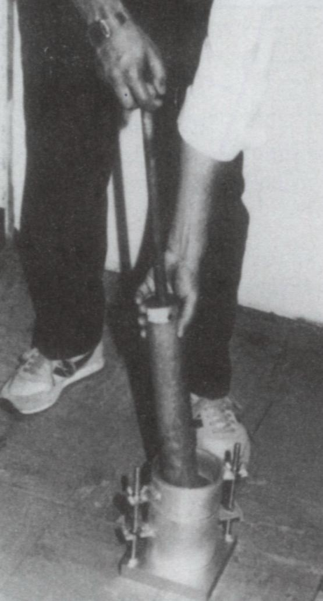
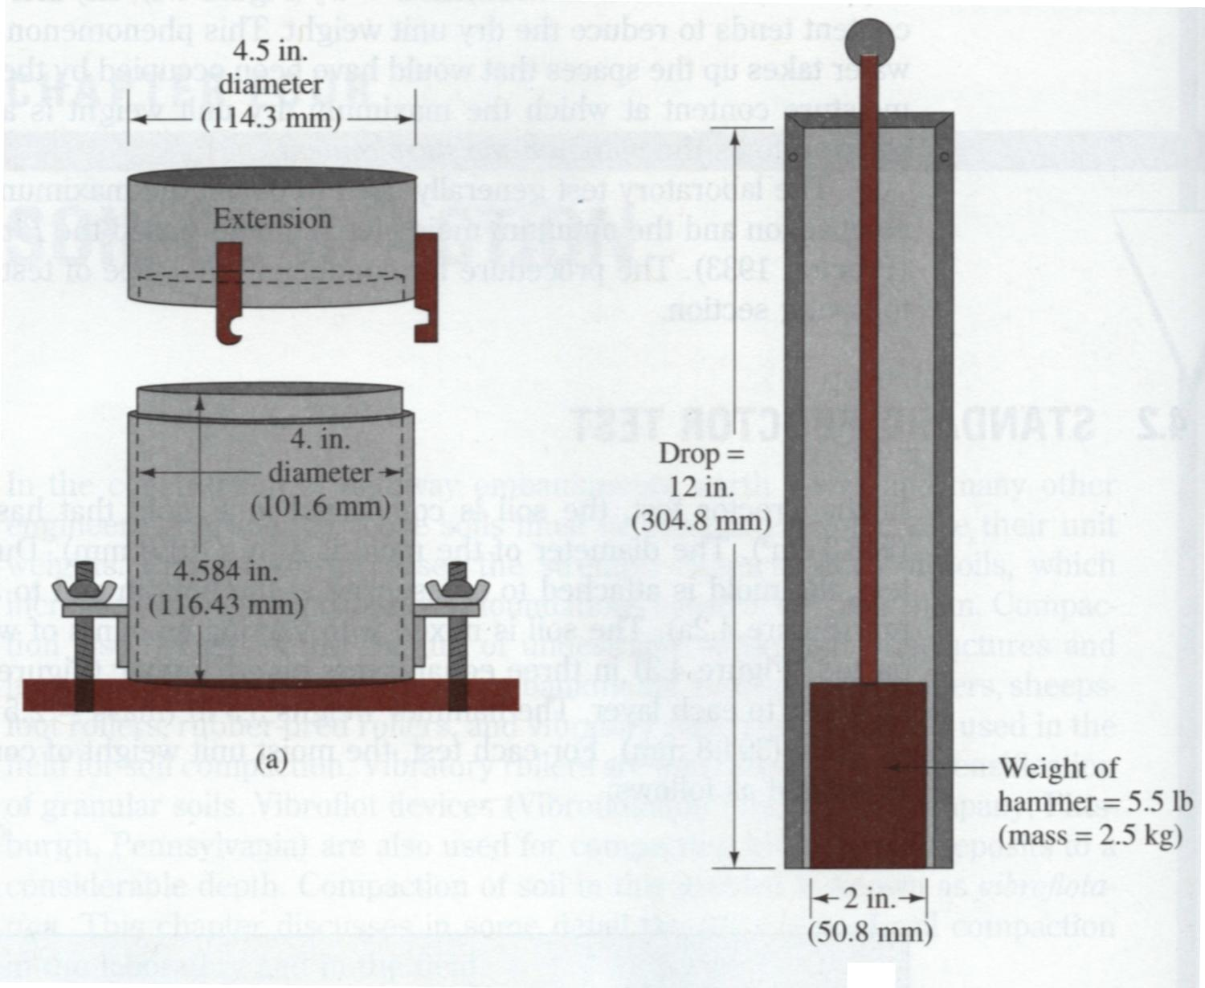
3.1.2 Test Equipment
Standard Proctor test equipment
Das, 1998

Slide 15
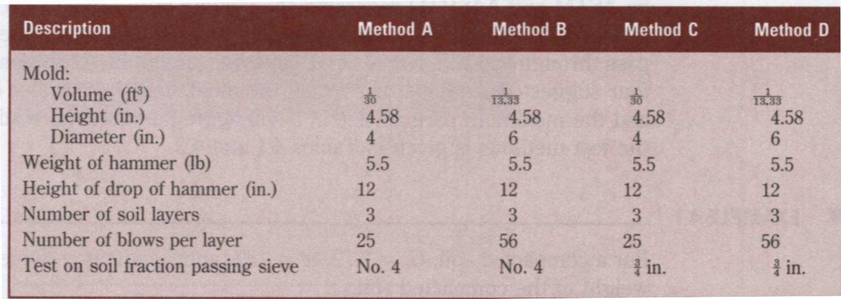
3.1.3 Comparison- Standard and Modified Proctor Compaction Test
Summary of Standard Proctor Compaction Test Specifications (ASTM D-698, AASHTO)
Das, 1998

Slide 16
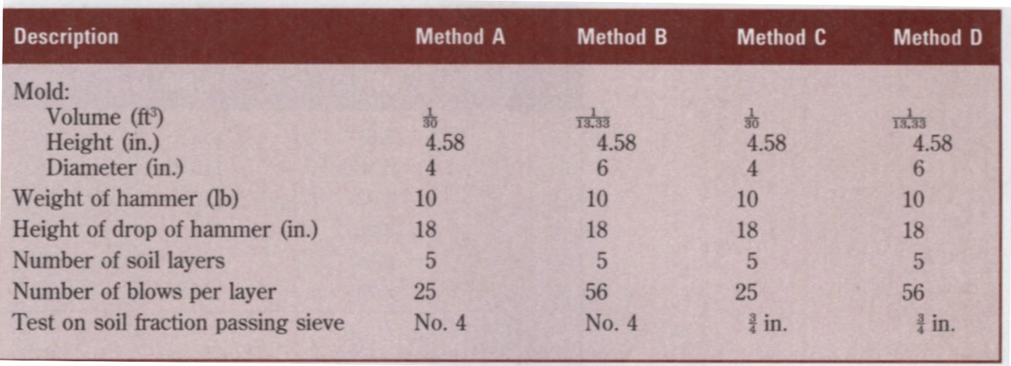
3.1.3 Comparison- Standard and Modified Proctor Compaction Test (Cont.)
Summary of Modified Proctor Compaction Test Specifications (ASTM D-698, AASHTO)
Das, 1998

Slide 17
3.1.3 Comparison-Summary
Standard Proctor Test
12 in height of drop
5.5 lb hammer
25 blows/layer
3 layers
Mold size: 1/30 ft³
Energy 12,375 ft·lb/ft³
Modified Proctor Test
18 in height of drop
10 lb hammer
25 blows/layer
5 layers
Mold size: 1/30 ft³
Energy 56,250 ft·lb/ft³
Higher compacting energy

Slide 18
3.1.4 Comparison-Why?
In the early days of compaction, because construction equipment was small and gave relatively low compaction densities, a laboratory method that used a small amount of compacting energy was required. As construction equipment and procedures were developed which gave higher densities, it became necessary to increase the amount of compacting energy in the laboratory test.
The modified test was developed during World War II by the U.S. Army Corps of Engineering to better represent the compaction required for airfield to support heavy aircraft. The point is that increasing the compactive effort tends to increase the maximum dry density, as expected, but also decrease the optimum water content.
(Holtz and Kovacs, 1981; Lambe, 1991)
Notes:
None of the commonly used laboratory tests lend themselves well to the study of the compaction characteristics fo clean sands or gravels.

Slide 19
3.2 Variables of Compaction
Proctor established that compaction is a function of four variables:
Dry density (ρ_{d}) or dry unit weight γ_{d}.
Water content w
Compactive effort (energy E)
Soil type (gradation, presence of clay minerals, etc.)
Weight of hammer
×
Height of drop of hammer
Number of blows per layer
For standard Proctor test
×
×
Number of layers
E =
Volume of mold

Slide 20
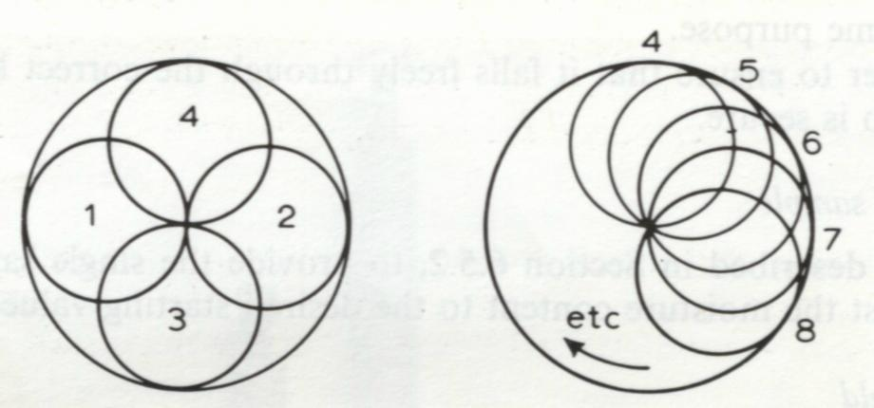
3.3 Procedures and Results
Procedures
Several samples of the same soil, but at different water contents, are compacted according to the compaction test specifications.
The total or wet density and the actual water content of each compacted sample are measured.
Plot the dry densities ρ_{d} versus water contents w for each compacted sample. The curve is called as a compaction curve.
The first four blows
The successive blows
Derive ρ_{d} from the known ρ and w

Slide 21
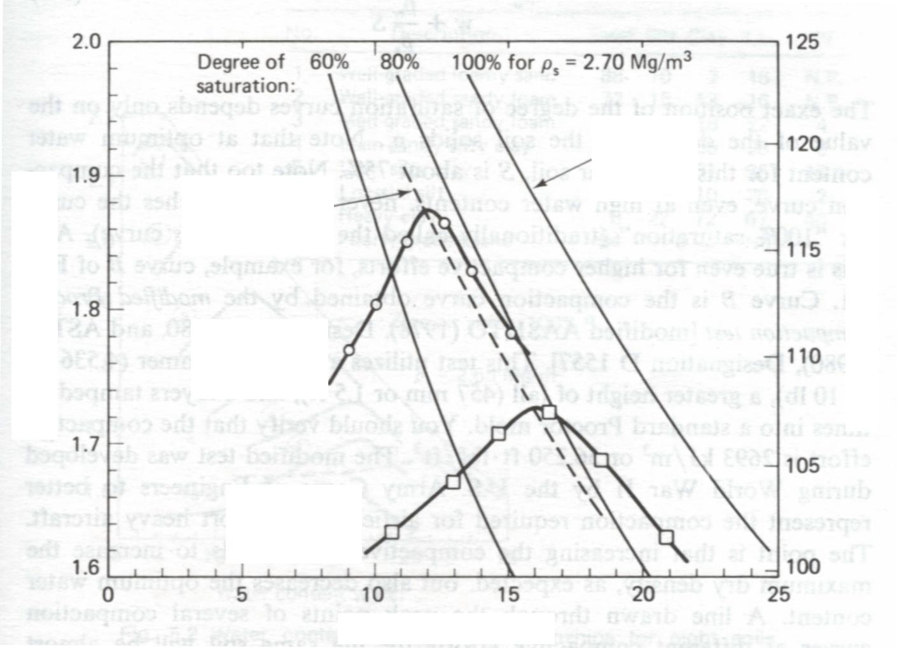
3.3 Procedures and Results (Cont.)
Results
Peak point
Line of optimum
Zero air void
Line of optimums
Zero air void
ρ_{d max}
Dry density ρ_{d} (Mg/m³)
Dry density ρ_{d} (lb/ft³)
Modified Proctor
Standard Proctor
w_{opt}
Water content w (%)
Holtz and Kovacs, 1981
Notes:
Optimum water content is typically slightly less than the plastic limit.

Slide 22
3.3 Procedures and Results (Cont.)
The peak point of the compaction curve
The peak point of the compaction curve is the point with the maximum dry density ρ_{d max}. Corresponding to the maximum dry density ρ_{d max} is a water content known as the optimum water content w_{opt} (also known as the optimum moisture content, OMC). Note that the maximum dry density is only a maximum for a specific compactive effort and method of compaction. This does not necessarily reflect the maximum dry density that can be obtained in the field.
Zero air voids curve
The curve represents the fully saturated condition (S = 100 %). (It cannot be reached by compaction)
Line of optimums
A line drawn through the peak points of several compaction curves at different compactive efforts for the same soil will be almost parallel to a 100 % S curve, it is called the line of optimums

Slide 23
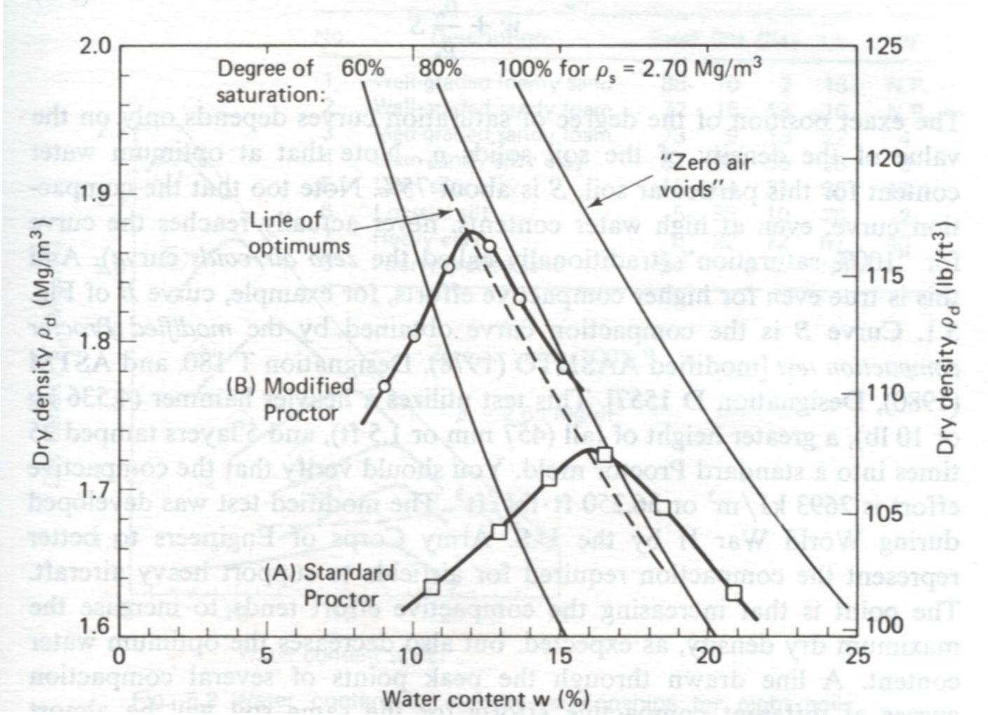
3.3 Procedures and Results (Cont.)
The Equation for the curves with different degree of saturation is :
You can derive the equation by yourself
Hint:
Holtz and Kovacs, 1981

Slide 24
3.3 Procedures and Results-Explanation
Below w_{opt} (dry side of optimum):
As the water content increases, the particles develop larger and larger water films around them, which tend to “lubricate” the particles and make them easier to be moved about and reoriented into a denser configuration.
Lubrication or loss of suction??
(w_{opt}, ρ_{d max})
At w_{opt}:
The density is at the maximum, and it does not increase any further.
ρ_{d}
Above w_{opt} (wet side of optimum):
Water starts to replace soil particles in the mold, and since ρ_{w} << ρ_{s} the dry density starts to decrease.
w
Holtz and Kovacs, 1981

Slide 25
3.3 Procedures and Results-Notes
Each data point on the curve represents a single compaction test, and usually four or five individual compaction tests are required to completely determine the compaction curve.
At least two specimens wet and two specimens dry of optimum, and water contents varying by about 2%.
Optimum water content is typically slightly less than the plastic limit (ASTM suggestion).
Typical values of maximum dry density are around 1.6 to 2.0 Mg/m³ with the maximum range from about 1.3 to 2.4 Mg/m³. Typical optimum water contents are between 10% and 20%, with an outside maximum range of about 5% to 40%.
Holtz and Kovacs, 1981

Slide 26
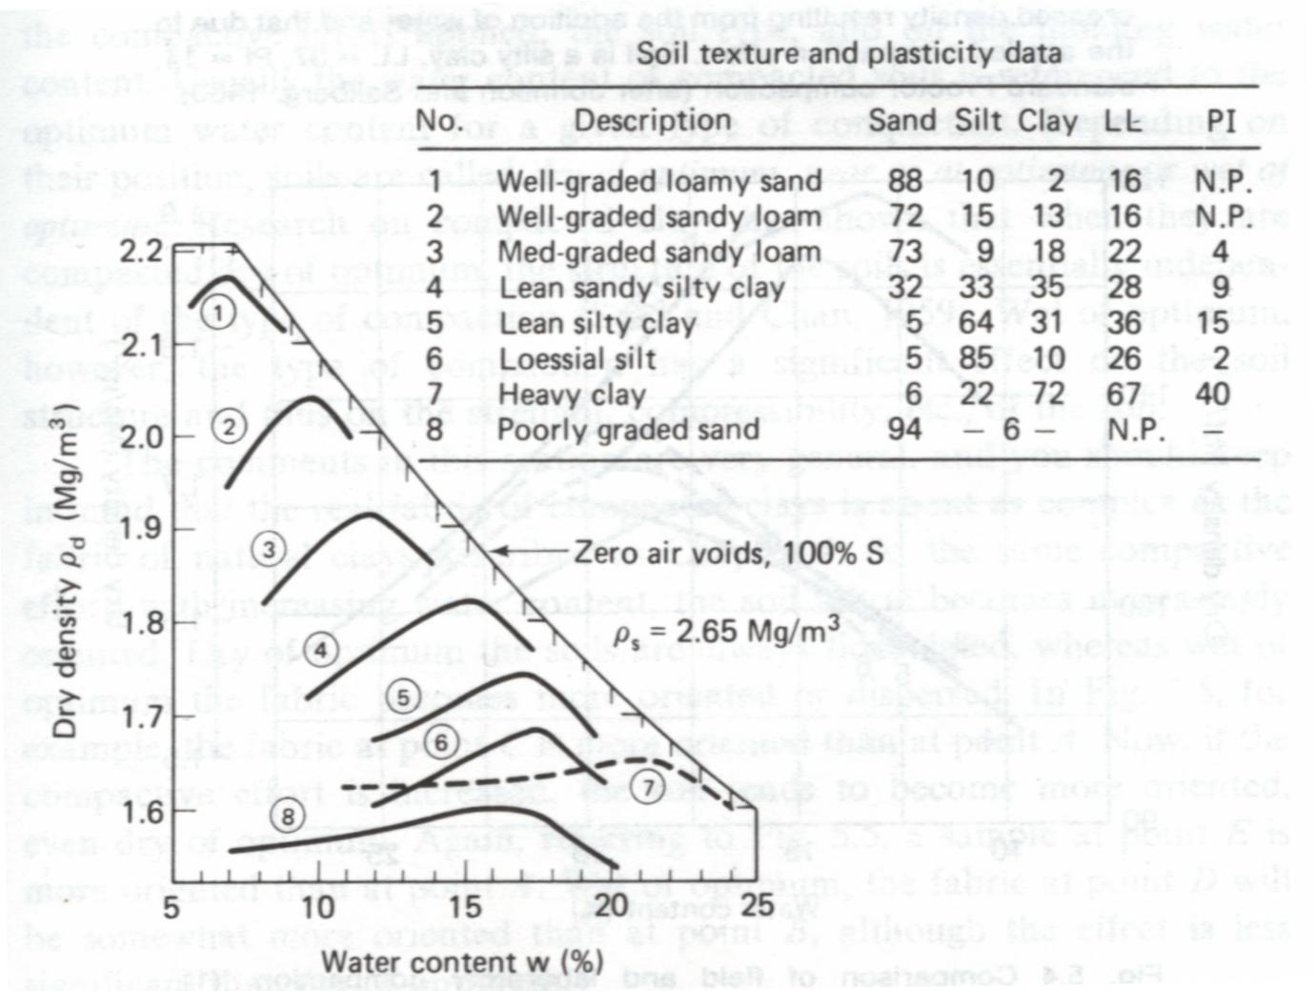
3.4 Effects of Soil Types on Compaction
The soil type-that is, grain-size distribution, shape of the soil grains, specific gravity of soil solids, and amount and type of clay minerals present.
Holtz and Kovacs, 1981; Das, 1998

Slide 27
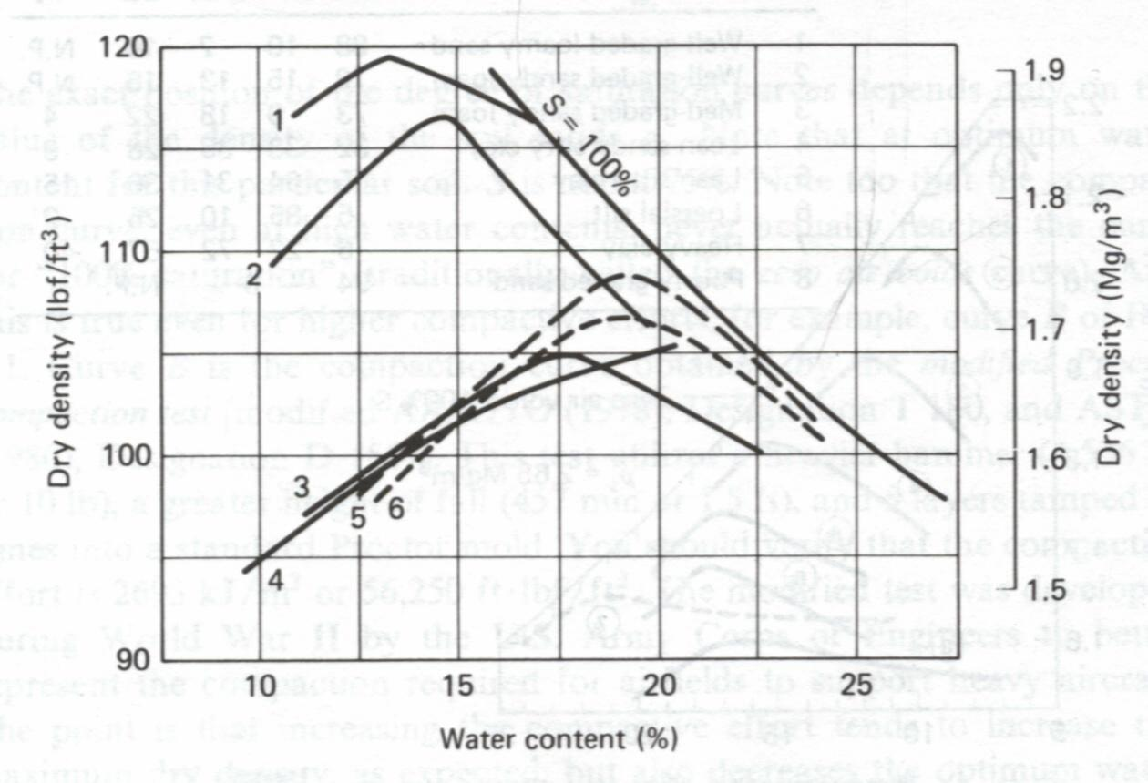
3.5 Field and Laboratory Compaction
It is difficult to choose a laboratory test that reproduces a given field compaction procedure.
The laboratory curves generally yield a somewhat lower optimum water content than the actual field optimum.
The majority of field compaction is controlled by the dynamic laboratory tests.
Curve 1, 2,3,4: laboratory compaction
Curve 5, 6: Field compaction
(From Lambe and Whitman, 1979)

Slide 28
4. Properties and Structure of Compacted Fine-grained Soils

Slide 29
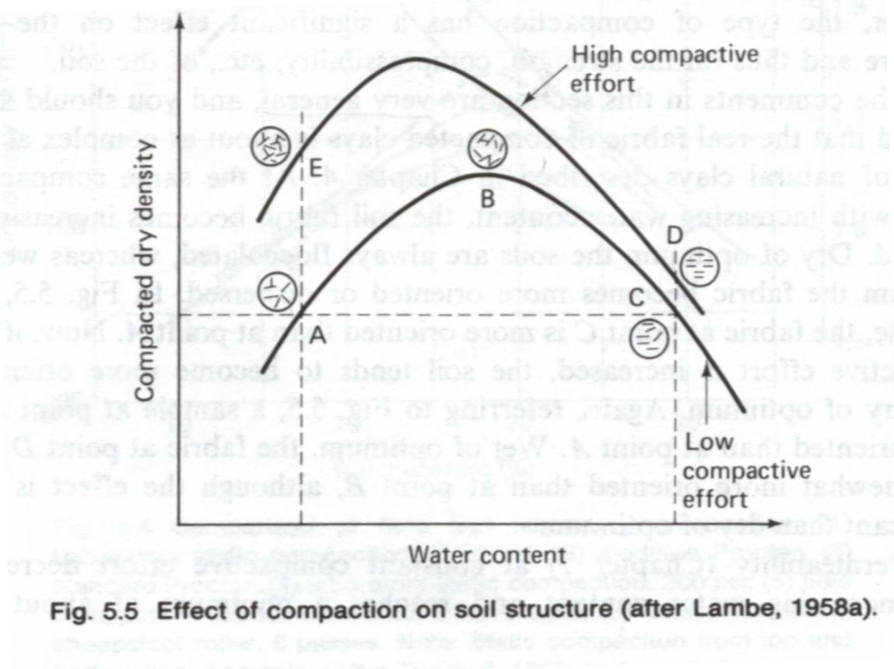
4.1 Structure of Compacted Clays
For a given compactive effort and dry density, the soil tends to be more flocculated (random) for compaction on the dry side as compared on the wet side.
For a given molding water content, increasing the compactive effort tends to disperse (parallel, oriented) the soil, especially on the dry side.
Lambe and Whitman, 1979

Slide 30
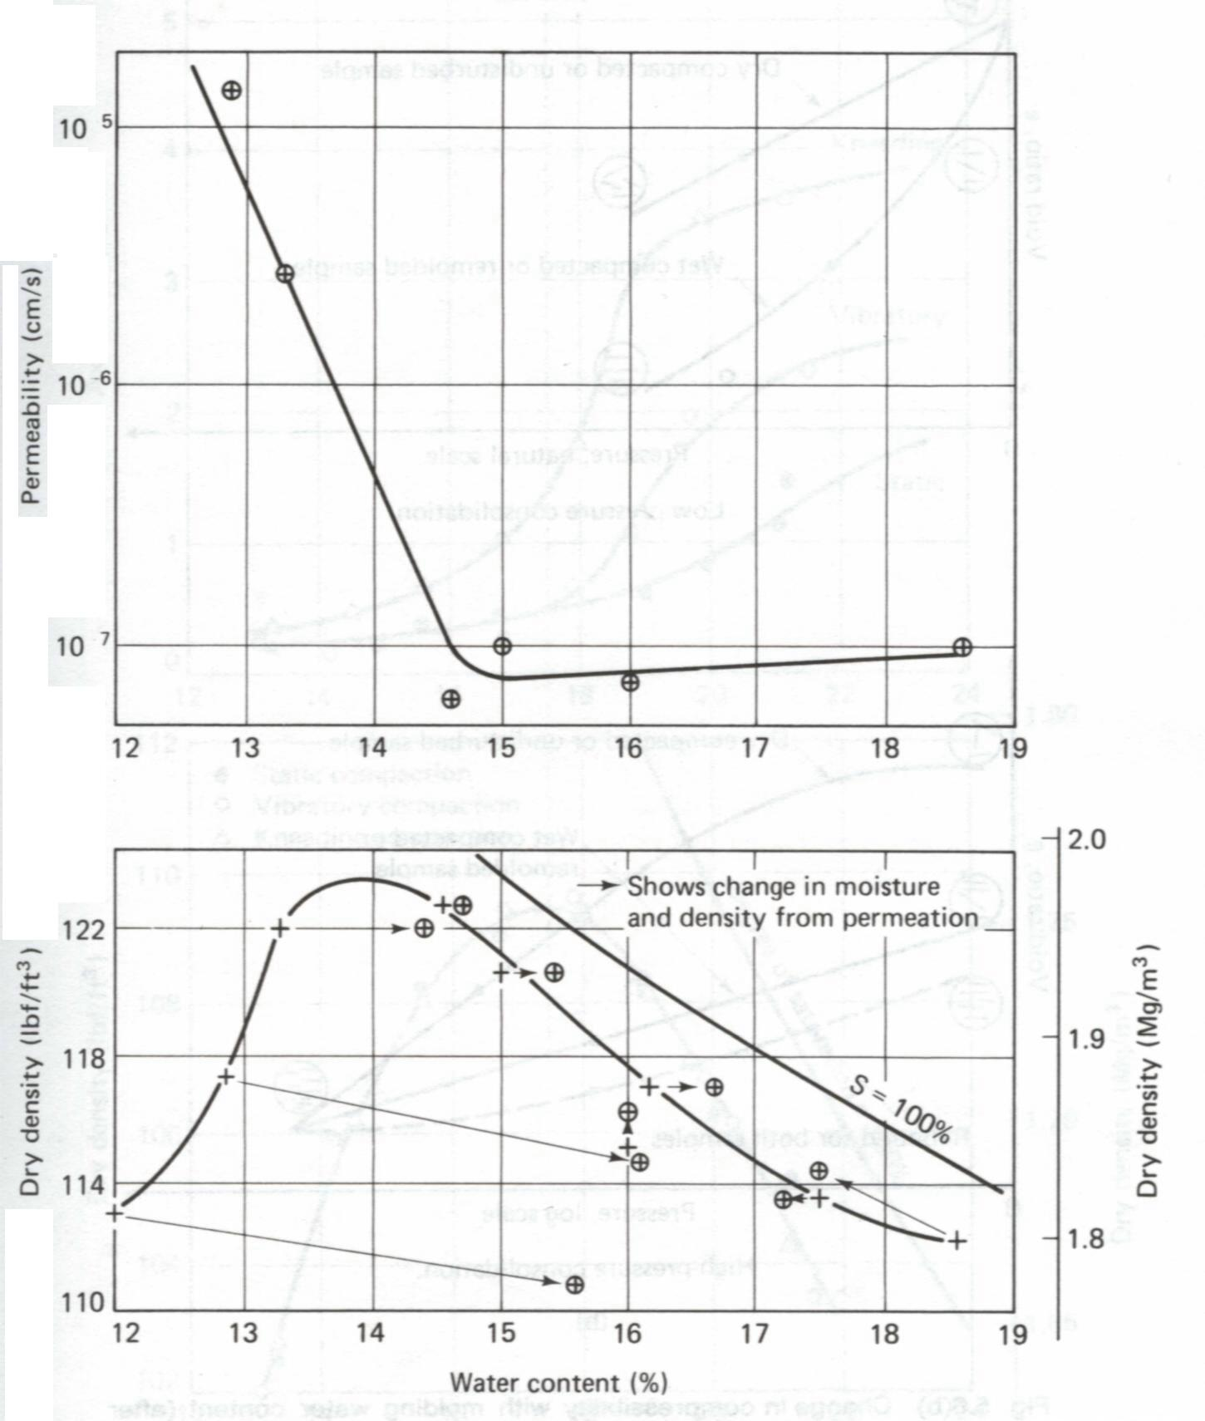
4.2 Engineering Properties-Permeability
Increasing the water content results in a decrease in permeability on the dry side of the optimum moisture content and a slight increase in permeability on the wet side of optimum.
Increasing the compactive effort reduces the permeability since it both increases the dry density, thereby reducing the voids available for flow, and increases the orientation of particles.
From Lambe and Whitman, 1979; Holtz and Kovacs, 1981

Slide 31
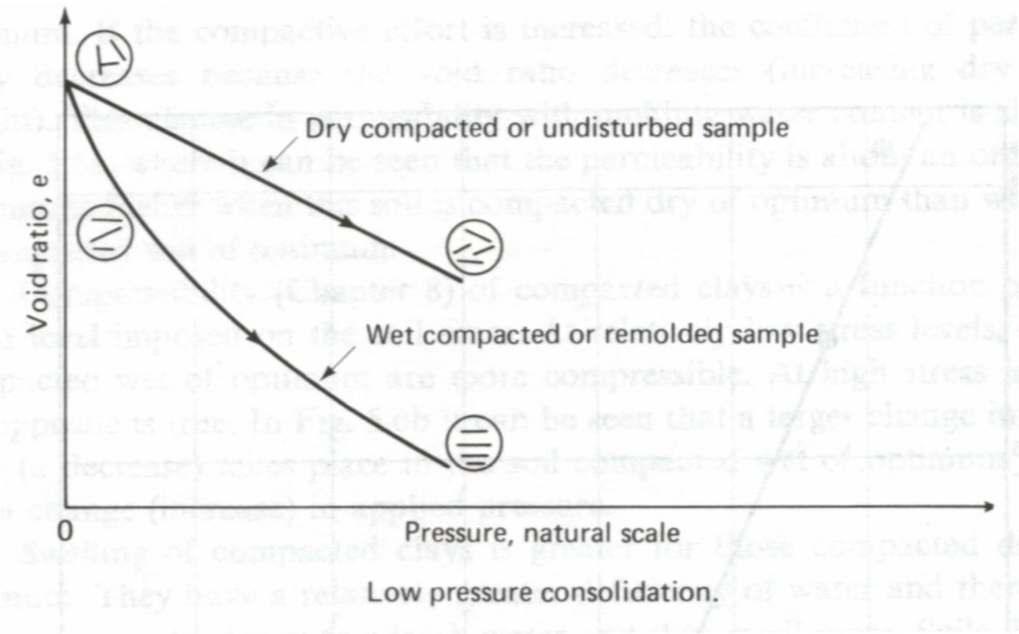
4.3 Engineering Properties-Compressibility
At low stresses the sample compacted on the wet side is more compressible than the one compacted on the dry side.
From Lambe and Whitman, 1979; Holtz and Kovacs, 1981

Slide 32
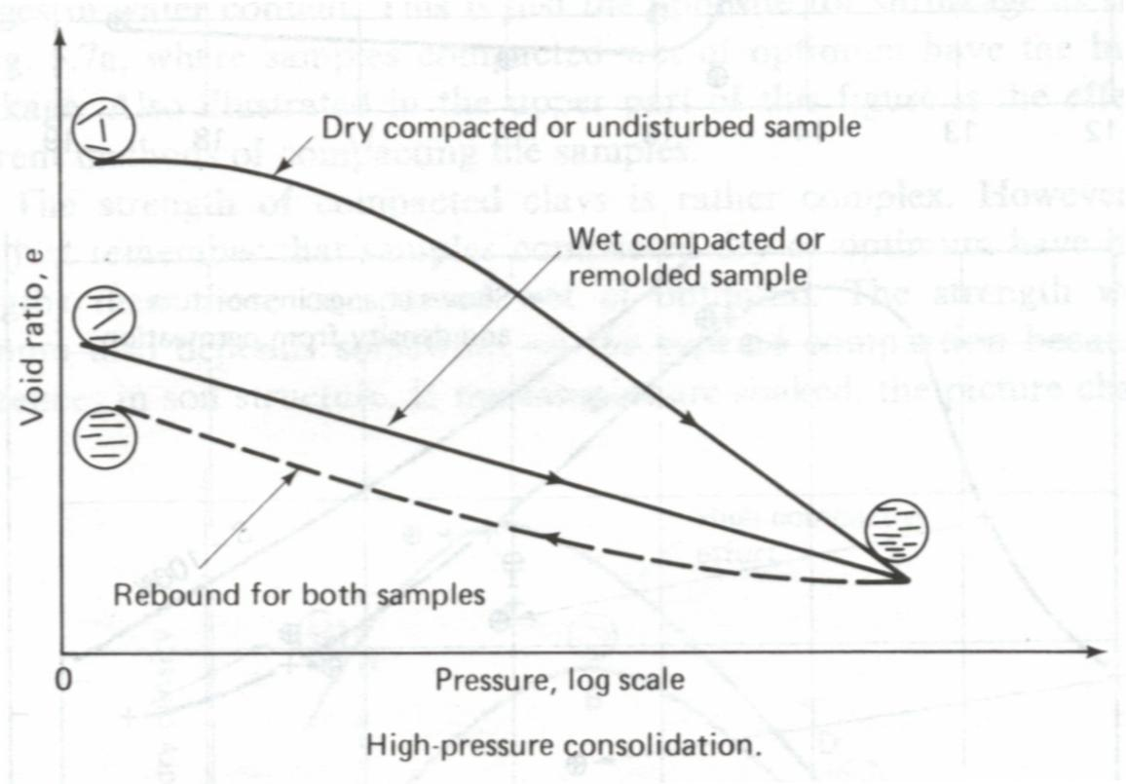
4.3 Engineering Properties-Compressibility
At the high applied stresses the sample compacted on the dry side is more compressible than the sample compacted on the wet side.
From Lambe and Whitman, 1979; Holtz and Kovacs, 1981

Slide 33
4.4 Engineering Properties-Swelling
Swelling of compacted clays is greater for those compacted dry of optimum. They have a relatively greater deficiency of water and therefore have a greater tendency to adsorb water and thus swell more.
(w_{opt}, ρ_{d max})
Higher swelling potential
Higher shrinkage potential
ρ_{d}
w
From Holtz and Kovacs, 1981

Slide 34
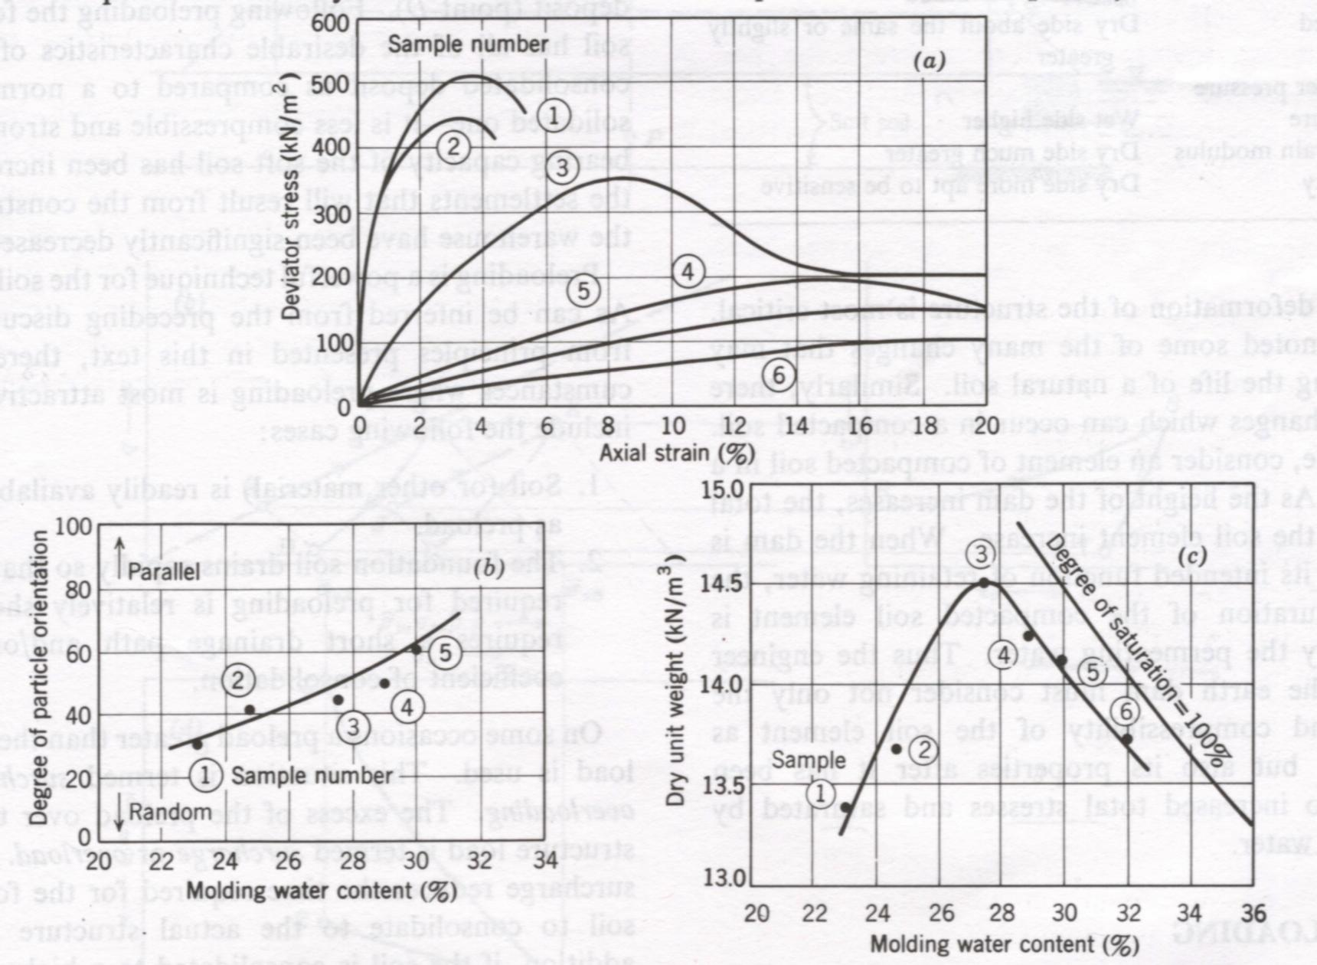
4.5 Engineering Properties-Strength
Samples (Kaolinite) compacted dry of optimum tend to be more rigid and stronger than samples compacted wet of optimum
From Lambe and Whitman, 1979

Slide 35
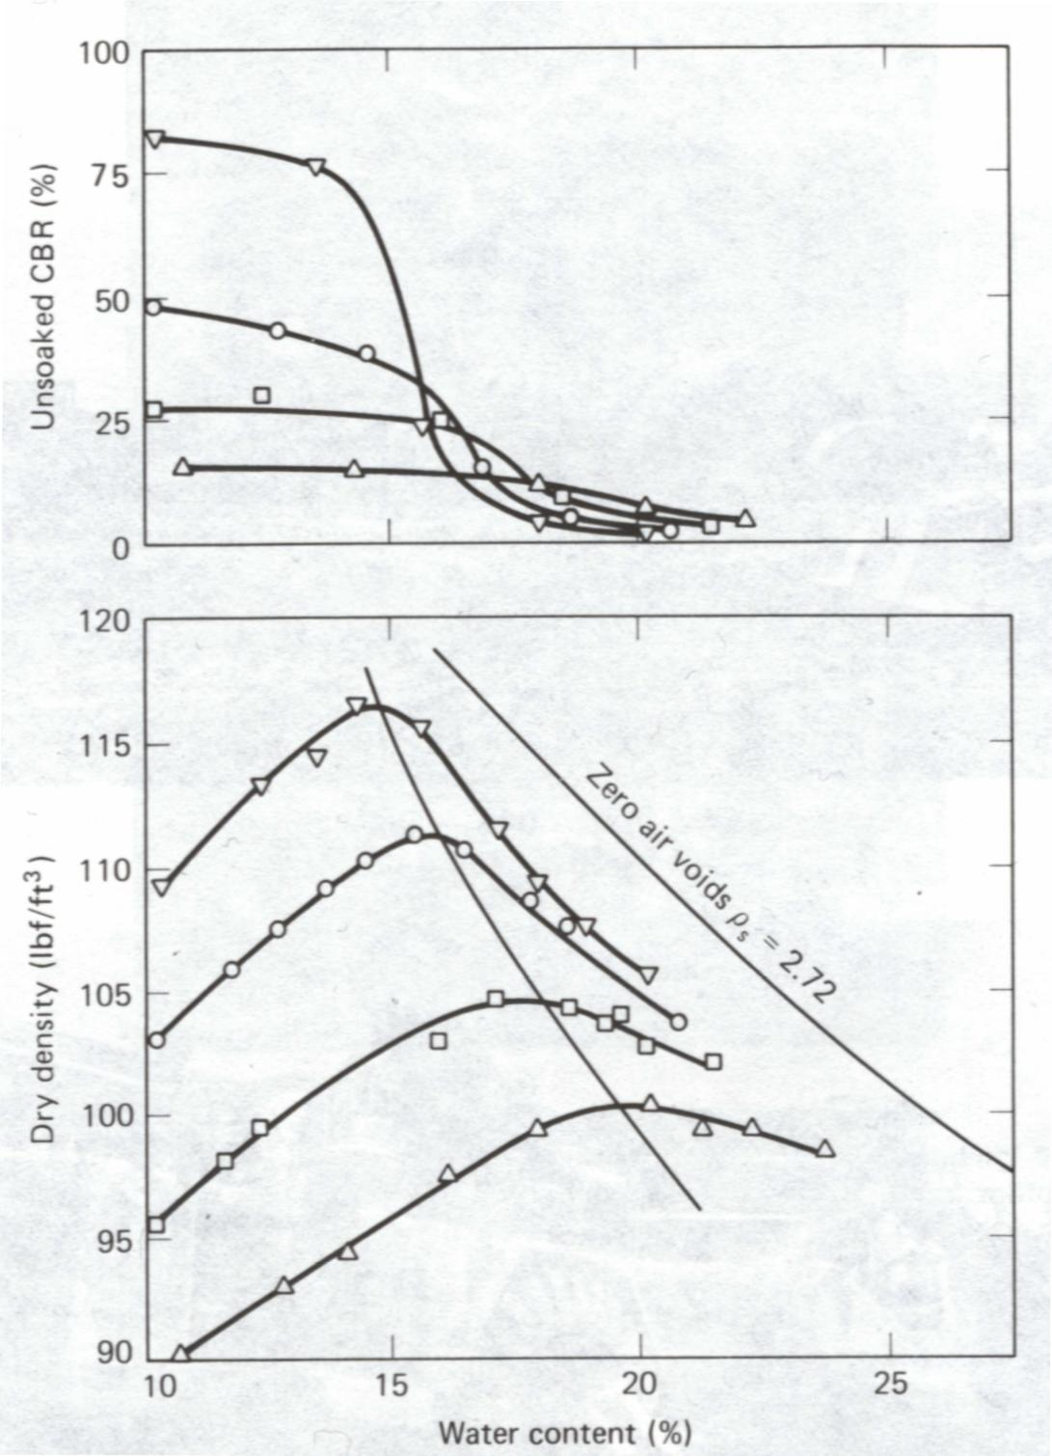
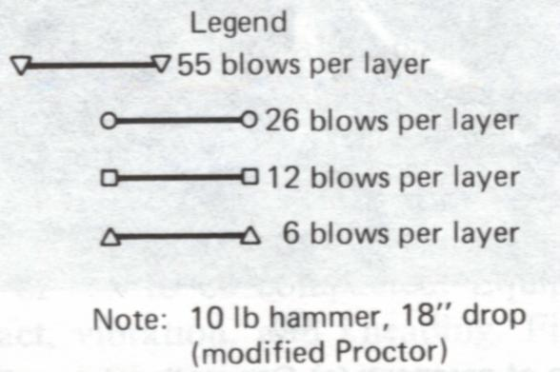
4.5 Engineering Properties-Strength (Cont.)
The CBR (California bearing ratio)
CBR= the ratio between resistance required to penetrate a 3-in² piston into the compacted specimen and resistance required to penetrate the same depth into a standard sample of crushed stone.
A greater compactive effort produces a greater CBR for the dry of optimum. However, the CBR is actually less for the wet of optimum for the higher compaction energies (overcompaction).
Holtz and Kovacs, 1981

Slide 36
4.6 Engineering Properties-Summary
Dry side
Wet side
Structure
More random
More oriented (parallel)
Permeability
More permeable
Compressibility
More compressible in high pressure range
More compressible in low pressure range
Swell more, higher water deficiency
Swelling
*Shrink more
Strength
Higher
Please see Table 5-1

Slide 37
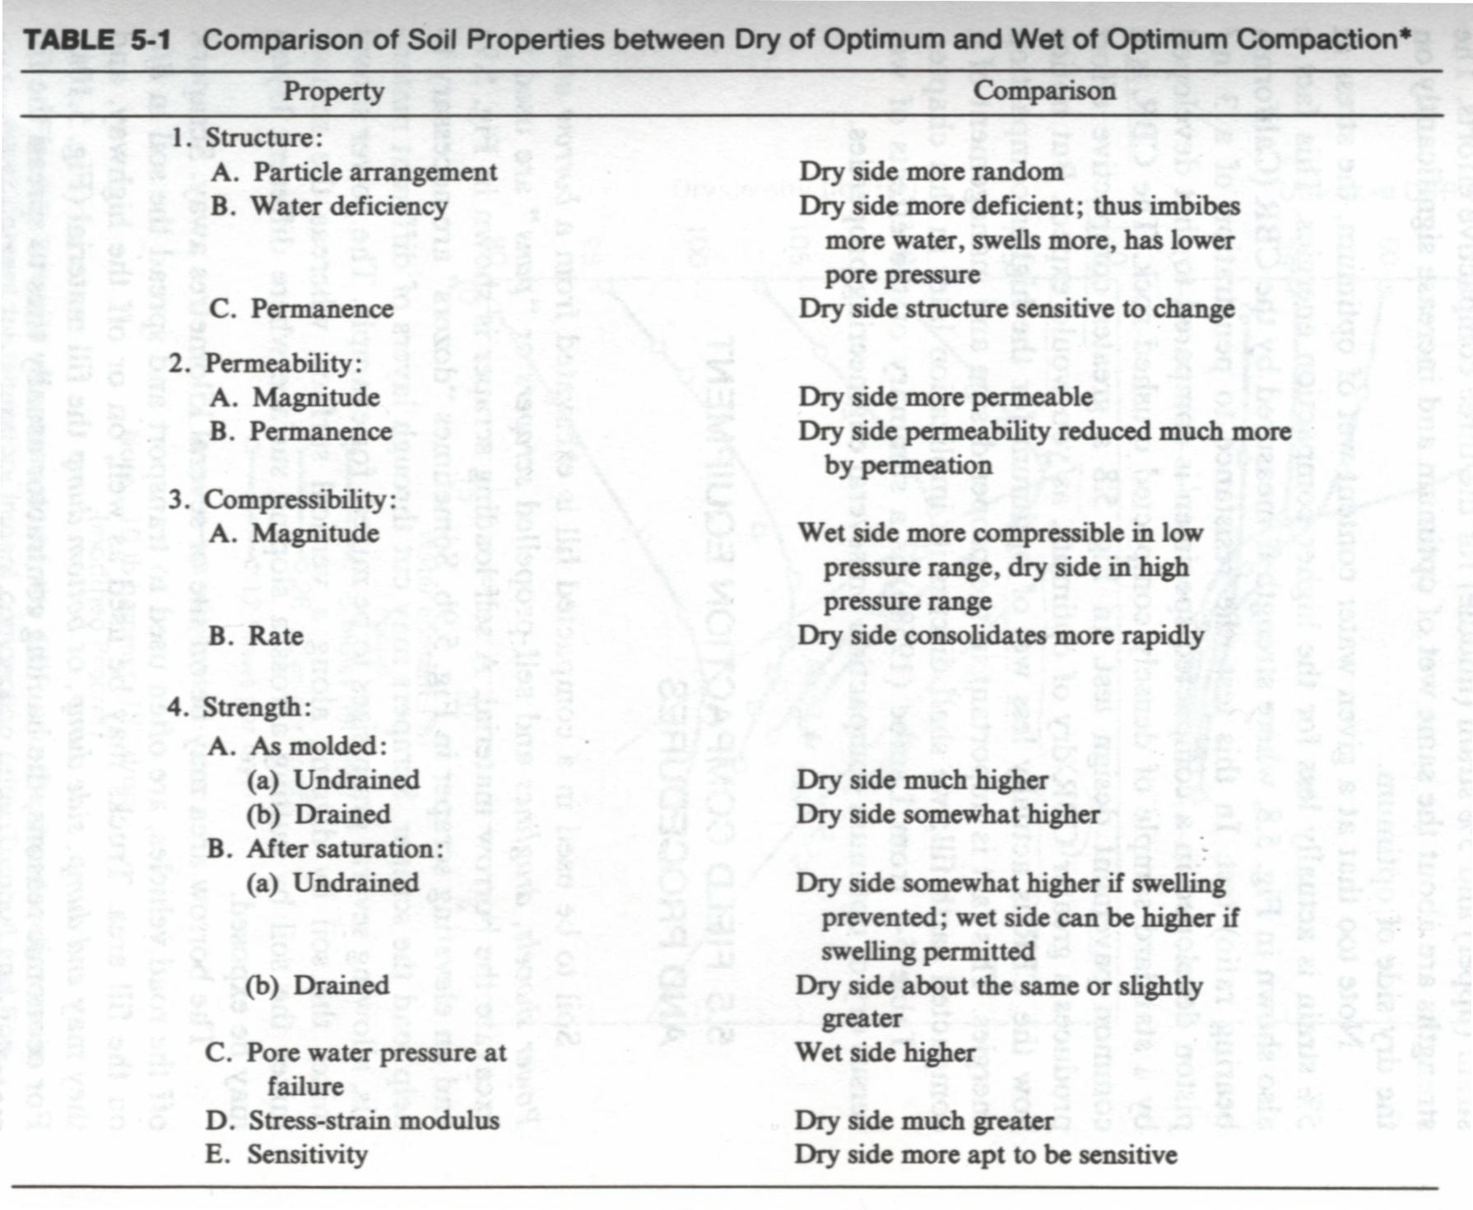
4.6 Engineering Properties-Summary (Cont.)
Please find this table in the handout
Holtz and Kovacs, 1981

Slide 38
4.6 Engineering Properties-Notes
Engineers must consider not only the behavior of the soil as compacted but the behavior of the soil in the completed structure, especially at the time when the stability or deformation of the structure is most critical.
For example, consider an element of compacted soil in a dam core. As the height of the dam increases, the total stresses on the soil element increase. When the dam is performing its intended function of retaining water, the percent saturation of the compacted soil element is increased by the permeating water. Thus the engineer designing the earth dam must consider not only the strength and compressibility of the soil element as compacted, but also its properties after is has been subjected to increased total stresses and saturated by permeating water.
Lambe and Whitman, 1979

Slide 39
5. Field Compaction Equipment and Procedures

Slide 40
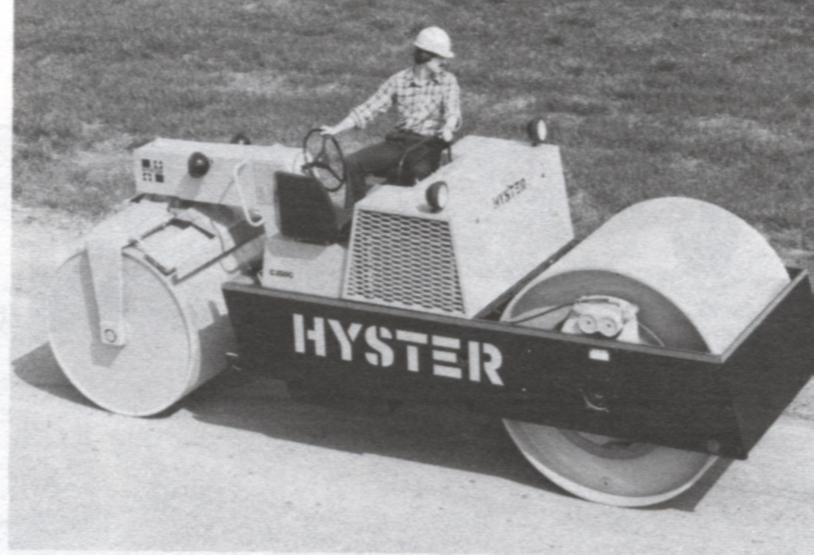
5.1 Equipment
Smooth-wheel roller (drum)
100% coverage under the wheel
Contact pressure up to 380 kPa
Can be used on all soil types except for rocky soils.
Compactive effort: static weight
The most common use of large smooth wheel rollers is for proof-rolling subgrades and compacting asphalt pavement.
Holtz and Kovacs, 1981

Slide 41
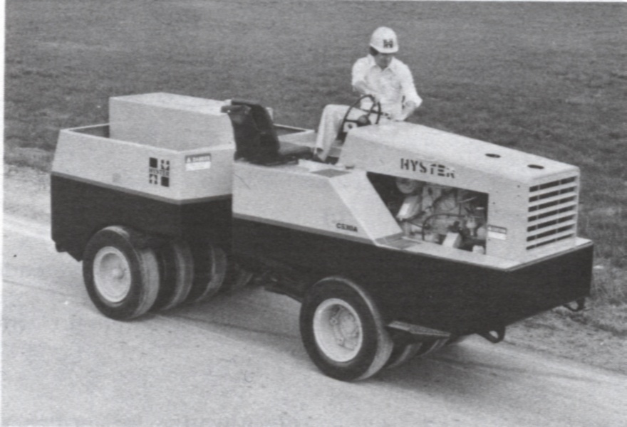
5.1 Equipment (Cont.)
Pneumatic (or rubber-tired) roller
80% coverage under the wheel
Contact pressure up to 700 kPa
Can be used for both granular and fine-grained soils.
Compactive effort: static weight and kneading.
Can be used for highway fills or earth dam construction.
Holtz and Kovacs, 1981

Slide 42
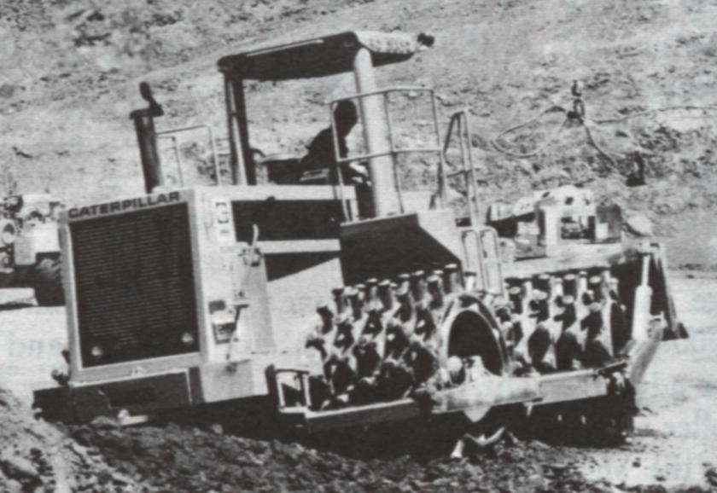
5.1 Equipment (Cont.)
Sheepsfoot rollers
Has many round or rectangular shaped protrusions or “feet” attached to a steel drum
8% ~ 12 % coverage
Contact pressure is from 1400 to 7000 kPa
It is best suited for clayed soils.
Compactive effort: static weight and kneading.
Holtz and Kovacs, 1981

Slide 43
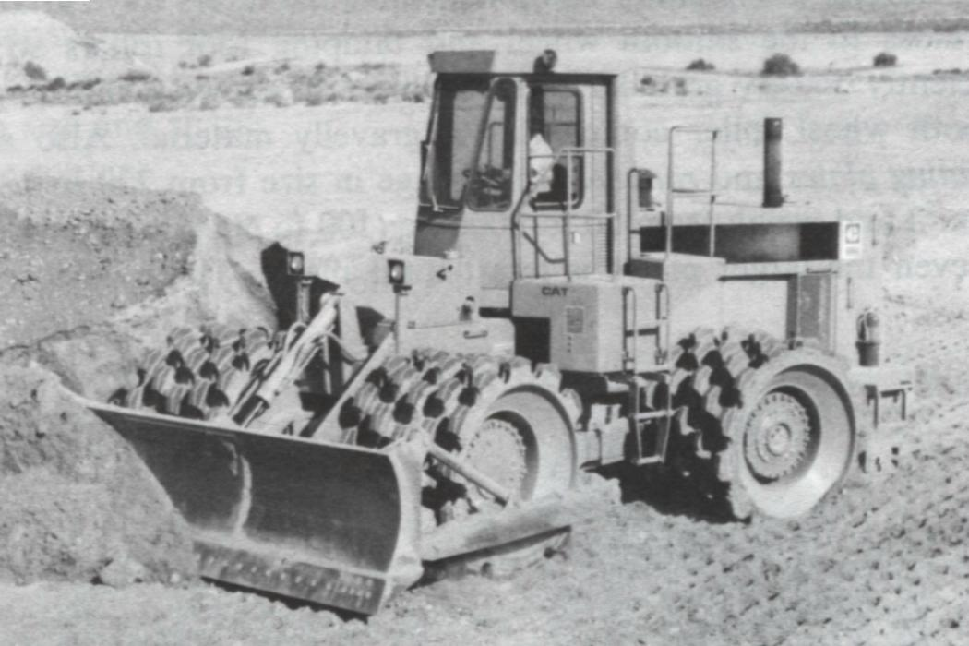
5.1 Equipment (Cont.)
Tamping foot roller
About 40% coverage
Contact pressure is from 1400 to 8400 kPa
It is best for compacting fine-grained soils (silt and clay).
Compactive effort: static weight and kneading.
Holtz and Kovacs, 1981

Slide 44
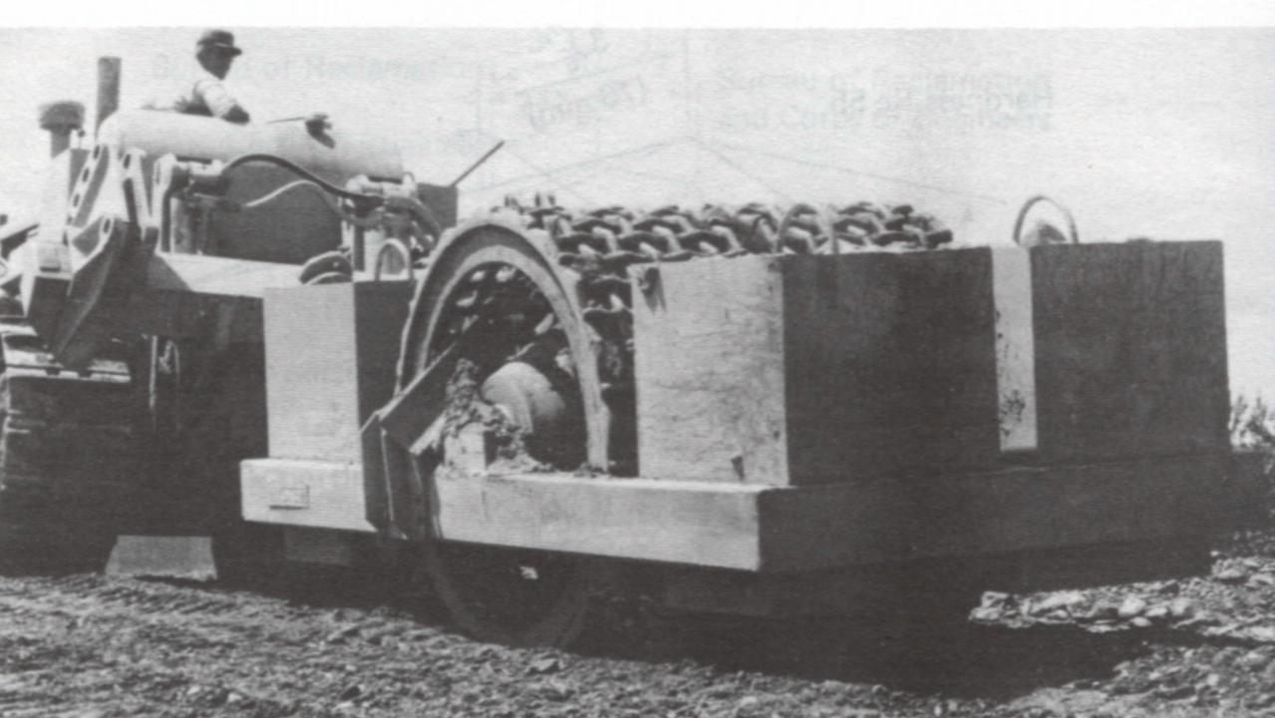
5.1 Equipment (Cont.)
Mesh (or grid pattern) roller
50% coverage
Contact pressure is from 1400 to 6200 kPa
It is ideally suited for compacting rocky soils, gravels, and sands. With high towing speed, the material is vibrated, crushed, and impacted.
Compactive effort: static weight and vibration.
Holtz and Kovacs, 1981

Slide 45
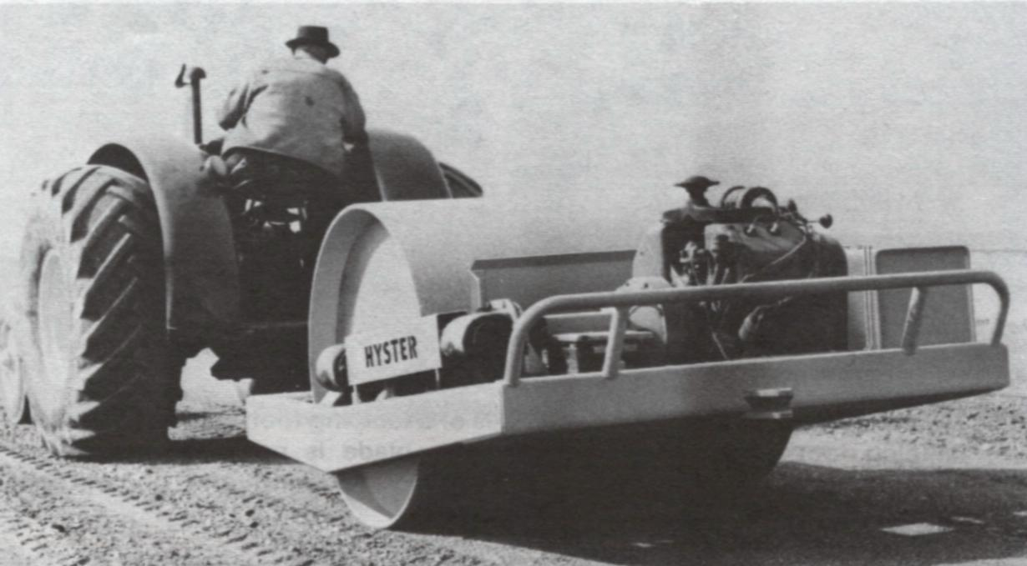
5.1 Equipment (Cont.)
Vibrating drum on smooth-wheel roller
Vertical vibrator attached to smooth wheel rollers.
The best explanation of why roller vibration causes densification of granular soils is that particle rearrangement occurs due to cyclic deformation of the soil produced by the oscillations of the roller.
Compactive effort: static weight and vibration.
Suitable for granular soils
Holtz and Kovacs, 1981

Slide 46
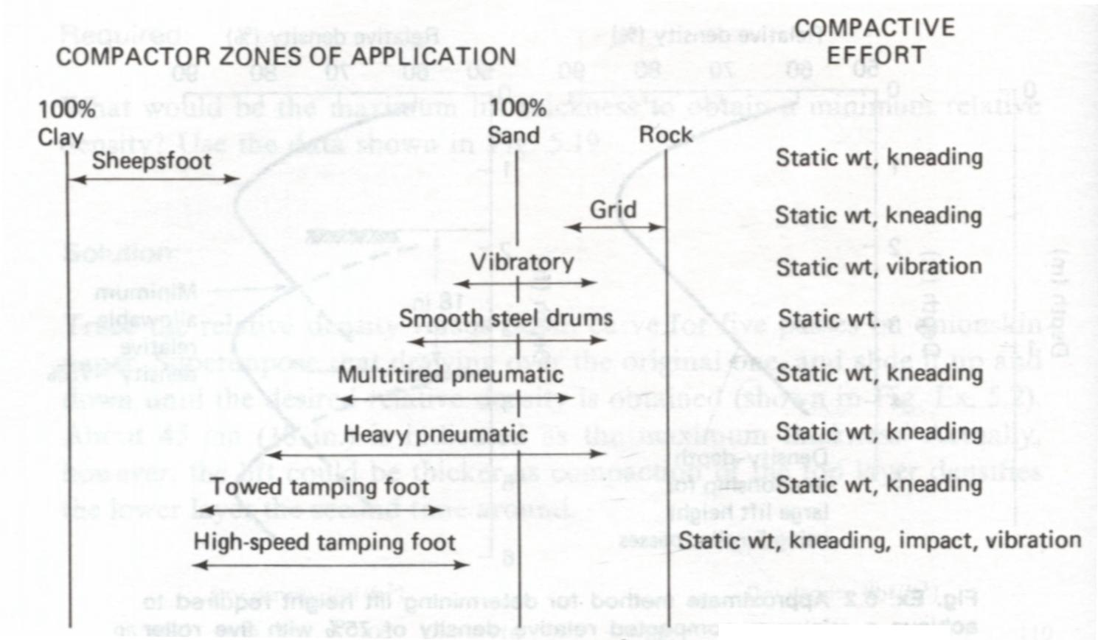
5.1 Equipment-Summary
Holtz and Kovacs, 1981

Slide 47
5.2 Variables-Vibratory Compaction
There are many variables which control the vibratory compaction or densification of soils.
Characteristics of the compactor:
(1) Mass, size
(2) Operating frequency and frequency range
Characteristics of the soil:
(1) Initial density
(2) Grain size and shape
(3) Water content
Construction procedures:
(1) Number of passes of the roller
(2) Lift thickness
(3) Frequency of operation vibrator
(4) Towing speed
Holtz and Kovacs, 1981

Slide 48
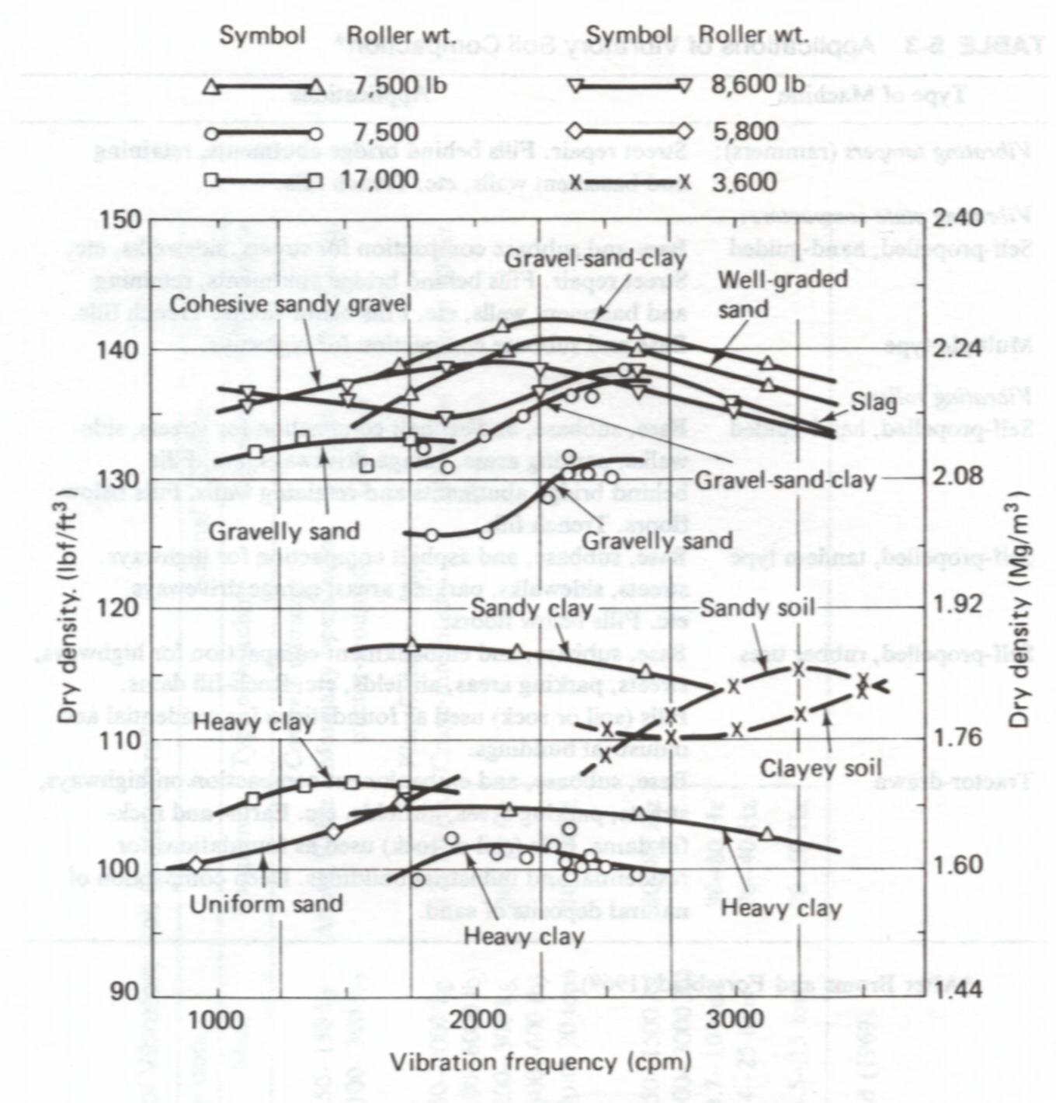
5.2.1 Frequency
The frequency at which a maximum density is achieved is called the optimum frequency.
Holtz and Kovacs, 1981

Slide 49
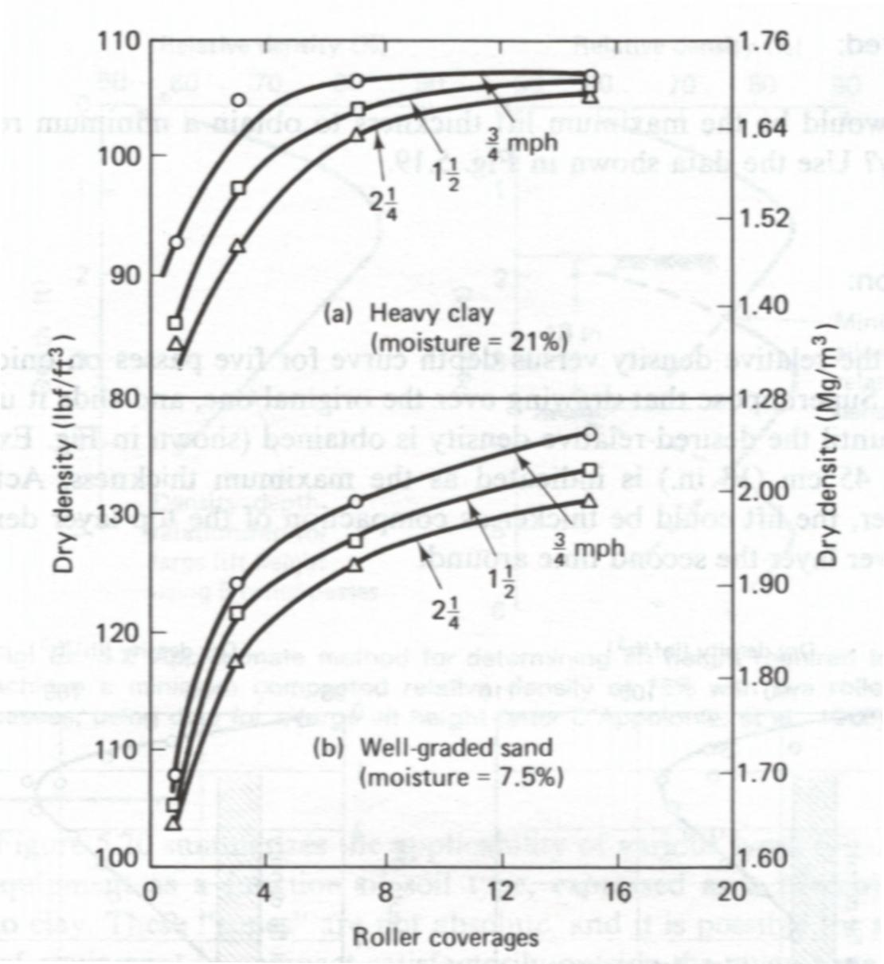
5.2.2 Roller Travel Speed
For a given number of passes, a higher density is obtained if the vibrator is towed more slowly.
Holtz and Kovacs, 1981

Slide 50
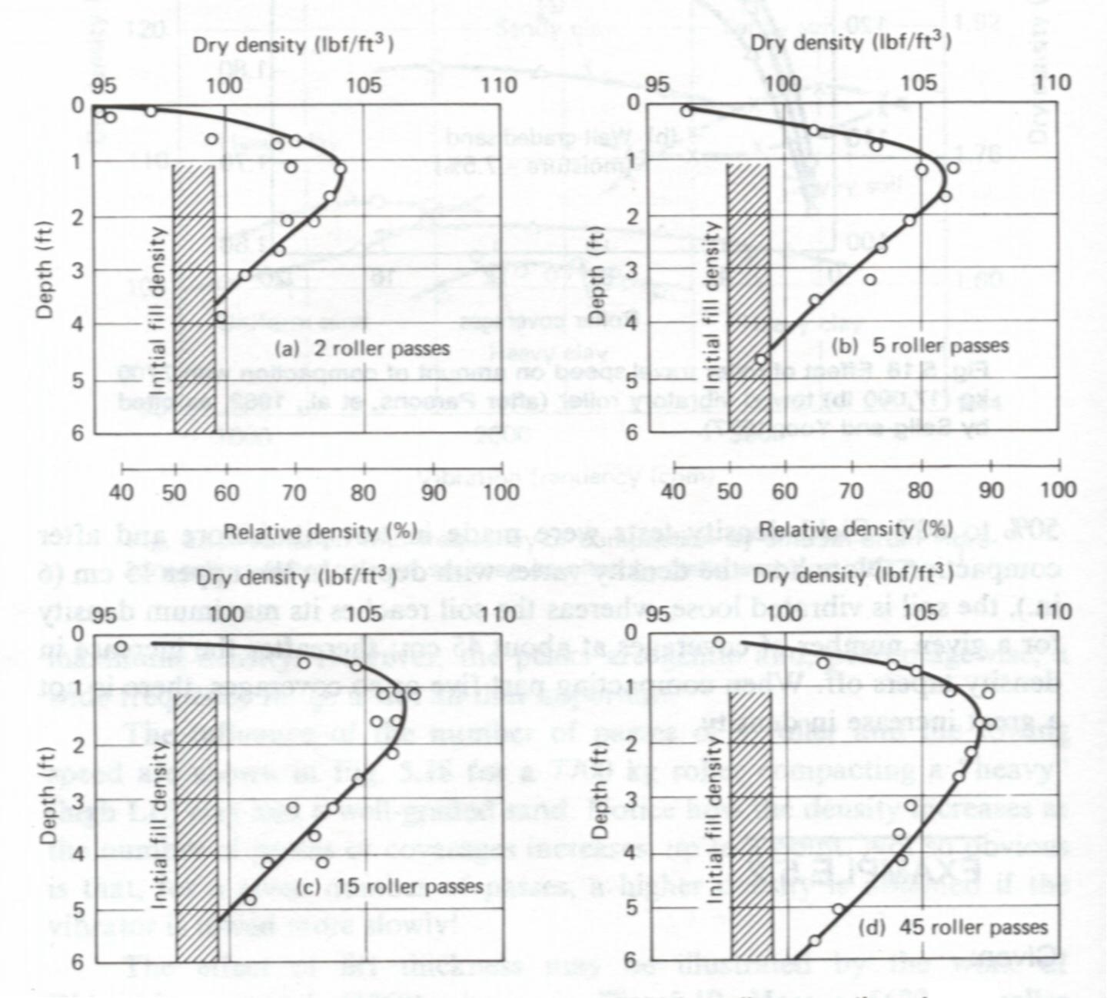
5.2.3 Roller Passes
When compacting past five or so coverages, there is not a great increase in density
240 cm think layer of northern Indiana dune sand
5670 kg roller operating at a frequency of 27.5 Hz.
Holtz and Kovacs, 1981

Slide 51
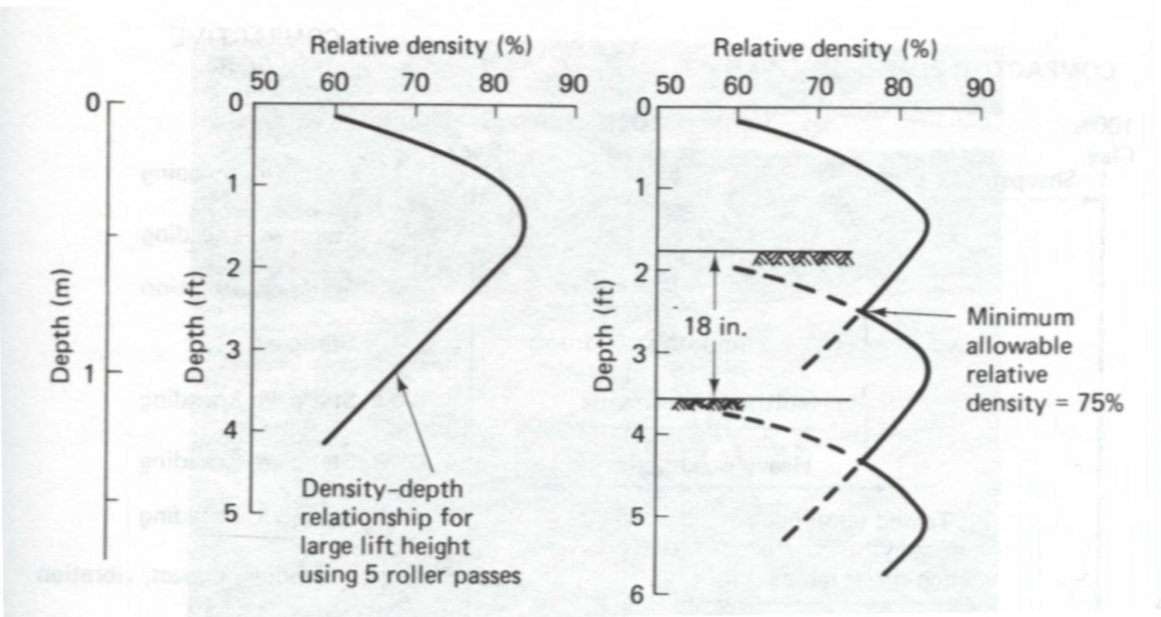
5.2.4 Determine the Lift Height
Holtz and Kovacs, 1981

Slide 52
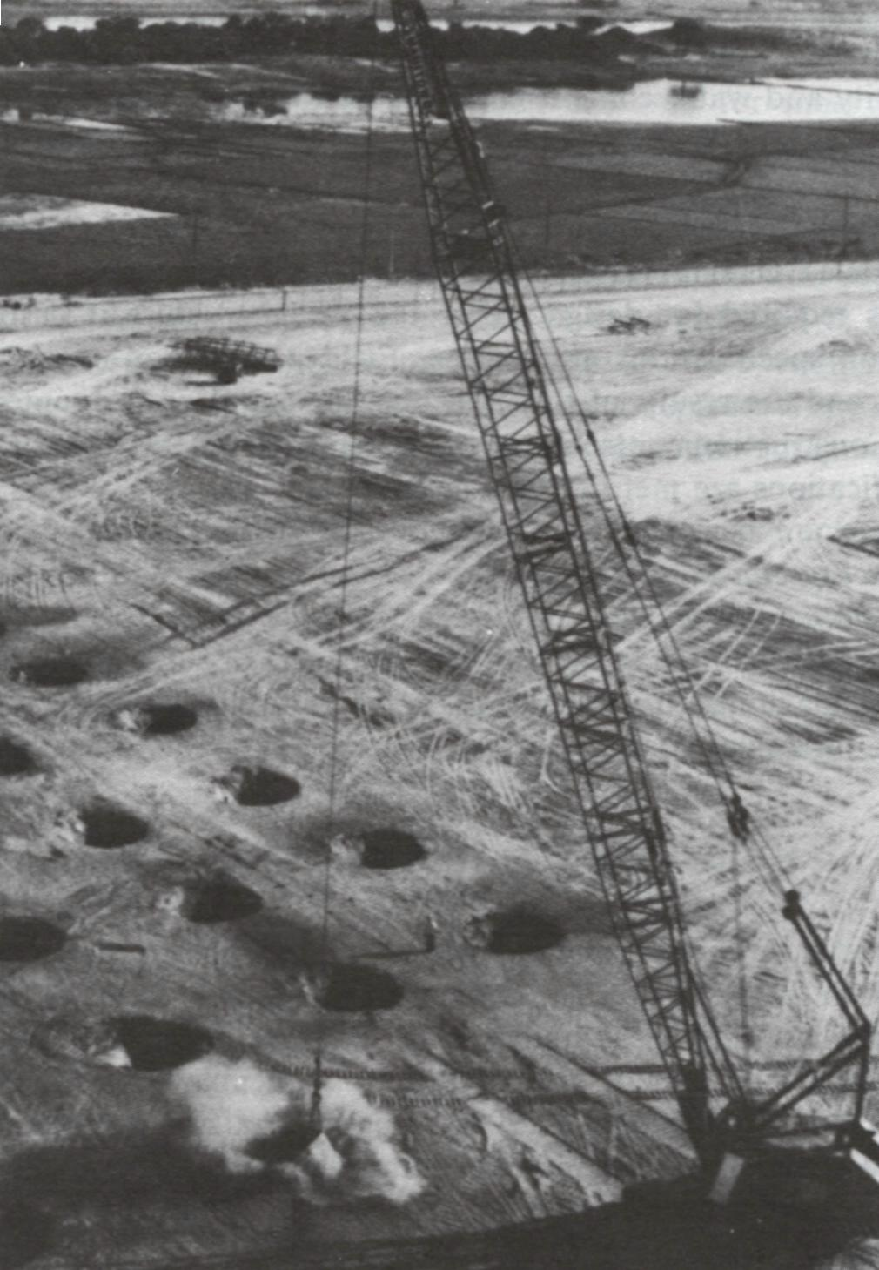
5.3 Dynamic Compaction
Dynamic compaction was first used in Germany in the mid-1930’s.
The depth of influence D, in meters, of soil undergoing compaction is conservatively given by
D ≈ ½ (Wh)^{1/2}
W = mass of falling weight in metric tons.
h = drop height in meters
From Holtz and Kovacs, 1981

Slide 53
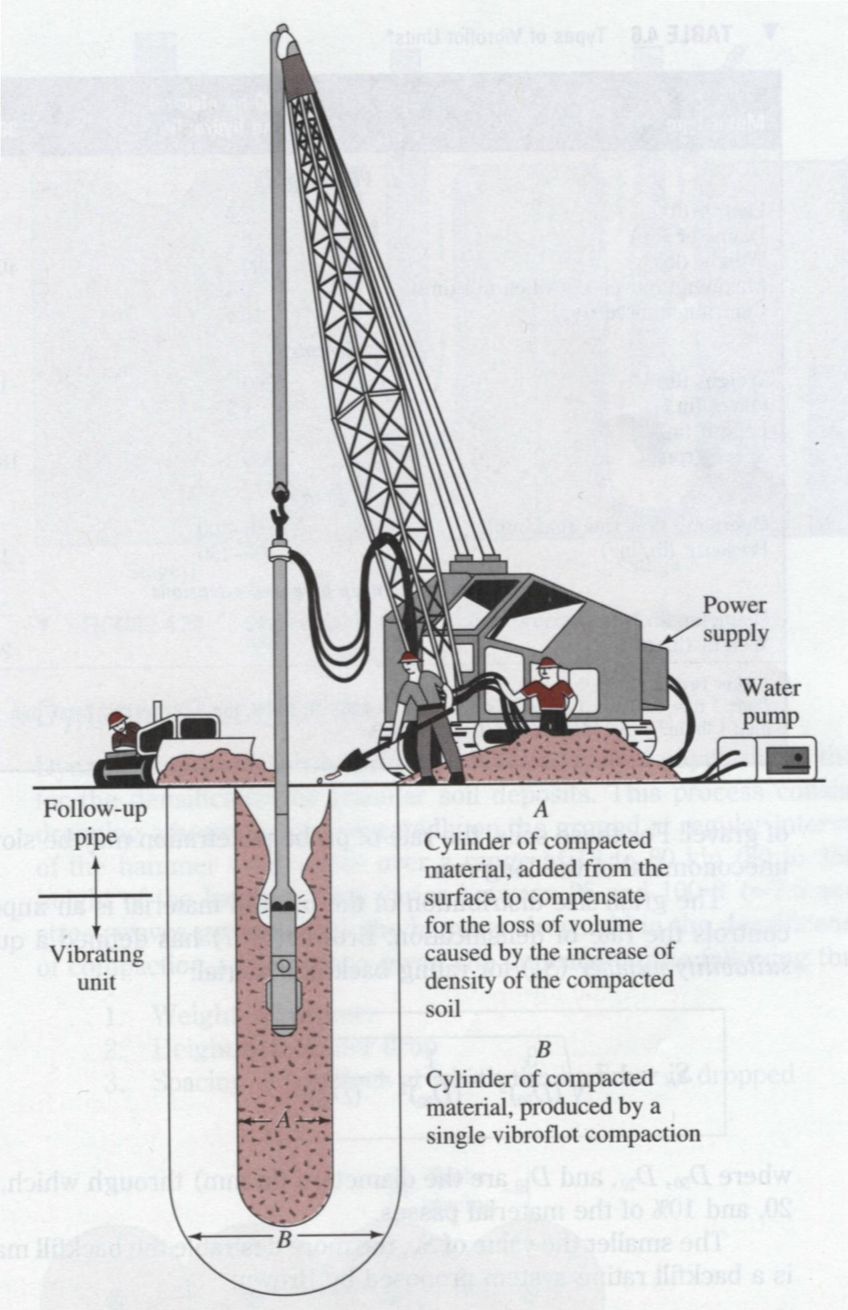
5.4 Vibroflotation
Vibroflotation is a technique for in situ densification of thick layers of loose granular soil deposits. It was developed in Germany in the 1930s.
From Das, 1998

Slide 54
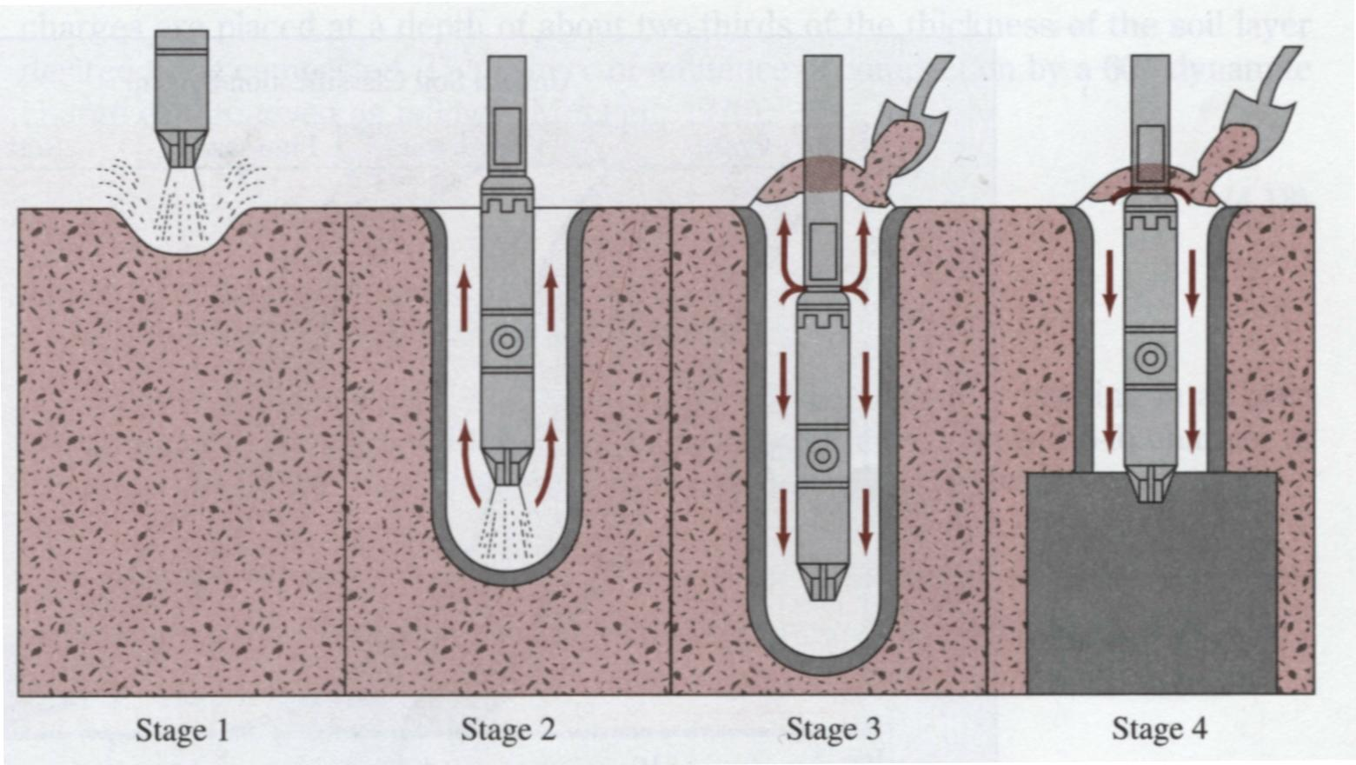
5.4 Vibroflotation-Procedures
From Das, 1998
Stage1: The jet at the bottom of the Vibroflot is turned on and lowered into the ground
Stage2: The water jet creates a quick condition in the soil. It allows the vibrating unit to sink into the ground
Stage 3: Granular material is poured from the top of the hole. The water from the lower jet is transferred to he jet at the top of the vibrating unit. This water carries the granular material down the hole
Stage 4: The vibrating unit is gradually raised in about 0.3-m lifts and held vibrating for about 30 seconds at each lift. This process compacts the soil to the desired unit weight.

Slide 55
6. Field Compaction Control and Specifications

Slide 56
6.1 Control Parameters
Dry density and water content correlate well with the engineering properties, and thus they are convenient construction control parameters.
Since the objective of compaction is to stabilize soils and improve their engineering behavior, it is important to keep in mind the desired engineering properties of the fill, not just its dry density and water content. This point is often lost in the earthwork construction control.
From Holtz and Kovacs, 1981

Slide 57
6.2 Design-Construct Procedures
Laboratory tests are conducted on samples of the proposed borrow materials to define the properties required for design.
After the earth structure is designed, the compaction specifications are written. Field compaction control tests are specified, and the results of these become the standard for controlling the project.
From Holtz and Kovacs, 1981

Slide 58
6.3 Specifications
End-product specifications
This specification is used for most highways and building foundation, as long as the contractor is able to obtain the specified relative compaction , how he obtains it doesn’t matter, nor does the equipment he uses.
Care the results only !
(2) Method specifications
The type and weight of roller, the number of passes of that roller, as well as the lift thickness are specified. A maximum allowable size of material may also be specified.
It is typically used for large compaction project.
From Holtz and Kovacs, 1981

Slide 59
6.4 Relative Compaction (R.C.)
Relative compaction or percent compaction
Correlation between relative compaction (R.C.) and the relative density Dr
It is a statistical result based on 47 soil samples.
As Dr = 0, R.C. is 80
Typical required R.C. = 90% ~ 95%

Slide 60
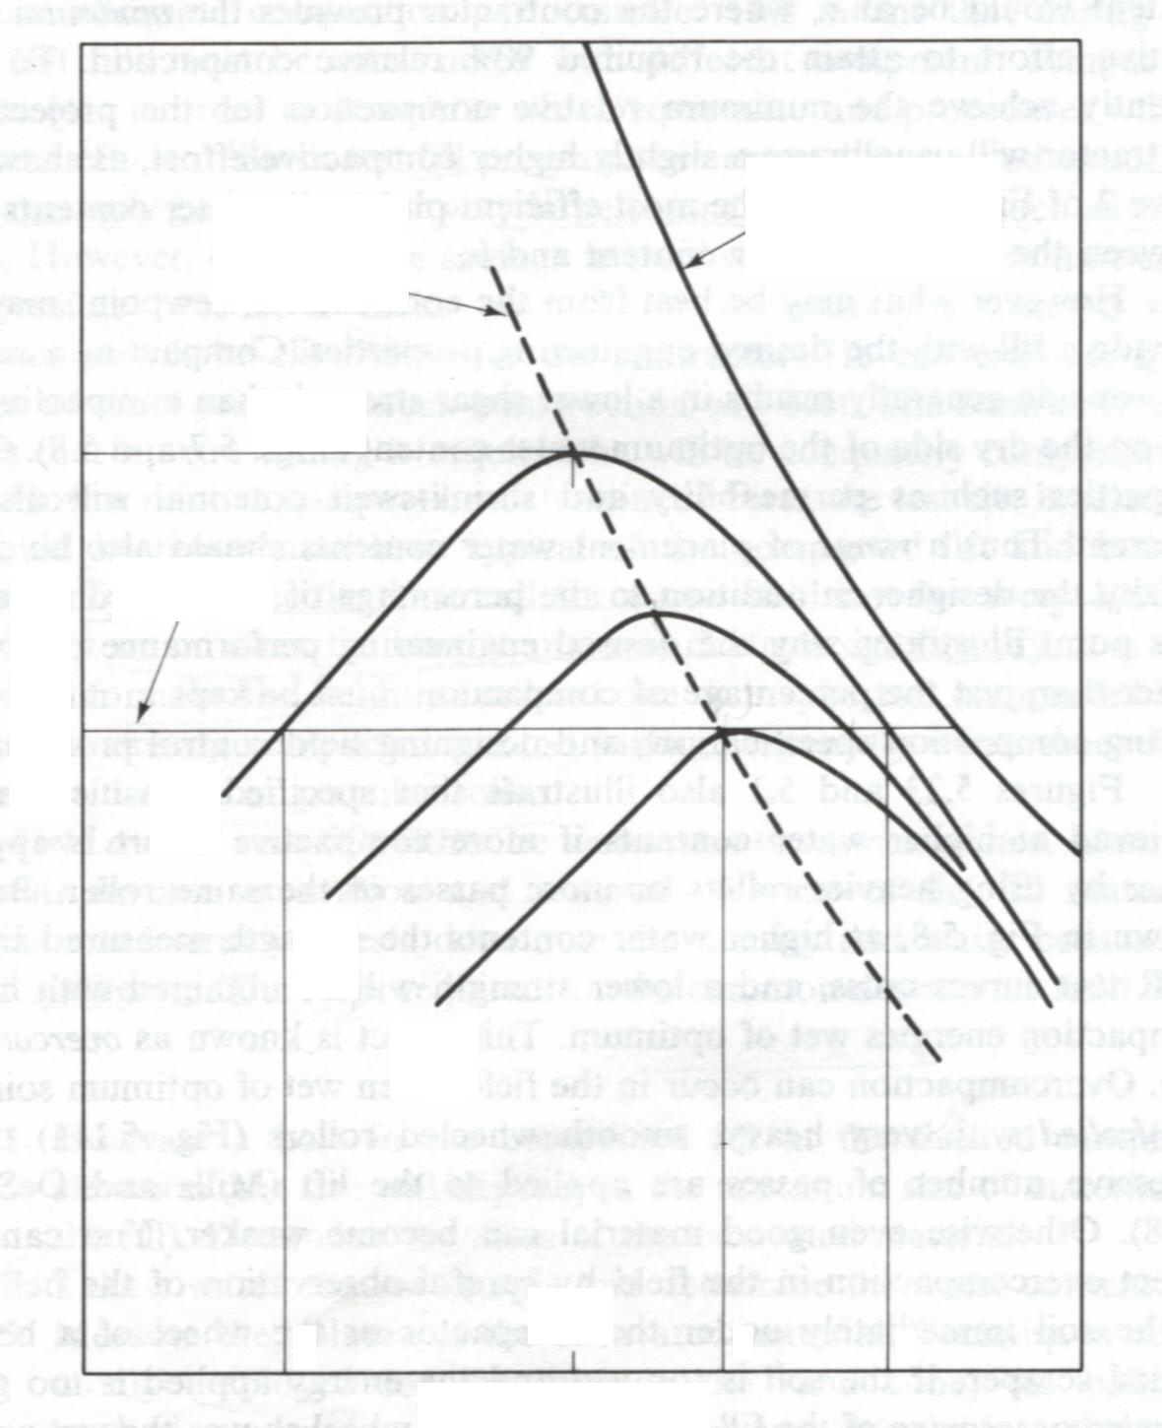
6.5 Determine the Water Content (in Field)
100% saturation
Control
(1) Relative compaction
(2) Water content (dry side or wet side)
Line of optimums
ρ_{d max}
90% R.C.
Dry density, ρ_{d}


●
Increase compaction energy
Note: the engineering properties may be different between the compacted sample at the dry side and at the wet side.
w_{opt}
a
b
c
Water content w %
Holtz and Kovacs, 1981

Slide 61
6.6 Determine the Relative Compaction in the Field
Where and When
First, the test site is selected. It should be representative or typical of the compacted lift and borrow material. Typical specifications call for a new field test for every 1000 to 3000 m² or so, or when the borrow material changes significantly. It is also advisable to make the field test at least one or maybe two compacted lifts below the already compacted ground surface, especially when sheepsfoot rollers are used or in granular soils.
Method
Field control tests, measuring the dry density and water content in the field can either be destructive or nondestructive.
Holtz and Kovacs, 1981

Slide 62
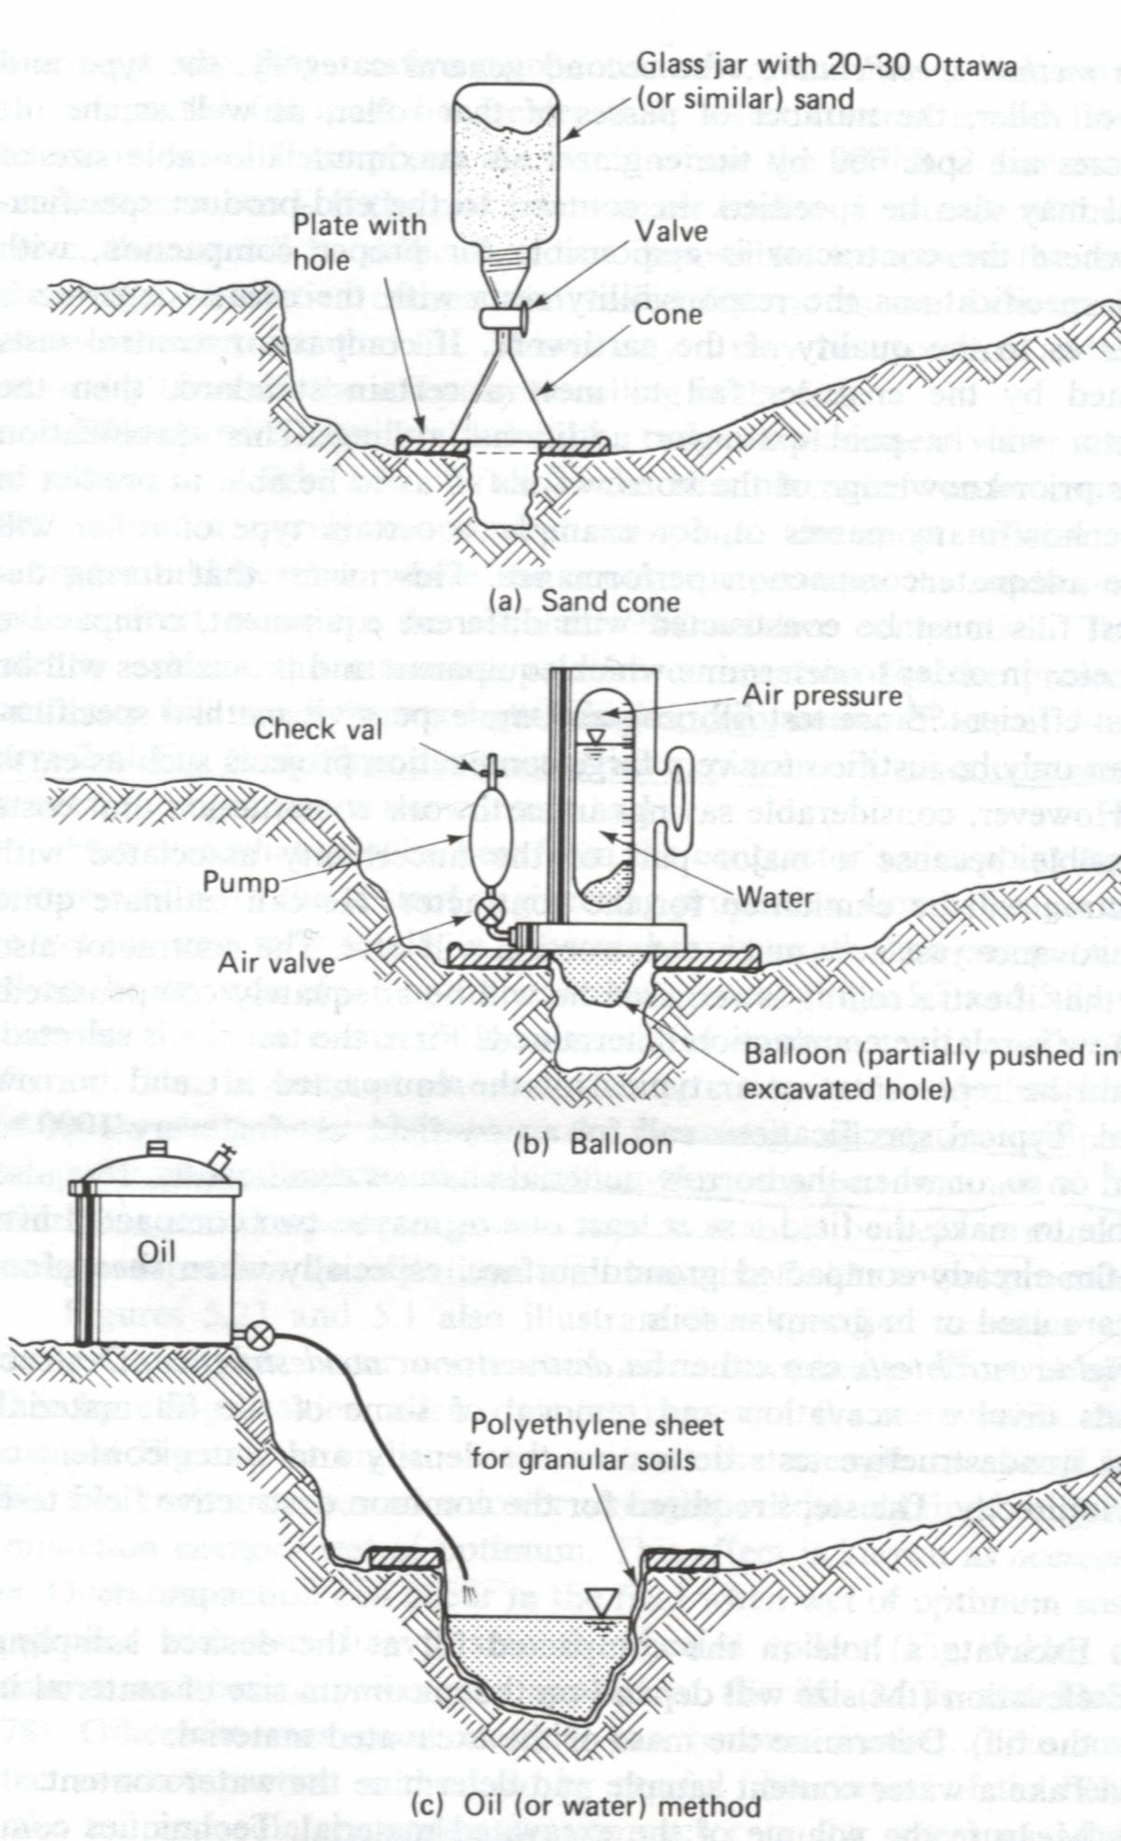
6.6.1 Destructive Methods
Methods
(a) Sand cone
(b) Balloon
(c) Oil (or water) method
(a)
(b)
Calculations
Know M_{s} and V_{t}
Get ρ_{d field} and w (water content)
Compare ρ_{d field} with ρ_{d max-lab} and calculate relative compaction R.C.
(c)
Holtz and Kovacs, 1981

Slide 63
6.6.1 Destructive Methods (Cont.)
Sometimes, the laboratory maximum density may not be known exactly. It is not uncommon, especially in highway construction, for a series of laboratory compaction tests to be conducted on “representative” samples of the borrow materials for the highway. If the soils at the site are highly varied, there will be no laboratory results to be compared with. It is time consuming and expensive to conduct a new compaction curve. The alternative is to implement a field check point, or 1 point Proctor test.
Holtz and Kovacs, 1981

Slide 64
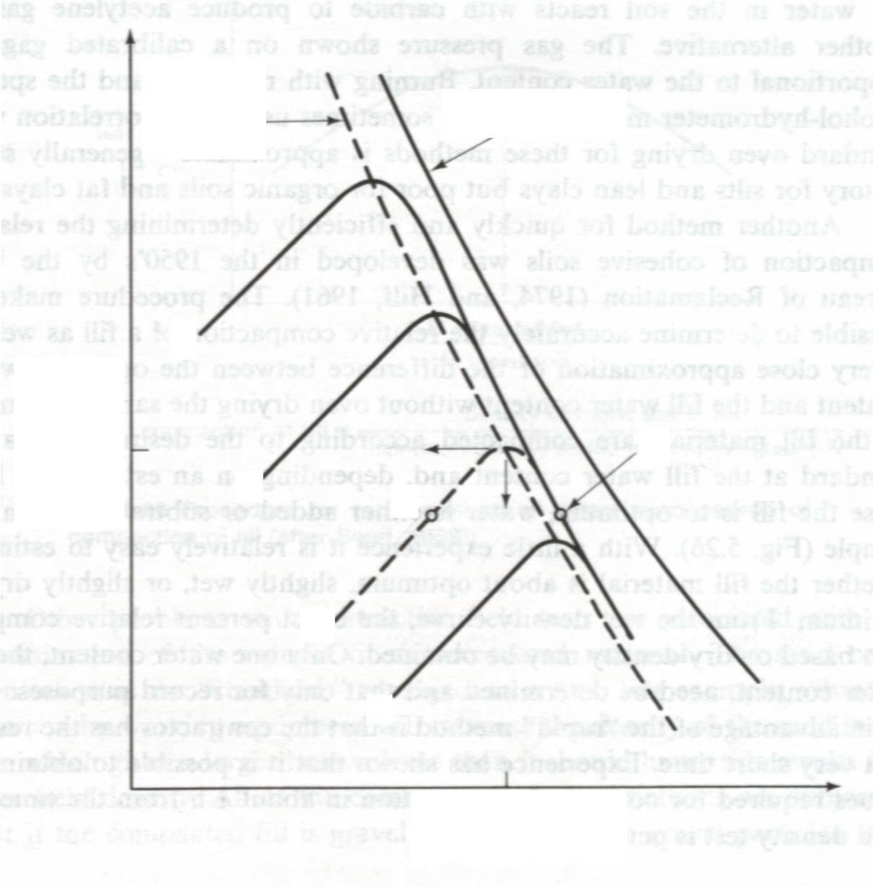
6.6.1 Destructive Methods (Cont.)
Line of optimums
Check Point Method
100% saturation
1 point Proctor test
Known compaction curves A, B, C
Field check point X (it should be on the dry side of optimum)
A
Y(no)
ρ_{d max}
Dry density, ρ_{d}
B
X
M
C
w_{opt}
Holtz and Kovacs, 1981
Water content w %

Slide 65
6.6.1 Destructive Methods (Cont.)
The measuring error is mainly from the determination of the volume of the excavated material.
For example,
For the sand cone method, the vibration from nearby working equipment will increase the density of the sand in the hole, which will gives a larger hole volume and a lower field density.
If the compacted fill is gravel or contains large gravel particles. Any kind of unevenness in the walls of the hole causes a significant error in the balloon method.
If the soil is coarse sand or gravel, none of the liquid methods works well, unless the hole is very large and a polyethylene sheet is used to contain the water or oil.
Holtz and Kovacs, 1981

Slide 66
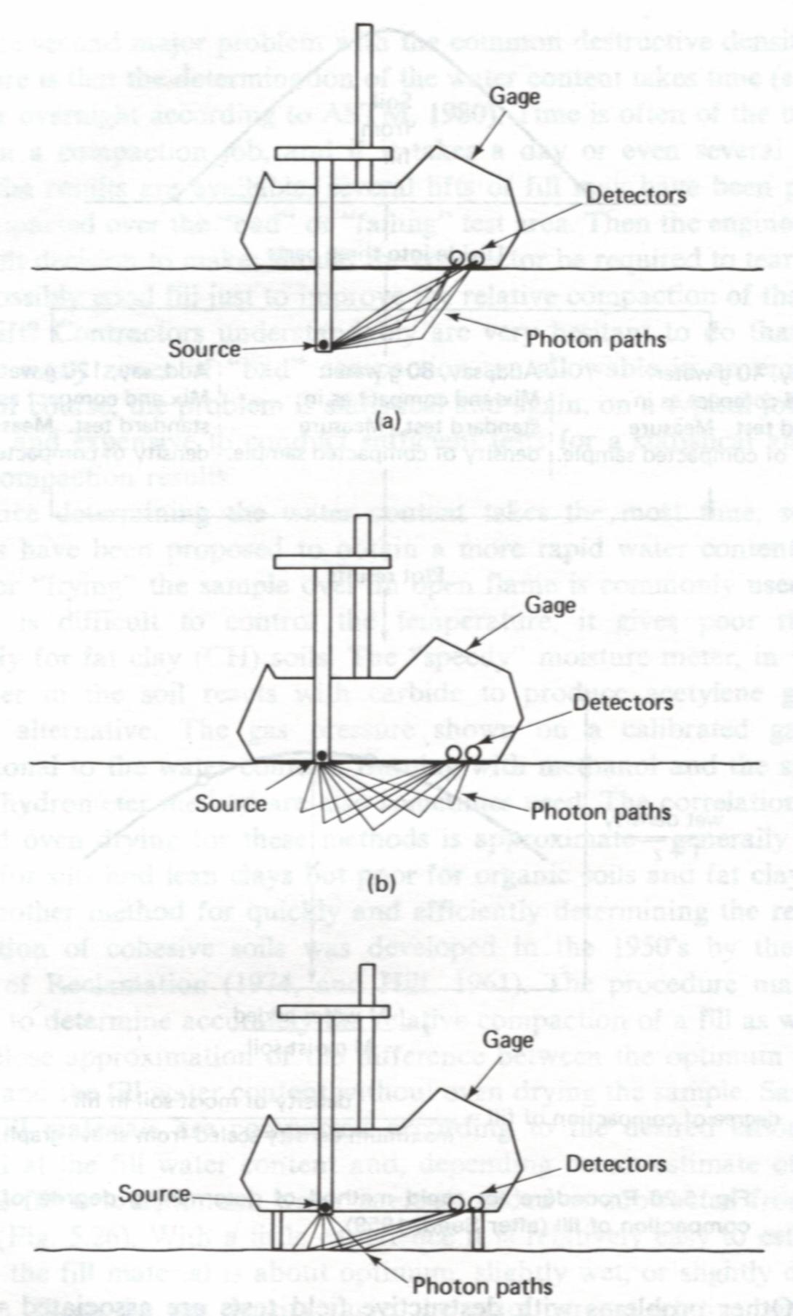
6.6.2 Nondestructive Methods
Nuclear density meter
(a) Direct transmission
(b) Backscatter
(c) Air gap
(a)
Principles
Density
The Gamma radiation is scattered by the soil particles and the amount of scatter is proportional to the total density of the material. The Gamma radiation is typically provided by the radium or a radioactive isotope of cesium.
Water content
The water content can be determined based on the neutron scatter by hydrogen atoms. Typical neutron sources are americium-beryllium isotopes.
(b)
Holtz and Kovacs, 1981
(c)

Slide 67
6.6.2 Nondestructive Methods (Cont.)
Calibration
Calibration against compacted materials of known density is necessary, and for instruments operating on the surface the presence of an uncontrolled air gap can significantly affect the measurements.

Slide 68
7. Estimating Performance of Compacted Soils

Slide 69
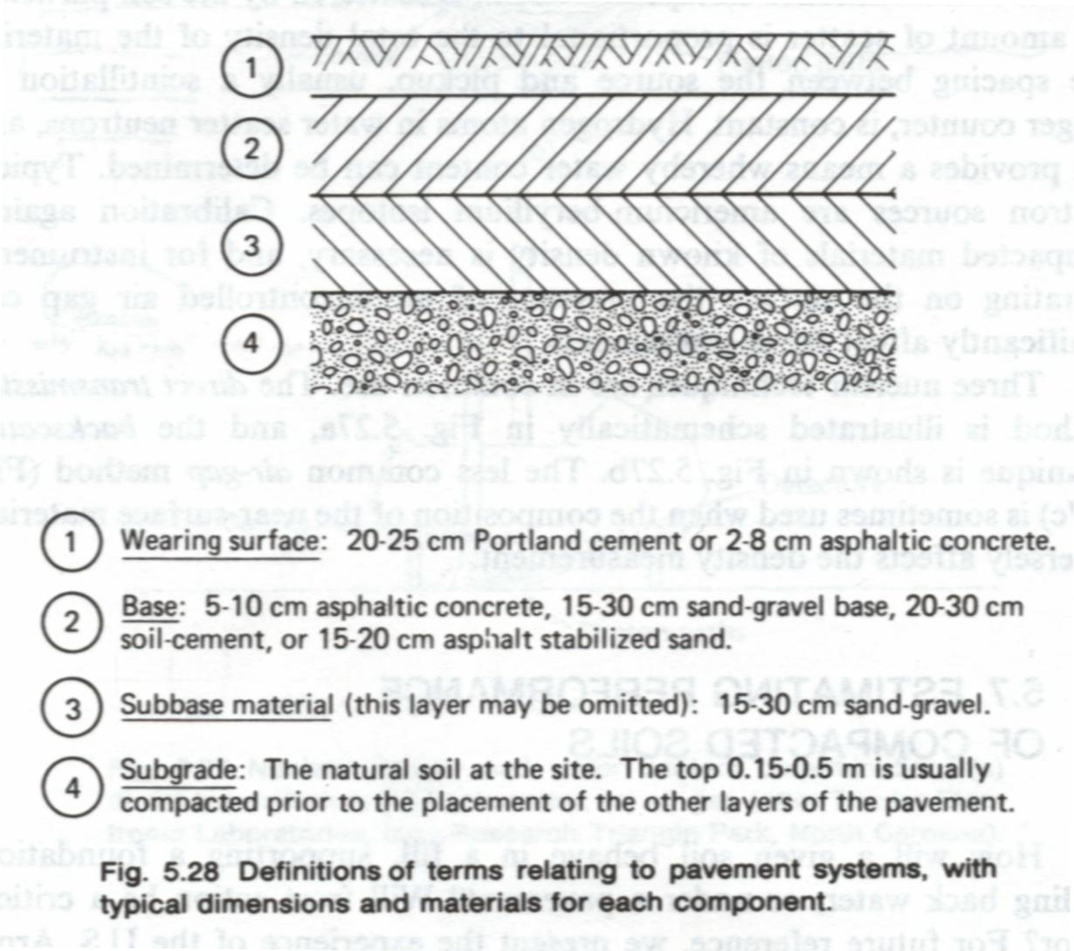
7.1 Definition of Pavement Systems
Holtz and Kovacs, 1981

Slide 70
7.2 Characteristics Pertinent to Roads and Airfield
Please refer to the handout
Holtz and Kovacs, 1981

Slide 71
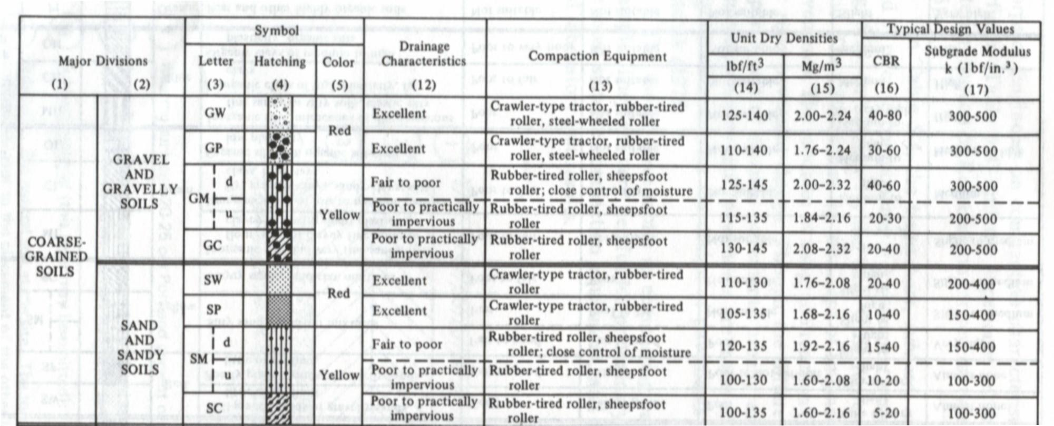
7.2 Characteristics Pertinent to Roads and Airfield (Cont.)
Please refer to the handout
Holtz and Kovacs, 1981

Slide 72
7.3 Engineering Properties of Compacted Soils
Please refer to the handout
Holtz and Kovacs, 1981

Slide 73
8. Suggested Homework
Read Chapter 5 (Holtz’s book)
Example 5.1 ~ Example 5.4
Problem 5.9, 5.12, 5.14

Slide 74
9. References
Main References:
Holtz, R.D. and Kovacs, W.D. (1981). An Introduction to Geotechnical Engineering, Prentice Hall. (Chapter 5)
Others:
Das, B.M. (1998). Principles of Geotechnical Engineering, 4th edition, PWS Publishing Company.
Lambe, T.W. and Whitman, R.V. (1979). Soil Mechanics, SI Version, John Wiley & Sons.
Schaefer, V. R. (1997). Ground Improvement, Ground Reinforcement, Ground Treatment, Proceedings of Soil Improvement and Geosynthetics of The Geo-Institute of the American Society of Civil Engineers in conjunction with Geo-Logan’97. Edited by V.R. Schaefer.

