Slide 2
IDEOLOGY OF PAKISTAN
Meaning and Historical background And it s DYNAMICS
Elements of Ideology
Aims
And
Objectives
For
creation of Pakistan
Importance of ideology

Slide 3
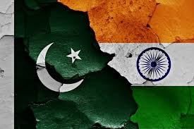
Meaning and
Historical
background
And its
DYNAMICS

Slide 4
The Sense of National Unity

Slide 5
Hindu Muslim Conciliation

Slide 6
Islam as a Dynamic Force

Slide 7
Beginning of Democracy

Slide 8
Bitter Experience

Slide 9
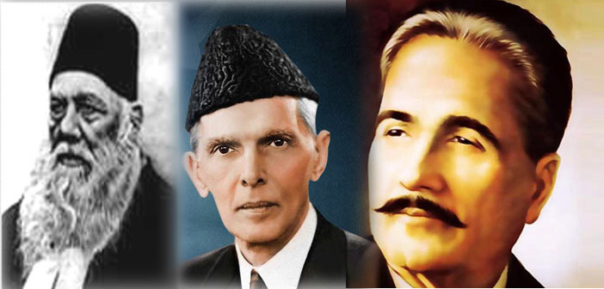
Elements of
Ideology

Slide 10
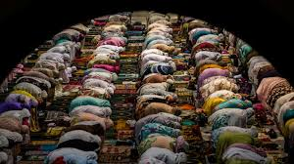
Islam

Slide 11
Piece of Land

Slide 12
Democracy

Slide 13
Basic Human Rights

Slide 14
Ideology of Pakistan in the
light of Alama’s Philosophy
Islam as a complete code of Life
Negation of Indian Nationalism
Relation of Islam and Politics
Separate Muslim Identify
Concept of Two Nation Theory
Idea of Pakistan
Islamic Unity and Brotherhood

Slide 15
Ideology of Pakistan in the
light of Quaid-e-Azam
Two Nation Theory
Islam as a Code of Life
Justification for the Partition of India
Objective of a Separate State
Protection of Islamic Culture
Democratic Attitude
The Constitution of Pakistan
Islamic System of Economy
Protection of Minorities
Participation of Minorities in Political System

Slide 16
Importance of
ideology

Slide 17
Crystal Clear Goal

Slide 18
Source of Protection

Slide 19
A Means of Success

Slide 20
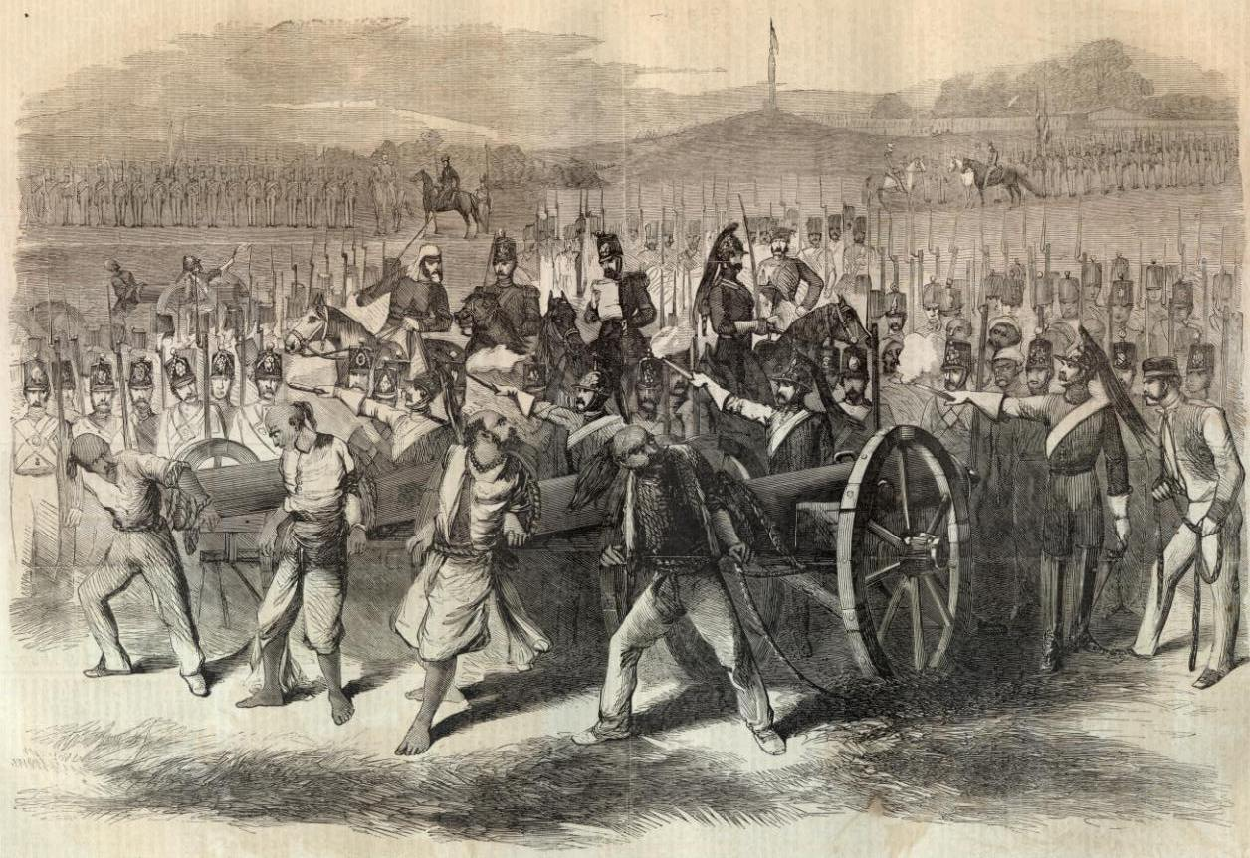
Main Cause of Independence

Slide 21
Source of Unity

Slide 22
Source of Power

Slide 23
Formation of Islamic Society

Slide 24
Ladder of Progress

Slide 25
Source for the Unity of Muslim World

Slide 26
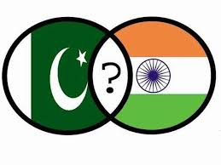
Aims
And
Objectives
For
creation of Pakistan

Slide 27
Enforcement of Sovereignty of Allah
Establishment of an Islamic State
Enforcement of Islamic Democracy
Two Nation Theory
Bitterness Between Hindus and Muslims
The English-Hindi Collusion
Revival of Status
Protection of Muslim Civilization
Shuddi and Sunghton Movement
Urdu Hindi Conflict
The British Parliamentary System
The Congress Ministries
Economic Progress

