Slide 1
Embryo recue and in vitro pollination
Saeed Rauf

Slide 2
Difficulties in Distant Hybridization
Pre-zygotic barriers
Failure of pollen germination
Failure of fertilization
Failure of zygote formation
Failure of embryo maturation
Endosperm abortion

Slide 3
Embryo culture
Embryo cultivation
Intact suspensor
Precocious germination
Stage of embryo excision

Slide 6
Stages of embryo
Cleavage and differentiation stage
Growth stage
Maturation stage

Slide 7
Requisite for embryo culture
Artificial pollination
Relationship between embryo development and DAP
Time of endosperm abortion

Slide 8
Requirements for embryo culture
Disinfection
Dissection
Globular stage embryo
Osmotic shock avoidance (9%)
Suspensor intact

Slide 9
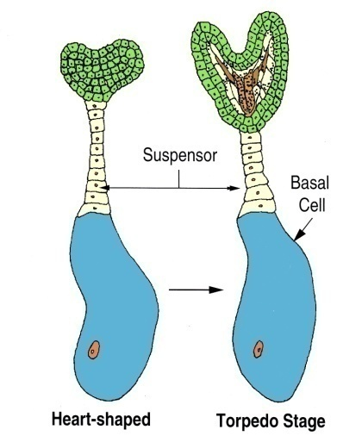

Slide 10
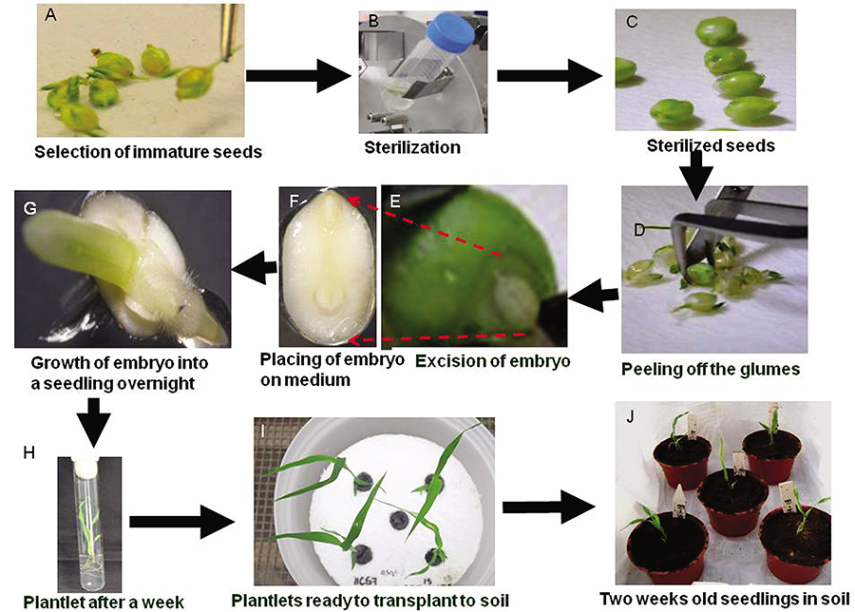

Slide 11
Growth and survival of immature embryos of capeslla species cultured in different media
Culture medium | Percentage of survival | Percentage growth
Knops medium | 67 | 80
Hellers medium | 67.5 | 150
MS medium | 56 | 210
Improved medium | 70 | 211
(devised by Monnier, 1976)

Slide 12
The improved nutrient medium developed for culture of young capsella embryos
Constituents | Amount (mg L⁻¹)
KNO3 | 1900
CalCls.H20 | 880
NH4NO3 | 825
MgSO4.7H20 | 370
KCl | 350
KH2PO4 | 170
Na2EDTA | 14.9
FeSO4.7H20 | 11.1
H2BO3 | 12.4
MnSO4.H20 | 33.6
ZnSO4.7H20 | 21
KI | 1.66
Na2MoO4.2H20 | 0.5
CuSO4.5H20 | 0.05
CoCl2.6H20 | 0.05
Glutamine | 400
Vitamin B1 | 0.1
Vitamin B6 | 0.1
Sucrose | 120000

Slide 13
Optimization of media
Iron level
Calcium concentration
Nitrogen level
Casein hydrolysate (50-400 mg L⁻¹)
Coconut milk (35-80 μ m)
pH 4.9-5.2

Slide 14
Applications of embryo culture
Distant Cross | Embryo failure | Hybrid recovered
Abelmoschus esculentus × A. manihot | Heart/Torpedo shape | Embryo culture
Abelmoschus esculentus × A. fisculneus | Heart/Torpedo shape | Ovule culture
G. arboreum × G. hirsutum | 8-10 DAP | Ovule culture (3 DAP)
G. max × G. clandestine |  | Ovule and embryo culture
H. annuus × H. tuberosum |  | Ovule and embryo culture
H. vulgare × H. spontanuym | 15 DAP | Embryo culture
L. esculentum × L. peruvianum |  | Embryo culture

Slide 15
Applications of embryo culture
Embryo rescue
Overcoming dormancy
Germination of difficult seed
In vitro fertilization
Haploid production

Slide 16
In vitro fertilization
Sperm isolation (540 kg⁻¹ mos mol)
Egg cells pectinase 0.75% + pectolyase 0.25%, hemicellulose 0.5%,

