Slide 1
CONSERVATION OF
BIODIVERSITY

Slide 2
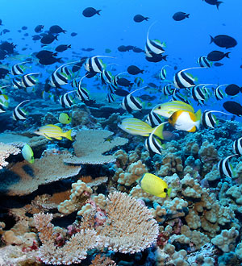
WHAT IS BIODIVERSITY ??
Biodiversity is the degree of variation of life forms within a given ecosystem, biome, or an entire planet.
Biodiversity is a measure of the health of ecosystems. Biodiversity is in part a function of climate.
In terrestrial habitats, tropical regions are typically rich whereas polar regions support fewer species.

Slide 3
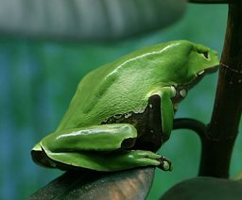
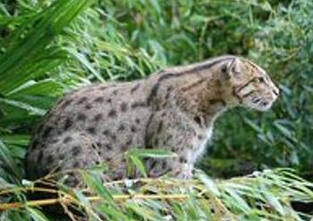
WHY BIODIVERSITY ??
Biodiversity boosts ecosystem productivity where each species, no matter how small, all have an important role to play.
For example :
A larger number of plant species means a greater variety of crops
Greater species diversity ensures natural sustainability for all life forms
Healthy ecosystems can better withstand and recover from a variety of disasters.
And so, while we dominate this planet, we still need to preserve the diversity in wildlife

Slide 4
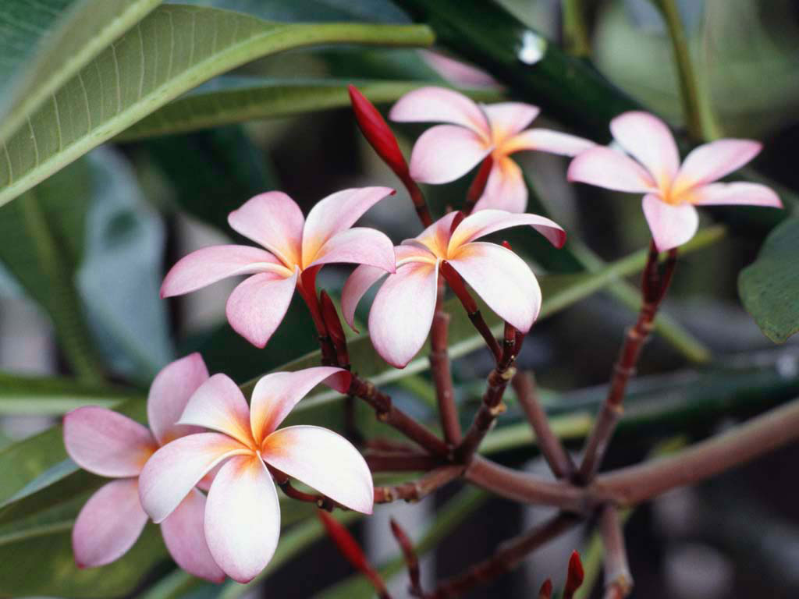
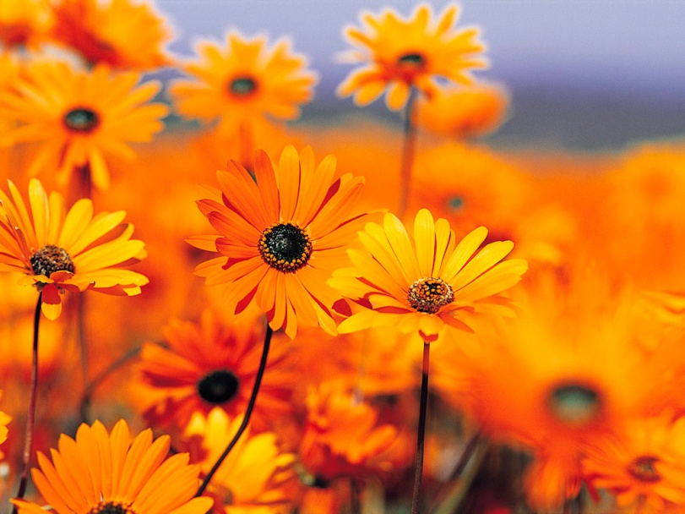
HEALTHY BIODIVERSITY
A healthy biodiversity provides A number of natural services for everyone:
Ecosystem services, such as
Protection of water resources
Soils formation and protection
Nutrient storage and recycling
Pollution breakdown and absorption
Contribution to climate stability
Maintenance of ecosystems
Recovery from unpredictable events
Biological resources, such as
Food
Medicinal resources and pharmaceutical drugs
Wood products
Ornamental plants
Breeding stocks, population reservoirs
Future resources
Diversity in genes, species and ecosystems
Social benefits, such as
Research, education and monitoring
Recreation and tourism
Cultural values

Slide 5
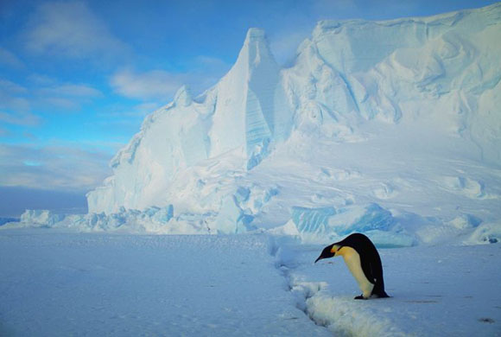
EFFECTS OF DISRUPTING
BIODIVERSITY.
Human actions are causing a massive disruption to the planet's climate that is severe, rapid, very variable over space and time, and highly complex.
Even the simple, slow warming of the climate will produce complex consequences to species numbers and distributions because of how species depend on each other.
Climate disruptions may cause the loss of a large fraction of the planet's biodiversity, even if the only mechanism were to be species ranges moving uphill as temperatures rise.
Nowhere is this more obvious than in the loss of species, for we cannot recreate them.

Slide 6
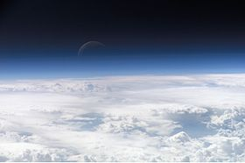
WAYS TO PROTECT
BIODIVERSITY
Habitat Protection:
To protect ocean biodiversity, fishing must be made sustainable and by-catch reduced. Forests must be preserved in adequate size to support the range of resident species. Fresh water must be conserved to preserve river, lake and wetlands habitats.
Promoting Genetic Biodiversity:
A report from a Nature magazine also explains that genetic diversity helps to prevent the chances of extinction in the wild (and claims to have shown proof of this).
Prevention Of Pollution:
pollution must be strictly controlled and eliminated wherever possible.
Dealing with Climatic Change:
greenhouse gas emissions must be brought down to sustainable levels.

Slide 7
FACTS ON BIODIVERSITY
OF THE WORLD
Earth is home to 80,000 species of snails and slugs.
About 5,000 species of frogs have been recorded.
Our planet provides habitats for about 3,000 species of snakes, at least 25,000 different kinds of fish, about 2,300 rodents, and innumerable forms of insects, bacteria, fungi and viruses.
Although we’ve named 100,000 types of fungi and documented more than a million species of insects, we’re conscious that we’ve identified only a fraction of the diverse species out there.
Experts estimate there are between 2 and 30 million species of insects on Earth.

Slide 8
By:
Devavrata Dixit
Sri Venkateshwar International School
Sector 18 Dwarka, New Delhi

