Slide 1
A passage to India Analysis

Slide 2
Analysis
Clear out, you fellows, double quick, I say. We may hate one another, but we hate you most . . . we shall get rid of you, yes, we shall drive every blasted Englishman into the sea, and then . . . you and I shall be friends.
[A Passage to India]

Slide 3
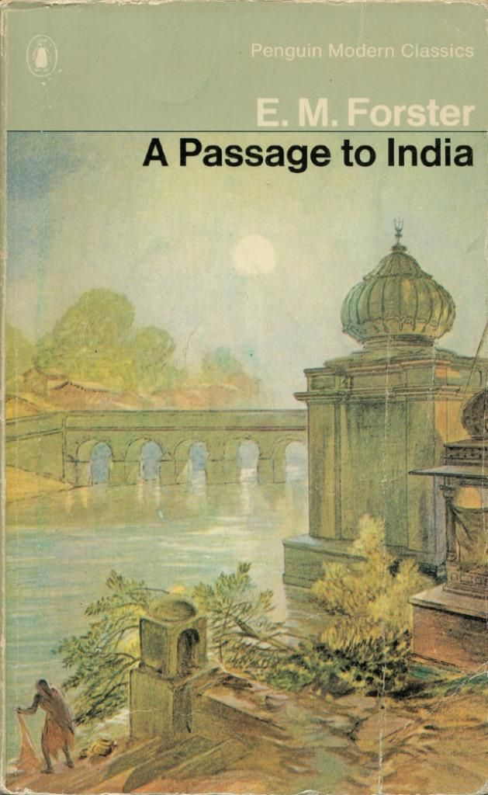
Characters
Aziz
Adela
Mrs. Moore
Fielding
Ronny
Professor Godbole
Hamidullah

Slide 4
Aziz
Aziz is a sensitive young Muslim doctor who is put on trial for attacking Adela Quested at the Marabar Caves.
Adela
Adela Quested is a repressed, intellectual young woman who comes to India to visit Ronny Heaslop and decide if they should marry; she also wants to see "the real India."
Mrs. Moore
Mrs. Moore is a kind Englishwoman who accompanies Adela Quested to India to see Ronny Heaslop, who is Mrs. Moore's son. Her unusual sensitivity impresses Aziz.
Fielding
Cyril Fielding is a liberal-​minded Englishman in his 40s who is principal of Government College in Chandrapore and a good friend to Dr. Aziz.
Ronny
Ronny Heaslop, Mrs. Moore's son, is the officious young Chandrapore City Magistrate. He and Adela Quested become engaged during her visit to India.

Slide 5
Title Significance
The title of A Passage to India is a reference to Walt Whitman's poem, "A Passage to India."
In the poem, Whitman takes his reader on an imaginary journey through time and space.
India is presented as a fabled land that inspired Columbus to seek a westward route from Europe to India, a route that ended up with his discovery of the Americas.
Whitman sees both as caught up in an inexorable thrust toward globalization, where all countries are swept up in the same push toward progress.
Passage to India! Lo, soul! seest thou not God's purpose from the first? The earth to be spann'd, connected by net-work, (Walt Whitman)

Slide 6
The Ending
"Friends again," begins the last chapter of A Passage to India, but despite this promising beginning, we're hardly left with an image of brotherly love.
The confusion about Fielding's marriage has finally been cleared up, and even though Aziz now knows that Fielding did not marry Adela.
Still, the two can't return to the easy friendship of the good old days in Chandrapore.
Despite the promising beginning of the chapter, the novel ends with the earth itself uttering with "its hundred voices, 'No, not yet,'" and the sky chiming in, "No, not there" (3.37.29).
These lines suggest that the historical moment – early 20th century colonial India – places insuperable barriers against a friendship between an Englishman and an Indian.

Slide 7
Seven Basic plot analysis

Slide 8
The Call
Adela Quested arrives in Chandrapore with the goal of seeing the "real" India and deciding whether she will marry Ronny Heaslop, the Civil Magistrate in Chandrapore.
Adela's last name – "Quested" – suggests that her quest is one important way of understanding the passage in the title, A Passage to India. Following the quest structure, Adela arrives in India, and feels the mysterious appeal of the force and life of the country.

Slide 9
The Journey
Adela attends a series of parties where she meets Indians, but the "real" India continues to elude her.
Adela attempts to see the "real" India, but the real India eludes her. Even when she does meet Indians, at the Bridge Party, for example, they are in such artificial and formal situations that she doesn't feel as though she can have a genuine conversation with them.

Slide 10
Arrival and Frustration
Adela accepts Dr. Aziz's invitation to see the Marabar Caves. While it seems that she has finally gotten her wish of seeing the "real" India, she believes that she is attacked by Aziz, who is consequently imprisoned.
Adela finally seems to have met her goal when she meets Mrs. Moore's charming Aziz at Fielding's tea party. On their excursion to the Marabar Caves, however, the thrill of hanging out with Aziz quickly sours when she believes he has attacked her.

Slide 11
The Final Ordeals
At the trial, Adela realizes that she has made a mistake and withdraws her accusation against Aziz.
Adela's ordeal only continues in the days leading up to the trial as she veers between her hatred of Aziz and her suspicion that Aziz is innocent. On the stand, she realizes her mistake and withdraws her charge. Far from solving her dilemma, this act opens up a whole new can of worms as she now has to deal with her ejection from Anglo-Indian society.

Slide 12
The Goal
Humbled by her experience, Adela realizes that she never wanted to see the "real" India. She was only willing to appreciate India abstractly, rather than connect with actual Indians.
For a quest, this seems like a rather humble goal. Other mythical quests involve the Holy Grail, the Fountain of Youth, Shalimar … and all Adela gets is the realization that she's not all that good at making friends? The anticlimactic end of Adela's quest fits in with the novel's general tendency to emphasize the fundamental meaninglessness of existence. This is not as depressing as it sounds. Freed from the attitude that life is meaningful and ought to be examined like a book, Adela no longer studies life, but actually lives.

