Slide 1
Subject: Population Studies
Class: MSc 4th
Lecture: 2nd week
Topic: Migration

Slide 2
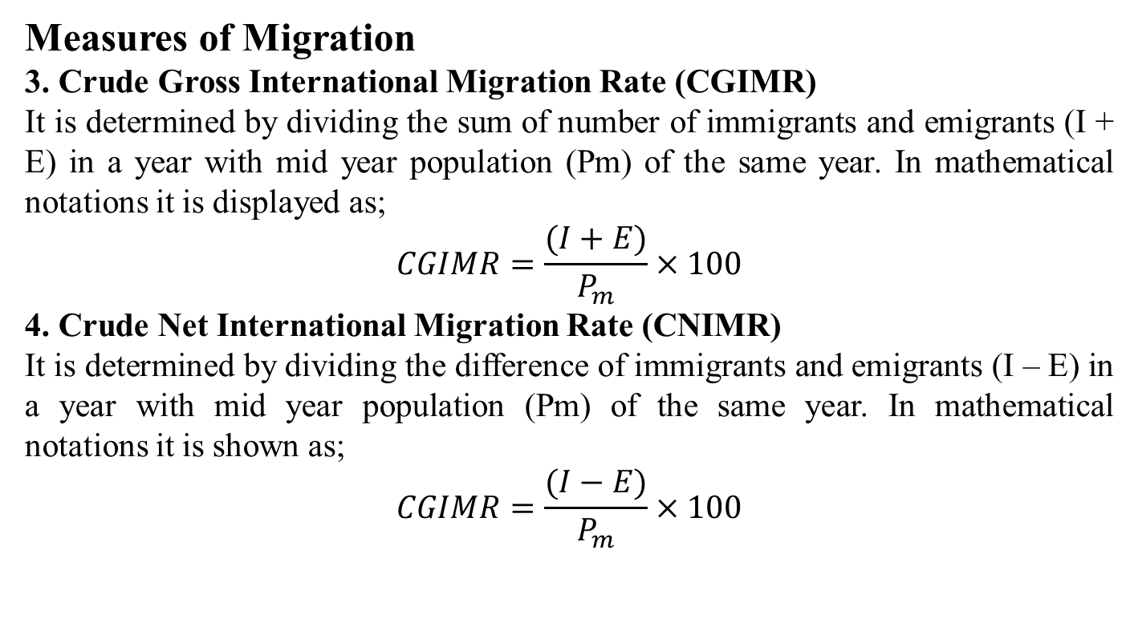
Measures of Migration
3. Crude Gross International Migration Rate (CGIMR)
It is determined by dividing the sum of number of immigrants and emigrants (I + E) in a year with mid year population (Pm) of the same year. In mathematical notations it is displayed as;
$$CGIMR=\frac{(I+E)}{P_{m}}×100$$
4. Crude Net International Migration Rate (CNIMR)
It is determined by dividing the difference of immigrants and emigrants (I – E) in a year with mid year population (Pm) of the same year. In mathematical notations it is shown as;
$$CGIMR=\frac{(I−E)}{P_{m}}×100$$

Slide 3
Question
The population of Pakistan in 1981 was 84253644 which increased to 132352279 in 1998. in the absence of statistics on vital events let us suppose that 54792560 children were born during the inter-censal period of 17 years, 10541816 persons died, 4764570 persons immigrated to pakistan and 916679 persons from Pakistan, calculate CGIMR and CNIMR.

Slide 4
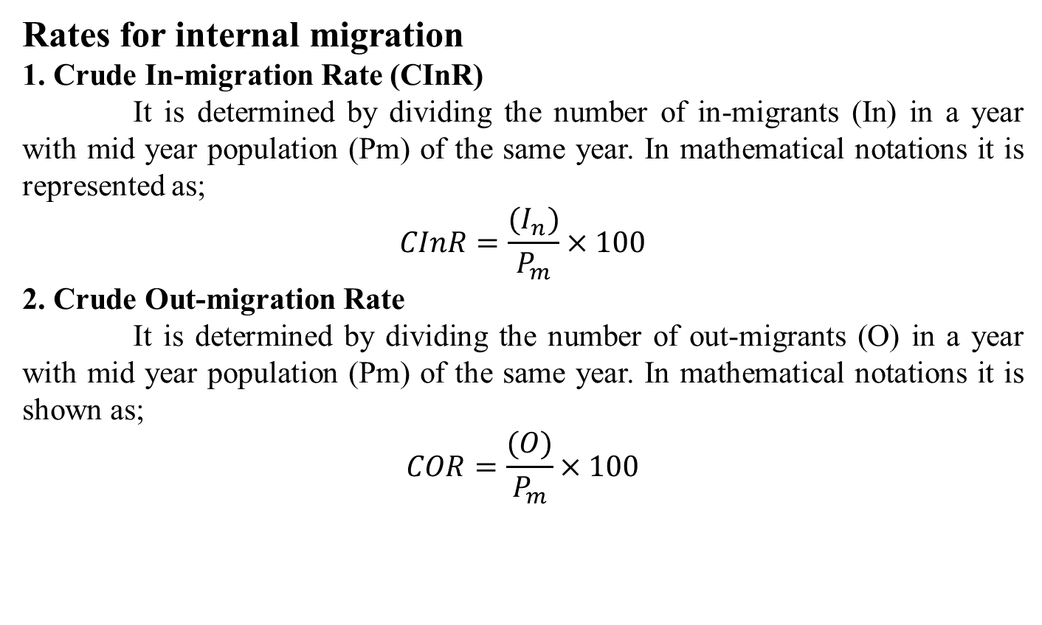
Rates for internal migration
1. Crude In-migration Rate (CInR)
It is determined by dividing the number of in-migrants (In) in a year with mid year population (Pm) of the same year. In mathematical notations it is represented as;
$$CInR=\frac{(I_{n})}{P_{m}}×100$$
2. Crude Out-migration Rate
It is determined by dividing the number of out-migrants (O) in a year with mid year population (Pm) of the same year. In mathematical notations it is shown as;
$$COR=\frac{(O)}{P_{m}}×100$$

Slide 5
Question
1. The population of Pakistan as on 5th March 1998 was 132352279, migrants during the last one year were 841220 persons and population average annual growth rate during that year was 2.06 percent, calculate CInR.
2. The population of Pakistan as on 5th March 1998 was 132352279, migrants during the last one year were 841220 persons (assuming out-migrants are equal to in-migrants at national level) and population average annual growth rate during that year was 2.06 percent. Calculate COR.

Slide 6
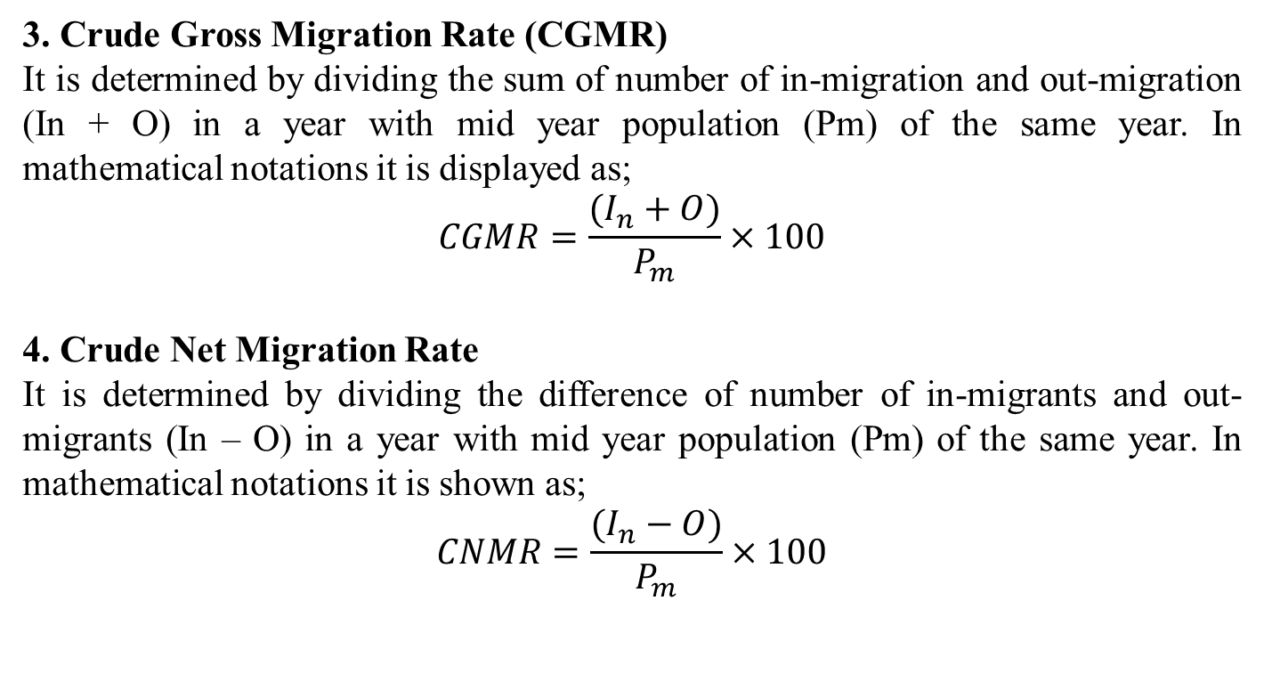
3. Crude Gross Migration Rate (CGMR)
It is determined by dividing the sum of number of in-migration and out-migration (In + O) in a year with mid year population (Pm) of the same year. In mathematical notations it is displayed as;
$$CGMR=\frac{(I_{n}+O)}{P_{m}}×100$$
4. Crude Net Migration Rate
It is determined by dividing the difference of number of in-migrants and out-migrants (In – O) in a year with mid year population (Pm) of the same year. In mathematical notations it is shown as;
$$CNMR=\frac{(I_{n}−O)}{P_{m}}×100$$

Slide 7
Question
The population of Pakistan as on 5th March 1998 was 132352279, migrants during the last one year were 841220 persons (assuming out-migrants are equal to in-migrants at national level) and population average annual growth rate during that year was 2.06 percent, Calculate CGMR and CNMR.

