Slide 1
Foregrounding: Deviation, Choice, and Parallelism
Raed Dakhil Kareem
PhD Candidate, University of Baghdad, College of Arts, Dept. of English

Slide 2
1. Foregrounding
Taken as a predominantly literary feature, the term foregrounding refers to an effect brought about in the reader by linguistic or other forms of deviation in the literary text(Leech, 1985:47).
The deviant features of the text, being unexpected, come to the foreground of reader's attention against the background of its normal linguistic features.
The Prague School linguists consider foregrounding, which confers unexpectedness, unusualness and uniqueness on literary texts, as the differentiating factor between poetic and non-poetic language (Mukarovsky, 1958:19).

Slide 3
They consider the maximization of foregrounding as the function of poetic language. Leech (1965:68) analyzes the poem "This Bread I Break" by Dylan Thomas and recognized the expressions "the oat was merry", and "broke the sun" in it, figuring in the stanza quoted below, as foregrounded.
Once in this wind the summer blood
Knocked in the flesh that decked the vine,
Once in this bread
The Oat was merry in the wind;
Man broke the sun, pulled the wind down.

Slide 4
In the expression "the Oat was merry ", the noun which normally has the feature of inanimacy in the language code is given an animate and more precisely a human feature in the poetic context, thereby creating a deviation which is foregrounded against normal expressions like ''the man was merry'' , ''the teacher was merry'' etc.
Foregrounding occurs here because the semantic features of these items in the language code do not correspond with those which are bestowed upon them by the contextual environment in which they appear.

Slide 5
1.1 Factors Contributing to Foregrounding
It is significant that Jan Mukarovsky refers to foregrounding as "the aesthetically intentional distortion of the linguistic components." (Mukarovsky, 1985:18).
This definition signifies two important aspects of foregrounding:
first, poetic foregrounding , being 'intentional', presupposes some motivation on the part of the poet which in turn demands careful attention from the reader,
and second, distortion of any 'linguistic component' may bring about foregrounding.

Slide 6
Thus concentration of any linguistic features - phonological, syntactic, or semantic - which are rare or unnoticed in ordinary speech but brought into prominence deliberately in the literary text with the purpose of contributing to its total effect can result in foregrounding.
This "calling of the reader's attention to linguistic structures", quite different from the way in which a non-literary writer will emphasize the language elements, " is an essential part of literary ''creation." (Chapman, 1982:5).

Slide 7
1.2. Kinds of Foregrounding
Leech and Short (1981:48) identify two kinds of foregrounding: qualitative foregrounding and quantitative foregrounding.
In the former, there is deviation from the rules of the language code or from the conventions of language use or both.
In the latter, the deviance is from some expected frequency of linguistic occurrence and not from the language code.
When a writer writes he is constantly involved in making linguistic choices. The choices he makes both outside and inside the language system may thus lead to foregrounding.

Slide 8
The following extract from James Joyce's Ulysses exemplifies qualitative foregrounding :
Bob Cowley's outstretched talons gripped the black deep-sounding chords.
In Ulysses, this sentence describes Bob Cowley who is playing the piano.
The pianist's hand placed above the keys becomes the talons of a bird of prey.
It grips not physical objects like table or chair but ''chords''. Further, the description attributes black color to the ''chords.''

Slide 9
Joyce here violates selection restrictions prescribed in the language code by providing a human possessor for ''talons'', an abstract object for ''grip'', and the modifier ''black'' for an abstract noun ''chords''.
Joyce thus presents his unique perception of reality, which may not be sanctioned by society as a whole, by bestowing on the linguistic elements values other than they have in the language code.
He combines what is kept separate in the code and separates what is combined in the code.

Slide 10
In quantitative foregrounding the writer, instead of utilizing a wider choice available in the language code, deliberately restricts himself to a selected pattern to produce uniformity(Ibid.).
The deviation here is not from the rules of the language code or from the conventions of language use but from some expected frequency in normal use where variety would normally be expected(Leech, Deucher, and Hoogenraad, 1982:15f.).
Hopkins' short poem "Heaven-Haven", on a nun's taking the veil, illustrates quantitative foregrounding :

Slide 11
I have desired to go
Where springs not fail,
To fields where flies no sharp and sided hail
And a few lilies blow.
And I have asked to be
Where no storms come,
Where the green swell is in the havens dumb,
And out of the swing of the sea.'‘
In both the stanzas, Hopkins restricts himself to the selection of the same grammatical structure of parallelism.
Thus by superimposing on language the over-regularity of the same syntactic choice within the language system, Hopkins achieves foregrounding effect for the poem(Ibid.).

Slide 12
1.3 Coherence of Foregrounding
In literary discourse, deviations are not just to be interpreted in isolation, but to be seen as forming a meaningful pattern with other linguistic features, both regular and irregular, to form a whole.
They are understood, therefore, "not in isolation with reference only to the linguistic system, or code, but also with reference to the context in which they appear''(Widdowson, 1975:27).
Inspired by Mukarovsky's observation , Leech searches for coherence of foregrounded features in a literary text at two levels (Leech, 1985:50):

Slide 13
at horizontal level termed as ''cohesion between deviations'' , and at vertical level termed as ''congruence between deviations''. Leech exemplifies both concepts with reference to Shelley's "Ode to the West Wind."
He recognizes cohesion of foregrounding in the parallelism of the three elements - Earth, Sky, and Sea - in the first three stanzas. In the fourth stanza, the same parallelism is resumed in the triple if-clause structure:
If I were a dead leaf thou mightest bear;
If I were a swift cloud to fly with thee;
A wave to pant beneath thy power,

Slide 14
The same pattern once again recurs in a variant form in
Oh, lift me as a wave, a leaf, a cloud!
---------------------------------------
The "Ode to the West Wind" also illustrates congruence of foregrounding by way of "anticipatory structuring" that takes place at different linguistic levels in the poem, as in, for instance, hyperbaton(i.e., Hyperbaton refers to the use of inverted or transposed word order in a text: for example, placing an adjective after the noun it qualifies (cities fair) instead of before (fair cities) at the syntactic level,
and the incompletion of the first three stanzas at the discourse level contribute to this foregrounding of anticipation in the poem.

Slide 15
2. Linguistic Deviation
The concept of deviation is important to the study of literary texts. To be stylistically distinctive, a feature of language must deviate from some norm of comparison.
To Leech (Ibid.:40) this norm may be an absolute one, functioning "for the language as a whole" or a relative one "provided by some set of texts which for the purposes of the study are regarded as comparable."
Levin (1963:277) proposes another distinction, in this connection, between determinate and statistical deviations.

Slide 16
Whereas statistical deviation is a quantitative measure of linguistic differences between the domain and the norm, determinate deviation is non-quantitative.
In determinate deviation, the deviation is observed as a discrepancy between what is allowed by the rules and conventions of the language system and what occurs in the text.
It is also possible to consider deviations in literary texts at three levels( primary, secondary, and tertiary): ''primary deviation'' where the text deviates from norms of the language as a whole,

Slide 17
''secondary deviation'' where it deviates from norms of literary composition in particular, and
''tertiary deviation or internal deviation'' where the deviation is from norms internal to a text.
---------------------------------------
Primary deviation takes two main forms:
(a) Where the language allows a choice within the rules of its code and the conventions of its use, the writer goes outside the choices available.
(b) Where the language allows a choice, the writer denies himself the freedom to choose, and uses the same item repeatedly.

Slide 18
The first category of primary deviation can be exemplified using the following extract:
:O thou,
Who chariotest to their dark wintry bed
The winged seeds, where they lie cold and low,
Here the deviation is caused by the use of the rare verb ''chariotest'' and the by the collocational oddity of ''the wind charioting the seeds to bed.'‘
Consider the figure below:

Slide 19
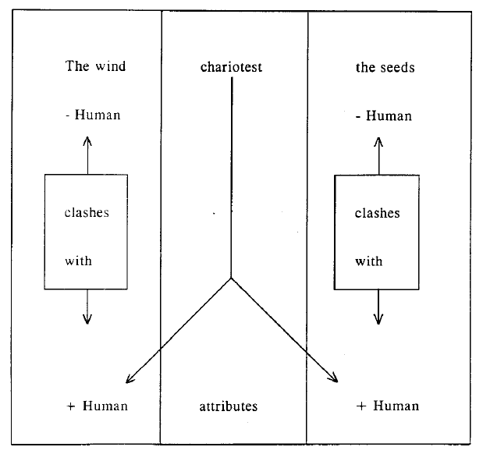

Slide 20
As the figure shows, 'wind' and 'seeds' do not share human feature in the language code; the predicator ''chariotest'' attributes these features to them in the context of the poem. thereby personifying both. Further, the phrase order
Who chariotest to their dark wintry bed / The winged seeds
S + P + A + O
is abnormal for English which demands the syntactic organization of Subject + Predicator + Object + Adverbial. Thus the breaking of the syntactic rule of the language code also contributes to the deviation of the lines quoted.

Slide 21
The second category of primary deviation can be exemplified using the very last line of Hopkins' "The Wreck of the Deutschland":
Our hearts' charity's hearth's fire, our thoughts'
Chivalry's throng's Lord.
Deviation here is caused by the repetitive use of the genitive construction to an unusual degree: three successive genitives occur in each parallel half-line.
This linguistic feature is ''more often than usual'' for, in practice, one very rarely has cause to make up a sequence of more than two genitives in spite of the fact that genitive construction in English is one of those which can be indefinitely repeated

Slide 22
In secondary deviation, the text deviates not from the norms of linguistic expression in general, but from norms of literary composition, including norms of author or genre.
Leech (1985:48) identifies this deviation in Shelley's "Ode to the West Wind" in which the metrical pattern shows a deviation from the ode's implicit iambic pentameter pattern of x / x / x / x / x .
He extends his analysis to reveal how the metrical variation contributes to the impression of the wind's unruly force in the poem.

Slide 23
In internal deviation, the features of language within the text depart from the norms the text itself has led us to expect. It is identified by its contrast with the preceding context. Internal deviation explains why even ordinary and banal pieces of language acquire extraordinary prominence and impact in literary contexts.
Analyzing Jane Austen's language, Page (1972:104f.) attributes the prominence of the three-word sentence "Miss Taylor married" at the beginning of the novel Emma to its internal deviation from the text's background of longer sentences where the average sentence length for the first five paragraphs runs up to 26.5 words. Internal deviation often signals a point of climax.

Slide 24
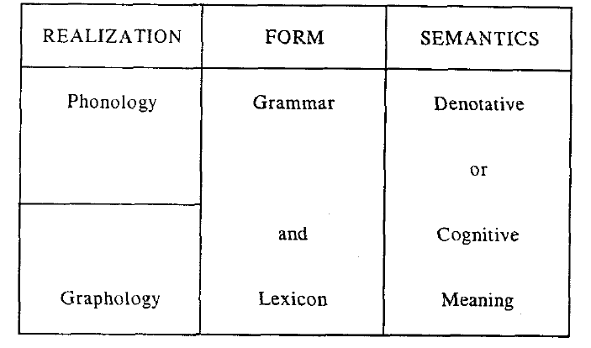
2.1. Kinds of Deviation
we shall identify specific deviations across different linguistic levels outlined in the figure(Tripartite Model of Linguistic Components) below:

Slide 25
As the figure shows there can be deviations of phonological (conventional poetic licenses such as elision, aphesis, apocope etc)
and graphological (visual patterning, capitalization, spacing, punctuation, etc.) kind within the linguistic level of realization.
Under semantics, we have semantic deviation which prompts the readers to prefer a figurative interpretation to a literal one in literary expressions. This is evident in Keats' celebrated paradox "Beauty is truth, truth beauty."
Lexical deviation results when a new word is coined, or a word is unusually converted, or a new word is formed through affixation.

Slide 26
As for the grammatical deviation, we shall examine the following introductory passage from James Joyce's A Portrait of the Artist as a Young Man:
Once upon a time and a very good time it was there was a moocow coming down along the road and this moocow that was coming down along the road met a nicens little boy named baby tuckoo. . . .
This passage provides us with a specimen of language that lacks normal logical transitions. Its repetitive structure and apparently un contextualized presentation impressionistically evoke a re-experience of Stephen's (the hero's) childhood consciousness.

Slide 27
2.2. Interpretation of Deviation
Since deviation is especially characteristic of poetic language, it provides us with a working criterion for the selection of those linguistic features which are of literary significance.
Leech and Short (1981:139) recommend two different models of style which could locate stylistic effect in a literary text. They are:
(a) 'Stylistic variants model' which locates stylistic effect against a background of other equivalent variants (i.e., Stylistic variants model assumes that language specifies a code and that a writer's style consists in preferences exercised within the limits of that code) , and

Slide 28
(b) 'foregrounding model' which locates stylistic effect against a background of more normal or expected expressions that could have occurred.
That is, foregrounding model assumes that creative users of language often overstep the rules and conventions of language code to produce original meanings and effects.).

Slide 29
3. Parallelism
While discussing linguistic deviation in section '2', we have referred to the linguistic choices a writer makes both inside and outside the language system.
Even when he confines himself to the system, the choices he makes can deviate from some expected frequency of linguistic occurrence.
Occurrence of language elements more often than usual is as quantitatively deviant as their presence more rarely than usual.
One obvious example of the former category is the repetition of lexical items or the grouping of words from the same area of association in a text.

Slide 30
Parallelism provides another example for this over-regularity of a particular choice within the system (Leech and Short,1981:142). Parallelism is identified as "structural repetition in which variable elements occur''. Short (1985:9)quotes the following line from Shakespeare's Othello as the "best example ever" of parallelism:
I kissed thee ere I killed thee
The line consists of two parallel clauses linked by ere:
< [SPO] cj [SPO] > . The Words I and thee are repeated. This leaves 'kissed' and 'killed' which are parallel, as shown below:

Slide 31
(i) phonetic - / kist/ , / kild/
There is phonetic parallelism through alliteration (the repeated word-initial / k / and the similarity of word-final / d / and / t / ) and assonance (the repeated / i / bowel). Further both the words are monosyllabic and have the same structure, CVCC.
(ii) orthographic - kissed , killed
The only orthographic difference between the words lies in the presence of double 's' and double ' I ' in 'kissed' and 'killed' respectively. Even here there is parallelism due to doubling.

Slide 32
(iii) morphological - kiss-ed , kill-ed
Both the words consist of two morphemes, the second of which is a past tense marker.
Both kissed and killed are predicators within the parallel clauses.
Short concludes that it is this parallel linguistic pattern in the line that makes it foregrounded and therefore important interpretatively(Ibid.).

Slide 33
3.1. Effect of Parallelism
Parallelism tends to foreground the relations of meaning between parallel words and phrases which fill the variable positions(Ibid.).
The relations of meaning foregrounded in this way are in general relationships of similarity or of contrast.
The synonymical or antonymical relations of meaning between the expressions paralleled may also be reinforced by phonological, morphological, and grammatical features.

Slide 34
In the expression "I kissed thee ere I killed thee" discussed above in section '3',
parallelism promotes the observation of antonymical relations of meaning between the paralleled items ''kissed'' and ''killed''.
It is this effect of parallelism that makes the readers see the two halves of the quoted line as opposed to each other and in particular 'kissed' as opposed to ''killed'' and thereby relate the former to the love theme in Othello and the latter to its theme of hate or jealousy(Ibid.:10).
Notes:
It may be noted that ''hissed'' and ''killed'' are not considered antonyms in the language code; the relationship of antonymy is attributed to them by the poetic context through the use of parallelism.

Slide 35
An example where parallelism promotes synonymical relations of meaning is found in Pope's ''The Rape of the Lock'':
Here files of pins extend their shining rows,
Puffs, powders, patches, bibles, billet-doux
This is a special kind of parallelism in which the writer resorts deliberately to a language pattern which resembles the structuring of items in a list. It exhibits morphological equivalence in that all are plural in number, grammatical equivalence in that all are nouns, and phonological equivalence in that word-initial / p /, / b / and / d / alliterate.

Slide 36
These features make us interpret the items in the list as being the same in some way.
Thus though the language code does not prescribe synonymical relationship between bible and cosmetics, the poetic context does with the help of the unique language pattern created through parallelism.
It is as elements of a pattern in a context that linguistic items acquire values other than they have in the language code.

Slide 37
Final Word
That literary discourse is characterized by the creation of unique language patterns and that its linguistic items contract special values as elements in these created patterns are of considerable importance in literary studies.
To the linguist, it points to the possibility of representing literary works not as totally different ways of using language but as extensions of the way language is used in ordinary kinds of discourse.

Slide 38
To the literary artist himself, it signifies the inadequacy of the resources of language code to provide for the expression of his individual perceptions and concepts and the demands it makes on him to devise his own patterns.
To the critic, it points to the need for restricting oneself to the linguistic analysis of textual data rather than muse over the extratextual details.
As for the teacher of literature, he becomes conscious of the pedagogic need to develop among his learners an awareness of the way language is used in literary discourse, as distinct from its use in everyday discourse, for the conveying of unique messages.

